Slide 1
2018 Doctoral Survey
PhD Pathway Initiative
NASPAA Annual Conference
Atlanta, GA

Slide 2
Survey Sections
General Information about the Program
Program’s Cultural Structure
Program’s Curricular Structure
Applications, Admissions, Enrolments, Cost of Education
Support for students
Program Outcomes
Alumni Employments
Student Demographics
Faculty Demographics
Support for Minority or Female Students

Slide 3
Survey Structure
Total number of questions=51
Total number of questions related to race/ethnicity/gender= 9
  Requiring disaggregated data=5
  Perception questions=2
  Dichotomous questions=2
Most of the questions are not mandatory
The survey URL can be accessed after completion and responses can be edited by the participant
The platform does not allow to SAVE AND EXIT
Consent for sharing student demographics is taken in the survey
Number of responses so far=36
The survey is still in field and will remain till we have an adequate sample

Slide 4
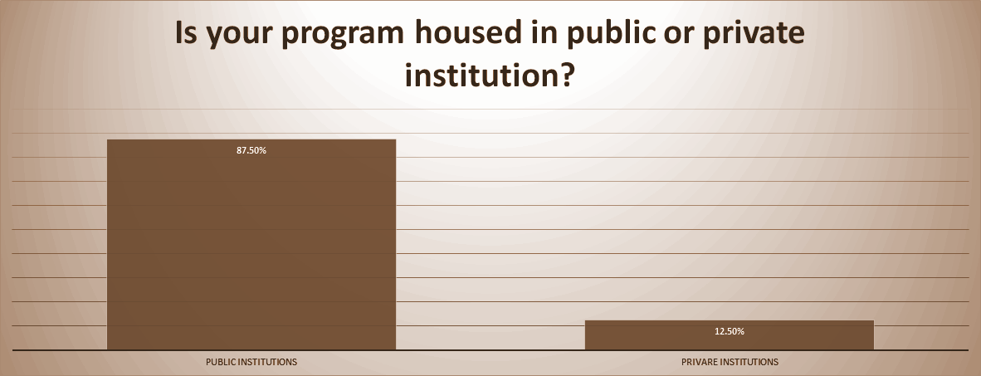
Types of Institutions

Slide 5
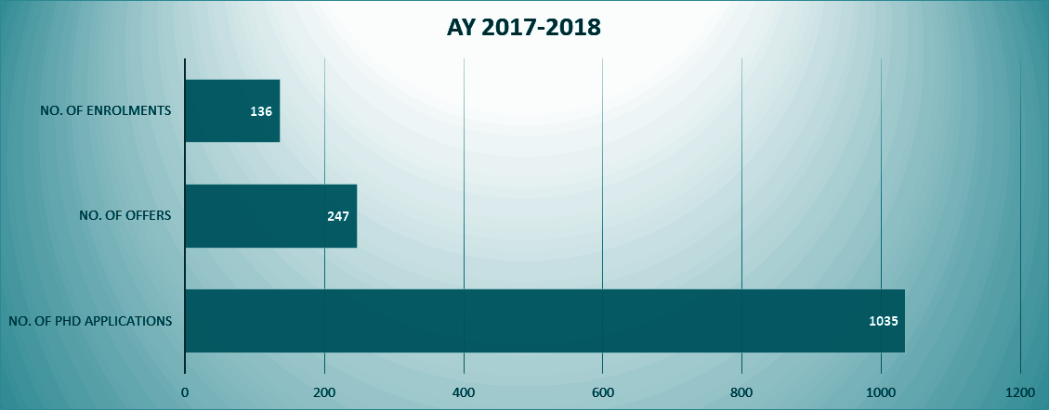
Applications, Offers & Enrolment Numbers

Slide 6
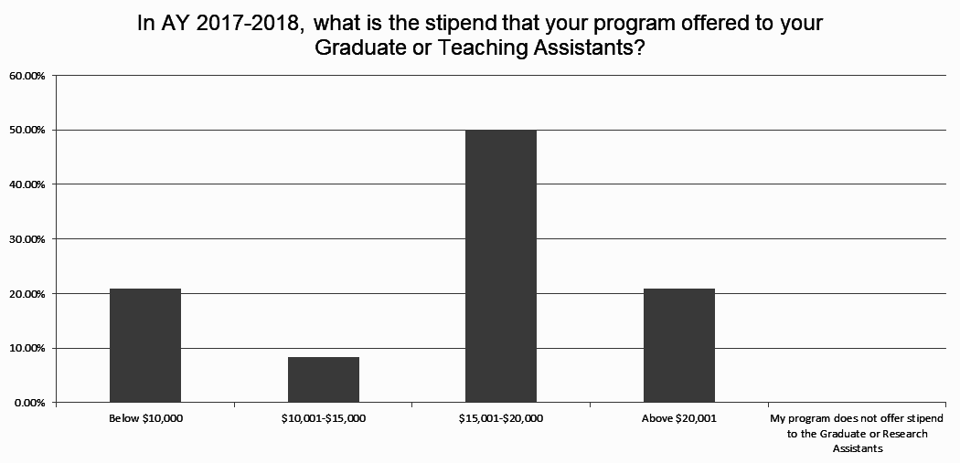

Slide 7
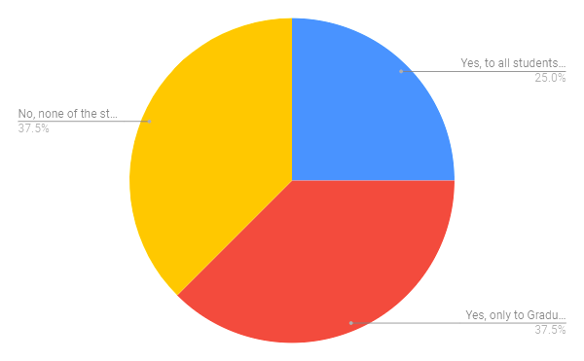
Does your institution offer health insurance to students as financial support?

Slide 8
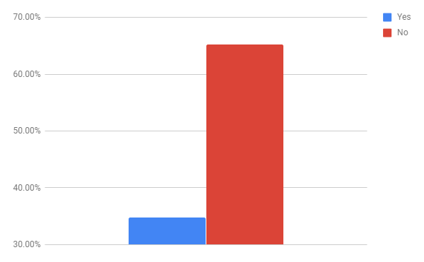
Do your TAs & GRAs have collective bargaining rights?

Slide 9
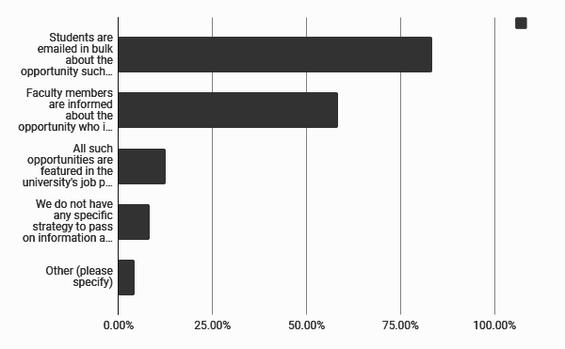
Disseminating research opportunity information

Slide 10
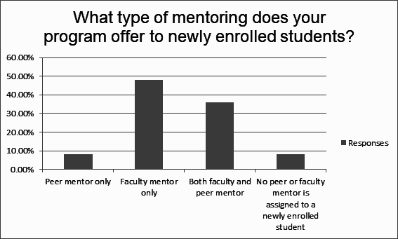
Types of Mentoring for Students

Slide 11
Rate the following according to their importance in assessing the quality of doctoral programs in public affairs, administration, and policy?
Attributes | Least Important | Somewhat Important | Most Important
% of students receiving full financial support | 7.14% | 42.86% | 50.00%
Student research productivity | 7.69% | 7.69% | 84.62%
% of minority students in the program | 12.50% | 75.00% | 12.50%
% of female students in the program | 14.29% | 85.71% | 0.00%
Number of advanced Quantitative courses provided to your students | 12.50% | 37.50% | 50.00%

Slide 12
Median Time to Degree
Median time to degree for a Full-time student
5 years
Median time to degree for a Part-time student
7 years

Slide 13
Do you consider your alumni placement efforts successful?
YES (100% RESPONSES)
“We have been successful in placing all alumni seeking academic position and are now focusing on the quality of the placements.”
“We work closely with our students, by providing mentoring, publication opportunities, regular feedback on their performance, and we encourage our students to regularly participate in academic conferences. This has been quite successful, as the majority of our students have found success in academia.”

Slide 14
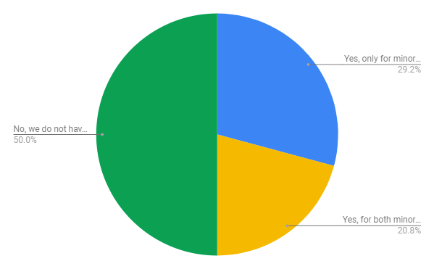
Does your program have any specific recruitment mechanisms for minority and /or female students?
50% said NO

Slide 15
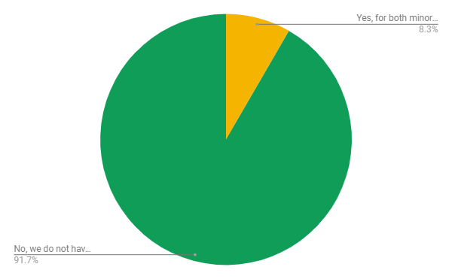
Does your program have any specific retention mechanism for minority and/or female students?
91.67% said NO

Slide 16
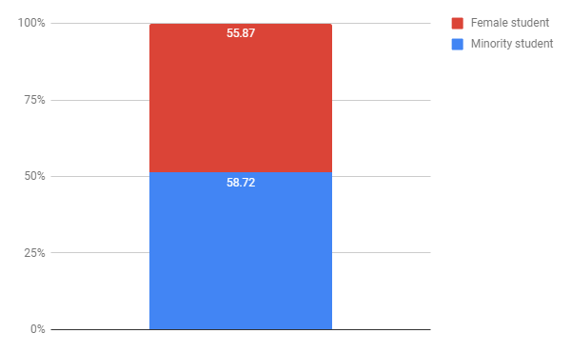
Percentage of students completing degree within 5 years of their enrolment
AY 2013/14-2917/18

Slide 17
What are the most important reasons for minority students to drop out of your program?
Personal problems or life-changing situations (for example, marriage, birth of children, job-related transfer, lack of at-home childcare facilities, divorce, death of a family member)= 50.00%
Feeling of stress, anxiety, exhaustion, and disillusionment with the program= 42.86%
Lack of academic preparedness for doctoral program (writing skill, quantitative applications)= 35.71%
Insufficient financial support from institution and/or program= 28.57%
Feeling of exclusion and isolation= 21.43%
Lack of scholarly community (supportive supervision, peer and faculty mentoring, career advice)= 21.43%
Inability to transition from student to scholar= 21.43%

Slide 18
What are the most important reasons for female students to drop out of your program?
Personal problems or life-changing situations (for example, marriage, childbirth, death of a family member, divorce, job-related transfer of self or spouse, ill health, lack of childcare facilities at home)= 69.23%
Feeling of stress, anxiety, exhaustion, and disillusionment= 46.15%
Lack of academic preparedness for doctoral program= 38.46%
Insufficient financial support from the institution and/ or program= 30.77%
Feeling of wrong fit or expectation mismanagement between the student and faculty= 30.77%
Inability to commit required time for coursework or research= 23.08%

Slide 19
THANK YOU
QUESTIONS & FEEDBACK

