Slide 1

NASPAA PhD Pathways Initiative
ASPA Annual Conference 2019
Washington, DC

Slide 2
Purpose
NASPAA seeks to increase the number of Under-Represented Minorities with PhD's in the Public Affairs field; and to provide information and resources to potential doctoral candidates of all backgrounds to assist them in navigating the doctoral education process.

Slide 3
Methodology
NASPAA seeks to improve the resources and information available to potential and current PhD public affairs candidates. In order to create these resources, NASPAA needs to understand the current state of the field; what is working, what is not, what resources are needed to fill any gaps?
NASPAA developed two surveys to better understand the current state of doctoral education in our field and in our programs:
PhD Programmatic Survey
Recent and Current PhD Student Survey

Slide 4

WE ARE STILL TAKING RESPONSES

Slide 5
Survey Demographics

Slide 6
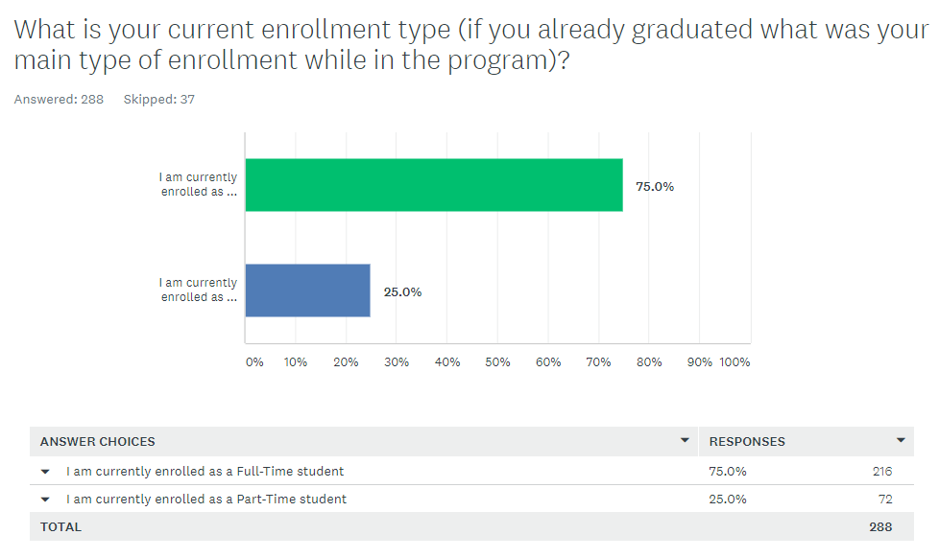
Survey Demographics

Slide 7
Survey Demographics
Race/ Ethnicity

Slide 8
Survey Demographics

Slide 11
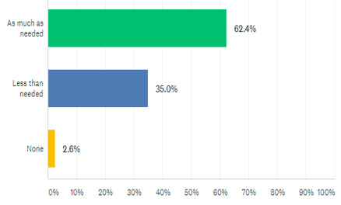
Degree Information
How much information did you receive in making your decision?

Slide 12
What types of resources/ information do you wish you had, that was not available to you when you were making a decision regarding a PhD?

Slide 13
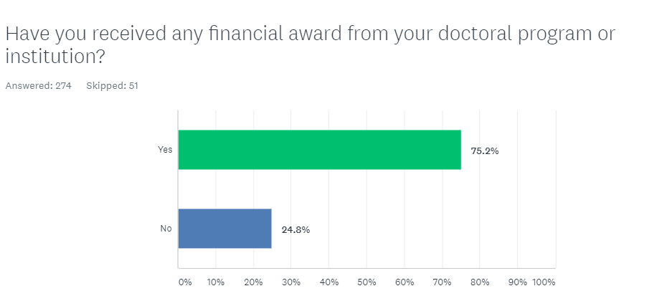
Financial Aid

Slide 14
Indicate which of these following are/ were presently a source(s) of financial support for your educational and living expenses as a doctoral student (check all that apply) (n=205)

Slide 15
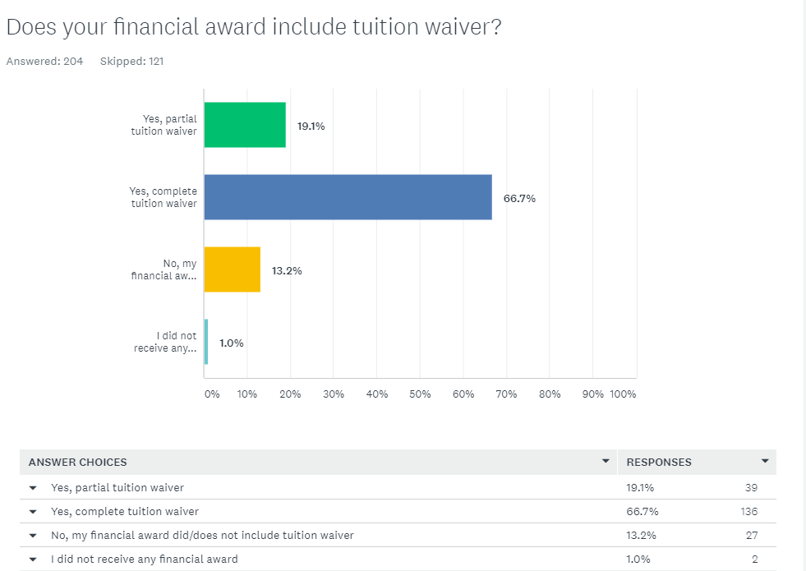
Financial Aid

Slide 16
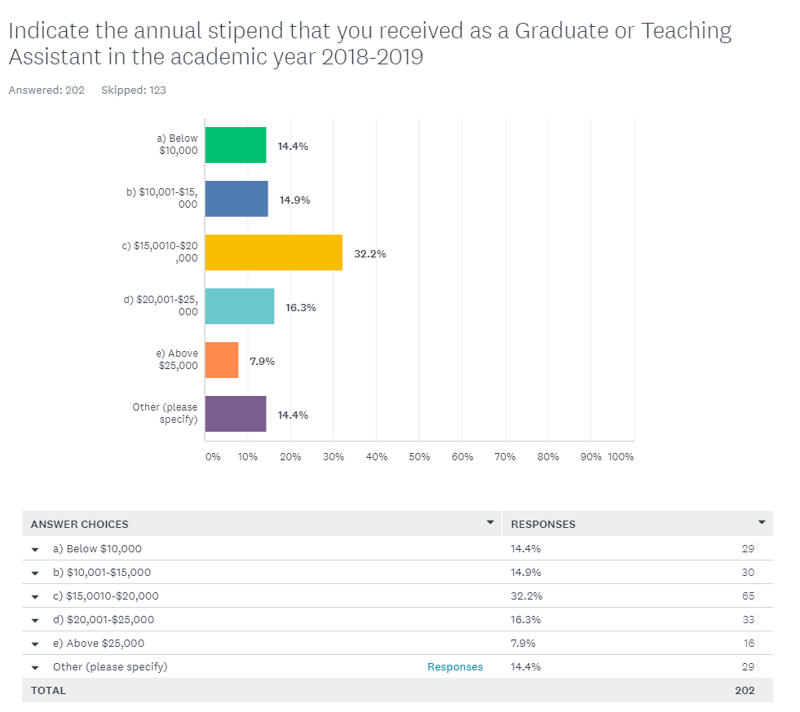
Financial Aid

Slide 21
NASPAA asked survey respondents “Please rank the following resources and opportunities NASPAA could seek funding to provide as part of our PhD Pathways Initiative. (1 is the opportunity you'd most like to see NASPAA do, 2 the second, and so forth)

Slide 22
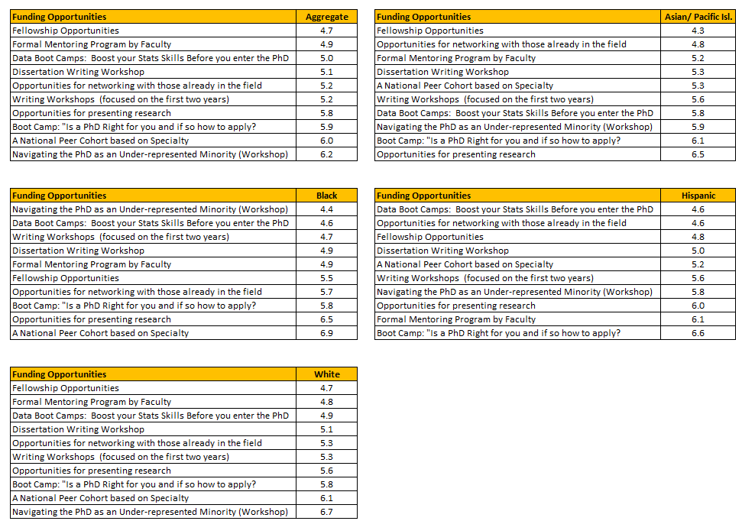
NASPAA Opportunities Rankings
by Race/ Ethnicity

Slide 23
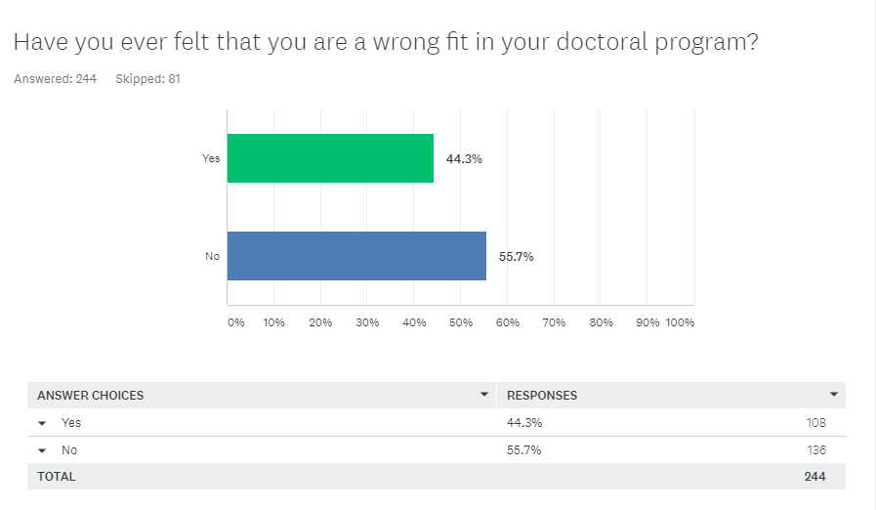

Slide 25
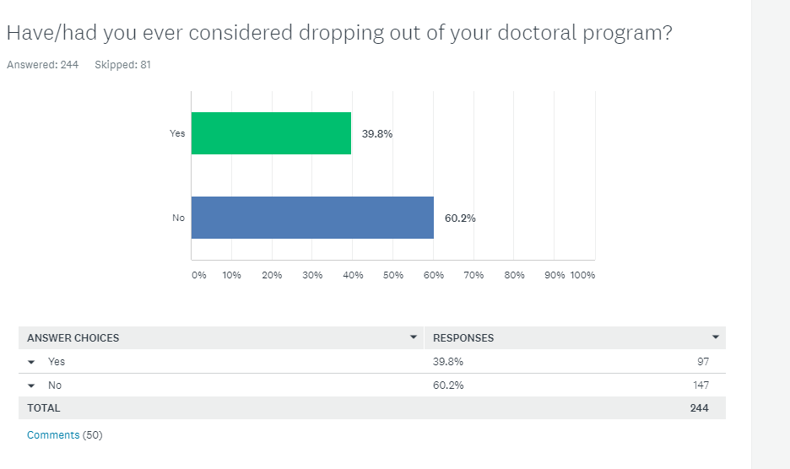
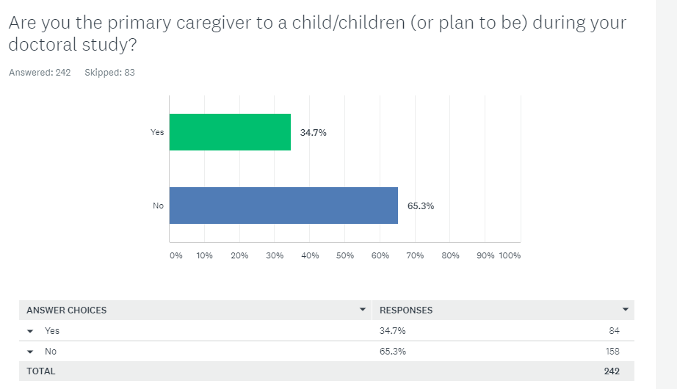

Slide 26
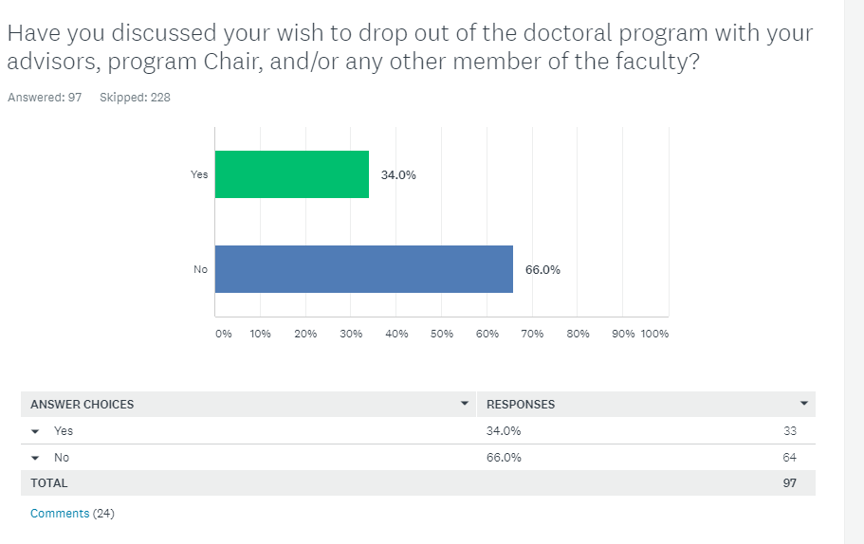

Slide 29
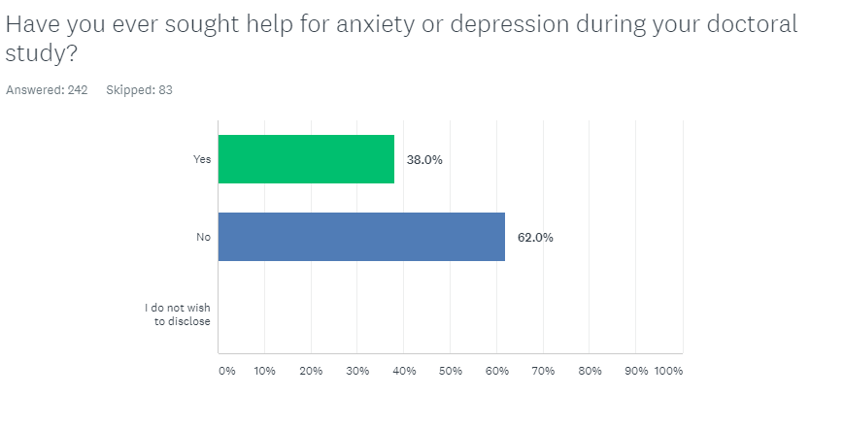

Slide 31
Highlighted Comments on Inclusiveness from open ended responses:
“There is a “majority” perspective that does not allow diverse viewpoints from non-White students. It is rather discouraging. Even to the point of being told to change my dissertation topic because as a Black person, it would not be well received by the popular white audience. But that if I was not Black, it would be better accepted. And that I would not be hired with a dissertation topic focused on race.”
“As a white male, I am over-represented. As a convicted felon, though, it can be difficult to be as open with everybody as I would like to be.”
“The administrators in my department do not show enough respect for the diversity of ethnicity. Some even showed bold discriminations to African-American PhD students and Asians.”
“There is a diverse group of students; however, those of color seem to be struggling more than others due to a lack of culturally responsive supports.”
“its inclusive, although white male tend to be over-represented in faculty positions so there is less demand for my expertise just because i am white and because i am male, i wish was told that before i applied

Slide 32
Highlighted Comments on Inclusiveness from open ended responses:
“Again, the issue is with including part-time students as contributing members of the class. We are treated differently than full-time students.”
“Many of our faculty are older, well-meaning white men who rarely include content on race, class, gender and other forms of diversity in their classes, and appear very uncomfortable in these discussions. The department feels like an old-fashioned, repressed, WASP-y organizational culture. This is an easy fit for me, but is not fair to students who are not from that culture. My decision not to pursue a career in academia after my doctorate is largely attributable to how unattractive the organizational culture of my department is to me. I like and respect my professors and can study here, but I wouldn't want to work in an environment like this.”
“In my academic journey, I encountered an overly represented (both in person and in materials presented) group - older, white men.”
“I think my opportunity to succeed were in some ways superior to my cohort members. Soecifically my female colleagues reported and I observed a difference in terms of how my opinions were treated and privileged at times. Also at least one conservative professor was at times mean spirited and dismissive of other views and Tet assumed I agreed with him.”

Slide 33
Highlighted Comments on Inclusiveness from open ended responses:
“I do some repressing of my background (fundamentalist evangelical Christian, etc.) because there is only so much time for discussion and it is easier to glide along on the default assumption, which is not false, that I am progressive. There have been a couple occasions where in my opinion things got out of hand, however, where people were calling for professors to be fired after they expressed conservative viewpoints (albeit with other factors, but still it was a bad sign). This is not the general tenor, and I have witnessed plenty of thoughtful interactions with conservative viewpoints on the whole.”
“My professors regularly complain about not being able to recruit black candidates. They apparently try their best. I have never seen black candidates present a job talk at my school. This worries me.”
“I am white and female. All white females flocked to one mentor. There was ONE female of color in my program and all SOC seemed to go to her. Both female professors were doing more than their fair share of mentoring and advising Ph.D students. There did not seem to be an acknowledgement of the extra labor they were doing in terms of course releases, etc.”

Slide 34
Highlighted Comments on Inclusiveness from open ended responses:
“I have always been labeled a non-traditional student. I am a first-generation college student in my family, Caucasian/Hispanic Latino, and did not begin college until age 26. I worked full time while attending classes because I had to. I grew up in poverty and have very little family/support. I firmly believe this doctoral program is incapable of understanding my background/experience. Whether this is by choice or something else, it remains the case. There is no understanding as to why I would be unable to attend month-long out of state workshops or multiple international conferences, every year/summer. Or why I would be unable to take a potentially risky post-doc two-year position across the country. Growing up in poverty meant that you were always at risk of losing what little you had, and you were a paycheck away from being homeless. I carry financial debt from my time in undergrad (federal loans), and cannot fall back on family in case things don't work out following graduation. There may be opportunities out there, but them being available, and you being able to take advantage of them are two completely separate things.

Slide 35
Highlighted Comments on Inclusiveness from open ended responses:
“Not all faculty, but the phd program in general systematically provided preferential treatment to white student, predominantly the male students, with regards to funding opportunities, fellowships, awards and other opportunities. The program also demonstrated discriminatory practices against minority candidates in a variety of ways. One such example was a group of faculty colluding to successfully terminate a minority candidate from the phd program through the comprehensive exam process. As a note on the questions above, race/ethnicity should not be the only determinant of a mentor. Also, just because there is a mentor available of my race/ethnicity, it does not mean that mentor is a quality mentor.”
“The college does push inclusion, which is commendable, but in the northwest it is difficult to get actual diversity which is a main way that i perceive inclusion. Further, in terms of faculty make up, diversity and thus one aspect of inclusion, is limited. There is often little room in most classes to talk about how my identity changes the perspective of the subject at hand.“
“The program has an MPA director that constantly and openly, makes racist comments. For example, she only got that job because she is black or they told me they didn't hire me because they wanted a minority candidate.”

