Slide 1

Career Professionals Meeting
December 2018
Hosted by: NYU Wagner
New York, NY

Slide 2
Introduction
Employment and Alumni Data
  Sources
    Annual Data Report
    Alumni Survey
Enrollment/ Degrees Awarded Trend Data
New NASPAA Website Preview
PhD Pathways Initiative
Other NASPAA News

Slide 3
NASPAA Annual Data Report

Slide 4
NASPAA Annual Data Report

Slide 5
NASPAA Alumni Survey 2015-2018

Slide 7
NASPAA Alumni Survey 2015-2018

Slide 9
NASPAA Alumni Survey Data

Slide 10
NASPAA Alumni Survey Data

Slide 11
NASPAA Alumni Survey Data

Slide 12
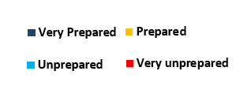
NASPAA Alumni Survey Data

Slide 13
NASPAA Alumni Survey Data

Slide 14
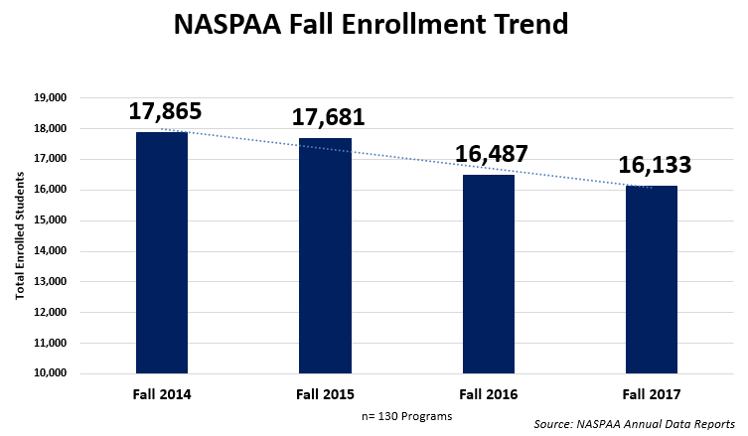

Slide 17
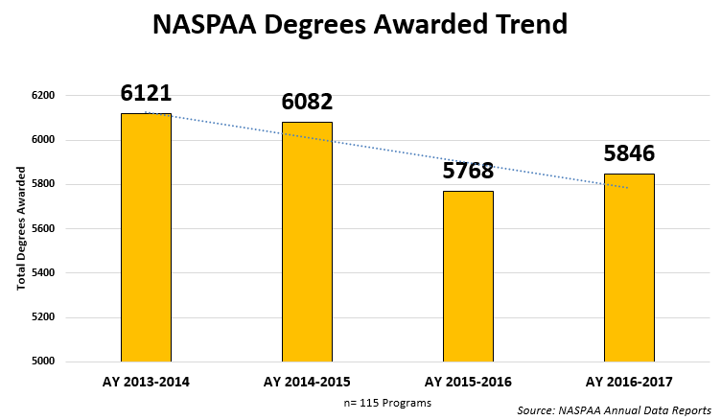
NASPAA 15-16 Annual Data Report
59% Members Reporting

Slide 18
New NASPAA Website Preview
Preview Website
Students, Career Resources

Slide 19

NASPAA is embarking on a PhD Pathways Initiative in which we seek to better understand the experiences of doctoral students in our degree programs. The goal of the initiative is to increase the number of under-represented minorities who receive a PhD in our field. NASPAA will use the information gathered in the survey to advise the development of information sessions, admission boot camps, mentoring, networking and other professional development opportunities.

Slide 20
Other NASPAA News
Student Simulation Competition
Civic Engagement Initiative
USNWR Update

