Slide 1



Simulation and Pedagogy for Public Administration
Renmin University, Beijing
April 7, 2018
David F. Andersen
Rockefeller College
University at Albany

Slide 2
Outline of Remarks
Part 1: Why Simulate?
Part 2: The NASPAA-Batten Simulation Competitions
  Origins of the First Competition in 2015
  Fast Overview of Recent Competitions in 2017 and 2018
Part 3: Diverse Uses of Simulations in MPA and MPP Education
Part 4: Let’s Run the 2016 En-Roads Simulation Today
Part 4: Where to Find More Information
  URLs and academic references for most simulators from today are in your packet

Slide 3
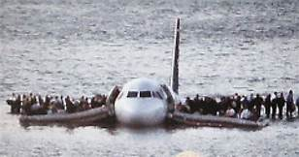
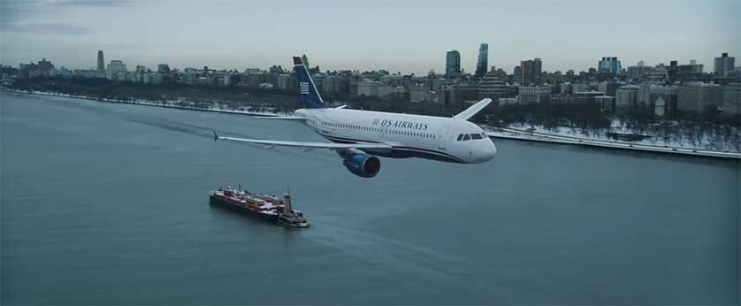
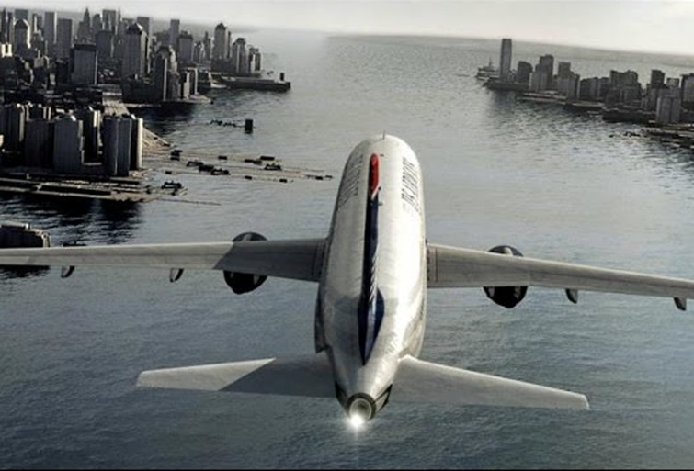
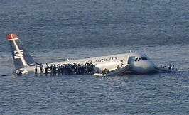
Part 1: Why Simulate?

Slide 4
Pilots, Managers, and Students
Can learn to handle once-in-a-lifetime challenges through repeated trial-and-error
Can learn by “crashing the system” without loss of life or public funds and confidence
Can come to understand the deeper structure of complex problems
Can design more robust systems that are easier and better to manage

Slide 5
Part 2: The NASPAA Batten Simulation Competitions
  2015 Reforming Health Care in the USA
    Some Background to the Competitions
  2017 World Food Shortages
  2018 Pandemic
  2016 Global Energy-Climate System
    I hope we can run this simulation in this room later today!!

Slide 6

2015: Reforming Health Care in the USA (with background to the competition)
Repeat of a Presentation to the System Simulation Community

Slide 7
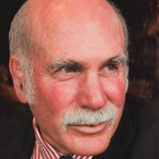
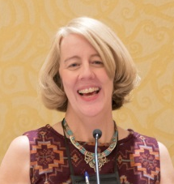
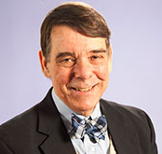
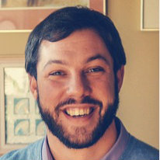
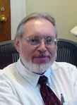
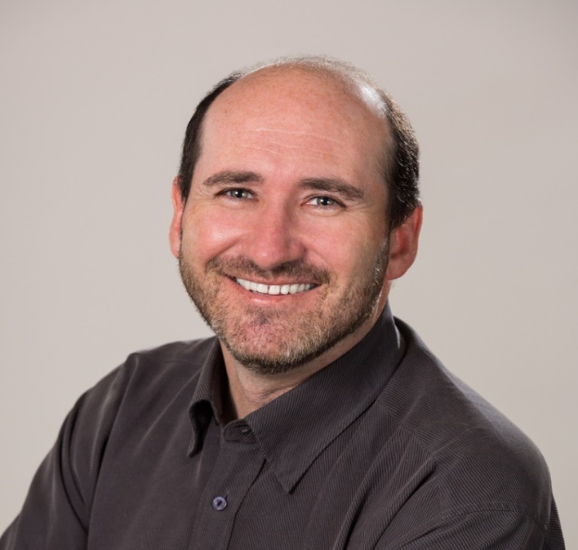
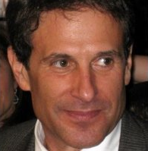
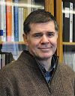
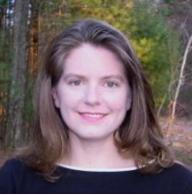
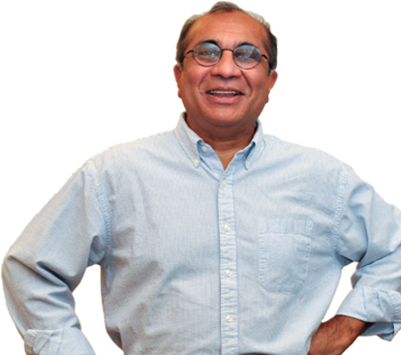
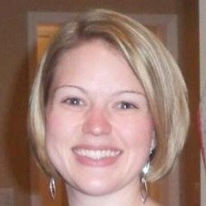
Simulation Authors
David Andersen
Laurel McFarland
Gary Hirsch
Ernest Cawvey
Ernest Cawvey
Jack Homer
Jack Homer
Richard Irving
Bobby Milstein
Rebecca Niles
Rebecca Niles
Emily Reineke
Anand Desai
Rod MacDonald
Anand Desai

Slide 8

What NASPAA does:
Accreditation
Ensure excellence in Education and Training for Public Service
& Promote the Ideal of Public Service
Annual Conference
Data Center
Student Competition
Notes:
Spend less time on the four..

Slide 9

Student Competition Goals:
Increase student learning
Advance pedagogy
Showcase student excellence
Highlight the value of public service education

Slide 10
NASPAA needed a simulation
  Public policy and administration focused
  Technically well developed
  Adaptable for student learning

Slide 11
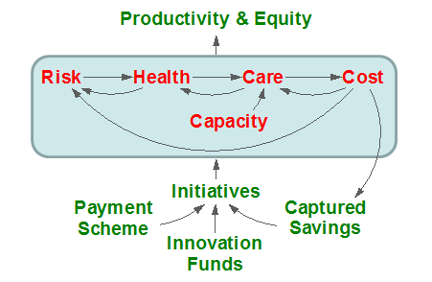
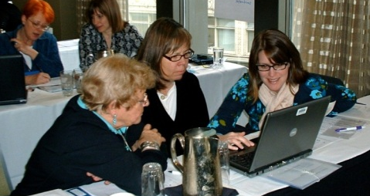
A Regional Health System in a Computer
Causal Pathways
Stewardship
Plausible Futures
Teams
2000
2010
2020
2030
2040
System
Dynamics
The ReThink Health model brings
greater structure, evidence, and creativity
to the process of multi-stakeholder strategy design

Slide 12

When we think of health systems, most think of…
Insurance
Hospitals
Drugs
Doctors
Patients

Slide 13

But anything that effects health is part of the system…
Quality Education
Clean Air
Safe Neighborhoods
Healthy Food
Good Jobs
Notes:
But really, anything that effects are health is part of that same system. We all need things like…

Slide 14


Everything has to work well, and together as a system

Slide 15
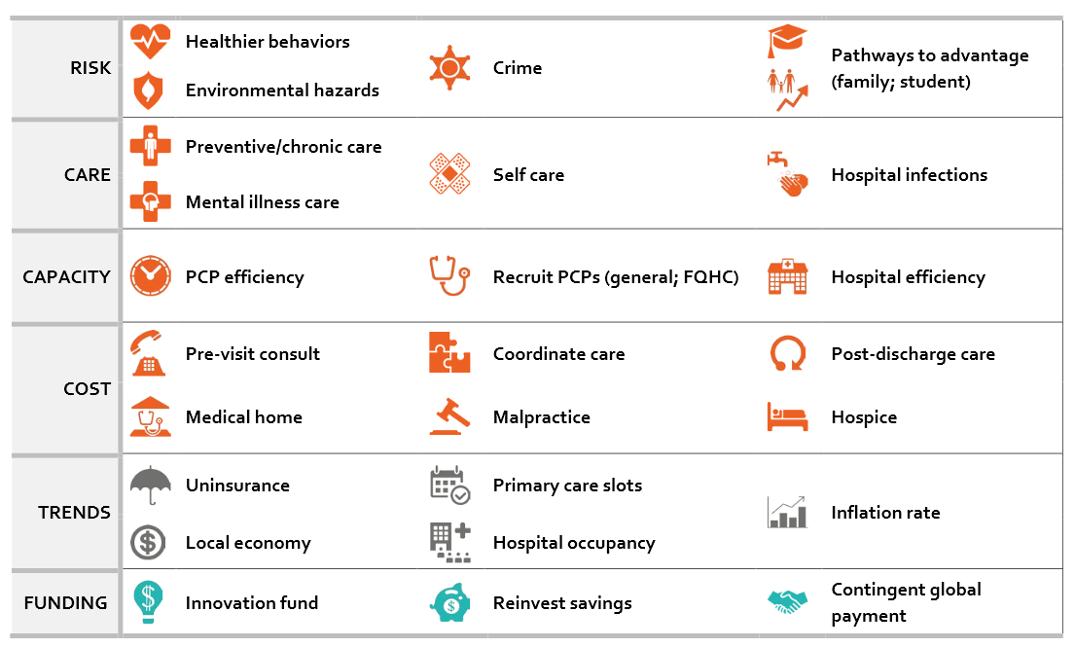
People everywhere are scrambling for solutions…
Deliver Better Care
Expand Insurance
Cut Costs
Change Payment Systems
Create Healthier Conditions
(at home, work, school, etc…)
* Definitions are available at:
http://www.rethinkhealth.org/wp-content/uploads/2015/02/Interventions.pdf

Slide 16
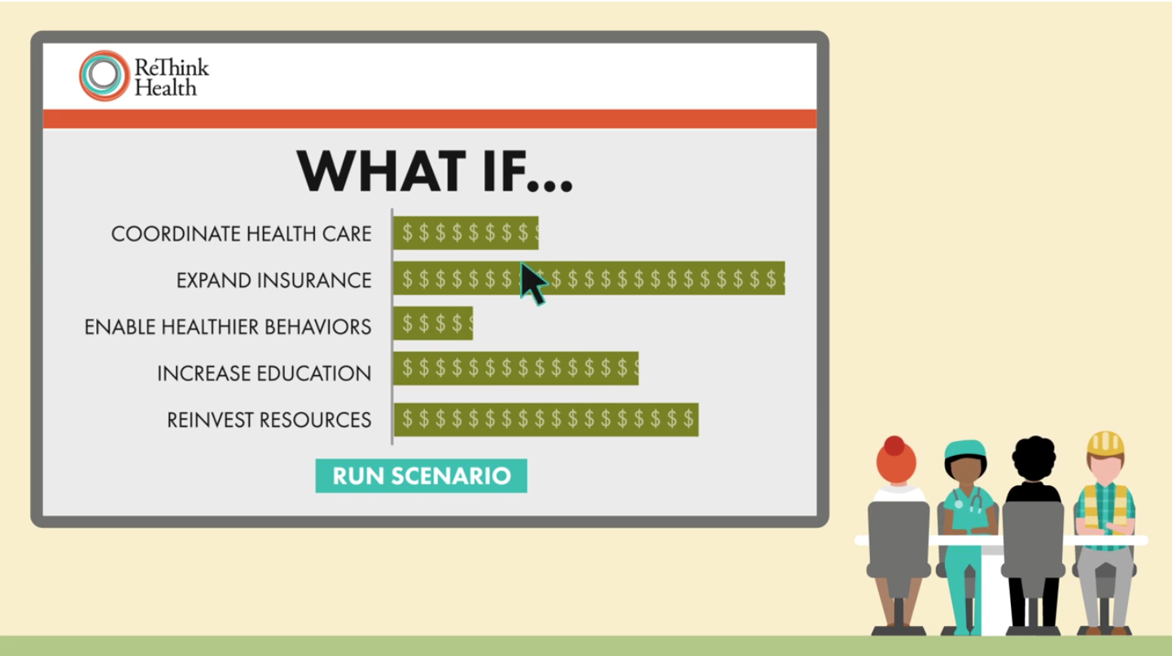
Instant answers to “What if?” questions…

Slide 17
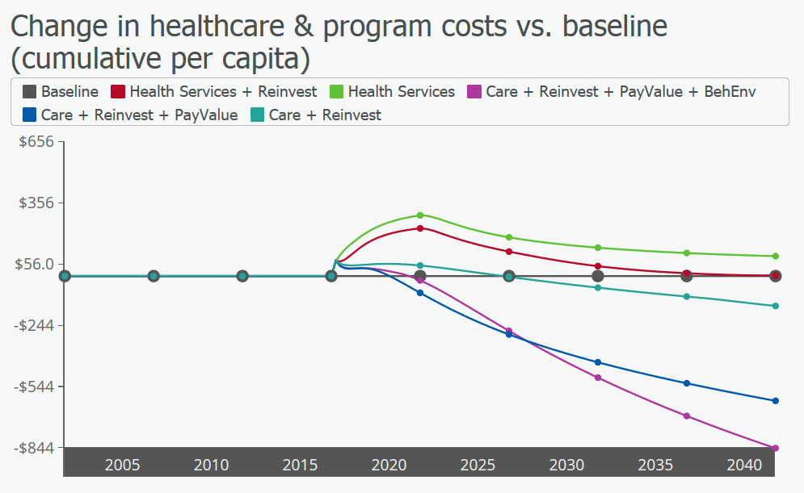
Explore how to do the most with our resources…
Net Costs vs. Baseline

Slide 18
In pursuit of a healthier health system
Lower Costs
Better Health
Greater Equity
Better Care
Higher
Workforce
Productivity
Notes:
But really, anything that effects are health is part of that same system. We all need things like…

Slide 19
Technical Challenges to Convert a Calibrated Policy Simulation Model to Student Exercise

Slide 20
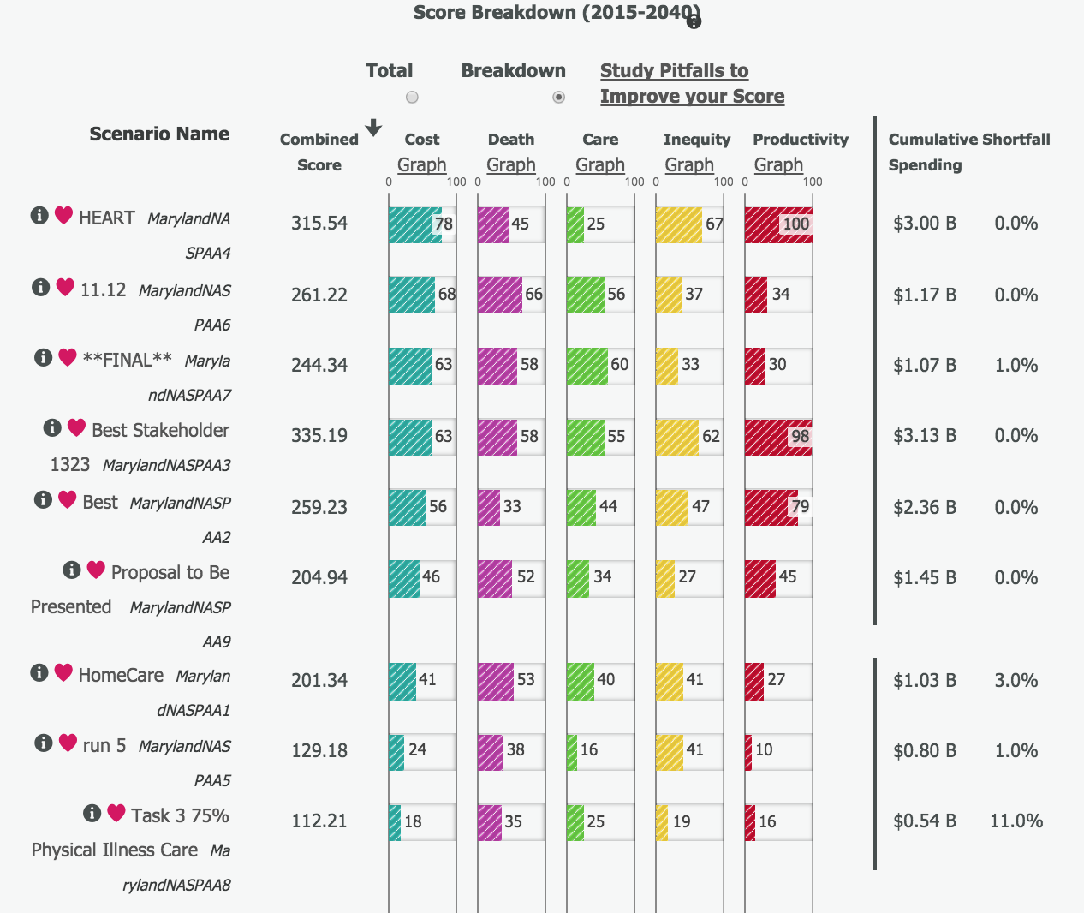
Creating A Superscore

Slide 21
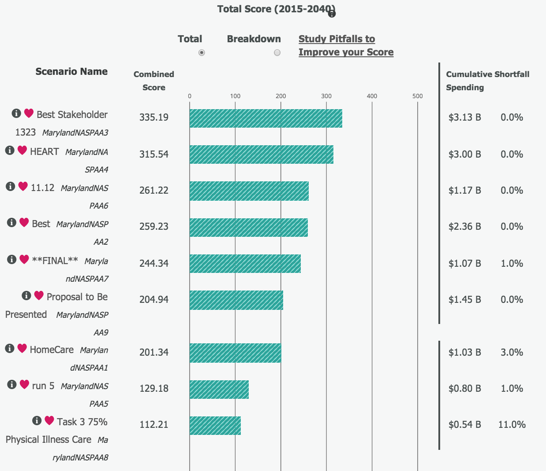
To Quickly Identify Technical Winners

Slide 22
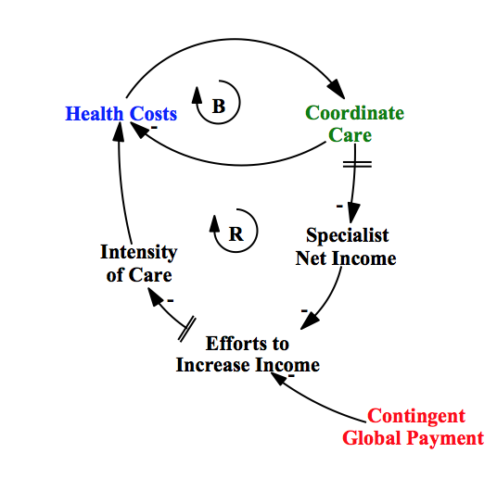
Embedding Diagnostics to Support Learning

Slide 23
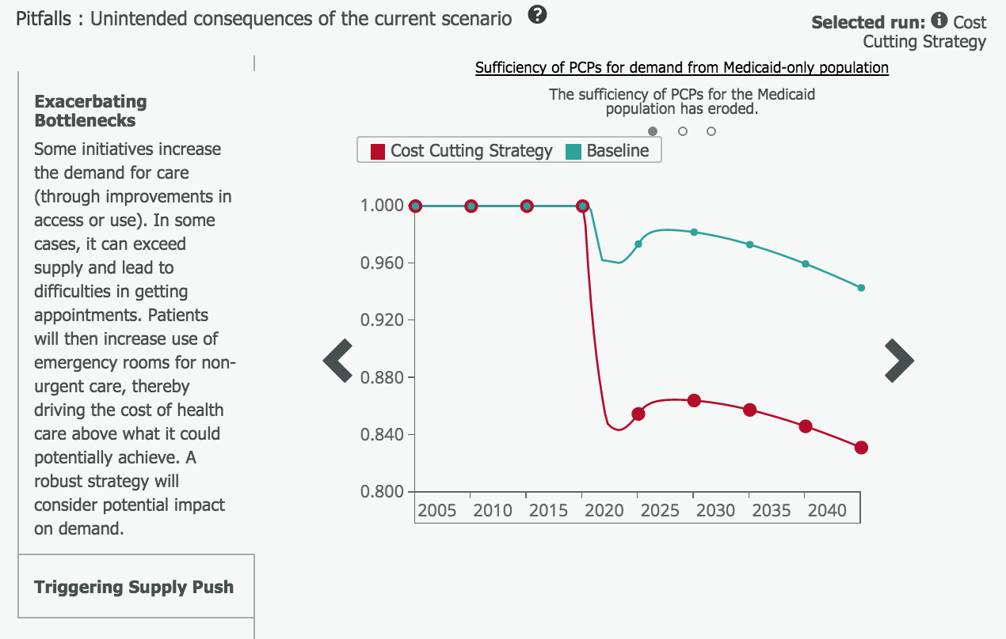
Reveal Pitfalls

Slide 24
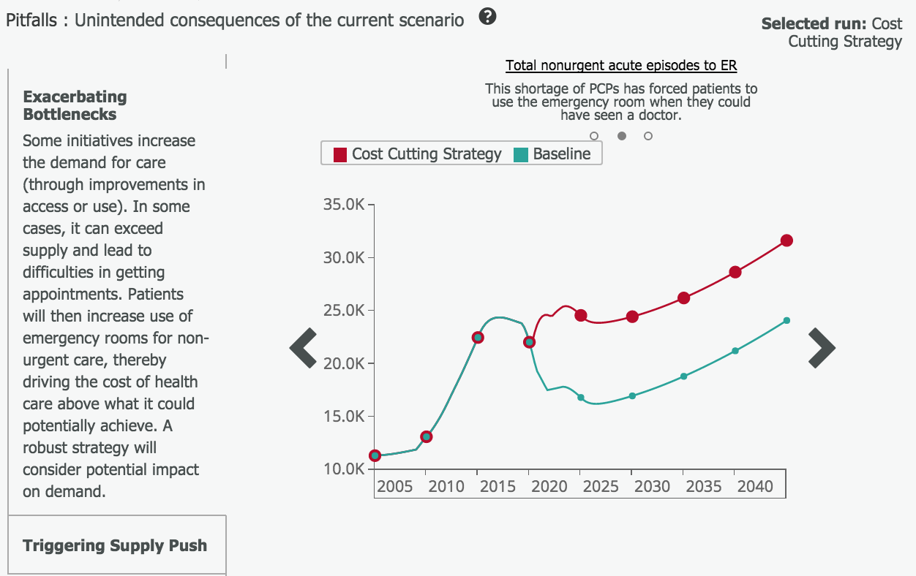
Help Unsupported Users See the System

Slide 25
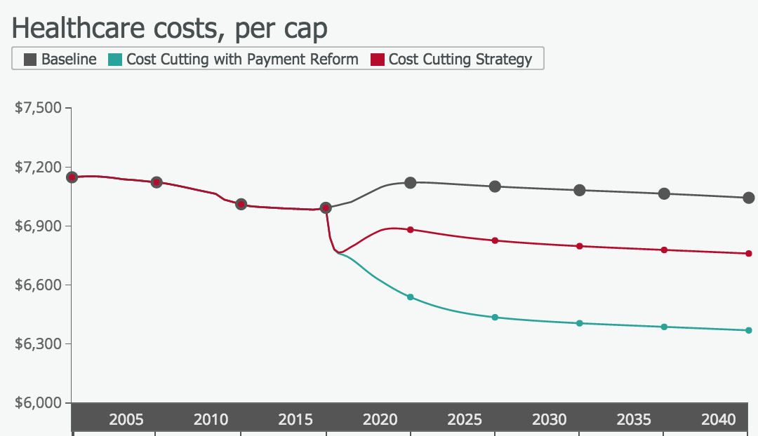
To Thoughtfully Improve It

Slide 26

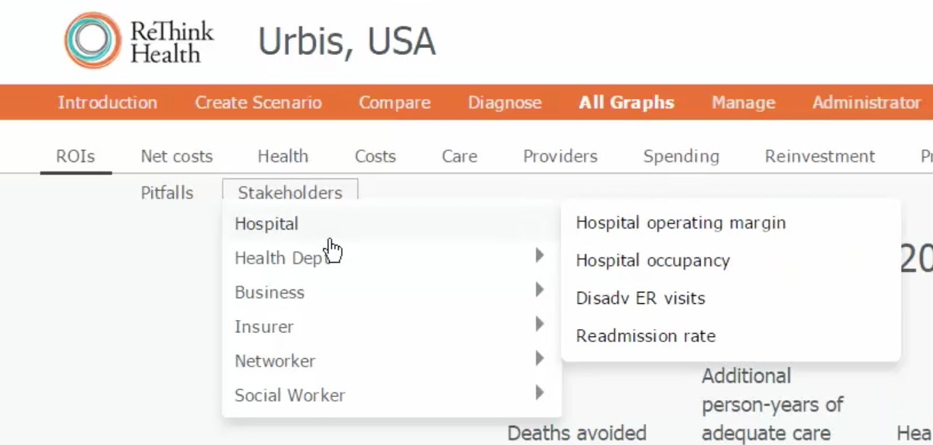
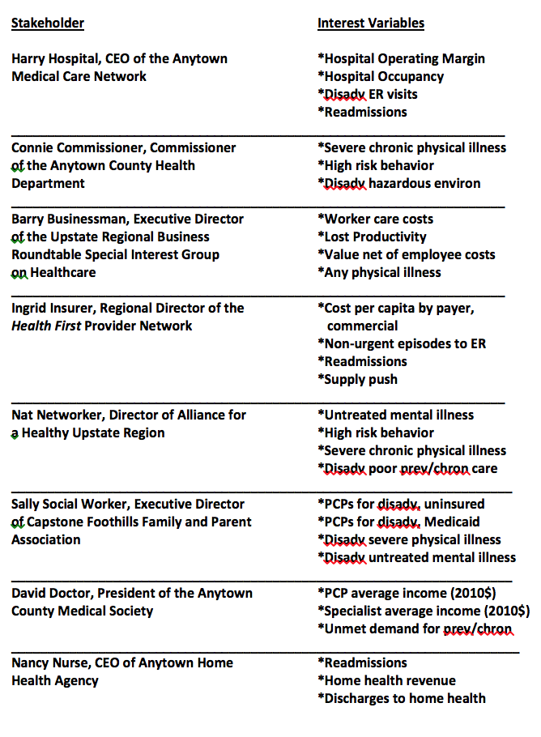
Making Stakeholder Concerns Visible

Slide 27
Video Showing
Results from the
Competition Day
Video created by University of Maryland School of Public Policy URL: http://bit.ly/CompetitionVideo
Notes:
3 minutes – This is the slide for the UMD video

Slide 28
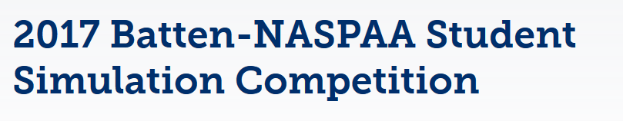
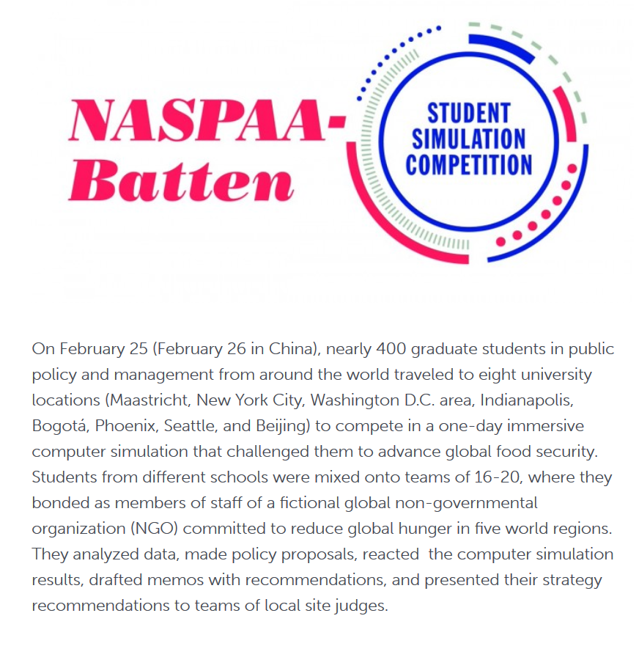
Global
Food
Security

Slide 29



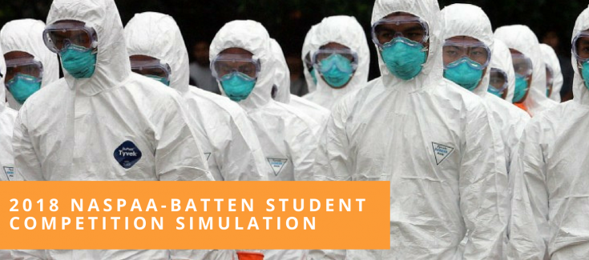

Slide 30
Part 3: Diverse Uses of Simulations in MPA and MPP Education
Simulator as a Competition or a Program “Kick-Off” Event
Simulator helps to organize a Capstone Course
Simulator in support of a Case Study
Simulator as an Organizing Framework for a Course on Quantitative Methods
And more, we are just getting started in this exciting area

Slide 31
Simulator as a Competition or a Program “Kick-Off” Event
Many business schools begin their academic years with a whole-class simulation exercise.
Especially MIT has developed a wide array of possible exercises
MIT Management, Sloan School. Learning Edge. Management Simulation Games. https://mitsloan.mit.edu/LearningEdge/simulations/Pages/Overview.aspx
The NASPAA International Simulation Exercises are excellent examples of large-scale simulation-based events

Slide 32
Simulator helps to organize a Capstone Course
At the Rockefeller College, we have organized a Capstone Exercise, including portfolio development around a whole class simulation-based exercise
The base simulators have been the “Stratagem” game developed by Dennis Meadows
http://content.globalmarshallplan.org/ShowNews.asp?ID=3058
Or the ReThink Health Simulator used in 2015 by NASPAA
ReThink Health, The Rippel Foundation. https://www.rippelfoundation.org/our-work/rethink-health/

Slide 33
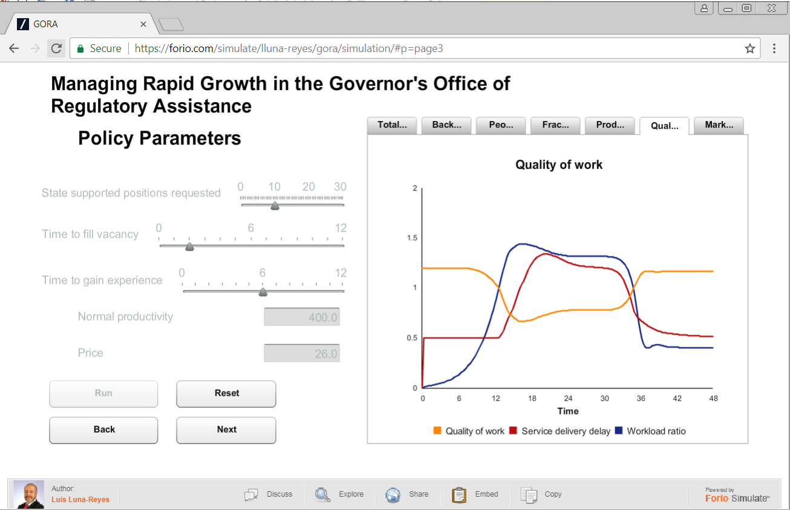
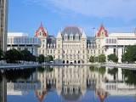
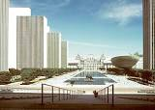
Simulator in support of a Case Study
One of my favorites is the Governor’s Office of Regulatory Administration (GORA) Case based on a New York State agency
https://forio.com/simulate/lluna-reyes/gora/simulation/#p=page1

Slide 34
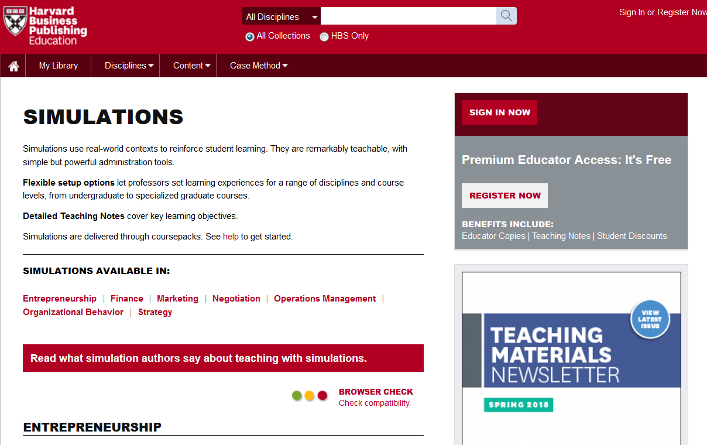
Simulators in support of a Case Study
There are also those cases from Harvard…

Slide 35
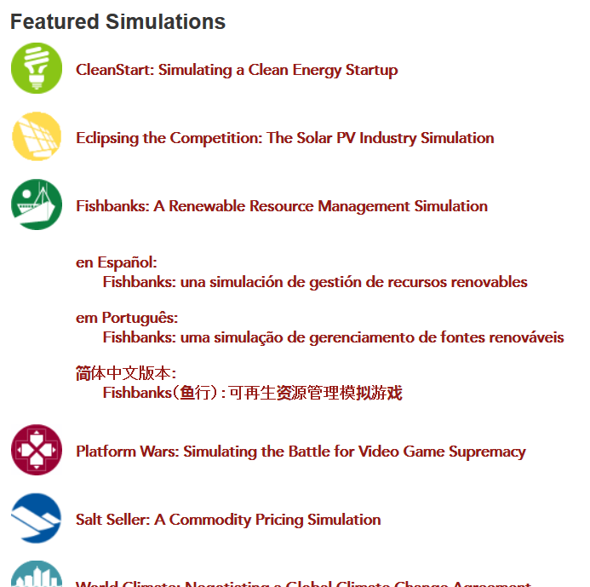
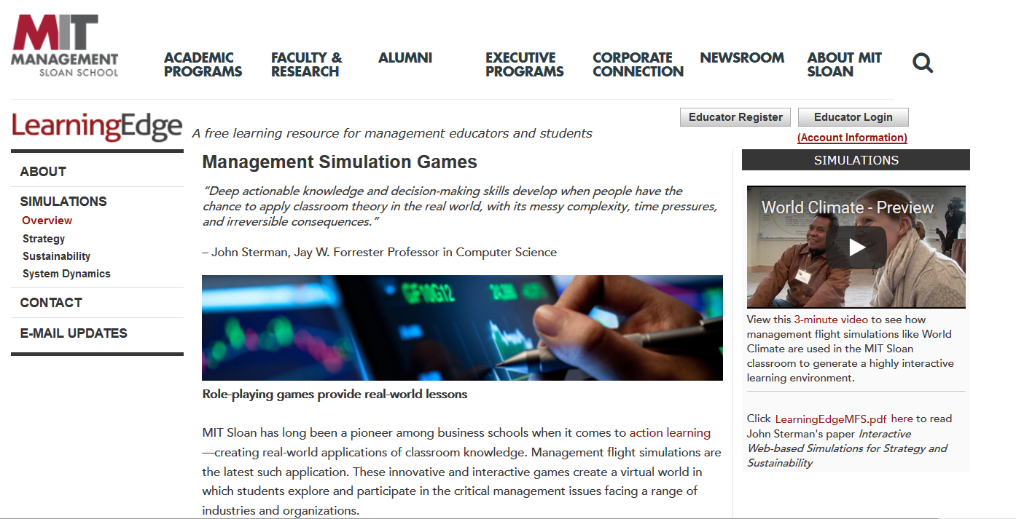
Simulators in Support of Case Studies
Or better yet, some of those cases from MIT Sloan

Slide 36
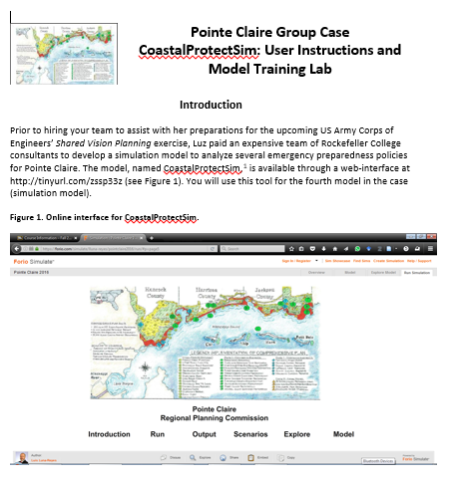
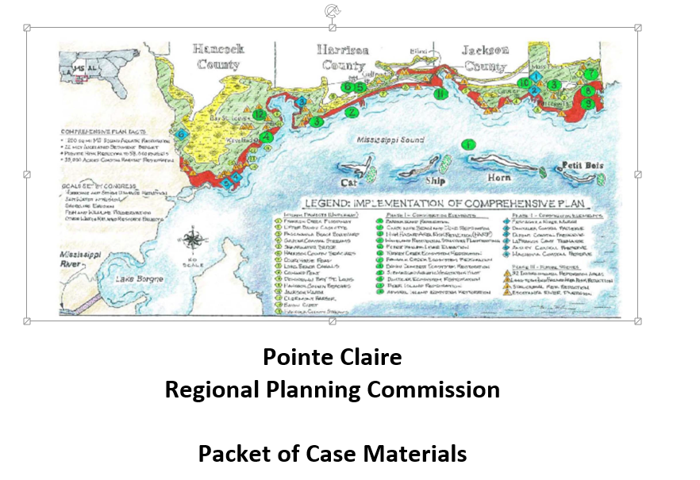
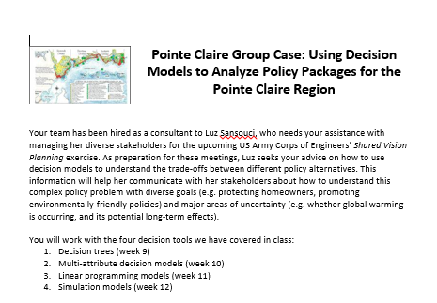
Simulator as an Organizing Framework for a Course on Quantitative Methods
MY Colleague, Luis Luna-Reyes has
Organized parts of his MPA methods
Class around a simulator

Slide 37
Part 4: Run the 2016 En-Roads Simulation Today
Step 1: Find the packet of information on En-Roads in your handouts
Step 2: Each World Team consists of Seven Teams, so we need to break into Several “Worlds” each with seven teams
  Carbon Pricing
  Climate Hawks
  Energy Efficiency
  Fossil Fuel
  Land and Agriculture
  Population and Consumption
  Sustainable Energy
Step 3: on how the simulator works
View video

Slide 38
Run the 2016 En-Roads Simulation Today (cont’d)
Step 4: Working in your small groups, read the case, paying special attention to the description of your group’s role in the case
Step 5: Using Worksheet 2.2, make all the decisions that your group is assigned on behalf of your whole (simulated) world. For each decision, you need to select a number between “Business as Usual” and “Extreme Policies”
Step 6: We will type all the decisions for your world into the simulator
Step 7: Repeat Step 6 for all the other worlds in the room
Step 8: Compare between worlds to see how each world did.

Slide 39
Part 4: Where to Find More Information
The handouts for this talk provide logon information to simulators that we have discussed today
The handouts for this talk provide academic references for the materials that we have discussed today

Slide 40
Logon Information for April 7, 2018 Seminar
Beijing, China
How to run simulator for 2015 NASPAA ReThink Health Simulation:
URL to get into the model:
forio.com/app/rippel/rethink-health-naspaa
Usename: NASPAATrainer
Password: NASPAATrainer1
How to run simulator for 2016 NASPAA En-Roads Simulator: World Energy
URL to get to the model:
https://forio.com/simulate/climateinteractive/naspaa2/simulation/#p=page18
username: climateinteractive
password: Ask David Andersen
How to run simulator for the Governors Office of Regulatory Assistance Case
https://forio.com/simulate/lluna-reyes/gora/simulation/#p=page1
No Username or password needed
How to run simulator for the Coastal Protect SIM Exercises
https://forio.com/simulate/lluna-reyes/pointclaire2016/run/#p=page5
No Username or password needed
If you experience trouble during login using the Safari browser, try using Firefox or Chrome. Make sure the Adobe Flash-Player plug-in is up to date.

Slide 41
References to materials discussed in this presentation Page 1
Andersen, David F., John M. Bryson , George P. Richardson , Fran Ackermann , Colin Eden and Charles B. Finn. Integrating Modes of Systems Thinking into Strategic Planning Education and Practice: The Thinking Persons' Institute Approach. Journal of Public Affairs Education. Vol. 12, No. 3 (Summer, 2006), pp. 265-293
Climate Interactive, En-Roads Simulations. https://www.climateinteractive.org/tools/en-roads/
Harvard Business Publications: Simulations. https://cb.hbsp.harvard.edu/cbmp/pages/content/simulations
Ku Minyoung, Roderick H. MacDonald , Deborah L. Andersen , David F. Andersen and Michael Deegan. Using a Simulation-Based Learning Environment for Teaching and Learning about Complexity in Public Policy Decision Making. Journal of Public Affairs Education. Vol. 22, No. 1 (WINTER 2016), pp. 49-66.
Learmonth Gerard P., David E. Smith, William H. Sherman, Mark A. White, Jeffrey Plank. A practical approach to the complex problem of environmental sustainability: The UVa Bay Game. The Innovation Journal: The Public Sector Innovation Journal, Volume 16(1), 2011, article 4.
Learmonth Gerard P., Jeffrey Plank. Participatory Simulation as a Tool of Policy Informatics. Definitions, Literature Review and Research Directions. Chapter 16 in Erik W. Johnson, ed. Governance in the Information Era: Theory and Practice of Policy Informatics. Routledge, 2015.

Slide 42
References to materials discussed in this presentation Page 2
Luna-Reyes, Luis, and Erika Martin. Course Material for RPAD 504: Models and Decision Making II:, Point Claire Group Case Study Coastal Protect Sim: User Instructions and Model Training Lab. Point Claire Group Case: Using Decision Models to Analyze Policy Packages: Point Claire Region. Point Claire Regional Planning Commission: Packet of Case Materials.
McFarland Laurel, Bobby Milstein, Gary Hirsch, Jack Homer, David Andersen, Richard Irving, Emily Reineke, Rebecca D. Niles, Ernest Cawvey, Anand Desai and Rod MacDonald. NASPAA Student Simulation Competition: Reforming the U.S. Health Care System within a Simulated Environment. Journal of Public Affairs Education, Vol. 22, No. 3 (SUMMER 2016), pp. 363-380.
MIT Management, Sloan School. Learning Edge. Management Simulation Games. https://mitsloan.mit.edu/LearningEdge/simulations/Pages/Overview.aspx
ReThink Health, The Rippel Foundation. https://www.rippelfoundation.org/our-work/rethink-health/
Sterman John. 2014. Interactive web‐based simulations for strategy and sustainability: The MIT Sloan Learning Edge management flight simulators, Part II. System Dynamics Review. 30(3):206-231. https://doi.org/10.1002/sdr.1519

Slide 43
Thank You
Comments or Questions?

