Slide 1
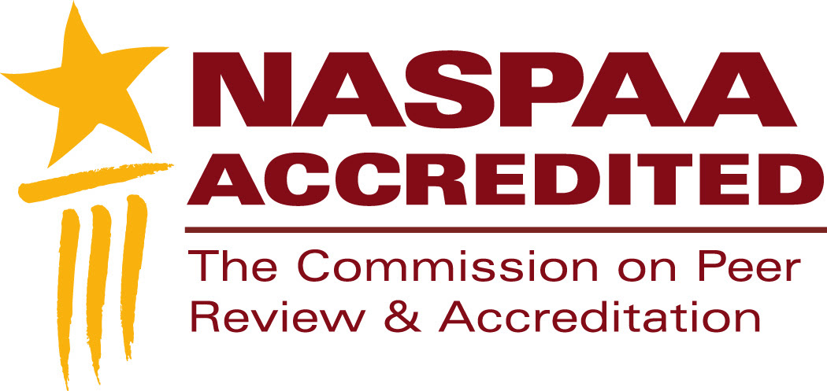
NASPAA Accreditation
Are you eligible? Are you ready?
Notes:
This segment is about your eligibility and readiness for accreditation.
These are not the same thing.
You should be both qualified for AND capable of being evaluated.
Feel free to pause this video at any time to study a slide.
Download the slides because they contain detailed notes.
You should send at least one representative from your program to the Accreditation Institute at NASPAA’s annual meeting.
The Accreditation Institute is where you’ll have an opportunity to practice applying the concepts and tools we review in these videos.

Slide 2
Condition 1: Institutional accreditation
Is the institution of which you are a part approved by a recognized regional, national or international agency?
Is your primary objective professional education?
Have you been operating long enough to have sufficient information about your operations and outcomes to support an evaluation?
Notes:
If you can answer “yes” to all three questions, you have met the first condition to be eligibie for accrediation review by COPRA
“Larger institutions” tend to be universities approved to give degrees by, for example, agencies of a national government.
“Professional education” is distinguished from liberal arts education: graduates pursue careers in the profession for which they have earned a degree, as opposed to, for example, seeking doctorate degrees.
Typically, 4 years is sufficient to generate information about program performance, assess outcomes, and implement improvements, but that is not a required minimum..
If you cannot answer these questions, stop. No point in proceeding.

Slide 3
Condition 2: Public Service Values
Can you define what your program values about public service, whether substantive or procedural?
Can you demonstrate your commitment to those values in your mission, governance and curriculum?
Does your commitment to public service values distinguish your program from other professional degrees?
Notes:
Honor, virtue, justice and other public service values are not necessarily in conflict with self-interest, at least not with enlightened self-interest, but they are closely associated with the ideals of public service.
If you can answer “yes” to all 3 questions, you have satisfied the second condition for accreditation review by COPRA
Public service values are enduring beliefs and ideals shared within your community about what is good and what is not. Make explicit what you might take for granted.
A substantive value, for example, could be equality. A procedural value, for example, could be accountability. You decide what matters to you.
Your mission should express your values.
Your program should model them. For example, if your program has a strong commitment to accountability, do you have processes in place that hold faculty and students accountable for violating program expectations of professional behavior? Your graduates should know how to design programs that hold decision-makers accountable.
Your public service values should help to distinguish your program from professional degrees in business, planning, social work, etc.
Image © Hermin Utomo | Dreamstime.com

Slide 4
Condition 3: Primary Focus
Is your focus preparing students to be leaders, managers, and analysts in public affairs, administration, and policy?
Do your students earn master’s degrees?
Notes:
If you can answer “yes” to both questions, you have satisfied the third condition for accreditation review by COPRA
COPRA accredits only master’s degrees. A programs offering undergraduate or doctoral degrees, as well, may seek accreditation for its master’s degree.

Slide 5
Condition 4: Course of Study
Does your program allow time for significant interaction among students and faculty?
Does your program allow time for collaborative work?
Does your program allow time to socialize students to the norms of the profession?
Does your program allow time for faculty to assess student’s interpersonal and communication skills?
Notes:
If you can answer “yes” to these questions, you have satisfied the fourth condition for accreditation review by COPRA.
The normal expectation for “time” is 36 to 48 semester credit hours of study, or the equivalent internationally
If you offer distance learning, international exchanges, or other innovative forms of delivering your program, the burden is on you to demonstrate that you have met the intentions of this condition, including governance by qualified faculty
You do that by documenting your decisions
Examples of documentation include: descriptions of the faculty who run the program, communications between faculty and students, sample work products
In other words, for any and every method of instruction you employ, COPRA needs evidence that each achieves its intended outcomes

Slide 6
Special Conditions
Fast-tracks
Dual degrees
Executive education
Notes:
Programs in which students may earn undergraduate and graduate degrees in less time than it would take to earn both degrees separately may seek accreditation review so long as the programs meet the criteria for an accredited graduate degree program.
Programs in which students may earn two graduate degrees in less time than required to earn each separately may seek accreditation review if the degree in public affairs, administration, and policy meets NASPAA’s accreditation standards and if the electives that satisfy requirements for the other degree also are appropriate electives for a degree in public affairs, administration and policy.
Programs designed especially for college graduates working as professionals in the field may seek accreditation review if the professionals have had at least 5 years of of work experience in the field, including at least 3 years at mid to senior level. And the degree program must demonstrate that its graduates have learned competencies expected of an accredited program and distinctive to executive education.
Bottom line: the pieces have to fit together, be consistent, tell a coherent story
Image © A1stock | Dreamstime.com

Slide 7
Principles of NASPAA accreditation
You may deviate from the normal expectations if you can justify it in terms of your mission.
The burden is on the program to make its case.
Demonstrating continuous process improvement is as important as meeting a “bright line” test
Notes:
NASPAA’s accreditation process models its public service values:
innovation and experimentation to improve the profession and public service: accreditation is not about making all degree programs identical
You may petition for special consideration if you do not meet a condition for eligibility in a literal sense. But you must comply with the spirit of the condition, show that your noncomformity aligns with your mission, and demonstrate quality outcomes.
Nonconformance arguments have been rare and success with nonconformance is rarer still.
Programs found to be out of compliance may be denied accreditation or may be asked to explain how they will come into compliance and monitored until that happens.
Accountability and transparency: You bear the burden of making the case. You must supply supporting argument and evidence. Your processes and outcomes should be observable to your stakeholders.
Equity: In contrast to design standards (numerical requirements for inputs), NASPAA’s accreditation standards are performance standards (outcomes consistent with program mission); they discriminate on the basis of merit, not reputation, power, or resources; they favor programs that demonstrably serve the public.
Image © Iqoncept | Dreamstime.com

Slide 8
Are you ready?
Have faculty, university administrators, and other stakeholders decided why to seek accreditation?
Has the program secured funding to cover the costs?
Has the program documented what it’s been doing?
Does everyone know their responsibilities?
Are you prepared to manage change if your self-study or continuous improvement processes reveal gaps?
Has leadership attended an Accreditation Institute?
Notes:
If you are eligible for accrediation review AND can answer “yes” to these questions, then you are eligible for accreditation review/
This doesn’t mean you are ready. You have to be able to demonstrate that your program in general conforms with the accreditation standards; that’s what the self-study report should document. If it does not, you have work to do.
Accreditation is voluntary and requires an ongoing commitment. Everyone needs to be on board with the decision
Costs include NASPAA fees, faculty and staff time to prepare the self-study report, and direct costs of collecting, maintaining and analyzing information. A program that’s ready to be accredited should already be incurring the direct costs as a matter of managing itself, so the incremental costs of documenting that in the self-study, while not trivial, should be incremental.
COPRA expects programs to report selected historical data about its performance, such as on admissions. The program shouldn’t initiate accreditation review unless it has been collecting information to document its performance over time.
Accreditation requires more than a designated person sequestered in a room, sitting before a keyboard and typing answers to online questions. It’s a team effort that draws on the resources of all of your stakeholders within and outside of the program for at least two years, three if you are seeking initial accreditation. It’s a project to be managed. Tasks include collecting data, analyzing data, preparing the self-study report, organizing the site visit. For well-run programs, though, the processes and documents describing them should already exist.
A self-study process affirms consensus on mission and program performance, as well as disagreements and gaps. Accreditors want you to document for them how you reached consensus on the management of your program and on its performance, recognition of the gaps, and evidence of movement to address them. Be prepared to make process improvements. COPRA does not expect a static/unchanging environment; it expects there to be evidence and rationales for change. No need to wait until after accreditation review to make changes you’ve planned and need. Indeed, accreditation validates that you have processes in place for studying yourself continuously and implementing changes.
Those designated to lead the program’s accreditation review, if not other stakeholders, should study the videos and attend an Accreditation Institute. If possible, seek a mentor or consultant from an accredited program to advise you.

Slide 9
Additional resources
accreditation.naspaa.org/resources
If you have questions stimulated by this video, submit them to:
accreditation.naspaa.org/ai-questions

Slide 10
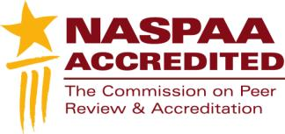
Mission-driven
Outcomes-oriented
Evidence-based
Accreditation-earning
Program Management
Notes:
This is not just about accreditation.
This is about improving public service.

