Slide 1
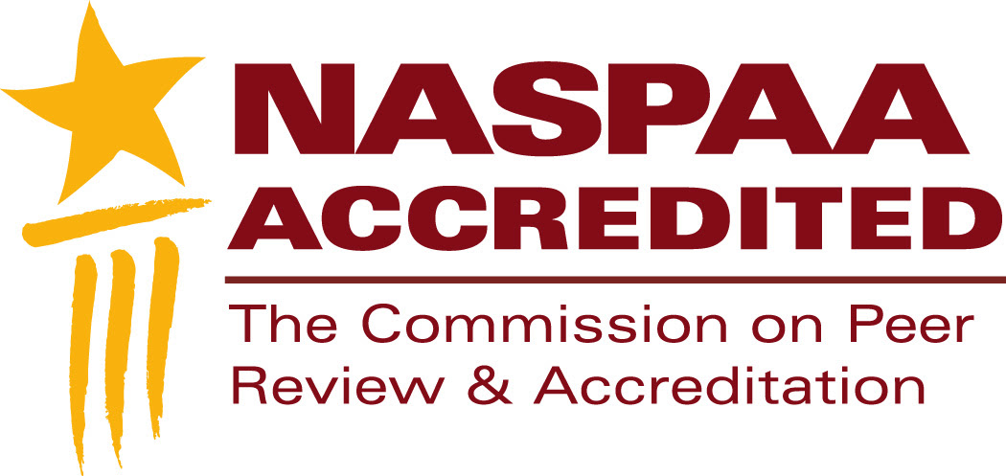
NASPAA Accreditation
Accreditation as a process
Notes:
This segment is intended to help you understand accreditation as a process.
NASPAA accreditation is a process that encourages programs to keep improving, which means identifying what success means to you and demonstrating how you are achieving it
We’ll compare the accreditation process to two other processes with which you might be familiar: writing a grant proposal and conducting an operational audit.
We’ll review the steps in the accreditation process and describe what we call, the “accreditation triangle”
If you understand the accreditation triangle, then you understand accreditation.
Feel free to pause this video at any time to study a slide.
Download the slides because they contain detailed notes
You should send at least one representative from your program to the Accreditation Institute at NASPAA’s annual meeting
The Accreditation Institute is where you’ll have an opportunity to practice applying the concepts and tools we review in these videos

Slide 2
Inputs Outputs Outcomes
Inputs
Outputs
Mission-driven Outcomes
Classrooms
Syllabi
Library resources
PhD faculty
…
Student exams
Credits/graduates
Faculty publications
Policy analyses
…
Student competencies
Job placements
Public policy changes
Agency improvements
…
Notes:
We begin at the end, with outcomes. To understand accreditation, you should understand the distinctions COPRA makes between between inputs, outputs, and outcomes.
An input is a resource that contributes to generating outputs: buildings, labor (lectures, exercises), journals accessible through your library, computers
An output is the product or service that results from combining the inputs in distinctive ways: student work products, faculty publications, etc.
An outcome is consequence, performance or value associated with outputs: student ability to do (competencies), impact of faculty on public administration and policy
A program can have many outcomes; if they aren't linked to your mission, they may not help demonstrate that you are achieving it, which is what COPRA wants to see.
Accreditation focuses on your strategy and processes for transforming inputs into outputs that generate outcomes consistent with your mission.

Slide 3
Think about the process of accreditation as:
Writing A Grant Proposal
Problem/Goals
Organization
People
Methodology
Budget
Evaluation
Notes:
What’s a private foundation or government agency want to know to justify funding your program rather than another one?
It begins with your goals: why do they matter; how will you know that you’ve achieved them.
A funder wants to know that its support will have meaningful and continuing impact.
So, a grant proposal, while a one-time or periodic occurrence, asks whether a program is managing itself strategically to use the funding to improve its performance
When you write a proposal seeking funds, you are trying to persuade the funder that your goals are worthwhile, that you have the processes in place to achieve them, and that you can demonstrate the outcomes
You craft your argument to address the ambitions of the funding source, much as you should manage your program to address the ambitions of your students, faculty, and employers.

Slide 4
Think about the process of accreditation as:
Writing a Grant Proposal
Conducting an Operational Audit
Problem/Goals
Organization
People
Methodology
Budget
Evaluation
Program objectives
Structure
Human resources
Policies & procedures
Budget
Monitoring
Notes:
Operational audits of program effectiveness follow a similar template.
It begins with the program’s objectives, asking whether they are appropriate for the organization’s environment, then looks at whether the program has appropriate processes in place to achieve them.
Those processes include measuring outcomes and re-allocating resources to improve program performance.
So, an operational audit, while a one-time or periodic occurrence, asks whether a program is managing itself for efficiency and effectiveness, which includes managing itself strategically to continually improve its performance

Slide 5
Think about the process of accreditation as:
Writing a Grant Proposal
Conducting an Operational Audit
Complying with Standards
Problem/Goals
Organization
People
Methodology
Budget
Evaluation
Program objectives
Structure
Human resources
Policies & procedures
Budget
Monitoring
Manage strategically: 1
Governance: 2
Faculty Performance: 3
Student Services: 4
Student Learning: 5
Resources: 6
Communications: 7
Notes:
Writing a grant proposal and conducting an operational audit have a lot in common with complying with accreditation standards:
What is your goal or objective and why: what’s your mission, how did it come about, and what’s your strategy for pursuing it? (S1)
How are you organized to pursue your mission: how do you govern yourself, executing on your mission? (S2)
Do faculty and staff have the knowledge skills and aptitudes to do their jobs: what are the characteristics of your human resources, especially faculty? (S3)
What’s your methodology, that is, your operating policies and procedures: for education, these include your student recruitment and services and your curriculum? (S4, S5)
Does everyone have the resources they need to pursue your mission : do you have sufficient budget, staff support, classroom space, library materials? (S6)
Are you monitoring your performance and self-correcting: are you generating information to support decision-making; are you transparent with your stakeholders? (S7)
It’s a challenge to manage to your mission if you’ve not been collecting information about faculty performance, student services and learning, and the resources supporting your decision-makers,
NASPAA’s standards operationalize the same expectations that grantors and operational auditors have AND expect similar documentation
All three have in common the importance of goals and mission, processes, and outcomes.
Practice what you teach: Think about what you want students to learn about public management and public administration: how to create and manage a program, including documenting their efforts.
That’s what you should do.

Slide 6
The accreditation triangle
Mission
Process
Outcomes
Notes:
Think about accreditation as a triangle, the strongest geometric shape because it can bear large loads without collapsing.
Each side of the triangle is a necessary part of your program and the story you tell about it.
Without a mission, what’s the point of having processes in place? Why select one process over another?
Without processes, how do you accomplish your mission?
Without observable outcomes, how do you know whether your processes are working and you are achieving your mission?
Like any good story, yours should come in three parts: a beginning, a middle and an end—mission, processes, and outcomes.
If yours is a good story, it will be apparent to outside parties—accreditors—that its parts reinforce each other.
Your story should be real, not a fantasy. COPRA does not expect perfection.
Real programs face real challenges. COPRA expects programs to describe the challenges they uncover, the processes they use for addressing—or planning to address—them, the outcomes, and how these support the mission.

Slide 7
NASPAA’s Accreditation Process
NASPAA Approves Standards
Program submits eligibility report
COPRA responds and advises
Program prepares & submits Self-Study Report (SSR)
COPRA subcommittee reviews and reports
COPRA prepares and sends Interim Report (IR)
Program responds to IR
NASPAA staff select Site Visit Team (SVT)
Program reviews and approves SVT
SVT reports to COPRA
COPRA decides and monitors
Decision sent to Program
Appeal possible
Program files annual updates
SVT reviews SSR, visits, drafts report
Program responds to SVT draft
Notes:
You can use this to think about NASPAA’s accreditation process. It’s twofold mission is to ensure excellence in education and training for public service and to promote the ideal of public service.
Accreditation is one process for achieving this mission. Here’s a quick overview of what it looks like:
COPRA advises programs seeking initial accreditation on conditions for eligibility. The Program’s eligibility report goes to an Eligibility Committee of three that recommends to COPRA to proceed, proceed after addressing selected issues, or do not proceed. COPRA decides and informs the program. Programs seeking reaccreditation skip this step.
If the program proceeds, it prepares a self-study report that requires approximately one-year to produce, due in August
COPRA subcommittee of 3 reviews SSR closely and reports on compliance to COPRA
COPRA decides whether to recommend against proceeding, delay, or proceeding
COPRA’s IR identifies areas of concern
COPRA staff check for conflict of interest among potential SVT members
Program negotiates SVT membership
SVT visit includes interviews with key stakeholders and reviews of documents (print and electronic)
SVT drafts a report on what it finds; does not rule on compliance
Program responds to SVT draft
Based on final report submitted by SVT, COPRA decides whether to accredit, typically for 7 years; whether to monitor; whether to extend accreditation for one year for program to come into compliance, or not to accredit
Program can appeal negative decisions
Program files annual updates
Note: The Council for Higher Education Accreditation (CHEA), a nonprofit that advocates voluntary self-regulation, sets standards for accrediting bodies who choose to comply with them. NASPAA is an accredited accrediting agency.

Slide 8
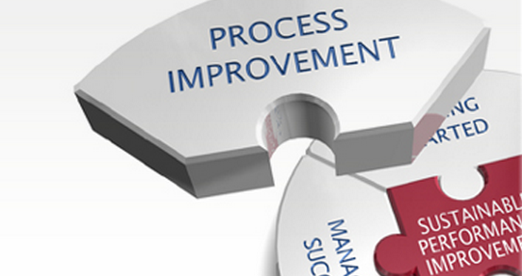
Accreditation is about process:
Improving management of the program
Documenting how you do that
To assure your stakeholders
Notes:
The goal of all of this is continuous improvement.
From the perspective of a program seeking accreditation, it is about telling the story of how you do this and having it verified.
The story is about your process for managing to your mission and improving how you do it
Verification asks programs to provide evidence that they are managing to their mission: documentating outcomes
Accreditation assures your stakeholders that you are doing what you tell them you are doing, that you are achieving outcomes related to your mission
Accreditation as a process promotes a shared vision among faculty, staff, students, and employers about your program.
NASPAA affords considerable flexibility in defining what you are doing and how you are doing it, so long as your primary intent is to educate leaders and managers for public service.
Image from Google images: Burton Group

Slide 9
Additional resources
Operational auditing:
www.gao.gov/products/GAO-12-331G
If you have questions stimulated by this video, submit them to:
accreditation.naspaa.org/ai-questions

Slide 10
…is not only about voluntarily conforming to standards set by NASPAA for educational programs in public service.
…is also about pursuing excellence in public service through education by executing well on a mission-based strategy.
Notes:
This is not just about accreditation. This is also about improving public service.

