Slide 1
2016 NASPAA Accreditation Institute
Session 2A
What are Your Program Goals?
Columbus, Ohio
October 19, 2016

Slide 2
Session 2A Fundamentals: What are your Program Goals?
Overarching Philosophy of Accreditation
Basic Process
Key Actors and Roles
Importance of Mission
Strategic & Program Management – The Role of the Logic Model
Notes:
9:00 – 9:50

Slide 3
Accreditation Philosophy
Mission-Driven
Outcomes-Oriented
Evidence-Based
Accreditation-Earning
Program Management
Notes:
9:04
Our philosophy is: Managing your program effectively is your highest priority. Earning accreditation validates that.
That’s why most of the videos end with this slide.
This philosophy is what allows NASPAA accreditation to apply to very different kinds of programs:
large public policy programs, small MPA programs, urban programs, rural programs.
It is also what allows NASPAA accreditation to be international in scope.
NASPAA standards do not dictate precisely how to do things,
but rather allows a program to define how best to do so in the terms of their own mission and the unique social, political, educational context in which they operate.

Slide 4
Overview of Process
Program with professional public service mission in operation with formal program evaluation
Eligibility
Self-Study Report
Interim Report (& Program Response)
External Site Visit (Draft Report, Program Response, Final Report)
COPRA Decision (may include Monitoring)
Annual Reports (required)
Notes:
9:06
These are the key elements of the accreditation process.
For today’s Accreditation Institute, the focus is on program management and in documenting program management that can lead to the Self Study Report.

Slide 5
Key Actors
NASPAA Staff
Commission on Peer Review and Accreditation (COPRA)
COPRA Liaison
Site Visit Team
NASPAA Executive Council
NASPAA Standards Committee
NASPAA Members
Council on Higher Education Accreditation (CHEA)
Notes:
9:10
COPRA is the Commission on Peer Review and Accreditation: 14 academics and practitioners with the authority to make accreditation decisions based primarily on information you provide in your self-study and the report of a site visit team.
Jo Ann and Jack are experienced with COPRA and accreditation. Jack has served on COPRA and been chair of the Standards Committee for a number of years. Jo Ann served on COPRA chaired COPRA.
People on COPRA reviewed the PPTs for the videos you reviewed.
We are Directors at accredited programs and gone through the accreditation process.
We have chaired Site Visit Teams.
We are not spokespeople for COPRA. Your COPRA liaison is your key source of information about COPRA.

Slide 6
It all starts with the mission
What makes for a good mission?
Content
A balance of realism and optimism
Not generic
Use of Mission - guides decisions and actions
Process
Inclusive of stakeholders
Revisited periodically
Notes:
9:12
NASPAA Standard One – the program will have a statement of mission that guides performance expectations and their evaluation

Slide 7
It all starts with the mission
A good mission answers four questions:
What do we do?
How do we do it?
Whom do we do it for?
What value are we creating?
Notes:
9:13

Slide 8
The Generic Mission
Our mission is
to train leaders for public service
Notes:
9:15 – ask for feedback on challenges of adopting this mission.
Why do departments adopt generic mission statements?
Departments adopt such a mission to try to:
Avoid internal conflicts among faculty with different interests
Avoid losing potential students from any sources
What are the challenges for this program in managing itself and for COPRA in accrediting it?
How will the program know that’s is succeeding or failing so that it can self-correct or improve?
What in this tells the program or COPRA about the content of its curriculum, the types of students it recruits, or the faculty it recruits?
Generic mission statements pose difficulties both for managers and accreditors?
If you were teaching your students to manage a program for a government agency, would you accept a statement like “Our mission is to serve the public,”
Practice what you teach.

Slide 9
Designing a useful mission statement
1 What are you particularly proud of with respect to your program?
2 What is your program especially good at?
3 What would you like your program to be known for in the future?
Notes:
9:20
On the paper provided on the tables, respond to these questions about your program (questions 1 through 3).

Slide 10
4 What distinguishes your program from others?
Serves rural communities
Serves urban areas
Focuses on national security
Focuses on economic development
Graduates generalists
Graduates policy analysts
Service learning
Quantitative emphasis
Low student/faculty ratio
Experienced adjuncts
Experienced student body
Diversity of student body
Inculcates leadership
Inculcates teamwork
Notes:
9:21
On that same paper, identify
What distinguishes your program from others that might attract students or faculty? (Q4)
Examples:
Serves students from a geographic area
Focus on particular area of public administration
Employment targets of graduates
Pedagogy
Key input features
Skill sets of graduates
Features of your students

Slide 11
5 What are your program’s public service values?
Civil rights
Constitutionalism
Equity
Efficiency
Sustainability
Accountability
Transparency
Inclusiveness…
Notes:
9:22
On that same paper, respond to Q5:
What is it about public service that’s important to you, your faculty, your students?
Think about values that are reflected in your curriculum, your approach to teaching, the research and service focus of your faculty, …

Slide 12
6 Whom does your program serve?
Rural or urban communities
International organizations
National government
Nonprofits
State agency employees
Municipal government employees
Recent grads from nearby universities
Criminal justice industry …
Notes:
9:23
And finally, answer the last question.

Slide 13
Exercise
Address the 6 questions about your program’s strengths, aspirations, distinguishing characteristics, public service values, and key constituencies.
Write a mission statement for your program based on the answers.
Share and discuss how well each mission captures the program’s essence.
Notes:
9:30
Having filled out answers to the questions:
– exchange papers and write mission statements for each other’s programs.
Discuss how the mission prepared by your partner compares to your current mission
– what is missing from either?
- How could the existing mission be improved?

Slide 14
Who are the stakeholders in your program?
University administrators
Partner units
Major employers
Faculty
Students
Staff
Alumni
Notes:
9:35
From the perspective of any stakeholder, what would they like to know about your program?
How could they contribute to articulating your mission?
How can you involve them in the process? What is the appropriate role in an inclusive process?

Slide 15
Current Practices and Expectations
Current Practices
Peer examples
https://accreditation.naspaa.org/resources/peer-examples/
2. Expectations
COPRA Policy Statements
https://naspaaaccreditation.files.wordpress.com/2014/08/copra-policy-statements-12-13.pdf
Notes:
9:35

Slide 16
Strategic and Program Management – Role of the Logic Model
Program Mission
Program Goals
Notes:
9:38 Standard One – statement of mission that guides performance expectations:
Its purpose and public service values
The population it intends to serve
The contribution it intends to produce (advancing knowledge, research and practice of public affairs)
1.2 Performance Expectations – observable goals and objectives, including student learning consistent with the mission
1.3 Program Evaluation – collect, apply and report on program performance

Slide 17
PROGRAM GOALS
Program Impact
Program Goals
Assessing and Communicating Impact and Goals

Slide 18
What are your program goals? - Exercise
Teaching
Research
Service
Other
Develop and List at the Table and Share with Those at the Table
Notes:
9:40
Explain goals for this session and then pause to introduce everyone since we are all together for the first time.

Slide 19
Articulating and Sharing Program Goals
Developing a Logic Model
Components of the Logic Model
Distinguish the Logic Model from an Assessment Model
Notes:
9:44

Slide 20
The basic LOGIC MODEL
INPUTS
ACTIVITIES & STRATEGIES
OUTPUTS
OUTCOMES
MEASURES & ASSESSMENT
MISSION
Notes:
9:45
We are going to approach this through two different activities:
First, you will work to convert generic logic model elements into more tailored, mission-driving elements
Second, we will engage in a backward design process to think through logic model elements

Slide 21
Exercise
Note Comments on Inputs, Activities, Outputs, Outcomes and Measures on Hand-out
Notes:
If there is time

Slide 22
Logic Model Elements – Converting from generic to mission-driven
Inputs
Classrooms, Offices and Computer Labs
Faculty and Staff
Money for Conference Travel
Students
Notes:
9:48

Slide 23
Logic Model Elements – Converting from generic to mission-driven
 | Activities and/or Strategies
 | Teach classes
 | Host guest speakers
 | Maintain a social media presence
 | Recruit at UG programs

Slide 24
Logic Model Elements – Converting from generic to mission-driven
 |  | Outputs
 |  | # of graduates with desired competencies
 |  | # of research publications of faculty
 |  | Internship placements at community organizations
 |  | Grant dollars generated

Slide 25
Logic Model Elements – Converting from generic to mission-driven
 |  |  | Outcomes / Impacts
 |  |  | Improved quality of public policy and management
 |  |  | Alumni as change agents in their organizations
 |  |  | Contributions to theory development and testing
 |  |  | Improved image of public service

Slide 26
Logic Model Elements – Converting from generic to mission-driven
 |  |  |  | Measures
 |  |  |  | Recognized source of expertise (consulting requests)
 |  |  |  | Accomplishments of alumni (placements, advancement)
 |  |  |  | Citations/ Recognitions/ Awards (documented in annual reports, P&T reviews)
 |  |  |  | Alumni referrals to program (increased quality of applicants)
Notes:
The usefulness of a logic model is that if you find you are not achieving the mission (not having the desired impacts) you can look to the other elements to see where you might be doing something wrong or might need to refocus energy.
Also, if you have new resources to hire new staff, for example, you can make an informed decision about what KSA’s you need to engage in the needed strategies and activities.
Or if you need to make cuts, you can avoid critical elements that are essential for the mission.
The same applies to a program. So, now let’s have you work at your tables on this process for a particular program.
Although the mission of NASPAA has not been changed in many years, it has been reaffirmed through several strategic planning processes of the Executive Council, and has been clarified interpretation to not simply focus on the US national government, but to also include subnational levels of government and has been expanded to include a global scale and programs throughout the world. As a result, the inputs, activities, strategies, outputs, outcomes, measures all have to be adjusted.

Slide 27
Logic model questions – backward modeling
Based on your program’s mission, what impacts or outcomes would you like your program to have?
What outputs would your program need to produce to have those impacts?
What strategies and activities would your program need to pursue to produce those outputs?
What resources or inputs does your program need to engage in these activities and strategies?
How can we assess or measure whether your program is having those impacts and achieving its mission?
Alternatively, what information do we already collect? For what purpose? And how sufficient is it in assessing mission accomplishment?
Notes:
10:30 – 10:45 work individually
Emphasize that this is a loop, there is no start or finish, it is not a linear process, but all things are related.

Slide 28
Value of logic model for continuous improvement
Logic Models allow for managing programs strategically
Emphasizes the importance of a clearly articulated mission in developing a logic model
Be able to illustrate or describe the connection between inputs, activities, outputs, and outcomes
Be able to design a logic model with mission-driven tailored (not generic) elements
Appreciate how a logic model encompasses much more than student learning outcomes
Have in place a way to assess and measure mission achievement

Slide 29
Generic Assessment Model
Program Assessment
Teaching Evaluations
Annual Faculty Evaluations
Alumni Evaluations
Advisory Board Input
Exit Survey
Course Embedded Program Assessment
Every Term
Each Year
Every Five Years
Twice a Year
Two Times a Year
Every Term
Annual Reviews
Once a Year

Slide 30
Sample Logic Models: University of Missouri – Saint Louis
Examples
Click for Logic Model Examples

Slide 31
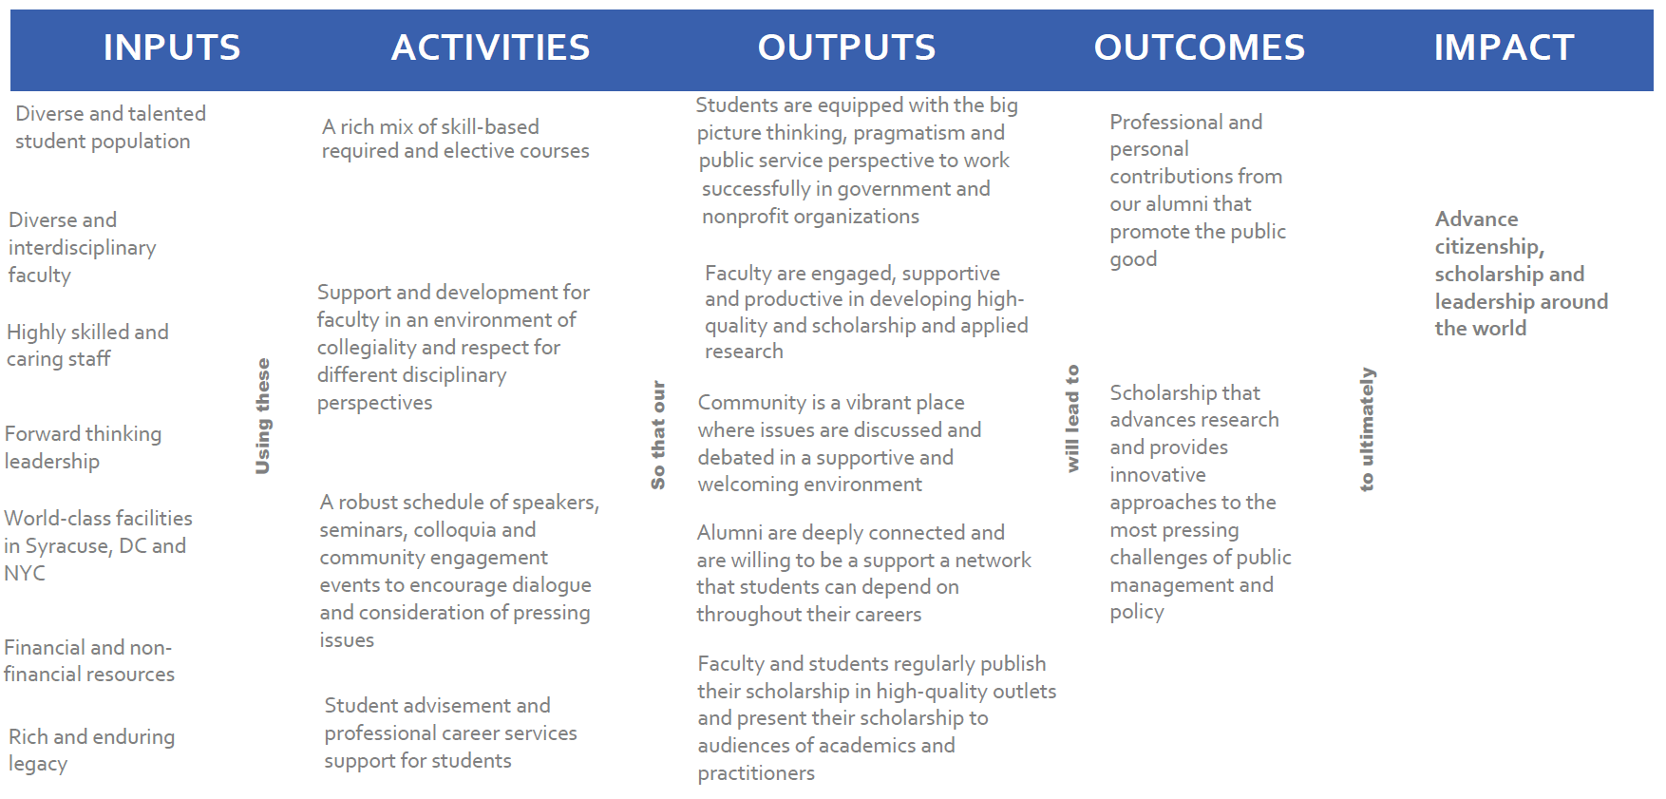
Sample Logic Models: Syracuse University
Examples
Click for Logic Model Examples
Notes:
Need to look at this in light of the mission, but for space/visual consideration it is not shown:
The MPA program at the Maxwell School of Citizenship and Public Affairs seeks to enhance knowledge and develop skills essential to careers in public service.
We believe public service means using one’s abilities and opportunities to contribute to the broad public good acrsoos levels of government and with nonprofit and for-profit organizations, nationally and internationally.
The MPA program is grounded in a comprehensive view of public service education that appreciates the need for three areas of mastery: formulating, implementing and evaluating policy; leading and managing orgaizations with diverse stakeholders; and applying rigorous and evidence-based analysis to inform decision making.
To accomplish this mission, the Maxwell School’s MPA program is designed with several distinctive features including a twelve-month intensive cohort experience, a broad cross-section of domestic and international students, productive and accessible faculty who are engaged in applied inter-disciplinary research, and a focus on citizenship in teaching, scholarship and service.

Slide 32
Sample Logic Models: University of Georgia – Part 1: The Model
Examples
Click for Logic Model Examples

Slide 33
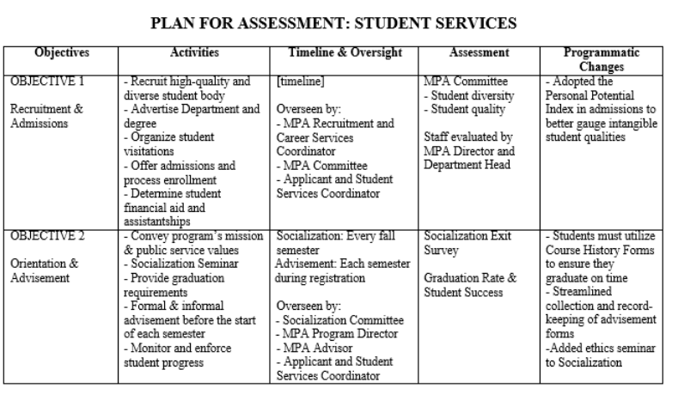
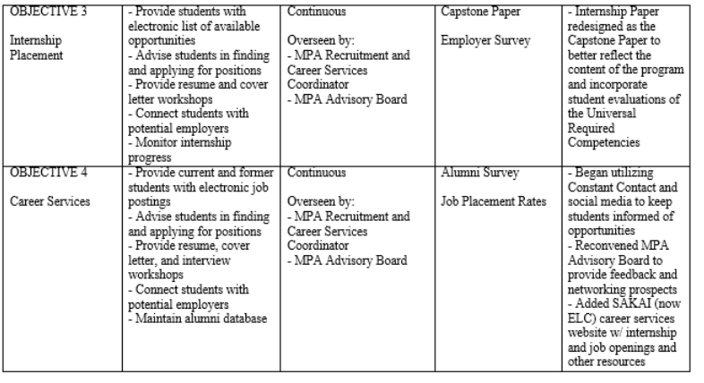
Sample Logic Models: University of Georgia – Part 3: Assessment (excerpts only)
Examples
Click for Logic Model Examples

Slide 34
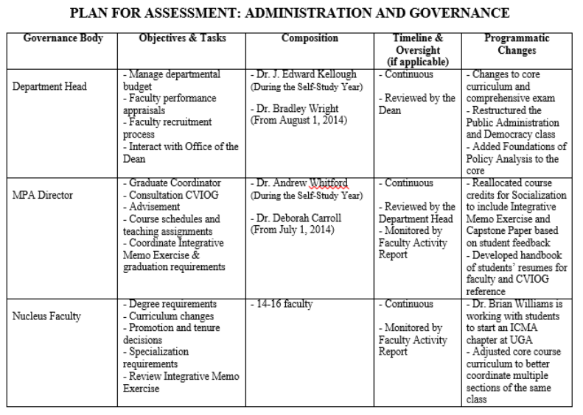
Sample Logic Models: University of Georgia – Part 3: Assessment (more excerpts)
Examples
Continues with plans for Dean, MPA Committee, Faculty Executive Committee, MPA Advisory Board, Carl Vinson Institute of Government
Click for Logic Model Examples

Slide 35
How the Logic model relates to program management & the SSR
Std | Elements
2 | Chairs, director, staff, placement or internship coordinator, org of university.
3 | AQ & PQ Faculty and Diversity, Faculty Accomplishments
4 | Services: student advising, placement, course frequency, class sizes, diversity of students
5 | Student learning outcomes, competencies
6 | Budget, offices, classrooms, technology
7 | Transparent communication: stakeholders prospective and actual students, employers,…
Notes:
10:45
Explain that although the formal presentation of a logic model (or its equivalent) is required within Standard 1,
the entire set of standards effectively ask for your to explain various elements of that logic model and how all of your resources (inputs), everything you do (strategies and activities), all of your accomplishments (outputs) and impacts (outcomes), and the ways in which your evaluate your effectiveness (measures/assessment) all link back to your mission.
Some have stronger ties and others weaker ties to the mission, but all link back.
For example, it may be easier to see the direct link between a course in the core curriculum than the adequacy of office space in contributing to the mission, but even offices are important if you expect faculty to engage in advising, research, preparing for classes, etc., all in service of the mission.
This table parallels the NASPAA and Program components linked to each of the standards.
If you outline this all in a logic model to start with (as required in Standard 1) it is much easier to explain and justify everything throughout the rest of the Self Study Report.
For example, if your program mission emphasizes having a national reputation for leading scholars, you might emphasize publication in top-tier journals when specifying the AQ criteria.

Slide 36
2015 NASPAA Accreditation institute
10-Minute Break
Notes:
Display from 10:50 to 11:00 am.

Slide 37
Thank you to our generous refreshments sponsor, Brigham Young University!

Slide 38
2016 NASPAA Accreditation Institute
Session 3A
Defining and Measuring – Assessment Plans and Rubrics
Columbus, Ohio
October 19, 2016

Slide 39
Session 3A: Defining and Measuring
Assessment Plans
Curriculum Mapping
Rubrics
Mission Based
Notes:
Start promptly at 10:00 am…
Explain goals for this session

Slide 40
Session 3A: Defining and Measuring
Session Objectives:
Better appreciate the challenges of generic vs. tailored mission statements
Understand the relationship between mission and competency
Be able to use program mission to define universal competencies
Be able to justify a competency definition based on mission

Slide 41
Universal competencies
Lead and manage in public governance
Participate in and contribute to the policy process
Analyze, synthesize, think critically, solve problems and make decisions
Articulate and apply a public service perspective
Communicate and interact productively with a diverse and changing workforce and citizenry
Notes:
10:10 Review the universal competencies
– emphasize how these are intentionally broad, vague, generic to encompass the full range of programs (MPA, MPP, MPAff and others) with a variety of missions and how the program is required / provided the opportunity to tailor them to their own mission.

Slide 42
At your table:
Select a facilitator and a recorder
Facilitator Responsibilities: Manage time, ensure participation by all at table, ensure completion of tasks
Recorder Responsibilities: Take notes on ideas discussed, areas of agreement, and challenges encountered by the group
Notes:
9:15 – provide just 2 minutes to select

Slide 43
At your table:
TASK: For each of the 5 UC’s, develop at least two distinct competency definitions that reflect different missions
ADVICE: Focus on what distinguishes a program and how that requires competencies in any or all of the 5 areas that might be different from a program without that mission
Notes:
9:17 – 9:30
Using the forms at your table, discuss how your different program missions could result in different competency definitions

Slide 44
Reflections & Reporting
Were some of the universal competencies easier than others to develop distinct competency definitions?
Did some program missions make it easier or more difficult to develop unique competency definitions?
Notes:
9:30-9:35 Reflections
9:35-9:40 Reporting Out

Slide 45
Role of curriculum mapping
Where competencies are to be implemented in the program
Mission and Universal competencies are mapped in the curriculum

Slide 46
The Mapping process
List of required courses
List of competencies (defined)
Process of matching in a matrix
Looking for gaps or disproportionate coverage
Linking back to mission
Basic and advanced versions
Notes:
See worksheet

Slide 47
MPA/MPP cartography 101: a basic curriculum map
 | UC 1 | UC 2 | UC 3 | UC 4 | UC 5
Research Design |  | X | X
Quant/Qual |  | X | X
Budget/Finance |  | X | X
Human Rsrc Mgt | X |  | X |  | X
Info Mgt |  | X | X
Org. Theory
Ethics | X | X | X | X
Leadership | X |  | X |  | X
Internship | X | X | X
Capstone | X | X | X
Notes:
Explain the basic curriculum mapping process
Have your mission-based competency definitions for each UC not just the generic UC’s as listed in the SSR instructions
Ask faculty who teach required courses to identify to what extent they address that competency in their required classes (individually, in small groups, as a committee of the whole, analysis of syllabi…)
Create a table that has all UC Definitions (columns) and all courses required in your program (rows)
Mark where these are covered
Look for sufficient (does not mean =) coverage of all competencies.
Since these are program competencies, they should generally not be restricted to a single course
Point out what this illustrates (both good and bad) in terms of coverage
RED FLAGS – competencies that are covered enough, courses that don’t contribute to any of the Ucs, competencies that are only in one course

Slide 48
MPA/MPP cartography 201: a more sophisticated map
 | UC 1 | UC 2 | UC 3 | UC 4 | UC 5
Research Design |  | I | I
Quant/Qual |  | P | P
Budget/Finance |  | I, P | P
Human Res. Mgt | I |  | P |  | I
Info Mgt |  | I, P | P
Org. Theory
Ethics | I | P | P | I,P,A
Leadership | I |  | P |  | P
Internship | A | P, A | P, A
Capstone | A | A | A
Notes:
Introduce the value of the IPA – Introduced, Practiced, Assessed
not only illustrates coverage or lack thereof, but also when we are assessing without giving sufficient time for practice, or not assessing at all, simply introducing.
Highlight the following:
UC 1, introduced several times and then assessed. Students never have a chance to practice.
UC4: all focused in a single course, not program wide.
UC5: never assessed, only introduced once and practiced once, sparse coverage
Org Th class: does not contribute to any of the UCs as defined. Either it doesn’t belong in the core curriculum, or the UC’s are not fully defined to reflect the program mission, or the program needs an additional mission-based required competency (Standard 5.2)
Lots of courses that introduce and practice. Assessment is concentrated in just a few classes.
If a competency is being practiced or assessed in a class (and not introduced), that implies that a class in which that competency was introduced would be a prerequisite.

Slide 49
INTRODUCE, PRACTICE, ASSESS = ipa
Would anyone like a different kind of IPA?
INDIA PALE ALE
Notes:
IPA
India Pale Ale == one of the most popular and common styles of craft beers

Slide 50
Activity
Mapping Activities
Notes:
Have them map their core/required courses to the competencies, first just with Xs and then with I, P, and A. Look for issues in their maps.
Have them think about a process for doing this within their program.
Would faculty who teach each class map their individual classes?
Would this be a collective process?
Is it a discussion about which classes should serve what purposes?
Are you working from classes to competencies, or from competencies back to classes?

Slide 51
Activity
Questions for Curriculum Mapping and Implementation
(see hand-out)
Mission connection’
Mission vs Universal Competencies
Assessment Strategies
Resources Needed
How often assessed
Use of assessment outcomes
Notes:
Have them map their core/required courses to the competencies, first just with Xs and then with I, P, and A. Look for issues in their maps.
Have them think about a process for doing this within their program.
Would faculty who teach each class map their individual classes?
Would this be a collective process?
Is it a discussion about which classes should serve what purposes?
Are you working from classes to competencies, or from competencies back to classes?

Slide 52
Learning
Outcomes
Courses
Mission Elements
Mission Driven Assessment
Learning Objectives
Assessment
NASPAA Competencies
Scorecard

Slide 53
Evidence for Assessment
Notes:
Display

Slide 54
Direct Evidence
Indirect Evidence
Annotated bibliographies
Student presentations
Mock interviews
Case study analysis
Course assignments
Service learning reports
Examinations
Final projects/theses
Internship reports
Blog, wiki, journal postings
Role play/simulation
Policy analyses
Exit interviews with grads
Focus groups with students, alumni, employers
Student self-assessments
National ratings
Surveys of employers
Surveys of students/alumni*
Notes:
In case there are questions about direct and indirect measures
Any of these measures of student learning can be done validly and reliably
Any of these measures of student learning can be done invalidly and unreliably

Slide 55
Partial RUBRIC FOR A CASE
ACTIVITY | EXCEEDS | MEETS | FAILS TO MEET
Identifies salient challenges | Identifies all salient challenges, substantiated with available conceptual and quantitative evidence | Identifies all salient challenges | Overlooks salient challenges
Applies analytical tools/concepts from the course/text | Applies analytical tools/concepts appropriately to relevant information. Draws correct inferences. Identifies non-obvious problems and relationships. | Applies chapter analytical tools/ concepts appropriately to relevant information from the case. Draws correct inferences. | Does not apply analytical tools/concepts. Fails to use relevant information. Draws incorrect inferences.
Notes:
What would you change? Add? Delete
Frames feedback for students by providing behavioral anchors
Other activities could be:
Identifies alternative solutions
Recommendations
Implementation
Answers case questions
Oral presentation

Slide 56
What are the characteristics
of a good rubric?
Notes:
Open discussion
Distribute examples and ask: “What do you like about them?”
Identifies a competency
Behaviorally-anchored rating scales
Detailed descriptions minimize variability across raters
See NASPAA website for examples and references on rubrics.

Slide 57
Establishing Rubric Reliability and Validity
Reliability = Consistency = Inter-Rater Reliability
Multiple evaluators, the same rubric, compare assessments
Discuss, clarify cell descriptions, minimize subjectivity
Validity = Measuring Intended Competency
In Design (face validity, Advisory Board)
In Application (multiple measures of each competency and compare)

Slide 58
What do they add to the Learning assessment process?
What’s the big deal about rubrics?
Notes:
Open discussion
Note on flip chart at front of room
Informs discussion by faculty, TA’s, etc.
Informs consensus among faculty about required competencies
Makes explicit and documents what faculty have been doing implicitly.
Manages student expectations.
Apply rubrics across courses and instructors.

Slide 59
Outcomes
Understand the relationship between course structure and universal competencies
Understand the concept of sustainable assessment
Understand the importance of a plan for sustaining assessment
Competency
Be able to map your curriculum

Slide 60
Management of Organizational Resources

Slide 61
Pulling it together for your program
Planning for defining universal competencies
Planning for measuring universal competencies
Planning for rubric design and use
Planning for curriculum mapping
Notes:
Summary on connections

Slide 62
Sustainability
Meaning in the Context of Assessment
Importance for Program Management and Accreditation
Strategies for Sustainable Assessment Processes
Documenting in The Assessment Plan
Following the Plan

Slide 63
…is not only about voluntarily conforming to standards set by NASPAA for educational programs in public service.
…is also about pursuing excellence in public service through education by executing well on a mission-based strategy.
If you have questions after the AI, submit them to:
accreditation.naspaa.org/ai-questions
Notes:
Finish

Slide 64
2016 NASPAA Accreditation institute
Notes:
Display

Slide 65
2016 NASPAA Accreditation Institute
Session 4C,5C
Site Visitor Workshop
Columbus, Ohio
October 18, 2016
Notes:
Introductions
Heather Hamilton – Accreditation Manager, Director of Assessment
COPRA is the Commission on Peer Review and Accreditation: 14 academics and practitioners with the authority to make accreditation decisions based primarily on information you provide in your self-study and the report of a site visit team.
We are not COPRA. I am experienced with COPRA and accreditation.
I directed an accredited programs and gone through the accreditation process.
We are not spokespeople for COPRA. Your COPRA liaison is your key source of information about COPRA.

Slide 66
Session Outcomes
Competencies
Be able to identify a program problem
Be able to understand where to gather information
Be able to understand how to document information for COPRA
Be able to communicate concerns appropriately
Understand the value of data sources
List of questions to use during site visits
Examples for demonstration
Notes:
These are the outcomes and competencies we want to achieve in this session

Slide 67
Site Visitor Foundations
[Handout]

Slide 68
Service as a Site Visitor –
Checklist
[Handout]

Slide 69
Site Visit Reference Materials
[Handout]
Notes:
Many thanks to all of you who have served on accreditation teams or who plan to do so.
You will learn a great deal and you will contribute to the profession.

Slide 70
Accreditation process & Reports
Self-Study Report
Interim Report
Program Response
External Site Visit (Draft Report, Program Response, Final Report)
COPRA Decision (may include Monitoring)
Annual Reports (required)
Notes:
Key elements for the AI workshop is in program management and in documenting program management in the Self-Study Report

Slide 71
Key actors
NASPAA Staff
Commission on Peer Review and Accreditation (COPRA)
COPRA Liaison
Site Visit Team
NASPAA Executive Council
NASPAA Standards Committee
NASPAA Members
Council on Higher Education Accreditation (CHEA)

Slide 72
Universal competencies
Lead and manage in public governance
Participate in and contribute to the policy process
Analyze, synthesize, think critically, solve problems and make decisions
Articulate and apply a public service perspective
Communicate and interact productively with a diverse and changing workforce and citizenry
Notes:
Review the universal competencies – emphasize how these are intentionally broad, vague, generic to encompass the full range of programs (MPA, MPP, MPAff and others) with a variety of missions and how the program is required / provided the opportunity to tailor them to their own mission.

Slide 73
The accreditation triangle
Mission
Process
Outcomes
Notes:
This is what guides your work.
You want to report evidence that the program is demonstrably managing to its mission
You are not reaching conclusions about whether a Program is doing this.
You are providing evidence that will allow COPRA to make that determination.
You want to be particularly responsive with evidence to standards cited by COPRA where it wants help in making that determination.

Slide 74
Guiding Questions
What information do you need?
How will you obtain it?
Data sources?
Qualitative vs. quantitative
Triangulation of multiple data sources
Look at matching SVTR:
How will you document your findings in SVTR? How would you improve the SVTR to help?

Slide 75
Case and Case Questions
Read Interim Report
Notes:
Start + 8 Hours 55 minutes
Distribute Example 3
Ask COPRA liaison
Same questions as above
Plus: Is this linked to a standard? If not, do not cite.

Slide 76
Case and Case Questions
1. What are the strengths of the mission statement provided in relation to the Standards. What are the weaknesses?
Notes:
Ask COPRA liaison
Same questions as above
Plus: Is this linked to a standard? If not, do not cite.

Slide 77
Case and Case Questions
2. During the Site Visit, who would you want to meet with to address COPRA’s Interim Report concerns? What questions might you ask?
Notes:
Ask COPRA liaison
Same questions as above
Plus: Is this linked to a standard? If not, do not cite.

Slide 78
Case and Case Questions
3. What supporting documentation might you need to see to explore the issues raised in the interim report and provide evidence back to COPRA?
Notes:
Ask COPRA liaison
Same questions as above
Plus: Is this linked to a standard? If not, do not cite.

Slide 79
Case and Case Questions
4. Writing a Response (Item 4)
Notes:
Ask COPRA liaison
Same questions as above
Plus: Is this linked to a standard? If not, do not cite.

Slide 80
Scenarios for SiTe Visit Teams
On the Ground Conduct
Site Visit Report
Notes:
Ask COPRA liaison
Same questions as above
Plus: Is this linked to a standard? If not, do not cite.

Slide 81
Final Lessons Learned
At every meeting, communicate:
The site visit is a collegial activity designed to improve programs and, thereby, the profession and public service
You do not speak for COPRA, you report to COPRA
The site visit report is a piece of the entire puzzle
The Program has an opportunity to comment on a draft of the SVT Report, and
Collegiality on the visit does not mean a positive decision
Notes:
Manage expectations
Ask members of the audience for their questions or advice they would give to members of a SVT

Slide 82
Reflection
What will you take away from this session?
Notes:
Track on flip chart

Slide 83
Mission-driven
Outcomes-oriented
Evidence-based
Accreditation-earning
Program Management
Notes:
Many thanks to all of you who have served on accreditation teams or who plan to do so.
You will learn a great deal and you will contribute to the profession.

Slide 84
…is not only about voluntarily conforming to standards set by NASPAA for educational programs in public service.
…is also about pursuing excellence in public service through education by executing well on a mission-based strategy.
If you have questions after the AI, submit them to:
accreditation.naspaa.org/ai-questions
Notes:
Finish up promptly at 2:50 pm

