Slide 1
NASPAA Accreditation
Matching operations with mission:
Student Learning
Standard 5.1:Universal Required Competencies
Notes:
This is a segment about Standard 5.1, the universal required student competencies, and how each program must define these competencies in the context of their mission and then measure, collect data, and analyze data as part of the full assessment cycle.
Feel free to pause this video at any time to study a slide.
Download the slides because they contain detailed notes
You should send at least one representative from your program to the Accreditation Institute at NASPAA’s annual meeting
The Accreditation Institute is where you’ll have an opportunity to practice applying the concepts and tools we review in these videos.

Slide 2
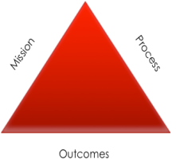
Universal Required Competencies: the ability to
lead and manage in public governance
participate in and contribute to the policy process
analyze, synthesize, think critically, solve problems and make decisions
articulate and apply a public service perspective
communicate and interact productively with a diverse and changing workforce and citizenry
Notes:
Standard 5.1. lists five broad areas in which all students who graduate from a NASPAA-accredited program are expected to have competencies. One connection follows from the domains of knowledge, skills and aptitudes (KSA’s) that NASPAA requires. Whatever its mission, graduates of accredited programs should be competent within these domains. In terms of expectations for a curriculum to generate outcomes, this defines what COPRA means by education for public service. These five areas represent things graduates of all accredited programs should be competent to do.
But COPRA affords great latitude to programs in defining these KSA’s so that they’re consistent with their missions
COPRA wants each program to make the case that its graduates have this knowledge, skill and competency, and put them to use in accord with the program’s public service values. Because the universal competencies are presented in such broad or general (some would say vague) terms, it is not possible to measure whether students have those competencies. The responsibility is on programs to define each of the competencies in a way that is consistent with their mission and is measurable.
The Self-Study Instructions provide numerous examples of potential competency definitions within in each domain, but this list is not exhausted and may not provide the best examples for a particular program. Each program may define operationally the competencies that it expects, indeed, requires, all of its graduates to have in each domain. The program’s mission guides the decisions to define the universal competencies in one way and not in others.
The Accreditation Institute provides an opportunity to practice developing mission-based definitions of these competencies. It is also where it will become clear that generic missions complicate the task of for programs engaging in this process and for COPRA as it reviews the Self Study Report.

Slide 3
What can students who complete your degree do?
“Our graduates will be creative city managers.”
“Our graduates will be able to set goals, design programs, manage stakeholders, and obtain resources to improve municipal services.”
Notes:
Here is one example of how to refine a competency definition to make it more meaningful and measurable.
This are program-level, presumably mission-driven student learning outcomes: what graduates are competent to do.
However noble the description in red, it does not meaningfully tell a stakeholder—faculty, student, employer—the value its graduates can contribute to public service.
The description in green does that.
Each program has to identify the knowledge and competencies that all of its graduates should have to demonstrate that they’ve satisfied the requirements of its degree. These are required degree competencies.
Image: Iqoncept | Dreamstime.com

Slide 4
What can students who complete your degree do?
“Our graduates will be stewards of the environment and architects of sustainability.”
“Our graduates will be able to design environmental polices and programs that implement targets for sustainability.”
Notes:
Here is a second example, once again for a program-level, presumably mission-driven student learning outcome: what graduates are competent to do.
However noble the description in red, it does not meaningfully tell a stakeholder—faculty, student, employer—the value its graduates can contribute to public service.
The description in green does that.
Each program has to identify the knowledge and competencies that all of its graduates should have to demonstrate that they’ve satisfied the requirements of its degree. These are required degree competencies.
Image: Iqoncept | Dreamstime.com

Slide 5
Program Competencies versus Course Competencies
What can students do who complete a course on budgeting?
“Students who complete the course will understand budgeting.”
“Students who complete the course will be able to prepare a performance budget and accompanying justifications.”
Notes:
Accreditation is about program level assessment and competencies, not simply the competencies associated with an individual course. And the program is assumed to be more than just the sum of its parts (its courses).
But even so, individual course assessments are important. Each course should be designed to instill particular competencies in a student and to contribute to the program level competencies the program has identified. As a result, you should be able to do this for each required course.
Here again, the description in red does not meaningfully tell a stakeholder—faculty, student, employer—the value the student who completes the course can contribute to public service.
The description in green does that.
Put differently, although accreditation doesn’t explicitly require you to do this for each required course, accreditation does require you to map your curriculum, which will be a challenge if you haven’t done this for required courses.
These are required course competencies.

Slide 6
Map your curriculum
Recruit representatives from stakeholder groups
Divide groups into task forces (TF) with cross-representation
Charter TF’s to identify competencies and knowledge consistent with the degree program’s mission
Each TF distributes competencies across the five domains
Faculty/staff committee (FSC) refines task force outputs into coherent, measurable learning objectives
FSC establishes measures to assess learning on each objective
Faculty assign competencies and knowledge across required courses
Draft matrix :
domains in columns, competencies in rows, courses in cells
Repeat periodically
Notes:
Mapping your curriculum is like taking an inventory and COPRA requires that you be able to articulate how individual courses in your curriculum contribute to the competencies you identified. It is also an extremely useful process.
COPRA doesn’t dictate a process for developing a curriculum map; it expects that there will be one and that it will engage multiple stakeholders in some way.
This diagram on this slide illustrates one potential process. The end product that is desired is a matrix (often called a curriculum map) that links each required course to the competencies it helps develop in students.
In this situation, you are taking an inventory of the knowledge, skills and aptitudes that your students learn by the time they complete the courses you require.
If your inventory reveals that students are not exposed to one of the five domains, or are not exposed to KSA’s important for your mission, then you should expand your inventory.
Expanding your inventory means changing the content of your curriculum.
COPRA would like to see a matrix linking courses and competencies and this map or matrix can take a number of different forms. Like any map, a curriculum map shows your faculty, students, employers, and COPRA the landscape of your curriculum, how its features fit together. Just as there are different types of geographic maps, there are different types of curricular matrices, but the end result is a tool to understand the logic that ties your curriculum to your mission.
One possible structure would be where each column is one of the five domains in the list of universal required competencies and each of the rows lists a Knowledge (K), Skill (S), or Ability (A). And where a row and column intersect to form a cell, the entry in the cell is the name or number of the course where students learn that K,S or A.
An alternative form would place the program’s mission-driven definitions of the five universal competencies in the columns, and list the program’s courses in the rows. Then at the intersection each cell would identify with a checkmark if that course contributes to that competency.
A more sophisticated version of that second example would replace the checkmarks with more information about whether a student is Introduced to (I), Practices (P) or is Assessed on (A) that competency in that class.
The content of most curriculum maps is too detailed to illustrate on a slide, and this is something that will be given attention in the Accreditation Institute workshops.
What do you do with your curriculum map or matrix after you have development it. You study it and look for things that stand out. Not every course needs to contribute to every competency, and not every competency needs to be covered in the same number of classes. The key is that there is sufficient coverage of all competencies across the curriculum and that every course contributes in some way to the competencies.
COPRA expects well-managed programs to collect and analyze data showing the extent to which your graduates have navigated the landscape successfully.
The data should reveal the extent to which your graduates have learned the required KSA’s.
By collecting data on performance, as with rubrics, you are doing a second inventory: an inventory of each student’s learning.
If this second inventory reveals that your students are not learning a required K, S, or A, even if your first inventory shows that you have exposed them to to it, then you should change the way you teach based on this evidence.
COPRA expects well-managed programs to make evidence-based decisions.
If you document whatever process you use to create and update the matrix, to collect data about student performance, and report changes that result, you have drafted a major part of the self-study report.

Slide 7
A Full Assessment Cycle
Define the competency in terms of your program’s mission
Determine when and how you will measure that competency (select appropriate direct or indirect measures)
Collect the information (quantitative or qualitative)
Analyze and interpret the information to assess whether students have the intended competencies and to consider as part of overall program assessment
Notes:
Making the case that its graduates can do these five things has three parts:
COPRA wants each program to explain its process for setting its expectations about educational outcomes: for identifying and keeping current its set of required competencies? Part A
Consistent with 1.3, COPRA wants programs to assess their efforts: how well their students are meeting their expectations: are their students capable, proficient, or expert in these universal, required competencies?
COPRA wants to know how programs use the assessment information to improve their programs
While it’s easy to get caught up in the challenges of doing this, keep in mind the primary motivation:
To articulate the knowledge, skills, and abilities you expect of your graduates, to assess their level of master of these KSA’s, and to improve your program based on weaknesses evidenced by the data
It’s an example of program management, something accredited programs often teach. Practice what we teach.
Doing this is the ground level process that addresses the expectations of Standard 1.3.

Slide 8
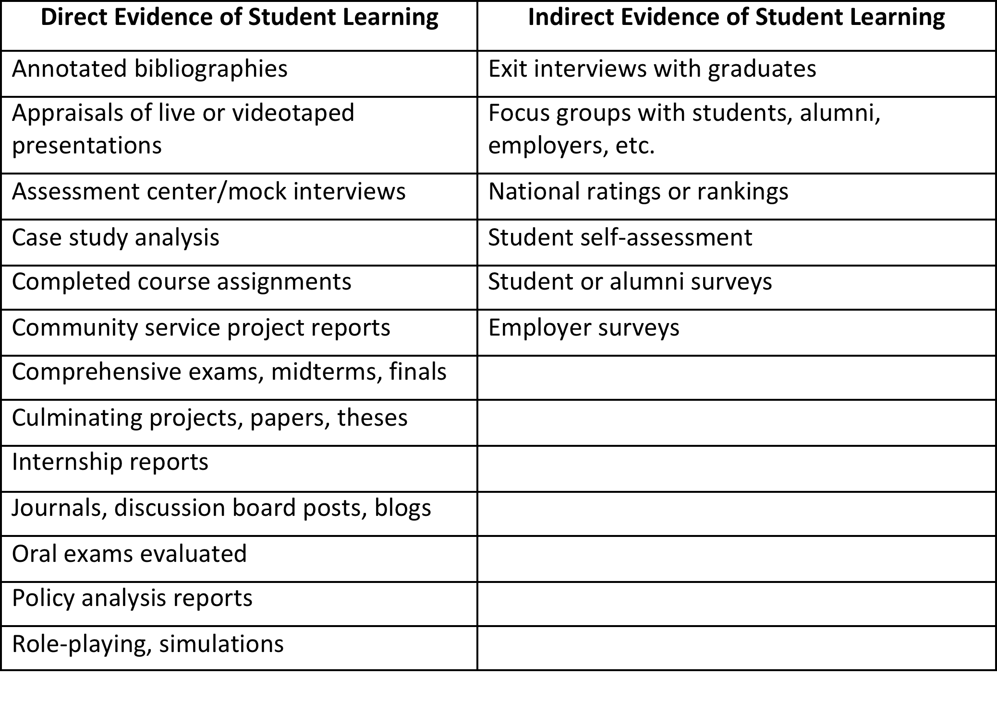
Measuring student learning
Notes:
Measures for assessing performance should be valid and reliable. The list here of direct and indirect measures is not intended to suggest that a program should be using all of them or that they are all equally valid and reliable. Programs must make informed mission-based and resource-based decisions about how to measure learning.
Which raises the question: what are acceptable measures of student learning if grades are not sufficient?
This table lists some.
Programs choose these or others that fit their missions and resources
Direct evidence measured not just by faculty but also by practitioners and other outside groups given guidance to improve inter-rater reliability constitutes strong evidence.

Slide 9
Sample Rubric Elements: Capstone Project
Activity | Exceeds | Meets | Fails
Identifies salient issues | Identifies salient issues, substantiates with conceptual and quantitative evidence | Identifies salient issues | Overlooks salient issues
Identifies alternative solutions | Identifies plausible, non-obvious, alternative solutions. | Articulates plausible solutions. | Fails to identify plausible solutions.
Prepares recommendations | Recommends with reasoning and criteria for choice. Evaluates proposed actions. Recognizes tradeoffs and risks. | Recommends with reasoning and criteria for choice. Evaluates proposed actions. | Recommends without reasoning. No criteria for choice.
More… | More… | More… | More…
Notes:
To ensure some level of reliability and validity, rubrics are a preferred approach to evaluating student performance and their level of competencies, as opposed to grades that are entirely subjective and not linked to a rubric. Once faculty agree upon the competencies, the rubrics follow. Here is a sample rubric for a capstone project.
Identifying the competencies within required courses might entail something of a cultural shift, a change in the way faculty think about assessment. The rubrics used in program level assessment (for example, those used for a capstone project) should be uploaded and included with the Self-Study Report.
Student grades matter, especially to students, but are not sufficient for program evaluation. Grades do not have internal validity as a measure of student competency. We all know of examples of instructors who are easy graders and then attract the weakest students who earn high grades despite their less than stellar performance.
Ideally, rubrics that are applied for program level assessments of competencies (such as those for capstones) are not used solely by one instructor, but rather by a committee or some other process that involves more than one person.
The percentages of A’s and B’s students earn wouldn’t necessarily inform decisions about improving the program.
Percentages of students performing below, at, or above expectation, especially when the judgments are made by people other than the instructor in the course (internship supervisor, employer, alumni panels, etc.) could inform assessments designed to monitor and improve performance.
Why?

Slide 10
Sustainability
Plan to assess student learning
Cycle through all required competencies continuously over a reasonable period of time
Every cycle includes three processes:
Defining the competency
Measuring and analyzing performance
Making evidence-based changes in the curriculum
Use the data for more than accreditation. Use it for internal improvements and for external bragging about the program.
Notes:
Every program must have and share with COPRA an assessment plan, explaining not only what has already been done with respect to assessment, but also what the plans are moving forward. Assessment Plans must be sustainable. Sustainability is about making this process useful, integrated and feasible.
You should be strategic about where and how you collect data, in what form, what process you use to analyze it and review it. If it is only for accreditation, it will only get done every 7 years and that will not be sufficient. It needs to be part of the day-to-day or at least year-to-year management of the program.
Decisions related to sustainability of assessment might include: not assessing every competency every year, not assessing competencies with so many data sources that it is burdensome to collect and might generate conflicting or confusing results, and instituting a process that allows for data collection and analysis to contribute to other program management goals, not simply accreditation review. This relates back to what was mentioned earlier about the value of data to engage in “bragging” or demonstrating effectiveness to external audiences (university administrators, employers of your graduates, potential students you are trying to recruit, potential faculty hires, etc.)
Document your plan: how are you collecting information, who is collecting it, when are you collecting, what decisions follow from the information?
Mapping your curriculum can be part of an assessment plan
Selecting measures can be part of an assessment plan
Directing measurement outcomes to administrators or faculty committees with authority to recommend changes can be part of an assessment plan.
COPRA has no fixed standard for cycle time in reviewing student performance on all of your competencies.
Red flag: The program assesses competencies in all five required domains only during its self-study year: Is the program committed to continuous improvement?
Multiple competencies in all five domains in one year might be unreasonably fast because it requires too much effort to be sustainable year after year.
One competency in one domain per year might be unreasonably slow to inform program decisions
As time passes, COPRA is expecting programs to have completed the cycle in more domains, which demonstrates that it is executing on its plan.
Collect information you will use
Do not collect information you don’t use.
In conclusion, if you are not achieving your mission as you would like, the root cause might have to do with the content and pedagogy of your curriculum.

Slide 11
Additional resources
Powerpoints and Rubrics:
accreditation.naspaa.org/resources
If you have questions stimulated by this video, submit them to:
accreditation.naspaa.org/ai-questions
Notes:
This slide lists several additional resources you may find helpful.
Please submit questions regarding this or any of the videos or regarding the Standards or Self-Study Instructions to the address listed on this slide. Answers will be compiled into FAQs that will be posted and updated regularly, and common concerns will be incorporated into the AI Training Workshop.

Slide 12
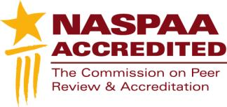
Mission-driven
Outcomes-oriented
Evidence-based
Accreditation-earning
Program Management
Notes:
This statement captures the essence of NASPAA Accreditation. It is mission-driven, outcomes-oriented, evidence-based, accreditation-earning program management. This is not just about accreditation. This is about improving public service. That is, accreditation is not the ultimate goal, the improvement of public service is. If you manage your program strategically in conformity with the standards you will contribute to improving public service and you will also be able to secure accreditation.

