Slide 1
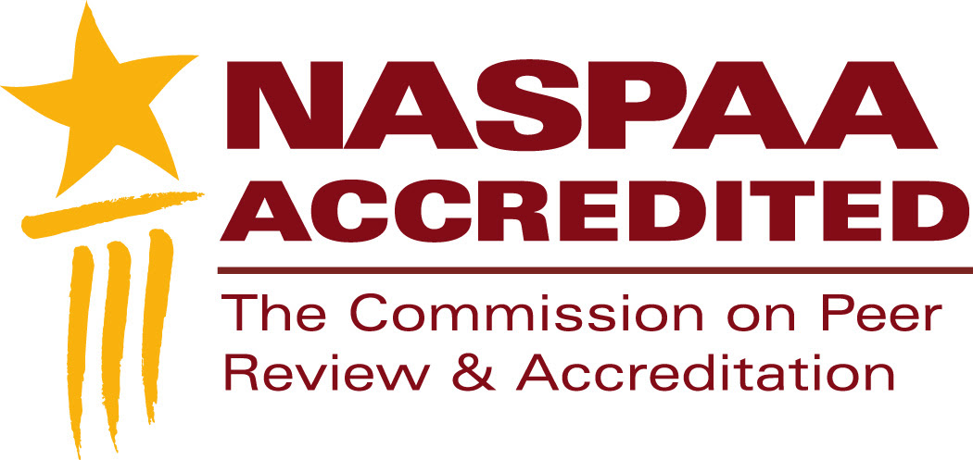
NASPAA Accreditation
Matching operations with mission: Serving Students
Standard 4
Notes:
This segment is about COPRA’s expectations for your student services, including recruitment, admissions, support, and diversity.
Feel free to pause this video at any time to study a slide.
Download the slides because they contain detailed notes
You should send at least one representative from your program to the Accreditation Institute at NASPAA’s annual meeting
The Accreditation Institute is where you’ll have an opportunity to practice applying the concepts and tools we review in these videos.

Slide 2
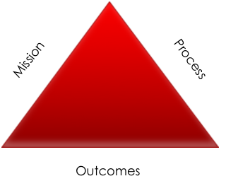
Standard 4.1: Recruitment
What types of students do you want to apply?
Where do you look for students?
How do you look for students?
Notes:
If the program’s mission targets potential students who have not yet initiated their careers (called pre-service), then it should be recruiting from undergraduate institutions using media that those students tend to access.
If the program’s mission targets potential students who have started their careers (called in-service), then it should be recruiting through agency human resource management offices and media those students are likely to access.
If the program’s mission emphasizes advancing the careers of in-service students in criminal justice and national security, then it should be recruiting from populations of public safety and military personnel using their newsletters, career fairs, etc.
If the program’s mission emphasizes quantitative skills, you should try to attract students from undergraduate departments or employment situations requiring facility with quantitative analysis.
In sum, the recruitment process and outcomes should be consistent with the program’s mission.

Slide 3
Standard 4.2: Admissions
What qualifies someone to learn public service?
What qualifies someone to learn public service as your mission defines it?
Notes:
COPRA does not specify admissions criteria. It expects each program to specify its admissions criteria consistent with its mission. (Remember: accreditation is about process.)
COPRA realizes that programs might be required by their universities to use admission standards, such as performance on the standardized test, even if the program itself does not want to require it.
Programs typically use prior academic performance as an indicator of ability to learn public service but which indicators and why? Standardized tests? Grades? Letters of reference?
If the program’s mission is to develop in-service, mid-career professionals, should grades and standardized tests be given as much weight in the admissions decision as on the job performance?
If the program’s public service values include participatory decision-making, will it give priority in admission to students whose prior activities or application essay demonstrate commitment to that value?
Is the program documenting how it makes its expectations clear in its communications to potential students?
Is the program documenting its decisions and explaining those that are not consistent with its mission?
Exceptions are not a problem so long as they are documented, explained in terms of mission, and evidence exists that applicants admitted by exception regularly succeed.
Red flag: The program’s mission is to educate managers serving cities and counties within its region but it admits international students from rural areas.

Slide 4
Standard 4.3: Support
“Our program’s website has contact information for alumni. I’ve never heard of alumni declining informational interviews. Like our placement office, they point us to agencies that are hiring.”
“I’d like to know how to access our alumni for career counseling. Our placement office will critique my resume and send me to online job postings, not always related to my career interest. The part-time faculty give us great career advice.”
Notes:
Which would you want students to tell the members of a site visit team?
The first statement suggests stronger student services than the second. Indeed, if this program could track student interactions with its alumni, that’s an indicator of alumni engagement and possibly performance on the program’s mission.
The second statement by itself is not a basis for finding the program in violation of the standard. It might be the best the program can do. From a process perspective, however, the program should know about and be working to address it.
The objective is to have processes in place to help students succeed: advising on curricular choices, placing and supervising their internships, career counseling, disability services, veterans services, etc.
Programs provide different services and different levels of the services they provide.
Some services provided might be internal to the program; others might be provided by the larger institution of which the program is a part.
What matters is that programs:
Are assuring that students know about the services
Are monitoring the demand for services and
Are assessing and improving the quality of the services in ways that further the program’s mission.
Examples:
if a program emphasizes pre-service education to prepare students to work in nonprofit organizations, it could allocate resources to identifying internships with nonprofits;
if a program emphasizes in-service education for students working for international organizations, the program could offer mentoring by senior alumni in those organizations.
If a program is preparing analysts to work for businesses with many or large government contracts, then it could invite representatives of those businesses to career fairs.
Red flag: a high percentage of students not graduating within a reasonable period of time, the root cause of which could be in appropriate or inadequate recruitment, admissions, or support
Red flag: a high percentage of pre-service graduates not placed within 180 days of graduation.
COPRA expects programs to report on career placement data, for both the self study year and for annual reports. Thus, programs should consider how to collect this data.
COPRA is particularly interested processes that programs employ to run their internship programs for pre-service programs because
Internships bring theory to life
Internships reinforce public service values
Internships frequently provide pathways to full-time employment
All assuming that the internships are meaningful, well-designed, learning experiences consistent with the program’s mission
Mission drives process which leads to outcomes that support the mission. That’s the fundamental logic model.
Image: Rafal Olechowski | Dreamstime.com

Slide 5
Diversity and inclusiveness
No community is homogeneous.
Anywhere in the world, how does a program ensure that its faculty, students and graduates serve their public, whatever dimensions of difference exist?
Notes:
Concept: Programs should admit students who reflect the diversity of the communities the program serves, whether that diversity is ethnic, racial, national, income, religious, gender…..
Programs should create an environment where everyone—faculty, students and staff—feels respected and included in the community.
The logic is that a student population representative of the program’s target community will provide a variety of opportunities for faculty and students to learn cultural competency, which better prepares students to work with a diversity of colleagues, whether locally or across jurisdictions, and to serve the public.
Image: Nvnkarthik | Dreamstime.com

Slide 6
Standard 4.4: Diversity and inclusiveness
What dimensions of diversity matter in your area?
How do you promote diversity and inclusiveness?
Notes:
If your student population does not reflect the market or area you serve, what is your plan or that of your institution to help students learn to manage diversity?
Diversity depends on the context of the program/country.
COPRA wants to know your diversity goals, the activities you will undertake to reach them, and how you will know that you are succeeding.
If legal or institutional policies preclude collecting data on diversity, students still need to know how to manage it, so you still need a plan, a process and the resources to execute it and assess its progress.
Again, accreditation is about process, how you manage diversity
It is not just about achieving diversity within your student population by investing in creative recruiting and admissions.
Having a diverse student population doesn’t mean your students are learning to manage diversity
Managing diversity should be reflected in your curriculum.
From an accreditation perspective, you should have a plan for assessing your student services and student experiences, overall.
In conclusion: if you are not achieving your mission as you would like, the root cause might have to do with the way you recruit, admit, and serve your students.

Slide 7
Additional resources
Powerpoints and examples of diversity plans:
accreditation.naspaa.org/resources
If you have questions stimulated by this video, submit them to:
accreditation.naspaa.org/ai-questions

Slide 8
Mission-driven
Outcomes-oriented
Evidence-based
Accreditation-earning
Program Management
Notes:
This is not just about accreditation.
This is about improving public service.

