Slide 1


The Center for Leadership Simulation and Gaming
NASPAA Simulation Workshop
October 17, 2019

Slide 2
Agenda
Introduction
Pandemic Game
Host Nations

Slide 3
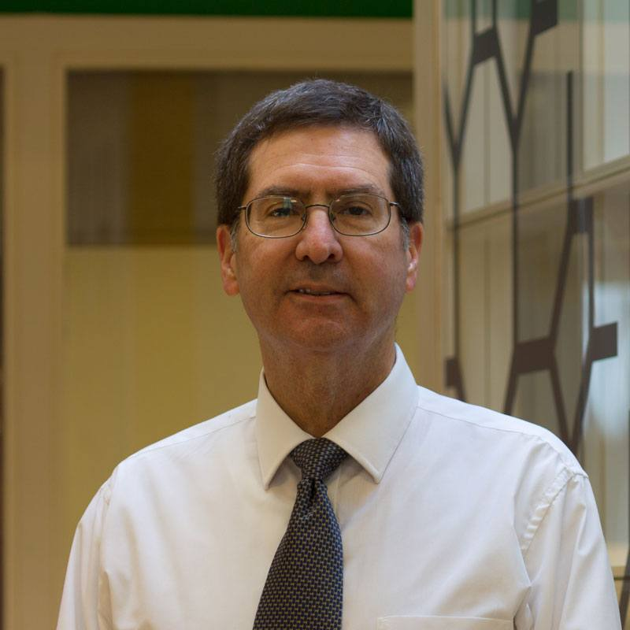
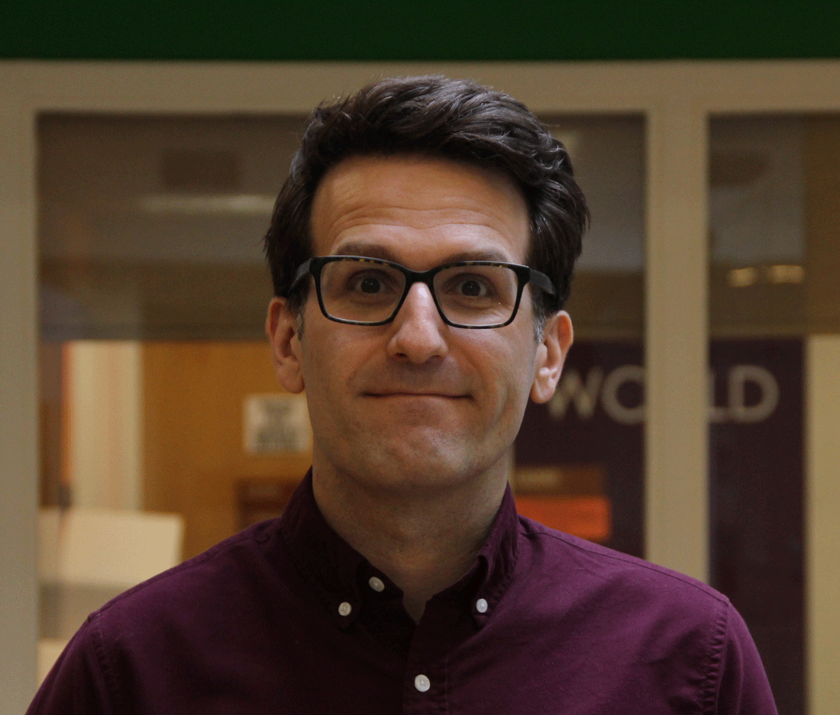
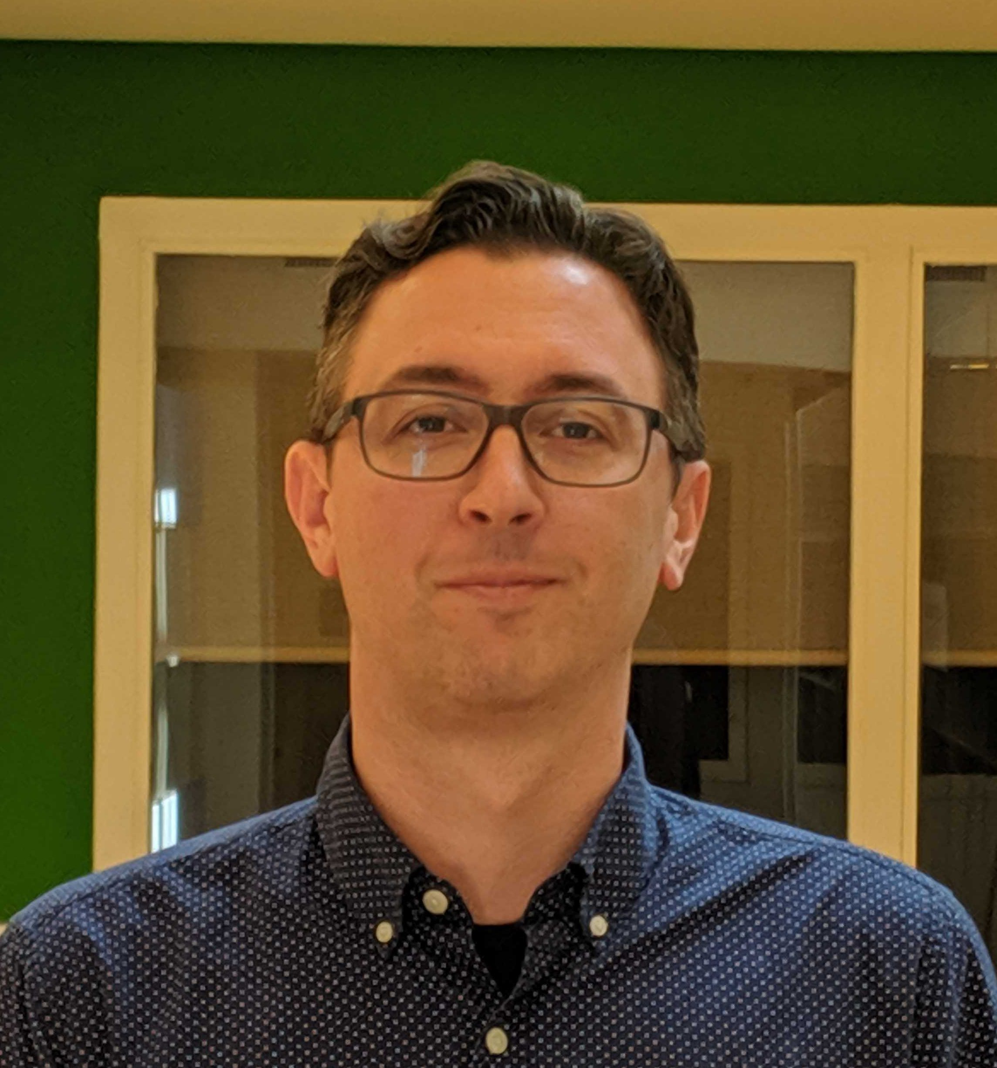
CLSG members here today
Andy Ortiz, MD
Senior Engineer
Adam Roux
Coordinator & Writer
Steven Parrott
Full Stack Developer

Slide 4
Mission
We design, develop, and implement cutting edge simulations and experiments to advance education and research in leadership & public policy, and to create a community of scholarship in our methodology.
Our Philosophy: “Tell me and I forget, teach me and I may remember, involve me and I learn”
  Immersive, experiential learning tools: bridge the gap between the structured textbook learning to dynamic real-world problems

Slide 5
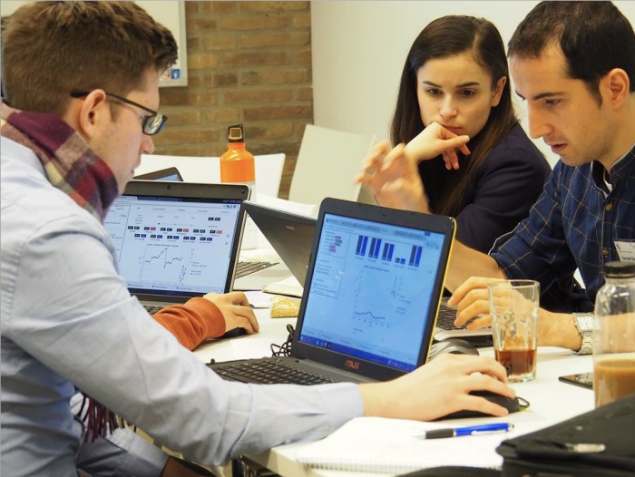
3 Characteristics
Public Policy Focus
  Learn about potential outcomes in policy settings
  Economics, Political Science, Behavioral Science, etc
Participatory Nature
  Human element (roles)
    Education in leadership
Computer-based
  Can be complex
    Computationally and conditional
  Scale
  Flexibility

Slide 6
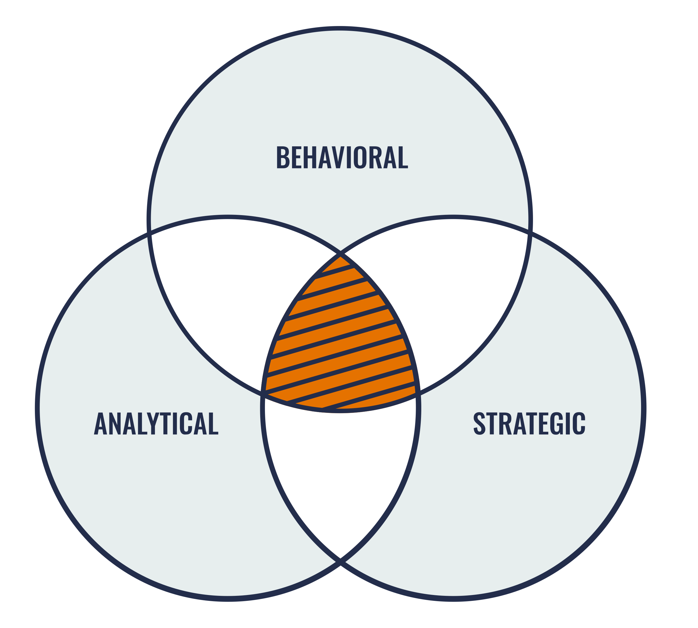
Participatory Simulations in Public Policy
Better understand the complex issues we present (pandemics, refugees, health care systems, etc)
Practice thinking analytically in the public policy arena using the limited information and tools at hand
Find consensus and work with others

Slide 7





External Collaborators
And we support many universities:
UIBE, JMU, Maryland, etc

Slide 8
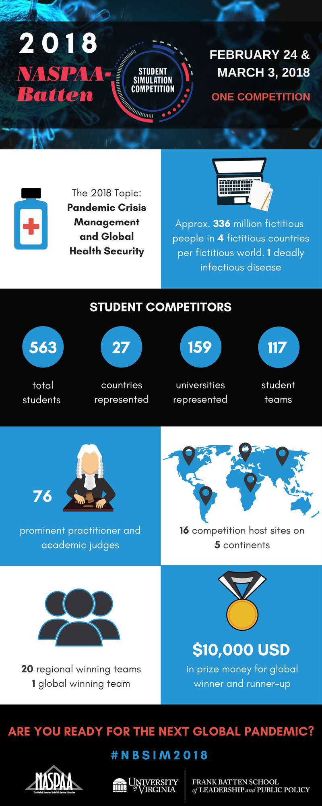
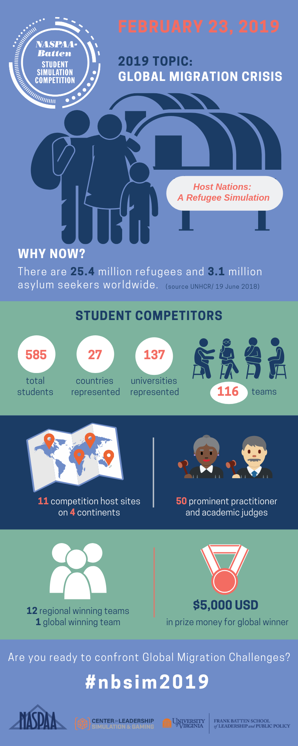
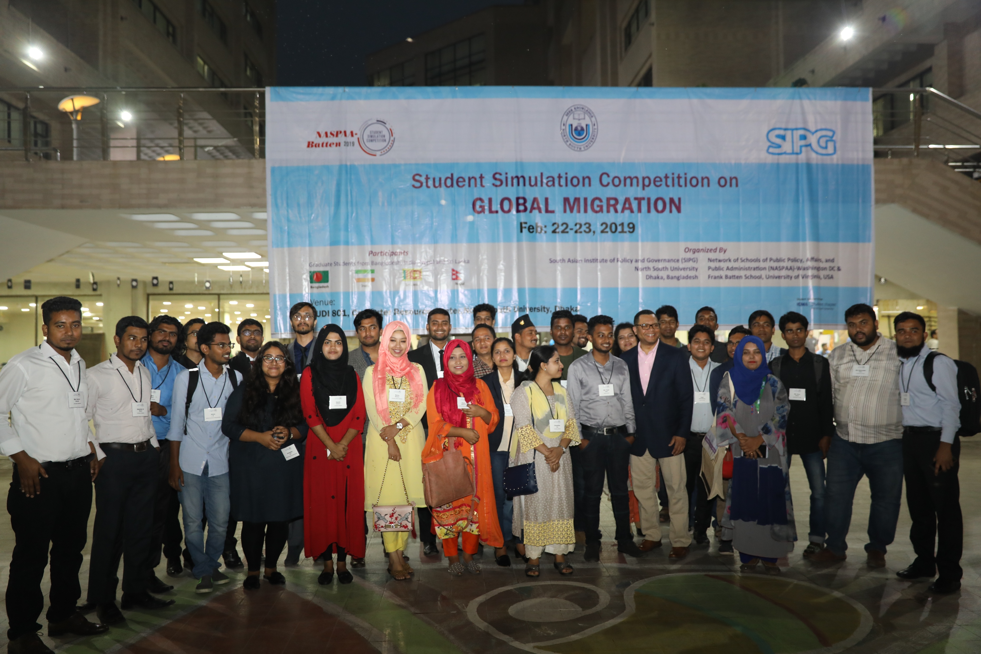
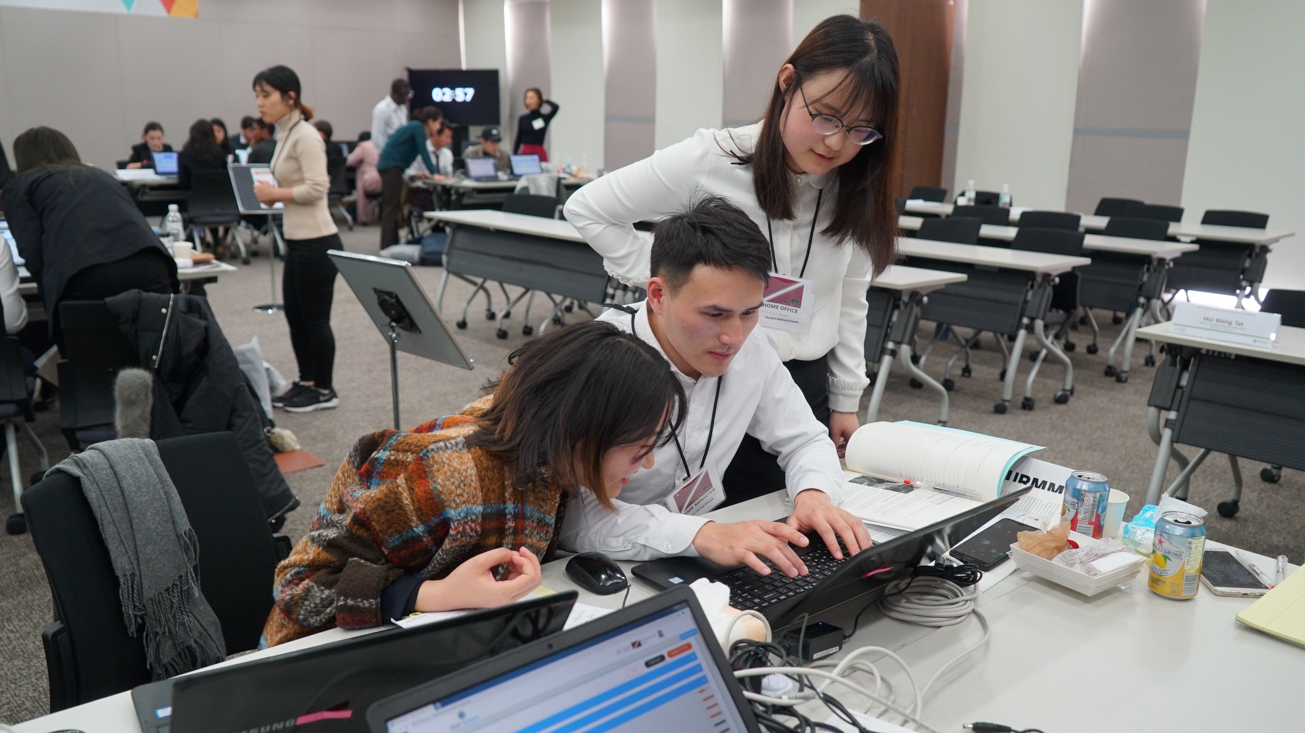
NASPAA-Batten Student Simulation Competition

Slide 9
Leadership Education
As you are working in a team environment with multiple teams
Defining and achieving a common goal for your country (strategic thinking)
Interactions with other countries: partnering and political savvy
Within your own team: leveraging diversity, conflict management
As leaders in your organization: decisiveness and negotiating
In all settings: Interpersonal skills and Problem Solving.
PROCESS MATTERS

Slide 10
Pandemic Game
Global Health Security Simulation
Motivated by 100 year anniversary of the Spanish Flu

Slide 11
Pandemic Simulation
This is an interactive, stochastic, and continuous game where you are challenged to –
  Make difficult public policy decisions in a fast paced environment with limited information
    Your decisions impacts lives, politics, and the economy
  Work effectively in a team environment
  Interact with other teams; it is a GLOBAL pandemic
You will be
  Developing strategies to preserve global health
  Making choices to fight against the pandemic
  Considering political and economic impacts

Slide 12
Game Scenario
Team consist of 3 to 5 players
  Teams are assigned to a single country
  Assigned following roles:
    Prime Minister
    Minister of Public Health
    Minister of Finance
    Minister of Communication
    WHO Representative
Each world consists of 4 countries
  Countries within a world impact and interact with one another.
These countries are based on real countries

Slide 13
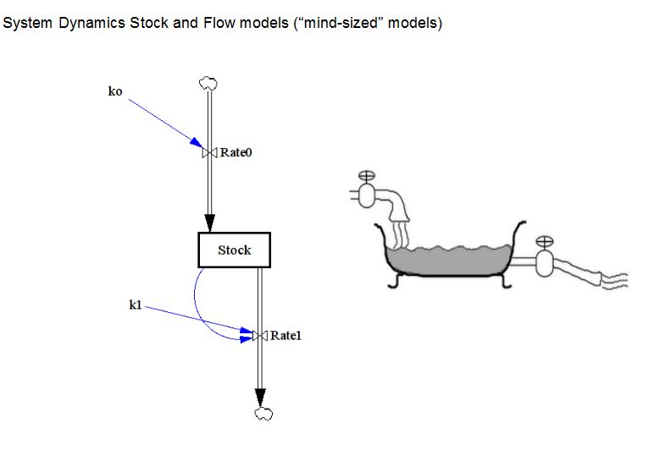
System Dynamics
Method used to understand complex systems using stocks, flows, feedback loops
http://www.resilience.org/stories/2013-09-27/mineral-resources-and-the-limits-to-growth/

Slide 14
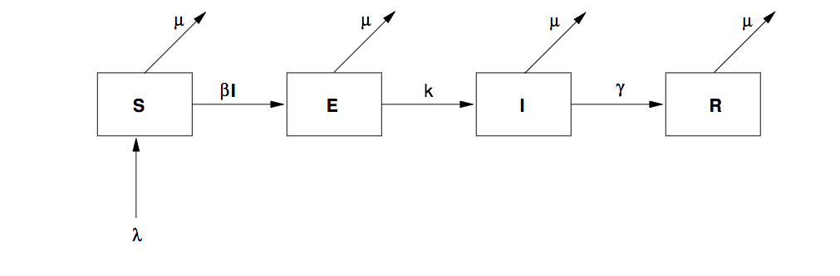
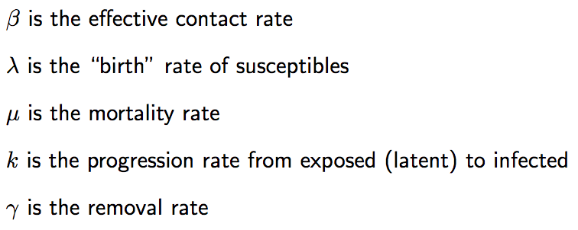
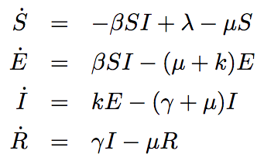
S-E-I-R Model
Susceptible-Exposed-Infectious-Recovered/Removed
Social Distancing
Antivirals
James Holland Jones. (2008, May 3). Models of Infectious Disease. Dept of Anthropology, Stanford University. Retrieved from https://web.stanford.edu/~jhj1/teachingdocs/Jones-Epidemics050308.pdf

Slide 15
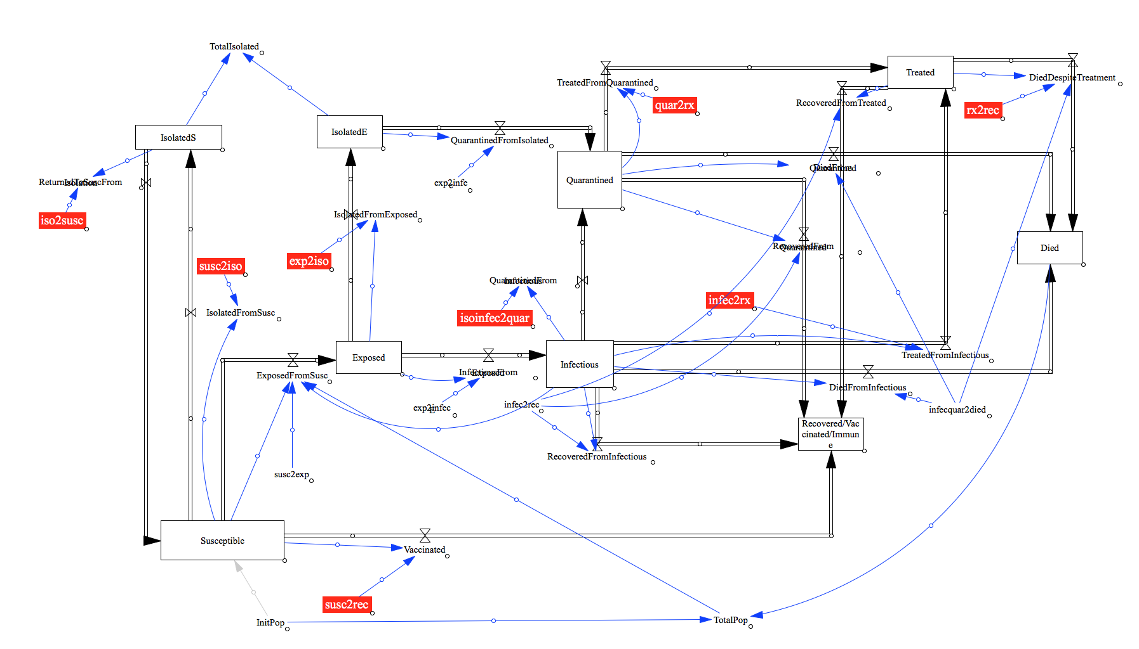
Our simulation (country level)

Slide 16
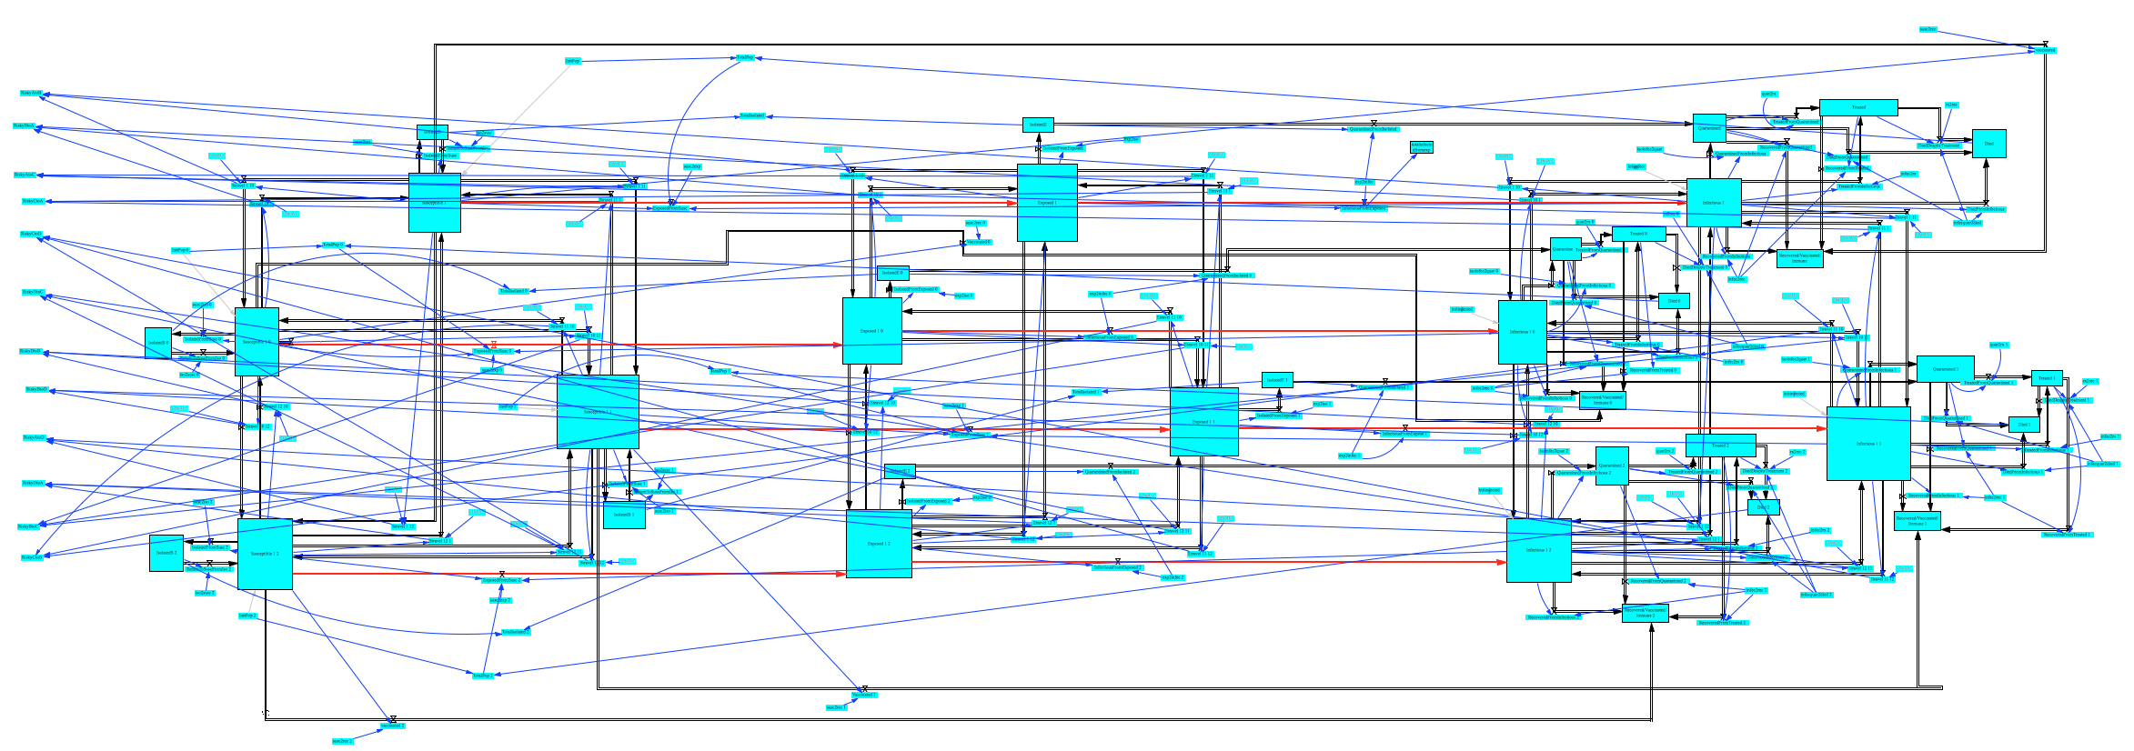
Our simulation (world level)

Slide 17
Taxation
P
Need tax to provide services
But taxes creates inefficient: Deadweight loss.
Goods with positive externality (vaccine) are under consumed
Raising taxes to help subsidize may be beneficial
S
P_{B}
DWL
Tax Revenue
P_{S}
D
Q
Q^{T}
Q*

Slide 18
Increasing DWL and Laffer curve
Tax revenue
DWL
Tax size
Tax size

Slide 19
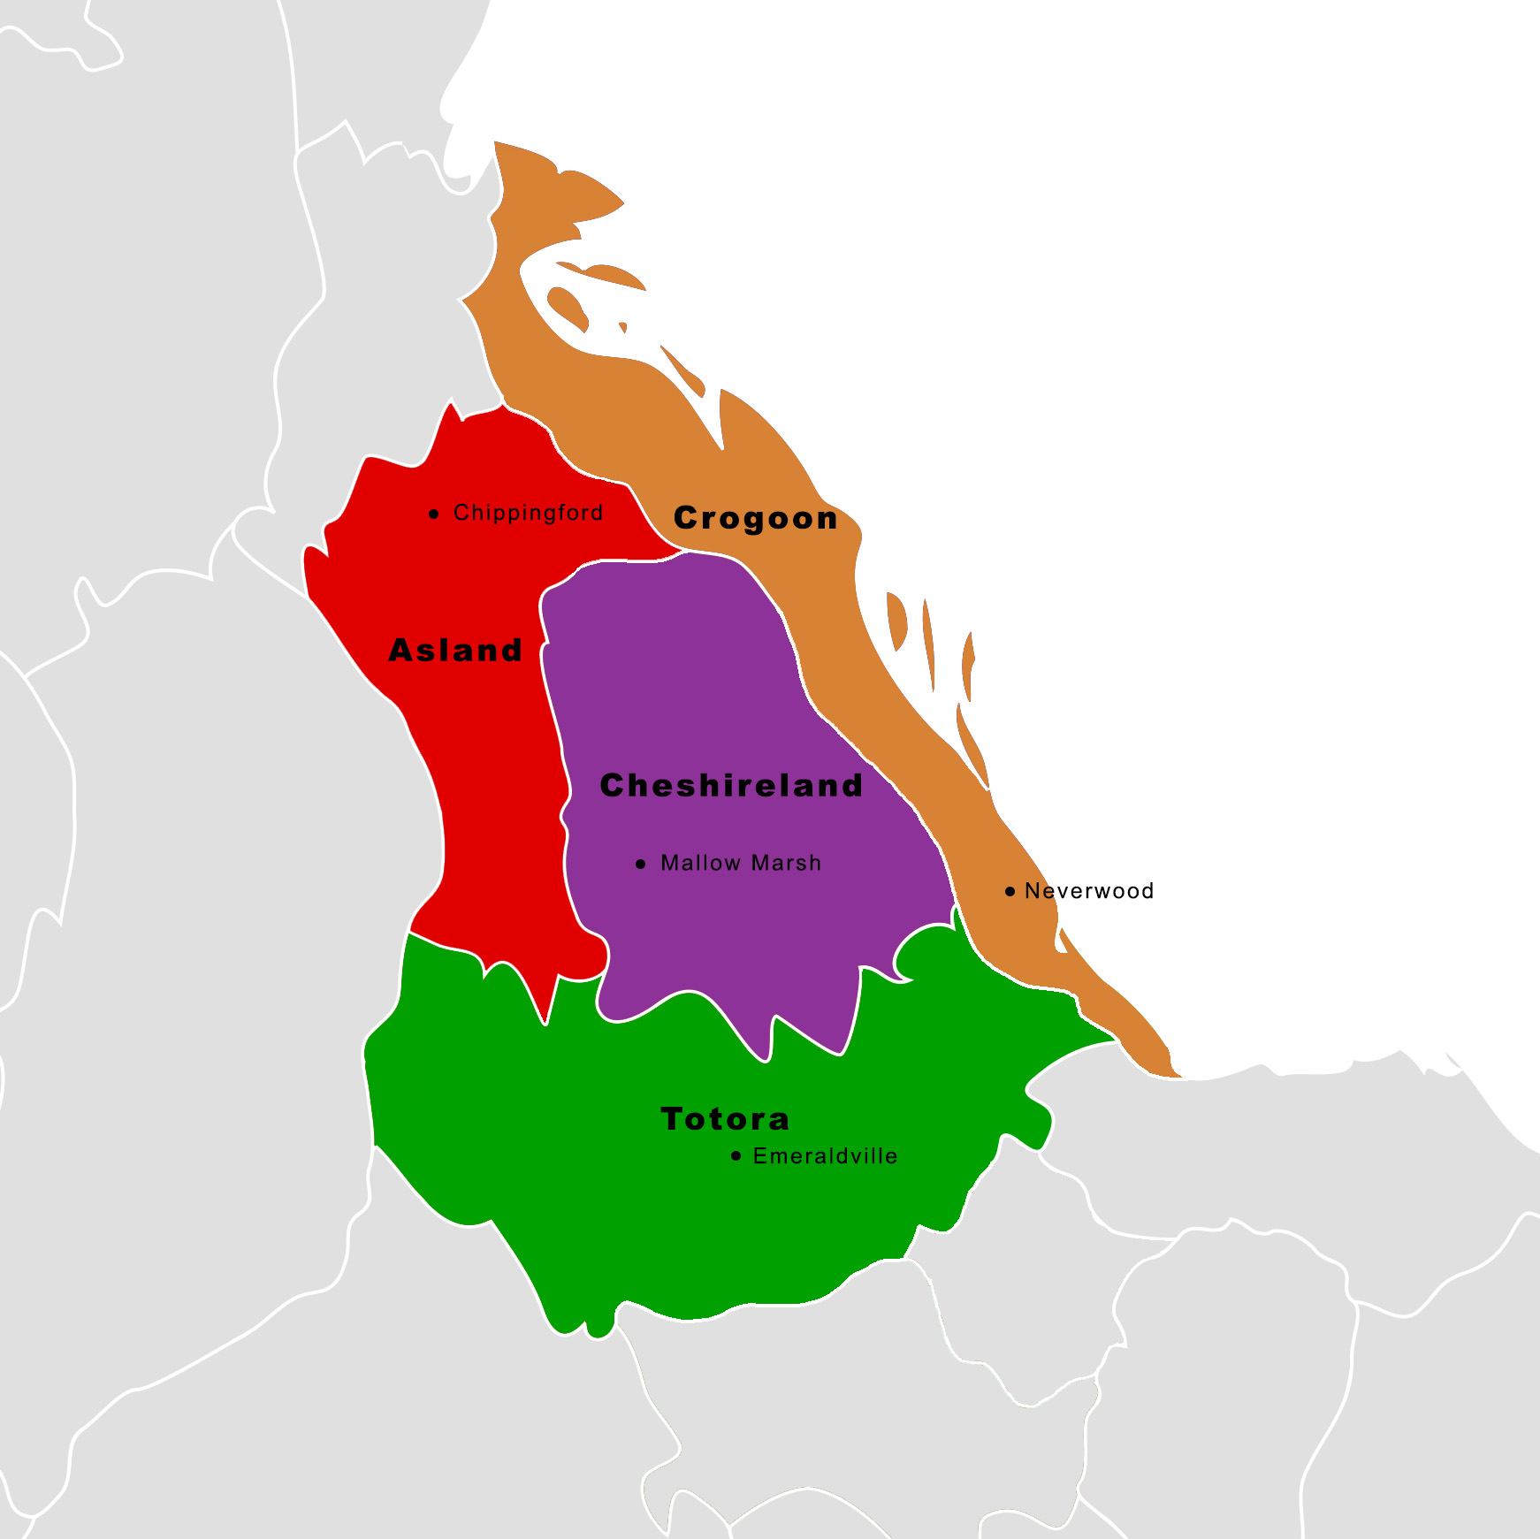
Based on Real Countries
Asland
  Based on Chile
Crogoon
  Based on Seychelles
Cheshireland
  Based on Guangdong, China and Hong Kong
Totora
  Based on NE India: Uttar Pradesh, Bihar, Jharkhand, and West Bengal
Notes:
Seychelles population increased from 93,000 to 9.3 million

Slide 20
Data used to build countries
Population and culture
Media Exposure and usage
Employment rate
Number of households
Population distribution
2011 GDP by Sector
Transportation usage, passenger versus cargo
Exports and imports
Most data was collected from census records, statistical sites, and surveys.
Data was used to gauge policy impact variance between countries.

Slide 21
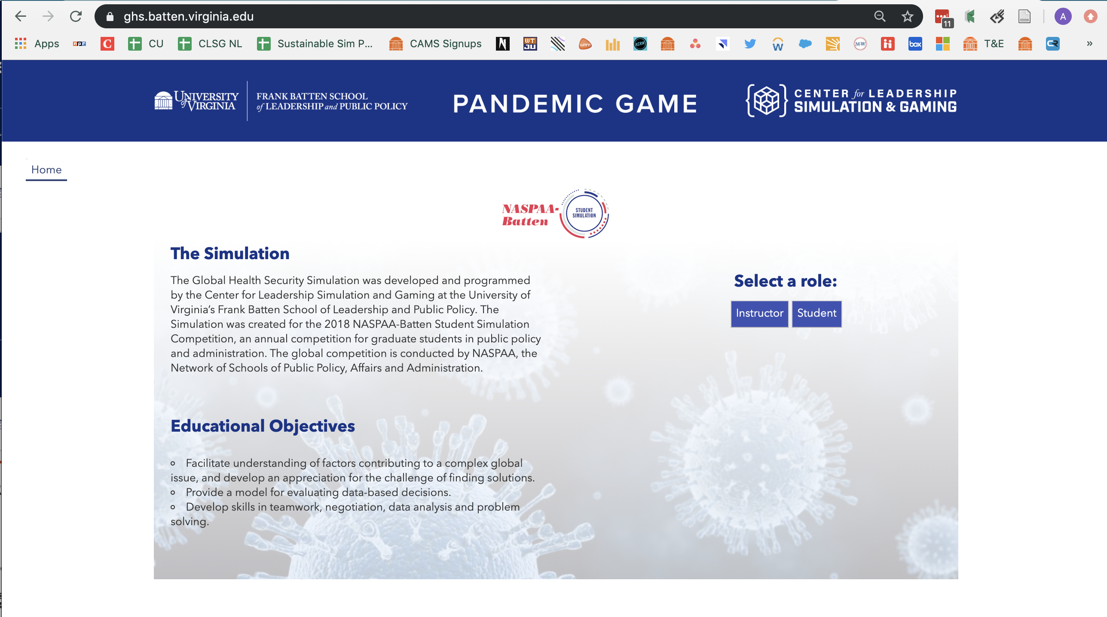
The Pandemic Game
ghs.batten.virginia.edu
Sign in as student
Don’t need to enter a real email (a@b.com is fine)

Slide 22
The Pandemic Game:
Interface Walkthrough

Slide 23
Educational Objectives
Cooperation and Consensus Building: issues like pandemics are global and cannot be solved by a single country; teams with conflicting interests must cooperate to resolve the situation
Crisis Management: participants must make learn to make effective decisions while the clock ticks down
Solving Complex Problems: simple solutions or simplistic thinking cannot capture the complex of a policy issue
Critical Analysis of Data: participants are required to make decisions with limited information
Public Health Policy: give participants a sense of the concerns and what tools are available
Interdisciplinary Approach: public policy and science should compliment one another

Slide 24
Simulation Structure
175 days in 30 minutes
Instructor can determine death rate and country of origin (replayability)
Inter-team communication via chat feature
Negotiations and cooperation necessary to resolve the crisis without damaging economy
Notes:
These informed our model.

Slide 25
Policies
Based off of policies that were enacted or proposed in past epidemics and in preparedness reports
Impacts based on data collected in scientific studies, surveys, and reports
Policies don’t always do what you’d expect
  Closing schools
    Can backfire, harm economy
  Quarantine
    Expensive and not very effective
  Vaccines
    Seasonal vaccines don’t protect against new strains
    Not all vaccines develop effectively
  Gloves, masks, and hand sanitizer
    The flu virus can live 100x longer on gloves than on skin
    Viruses are small enough to go through most masks
    Distributing hand sanitizer can cause a condition of Risk Compensation
Notes:
3 to 5 policies that surprisingly don’t work / do work

Slide 26
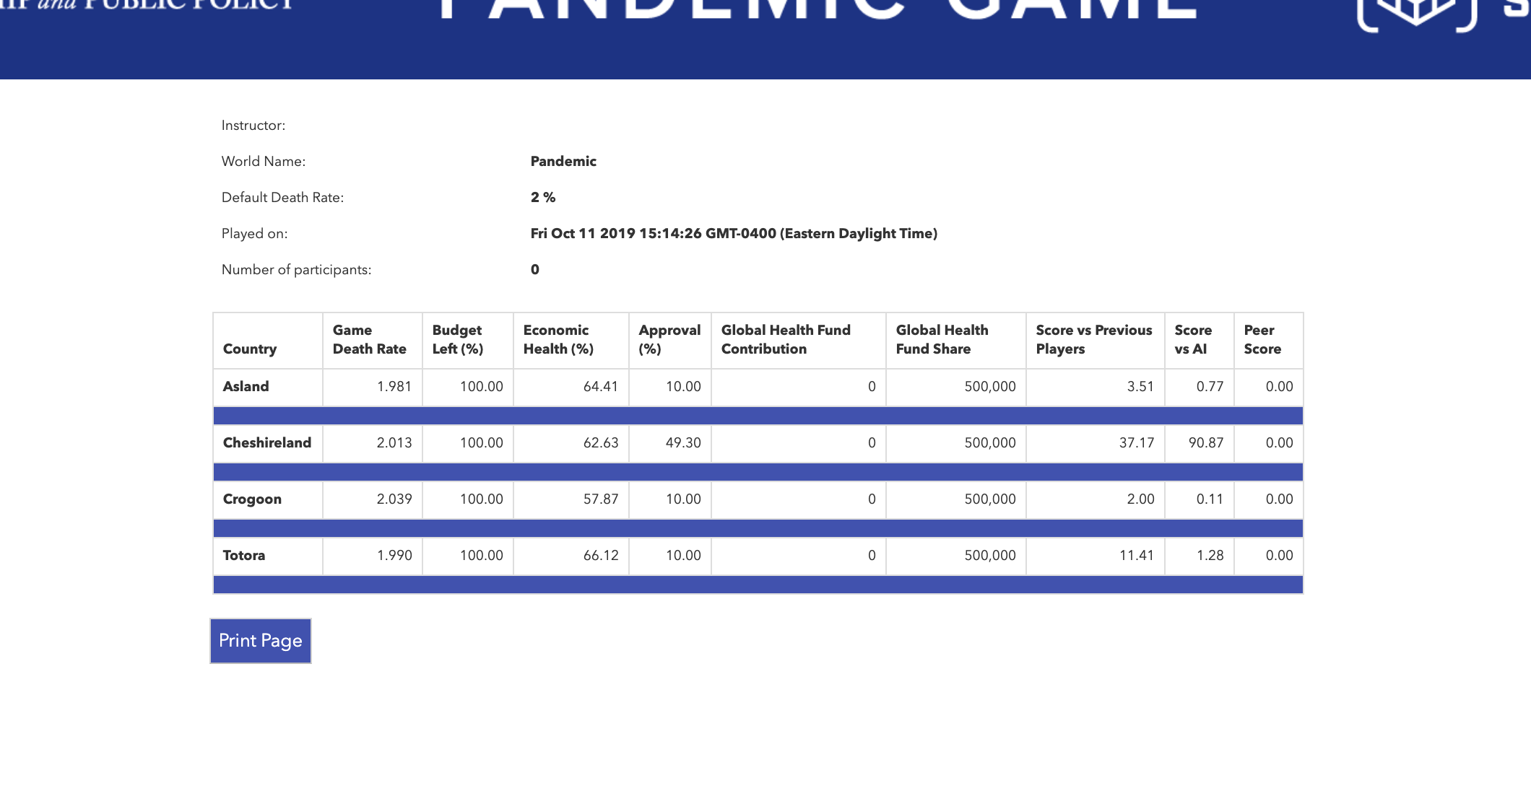
Check your countries!

Slide 27
Host Nations
A Refugee Simulation
Motivated by pressing global issue of forced migration

Slide 28
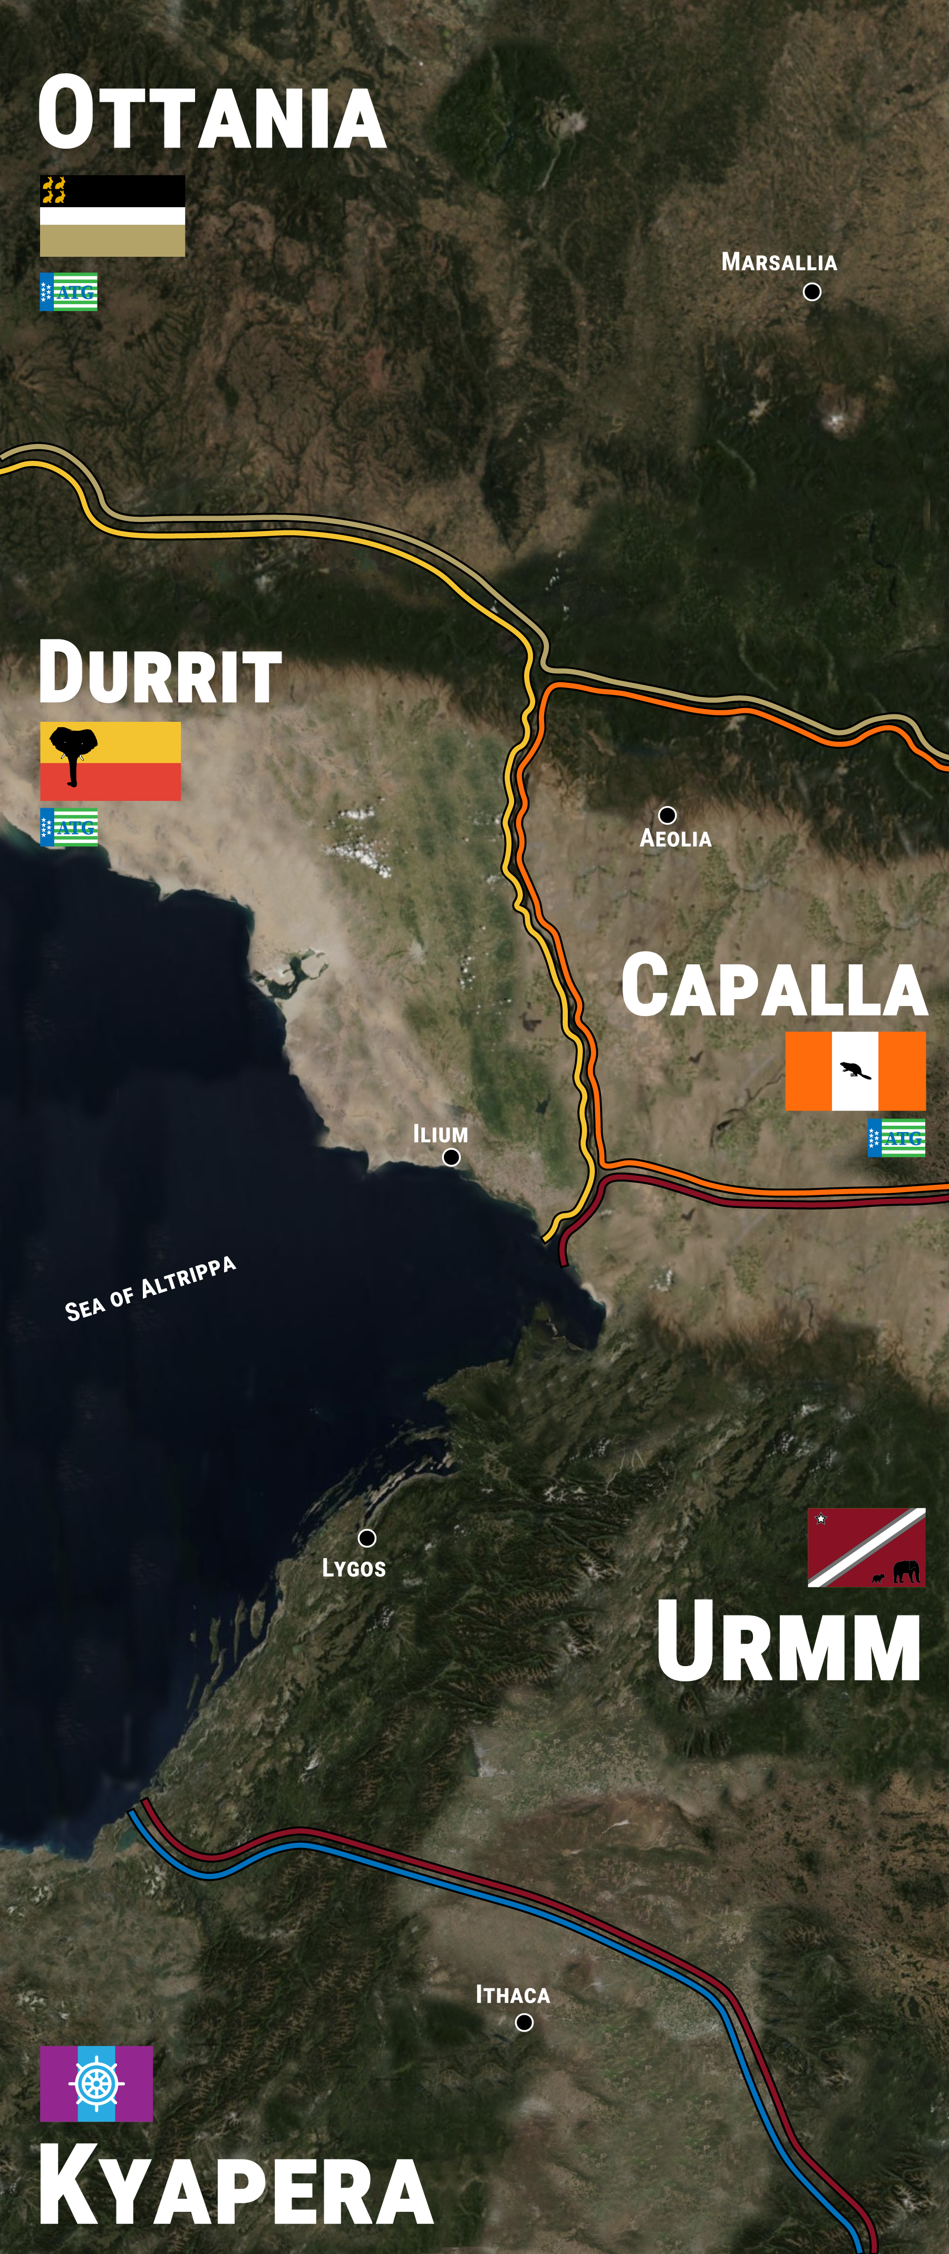
Simulation Structure: Welcome to Altrippa
Migrants fleeing failed state move north
Round-based for adaptable time frame
Iterative, replayable
Multiple time frames
Four playable countries: Ottania, Durrit, Capalla, Urmm
Each team has five roles: Prime Minister, ATG Delegate, Home Office Secretary, Minister of Labor, Minister of Health & Human Services
Regional body to emphasize negotiations between team:
  ATG (Altrippa Treaty Group)
Worlds that find a regional solution to the crisis do better than worlds where teams go it alone

Slide 29




Where did we get our data?
The game was built using data from the 2015/16 EU Refugee Influx
Specifically, we looked at four countries:
Urmm was built using data from Turkey
Capalla was built using data from Austria
Durrit was built using data from Hungary
Ottania was built using data from Germany

Slide 30








Where did we get our data?

Slide 31
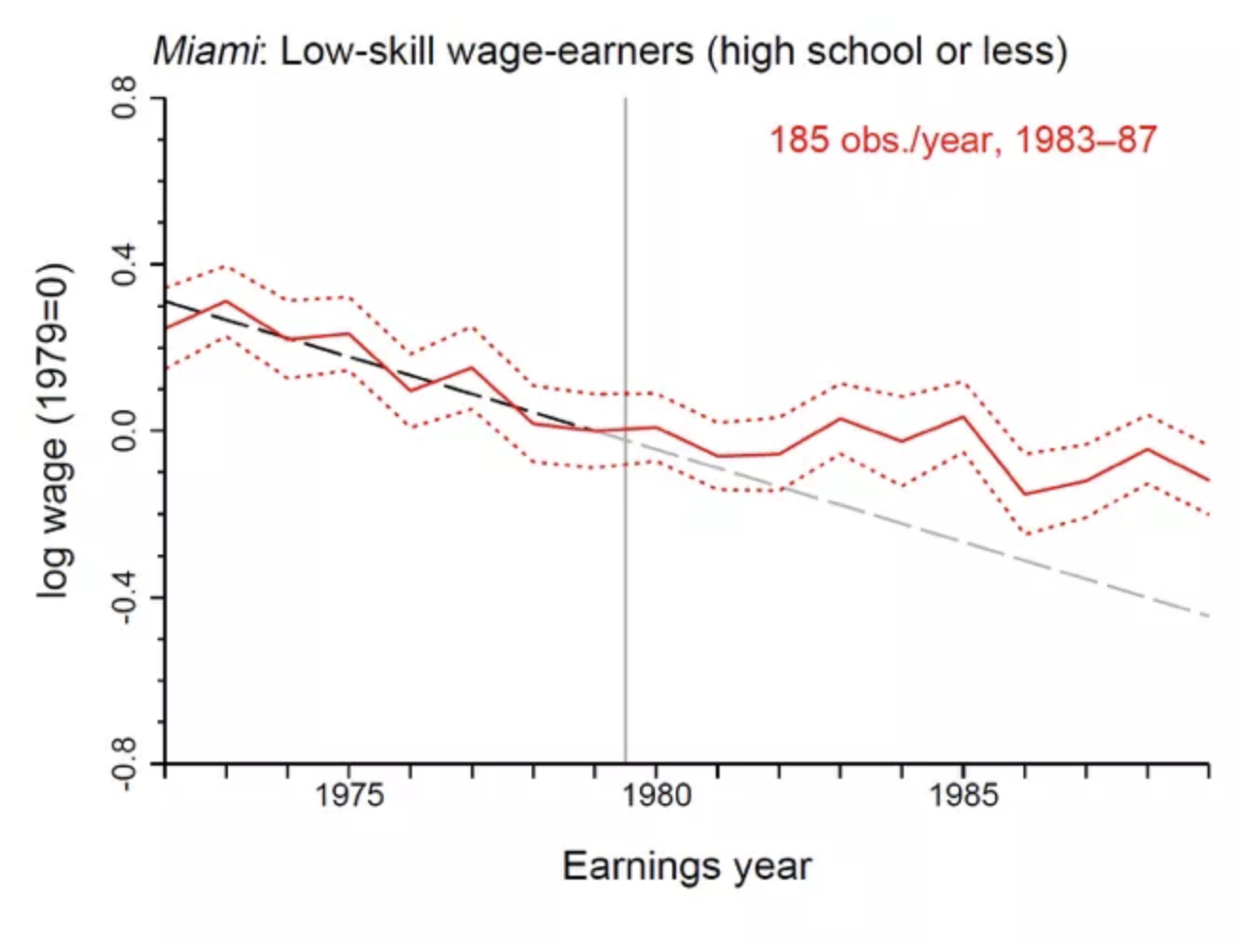
Card, David (1990). “The Impact of the Mariel Boatlift on the Miami Labor Market.”
  Apr - Oct 1980: 25,000 Cuban Refugees entered Miami, Florida
Findings:
Overall workforce earnings 8% higher vs. national rate
Low-wage earnings 20% higher vs. national

Slide 32
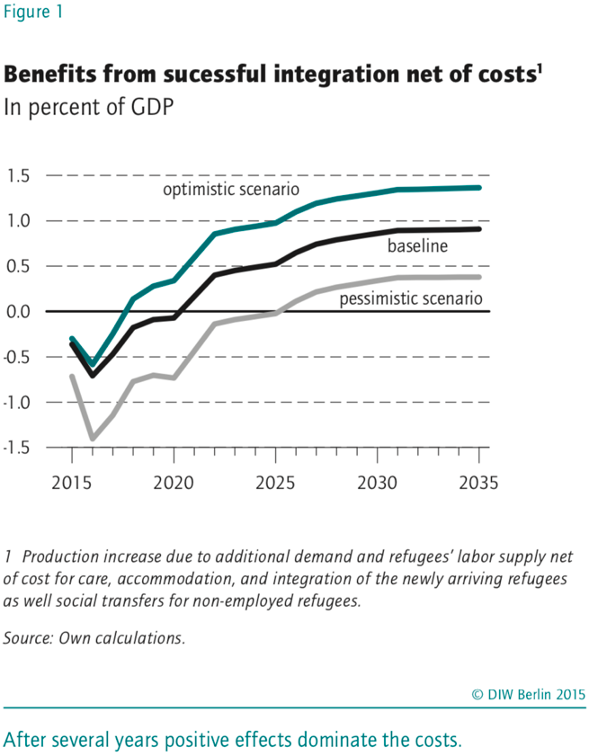
DIW Berlin
Integrating refugees: A long-term, worthwhile investment (November 2015)
“Much evidence that unemployment is initially very high among recognized refugees, probably because many refugees do not immediately have the required qualifications, starting with language skills. The longer the refugees remain in Germany, however, it can be assumed that these obstacles will be gradually overcome, and thus the unemployment rate will slowly decrease over time”

Slide 33
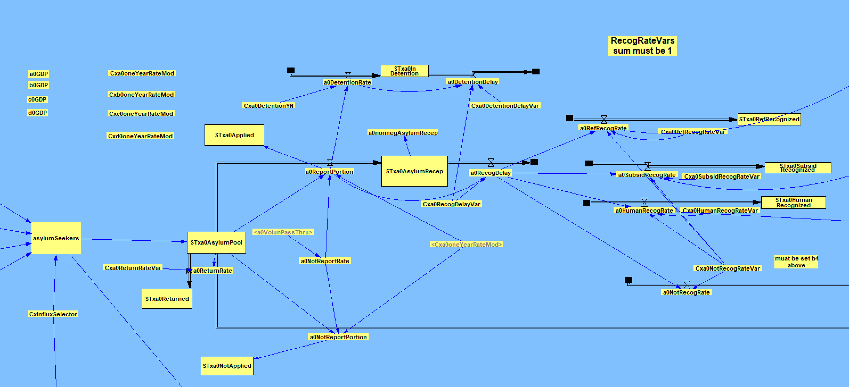
Simulation Model (Country Level)

Slide 34
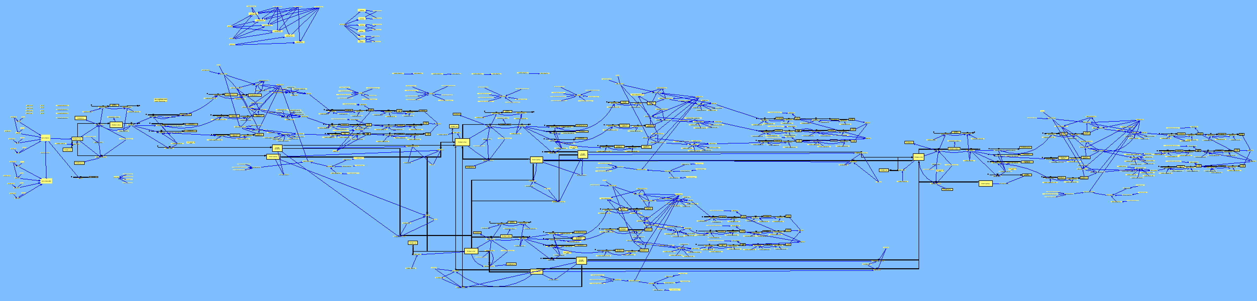
The Simulation Model (World Level)

Slide 35
Germany
Invested heavily in migrants
  Group housing while processing
  Gave us idea for ‘Welcome Classes’
  Expanded apprenticeship system for refugees
  ‘We can do it!’ Angela Merkel, who announced Germany would take in large numbers
Took in 1.1 million refugees in 2015, ½ applied for protection in Germany
Percent of population with migrant background jumped 8.5% to 22.5%
Significant Turkish population
Holocaust
Hungary
Deterrence
  Transit Zones
  Expanded border patrols
  Victor Orban: ““Multiculturalism means the coexistence of Islam, Asian religions and Christianity. We will do everything to spare Hungary from that.”
Fairly homogenous
Notes:
https://www.reuters.com/article/us-germany-immigration/immigrant-population-hits-new-high-in-germany-idUSKBN1AH3EP
https://www.bbc.com/news/uk-politics-eu-referendum-36169684

Slide 36
Austria
Provided buses to ferry migrants to Germany
Offers Refugee, Subsidiary, Humanitarian protection
Tried to do what they could: offered cash, job training, language training
Refused to transfer migrants to Hungary
Anti-immigrant party voted into power
Turkey
En masse recognition of Syrians—but can’t naturalize
Closed access to EU once they started receiving payments
Ethnic overlap with some refugees (Kurds)
Absorbed largest number of refugees by far
Notes:
https://www.reuters.com/article/us-germany-immigration/immigrant-population-hits-new-high-in-germany-idUSKBN1AH3EP
https://www.bbc.com/news/uk-politics-eu-referendum-36169684

Slide 37
European Commission
European Economic Forecasts - Autumn 2015
“If managed properly, the inflow of refugees will have a small favourable effect on growth in the short and medium term. This will crucially depend on policies to integrate accepted refugees in the labour market.”

Slide 38
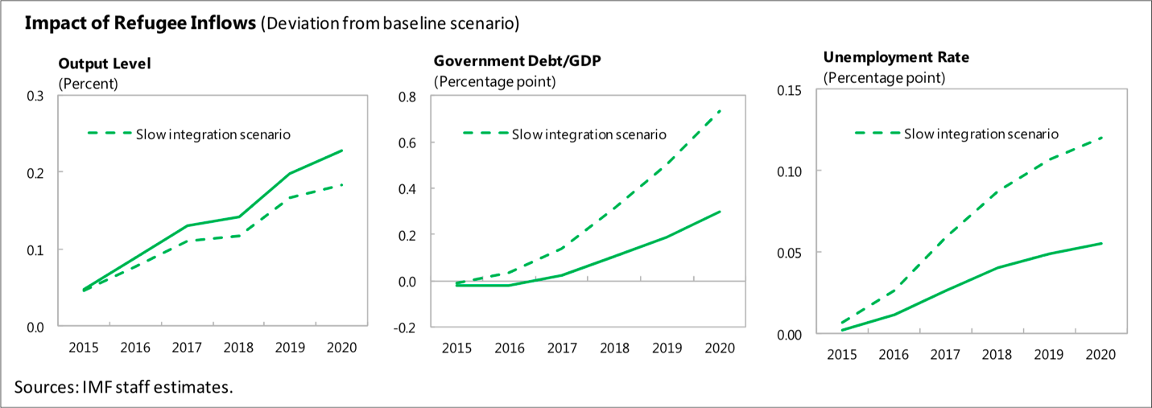
“If labor integration is less successful, the positive output impact would diminish but government debt and the unemployment rate would further rise, as illustrated in a scenario where labor market integration is assumed to be slower (dashed line in chart).”
International Monetary Fund
The Refugee Surge in Europe: Economic Challenges (January 2016)

Slide 39
Educational Objectives
Leadership, Critical Thinking, Consensus Building
Working in a team environment with multiple teams
Strategic Thinking: Defining and achieving a common goal
Interactions with other countries: partnering and political savvy
Different conditions: countries can contribute in different ways
Within own team: leveraging diversity, conflict/crisis management, decisiveness and negotiating
Learn potential policy outcomes in a risk-free environment
Complexity and Shortcomings of Asylum & Refugee Policy
Trade-offs: human rights and budget restrictions
Long-term benefits outweigh short-term costs; weathering short-terms costs & downturns
Integration: skills training, language training, housing, permission to work, freedom of movement
Notes:
Five styles for conflict management, as identified by Thomas and Kilmann, are: competing, compromising, collaborating, avoiding, and accommodating.

Slide 40
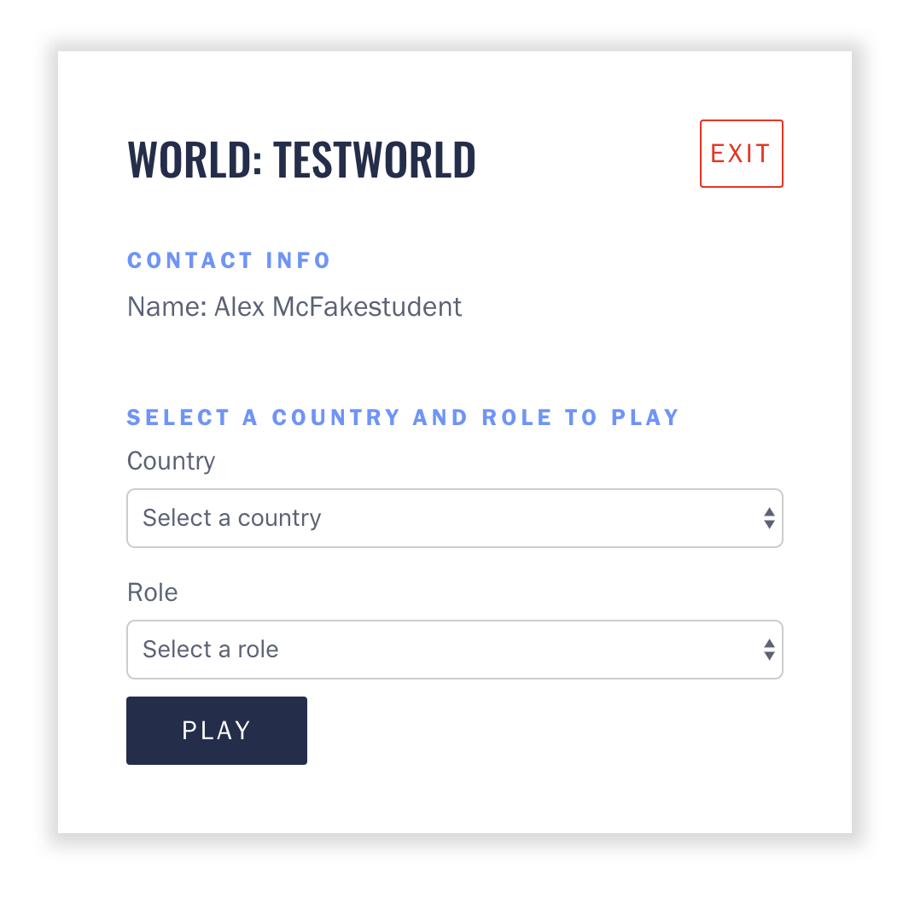
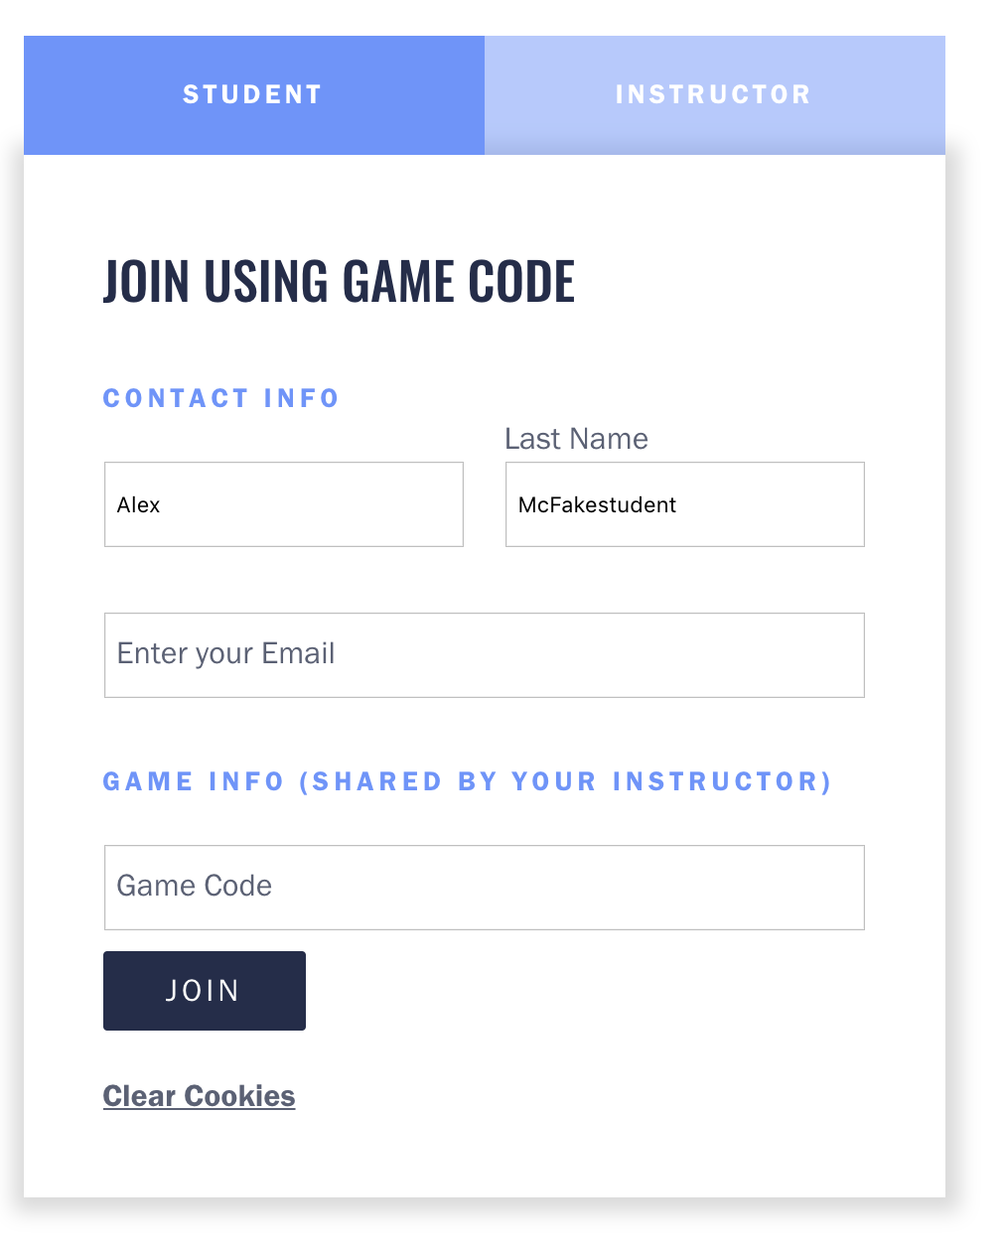
Login
http://hostnations.batten.virginia.edu
Please use Google Chrome only

Slide 41
Host Nations:
Interface Walkthrough

Slide 42
European Commission
European Economic Forecasts - Autumn 2015
“If managed properly, the inflow of refugees will have a small favourable effect on growth in the short and medium term. This will crucially depend on policies to integrate accepted refugees in the labour market.”

Slide 43
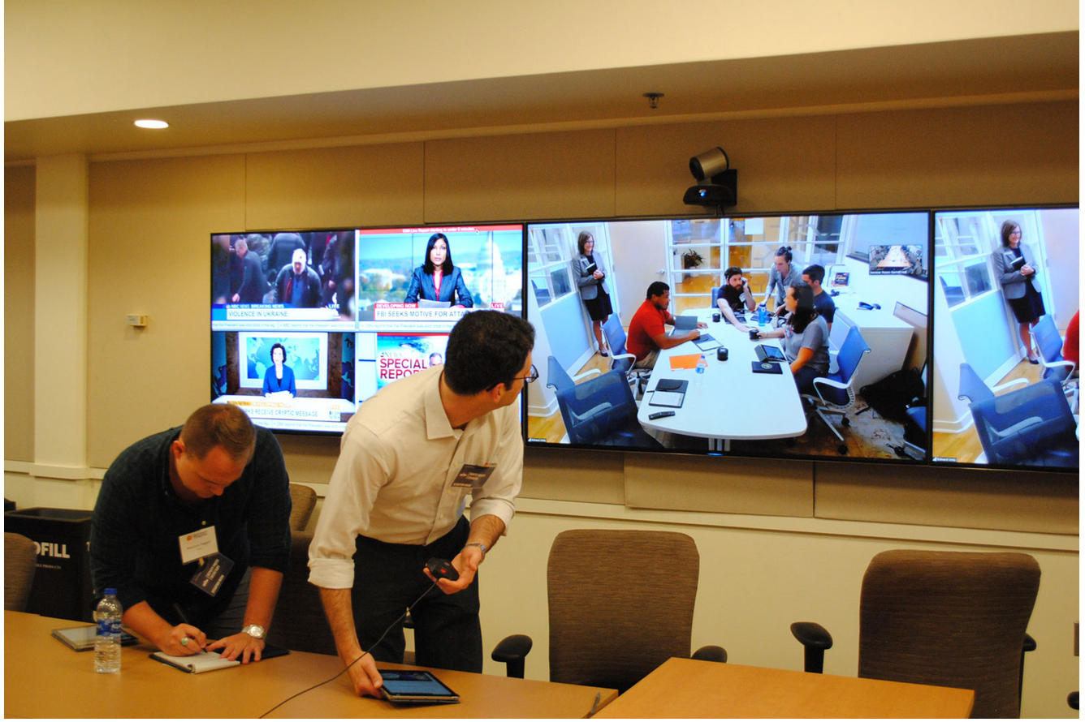
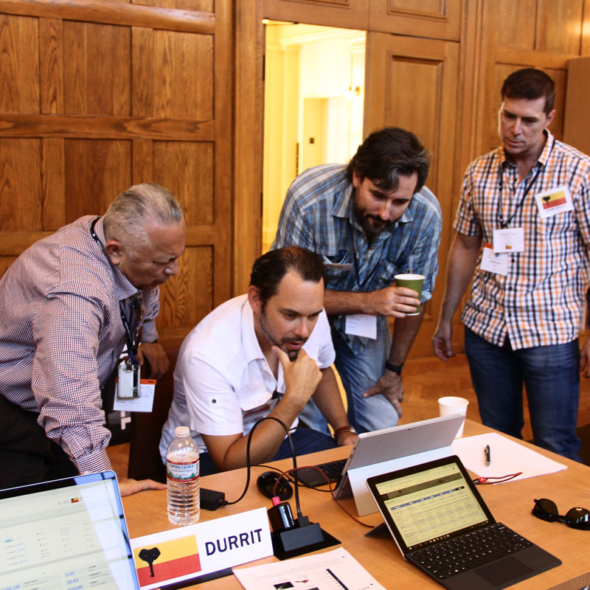
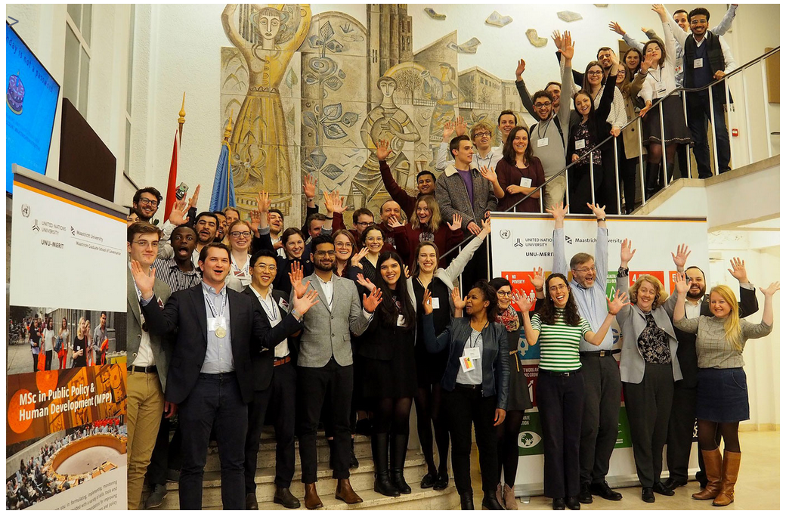
www.clsgbatten.org

