Slide 1
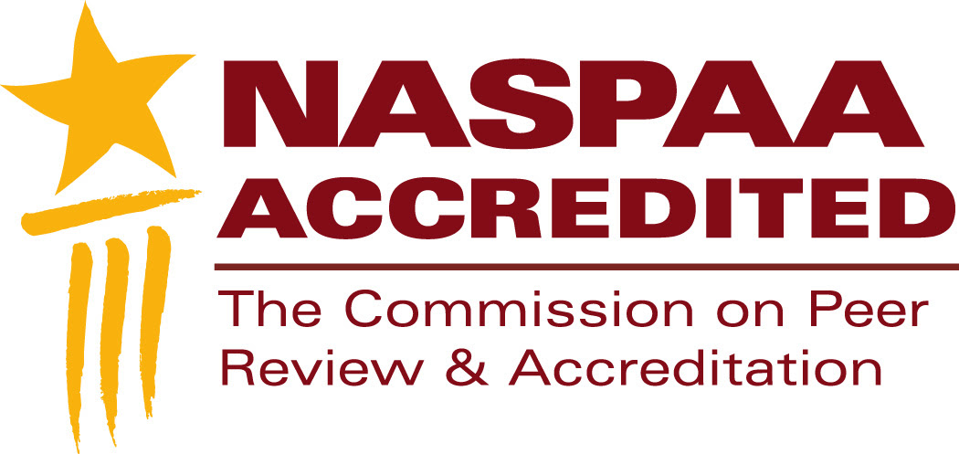
NASPAA Accreditation
Why seek accreditation?
Notes:
This is a segment about the benefits of seeking accreditation.
Feel free to pause this video at any time to study a slide.
Download the slides because they contain detailed notes
You should send at least one representative from your program to the Accreditation Institute at NASPAA’s annual meeting
The Accreditation Institute is where you’ll have an opportunity to practice applying the concepts and tools we review in these videos
Accreditation involves a commitment of time, energy, and money. Why do it?

Slide 2

To improve the program
Contributions to advancing knowledge and practice
Notes:
Programs learn by completing their self-studies:
the process includes engaging in a systematic self-study based on established criteria, where you’ll document how you assess your performance and improve it: this has value in terms of obtaining agreement among everyone involved in your program on its mission and indicators of success
If everyone agrees on your mission, outcomes, and improvements, then accreditation is about documenting it in a prescribed format, showcasing what you do
NASPAA’s standards embody the notion that programs will manage themselves to improve continuously in ways consistent with their missions
Programs learn from other programs by having staff participate on site visit teams
Programs learn by having site visit teams offer advice: heterogeneity, including international programs, fosters innovation and creativity

Slide 3

To validate program quality
…to all stakeholders:
students
prospective faculty members
employers,
university administrators,
funders,
government regulators….
Notes:
An independent assessment
Sends a signal to all stakeholders that:
The program will provide the resources students to learn and pursue careers in public service
The program will provide employers with graduates who can fulfill their needs in public service
The host institution will ensure that the program has sufficient resources to do this.
In an international context, programs that have international accreditation by a reputable body, like NASPAA, can find the local government accreditation process to be almost pro-forma.
Image: Public Domain

Slide 4

To increase program visibility
To peers, students, employers
Notes:
Enhances program reputation within the host institution and outside
Accredited programs are distinguished from programs that are not
Accredited programs learn about each other.
Assists in creating partnerships, faculty exchanges, student transfers

Slide 5

To commit
To public service education
Notes:
NASPAA standards and accreditation process enhance the recognition and reputation of graduate degrees in public service
Accredited programs demonstrate their engagement with the community of public affairs educators, sharing and learning to improve the profession
Accredited programs play a role in preserving and perpetuating public service values.
Image: Wikipedia

Slide 6
…is not only about voluntarily conforming to standards set by NASPAA for educational programs in public service.
…is also about pursuing excellence in public service through education by executing well on a mission-based strategy.
If you have questions stimulated by this video, submit them to:
accreditation.naspaa.org/ai-questions
Notes:
The mindset approaching accreditation should not be instrumental: tell us the clear guidelines that we can check off to satisfy COPRA; we’ll be sure we can do that every seven years.
The mindset approaching accreditation should be intrinsic: we’ll conform voluntarily to NASPAA’s procedural guidelines to help us achieve our mission by managing strategically, day in and day out.

