Slide 1
NASPAA ACCREDITATION
Standard 5: Matching Operations with Mission: Student Learning

Slide 2
Matching Operations with Mission: Student Learning
PART A: How does the program define what students are expected to know and to be able to do upon graduation with respect to the required universal required competencies and/or mission-specific required competencies in ways that are consistent with its mission?
PART B: How does the program know how well its students are meeting faculty expectations for learning on the required (or other) competencies?
PART C: How does the program use evidence about the extent of student learning on the required (or other) competencies for program improvement?

Slide 3
Universal Required Competencies
To lead and manage in the public interest
To participate in, and contribute to, the policy process
To analyze, synthesize, think critically, solve problems and make evidence-informed decisions in a complex and dynamic environment
To articulate, apply, and advance a public service perspective
To communicate and interact productively and in culturally responsive ways with a diverse and changing workforce and society at large

Slide 4
Other Mission-related Competencies
Mission-specific Required
Mission-specific Elective
Professional
Expectations for student learning beyond the five universal competencies that are required of all students
Expectations for student learning that reflect specialized, advanced learning that are required only for those students seeking the credential
Expectations for student learning achieved through experiencing public service

Slide 5
Part A: Operationalizing the Competencies
Analyze, Synthesize, Think Critically, Solve Problems, and Make Evidence-Informed Decisions in a Complex and Dynamic Environment
Our mission requires that mastery assure graduates have an ability to make difficult decisions alongside of those affected by the decisions in ways that are informed by logic, research, and reason with the ultimate goal of advancing the common good.

Slide 6
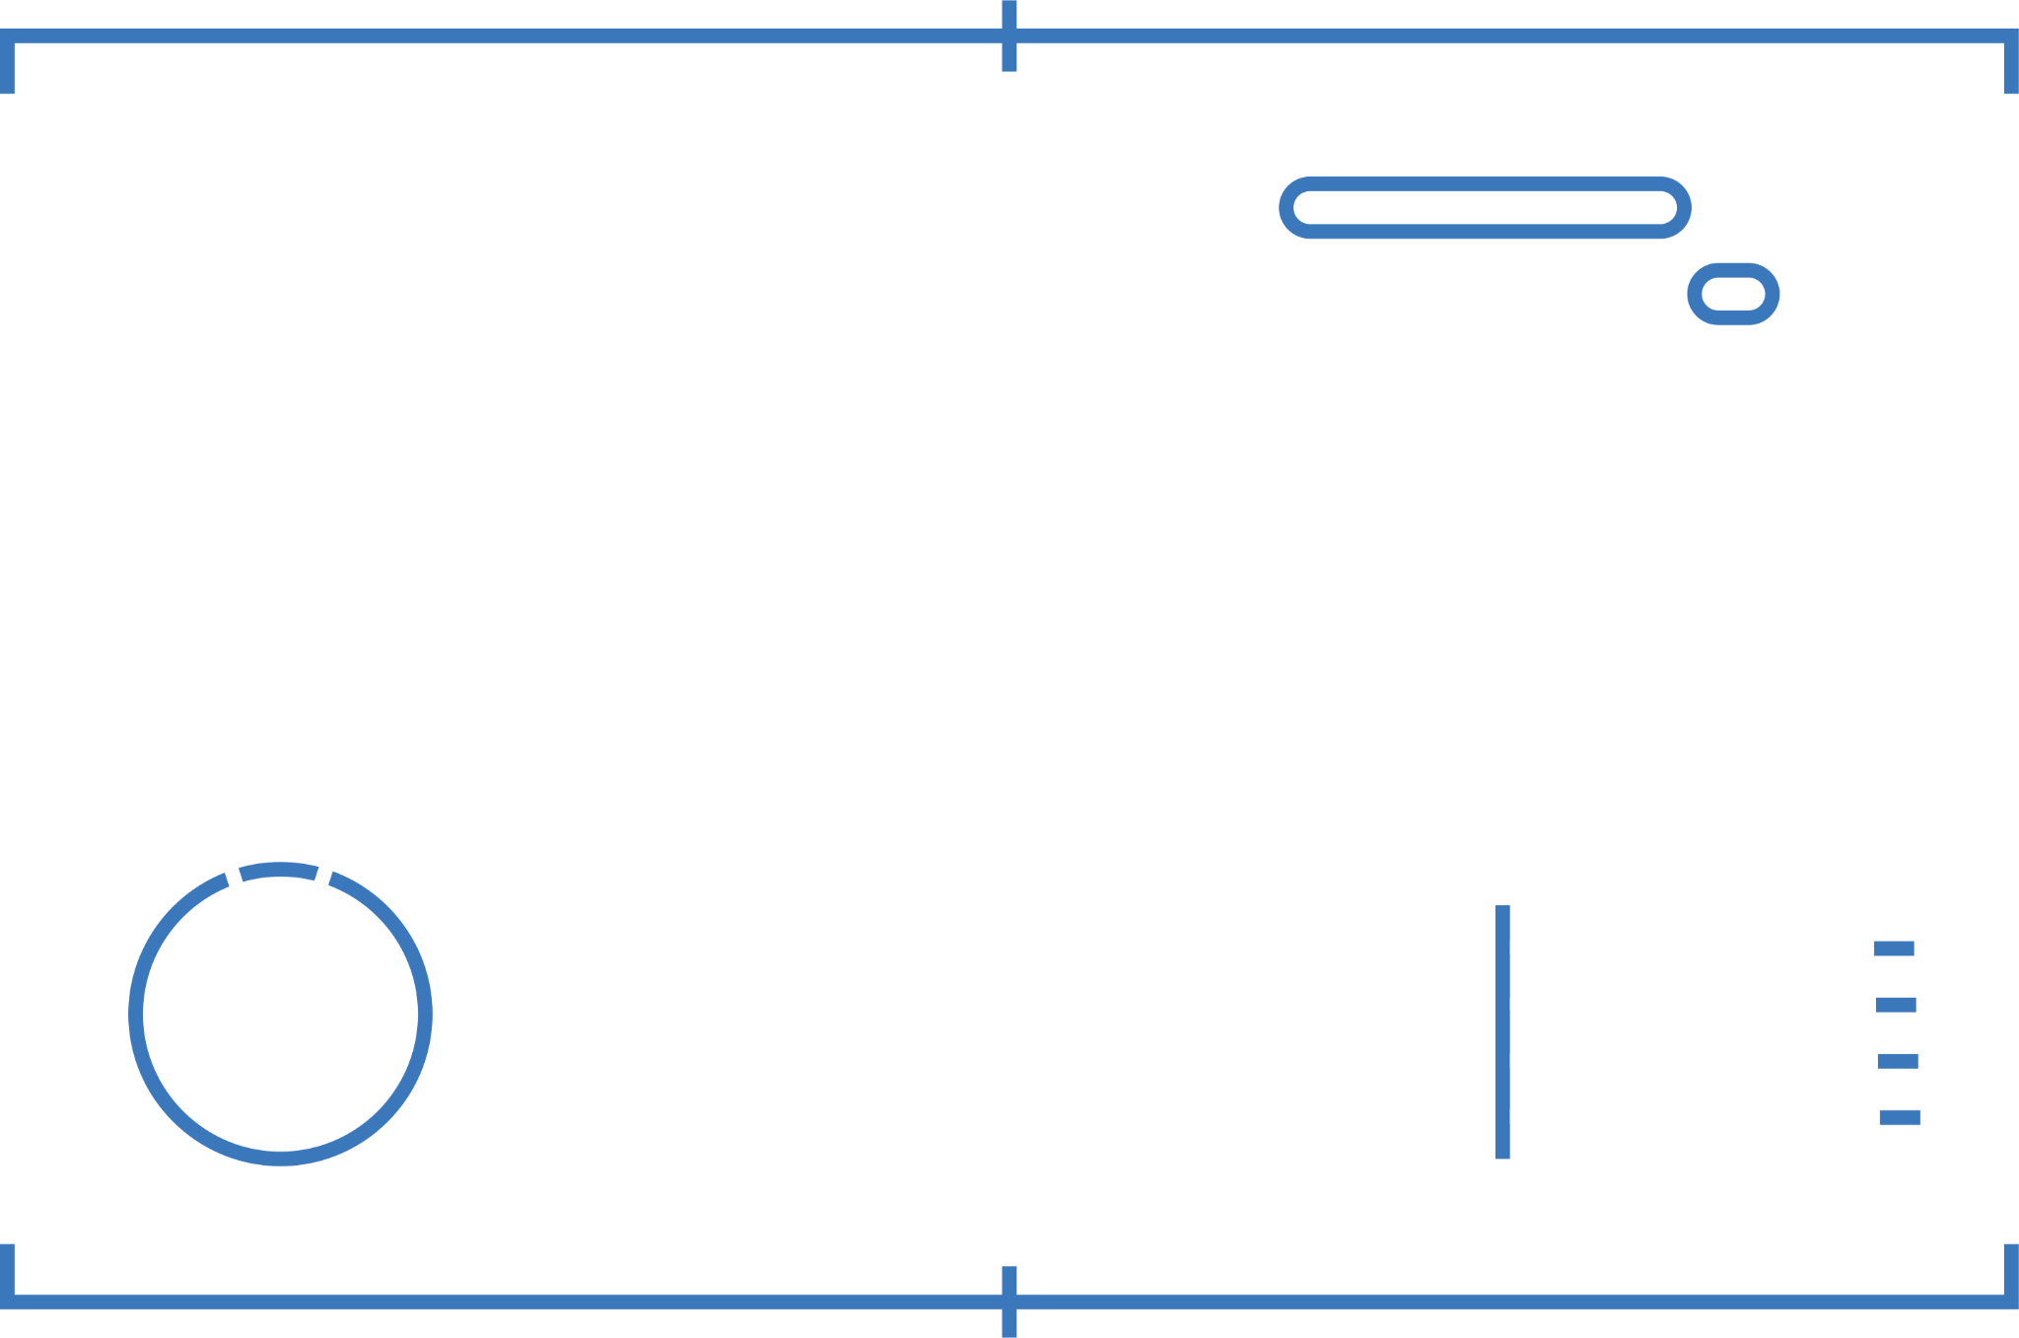
Defining Learning
Outcomes
Analyze, Synthesize, Think Critically, Solve Problems, and Make Evidence-Informed Decisions in a Complex and Dynamic Environment
Upon graduation students will be able to:
Describe the scientific method/evidence-based methods and identify reliable data sources to inform decision making
Employ appropriate qualitative or quantitative data collection and analysis methodologies to aid in decision making or problem solving
Demonstrate a spirit of inquiry that values diverse perspectives, reflection, and transparency

Slide 7
Measuring Outcomes
Describe the scientific method/evidence-based methods and identify reliable data sources to inform decision making
Measure: A Budget Analysis Assignment will be assessed to determine student ability to provide a strong argument in support of evidence-based decision making grounded in appropriate theoretical frameworks and informed by reliable data and valid research.
Employ appropriate qualitative or quantitative data collection and analysis methodologies to aid in decision making or problem solving
Measure: The Final Research Paper will assess student performance in relation to both his/her ability to decide on an appropriate data collection strategy and research methodology that adequately considers what is to be accomplished and the constraints affecting the process so that in the end, administrative practice is improved.
Demonstrate a spirit of inquiry that values diverse perspectives, reflection, and transparency
Measure: Reflective Essays will be used to evaluate the degree to which students openly acknowledge bias and reflect on how personal attributes such as culture, identity, life experience, etc. influence critical thinking and decision making. Students are expected to advance a compelling argument for embracing a spirit of inquiry that values diverse perspectives.

Slide 8
Part B: Ongoing Assessment
The program is expected to engage in ongoing assessment of student learning for all universal required competencies and all mission-specific required competencies.
That is, how does the program know how well its students are meeting faculty expectations for learning on the required (or other) competencies?

Slide 9
Part C:
Closing the Loop
How does the program use evidence about the extent of student learning on the required (or other) competencies for program improvement?
Define student learning outcome
Provide evidence of learning that was gathered
Explain how the evidence was analyzed
Share how the evidence was used to inform future practice

