Slide 1
Session 3: 12:00pm-12:50pm Student Learning Assessment
Notes:
RBJ

Slide 2
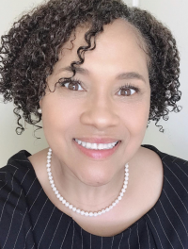
Session Facilitators
RaJade M. Berry-James, PhD
Calvin C. Johnson, PhD
Associate Professor
North Carolina State University
School of Public and International Affairs
Campus Box 8102
Raleigh, NC 27695-8102
Email: rmberryj@ncsu.edu
Phone: 330-519-7519
Visiting Professor
Bowie State University
Management, Marketing and Public Administration
14000 Jericho Park Road
Bowie, MD 20715-9465
Email: ccjohnson@bowiestate.edu
Phone: 301-455-2047

Slide 3
Facilitators’ Bios
RaJade M. Berry-James, PhD
Calvin C. Johnson, PhD
NC State University, School of Public and International Affairs
Associate Professor
MPA Capstone, Social Equity, Cultural Competence, Program Evaluation
NASPAA Executive Council
NAPA Fellow
NASPAA Committee on Diversity, Equity & Inclusion (DEI)
Chair of COPRA, NASPAA
Visiting Professor, Bowie State University
Public Policy Analysis, Evaluation Research
Deputy Assistant Secretary, Research, Evaluation and Monitoring (HUD)
University of Pennsylvania
Executive Office of the Mayor, District of Columbia
The Urban Institute
PhD, University of MD

Slide 4
Overview
Discuss sustainable assessment approaches.
Discuss rationale, basic assumptions and basis of judgment for Standard 5.1.
Examine assessment cycle that links program mission and goals to objectives and student learning competencies.

Slide 5
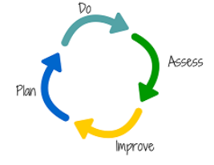
Standard 7 Matching Communications with Mission
Standard 6 Matching Resources with Mission
Standard 5 Matching Operations with Mission: Student Learning
Standard 4 Matching Operations with Mission: Serving Students
Standard 3 Matching Operations with Mission: Faculty Performance
Visual Roadmap
Standard 2
Matching Governance with Mission
Standard 1
Managing the Program Strategically
Notes:
Assess: ASSESS the learning outcome
Improve: Adjust or IMPROVE following the results of the assessment
Plan: Clearly define and PLAN learning outcome
Do: Analyze the results of the outcome assessment

Slide 6
Student Learning Assessment
Defined as:
A written plan which includes the frequency and strategies underlining the assessment of student learning outcomes as well as the program’s approach to programmatic improvement
The assessment plan details direct (and indirect, as needed) measures, the use of rubrics for evaluation, faculty and stakeholder involvement, analysis procedures, and how analysis is used for overall program improvement.

Slide 7
Standard 5.1 | Universal Required Competencies
As the basis for its curriculum, the Program will adopt a set of required competencies determined by its mission and public service values. The required competencies will include five domains, the ability:
to lead and manage in the public interest;
to participate in and contribute to the public policy process
to analyze, synthesize, think critically, solve problems and make evidence-informed decisions in a complex and dynamic environment;
to articulate, apply, and advance a public service perspective;
to communicate and interact productively and in culturally responsive ways with a diverse and changing workforce and society at large.

Slide 8
Standard 5 |Rationale
Graduates should be able to:
apply their knowledge, understanding, and problem solving abilities in new or unfamiliar environments, and within broader or multidisciplinary contexts related to public nonprofit affairs, administration, and policy.
identify, collect, analyze and use qualitative and quantitative data to inform decision making that best serves the well-being of the public;
actively engage others to learn, understand, and respect different cultures and contexts;
make decisions that address and adapt to the needs, interests, and norms of different cultural groups.
recognize, adapt to, and make decisions in changing and increasingly complex environments.
reflect upon the social and ethical responsibilities and the equity implications linked to the application of their knowledge and judgments.
An accredited program should implement and be accountable for delivering its distinctive mission through the course of study it offers and through the learning outcomes it expects its graduates to attain. While all accredited degree programs must meet these standards, NASPAA recognizes that programs may have different missions with varying emphases.
The curriculum should demonstrate consistency and coherence in meeting the program’s mission. The program being reviewed should demonstrate how its curricular content matches the emphasis of its overall mission and public service values.

Slide 9
Standard 5 | Basic Assumption
NASPAA intends the accreditation process to be developmental that is to advance the public esteem for all the programs that it accredits as well as to improve the education effectiveness for each degree program.
The program that provides accurate information on student learning and student attainment of required competencies will not be held to an ideal standard of perfection.
The program will be expected to demonstrate that it understands the competencies expected of graduates, that it has instituted teaching and learning methods to ensure that students attain these competencies, and, where evidence of student learning does not meet program expectation, that action has been taken to improve performance.
The overall assumption is that students will graduate from the program with the necessary competencies to embody the program’s mission statement and public service values.

Slide 10
Standard 5 | Basis of Judgment
It is expected that all students in a NASPAA-accredited degree program will have the opportunity to develop knowledge and skills on each of the five universal required competencies.
The program shows that it requires the five universal competencies of public and nonprofit affairs, policy and administration and links them to the program mission.
The program defines each of the required competencies in terms of at least one student learning outcome (but there may be more than one) and demonstrates student achievement of those competencies at the program-level.
The emphasis that a particular program places on each of these competencies is consistent with its mission.
An accredited program need not assess all competencies every year or cohort, but rather at a frequency appropriate for its mission and goals.
However, assessing each competency only once during a seven year accreditation cycle would not likely be sufficient for conformance in most programs.

Slide 11
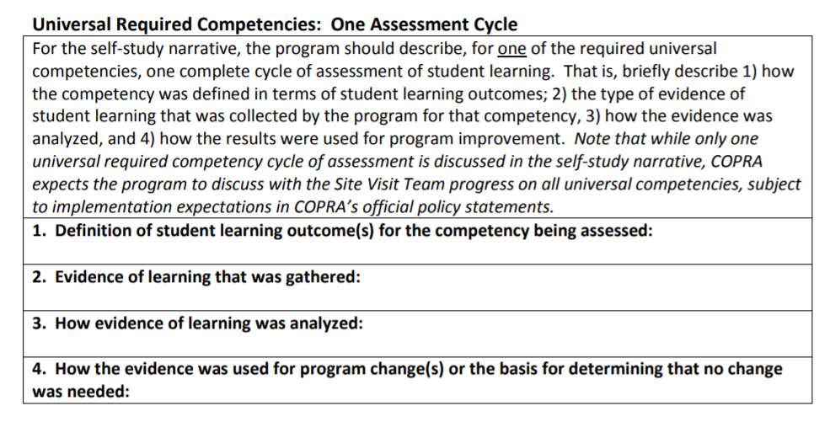
One Assessment Cycle

Slide 12
Assessment Planning
Keys to Assessment Planning | Important Questions
Assessment Methods | By what measure(s) will you know that students are meeting programmatic learning objectives?
 | From whom, and at what points, will you gather data?
 | How will you collect the assessment information?
Assessment Processes | When will you conduct the assessment?
 | Who will be responsible for each component?
 | What is the overall timeline for the assessment plan?
 | How will your data be used to evaluate the program?
Adapted from University of Massachusetts - Amherst. (n.d.) Program-Based Review and Assessment: Tools and Techniques for Program Improvement. Office of Academic Planning and Assessment. Retrieved from https://www.umass.edu/oapa/sites/default/files/pdf/handbooks/program_assessment_handbook.pdf

Slide 13
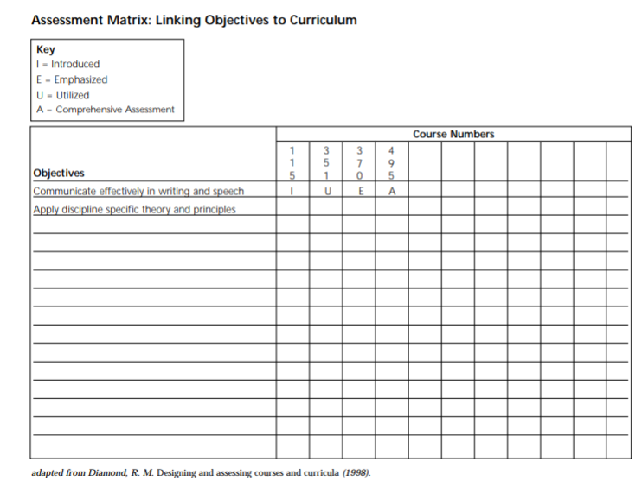
Assessment | Linking Objectives to Curriculum
Source: University of Mass- Amherst. (n.d.) Program-Based Review and Assessment: Tools and Techniques for Program Improvement, https://www.umass.edu/oapa/sites/default/files/pdf/handbooks/program_assessment_handbook.pdf

Slide 14
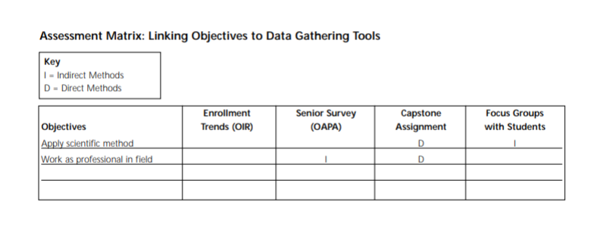
Assessment | Linking Objectives to
Data Sources
Source: University of Mass- Amherst. (n.d.) Program-Based Review and Assessment: Tools and Techniques for Program Improvement, https://www.umass.edu/oapa/sites/default/files/pdf/handbooks/program_assessment_handbook.pdf
Notes:
No grades!

Slide 15
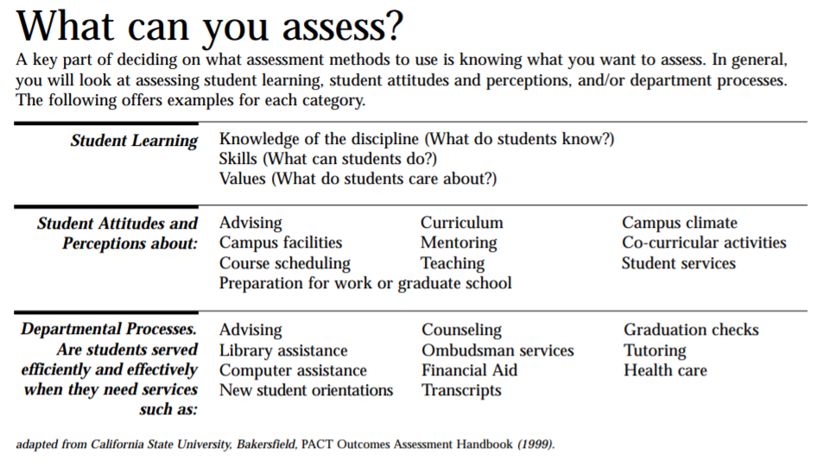
Assessment | Student Learning, Attitudes, Perceptions, and Departmental Processes
Source: University of Mass- Amherst. (n.d.) Program-Based Review and Assessment: Tools and Techniques for Program Improvement, https://www.umass.edu/oapa/sites/default/files/pdf/handbooks/program_assessment_handbook.pdf
Notes:
No grades!

Slide 16
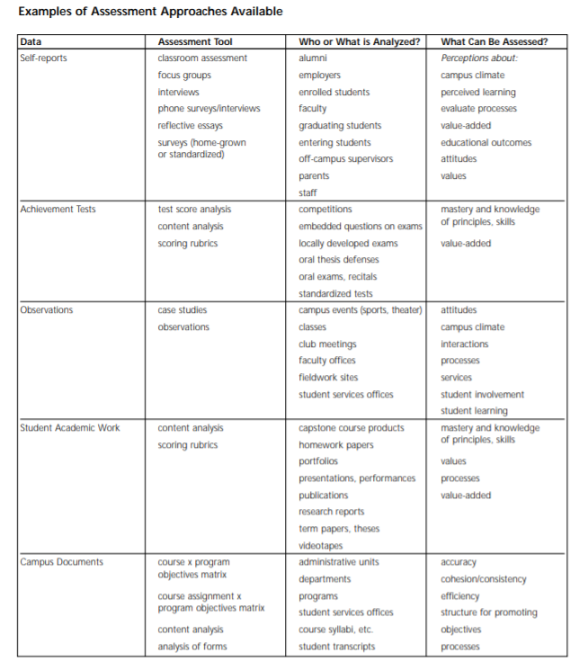
Direct Measures
Notes:
Direct and indirect measures
Limited – most important – measures
Use rubrics, multiple assessors
Do not use grades as your metric
Pay attention to reliability and validity

Slide 17
Best Practices
Multiple measures – direct and indirect.
Rubrics or other assessment tools used.
Validity: Faculty (or other stakeholders) who have not taught the course assess student work.
Reliability: Two or more faculty reviewing common work.
Achievement of performance targets: If your program finds that students are not meeting targets, the temptation is to change the targets or the process rather than reflecting on what substantive changes should be made to curriculum, pedagogy, or the like, based on the evidence you found.
Use results: Inform program enhancement decisions based on the evidence you found.

Slide 18
Before you leave …
Do you understand how to create a sustainable assessment strategy for your graduate degree program?
Is your assessment plan realistic, given your program realities? Your program’s self-study timeframe?
Does your assessment strategy include the collection of direct measures as well as indirect measures?
Is your assessment plan sustainable, with a SMART Program Goals and Objectives (Specific, Measurable, Achievable, Realistic and Time-bound) identified?
Do your program resources support your assessment processes? Have you identified an assessment committee? Did you charge the committee?
Are you following best practices in student learning assessment?

Slide 19
Peer Examples |Assessment Plans
Eastern Kentucky University
Georgia State University
Georgia Southern University
Indiana University, Bloomington
Northeastern University
The KDI School of Public Policy and Management (Assessment Visual)
San Francisco State University
Syracuse University
The University of Georgia
University of Minnesota
University of North Texas
The University of North Carolina at Chapel Hill
West Chester University
Adapted Assessment Plan Self-Evaluation Tool
Sample Assessment Plan Template
Source: NASPAA Peer Assessment Plans, https://www.naspaa.org/accreditation/standards-and-guidance/peer-examples

Slide 20
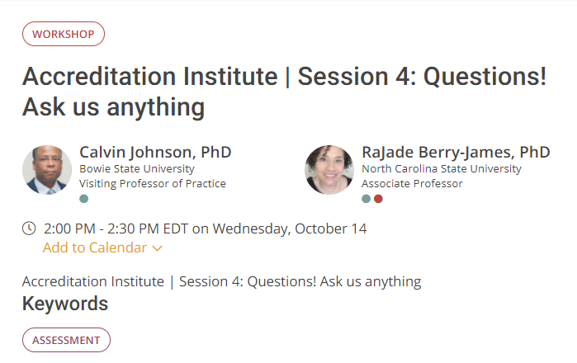
Thank You! After Lunch, Join Us for Session 4
Session 4 Questions! Ask Us Anything! @ 2PM Online at https://naspaa2020.pathable.co/meetings/virtual/i2JThuoDn4jdpjFZo

