Slide 1
Session 2: 11:00am-11:50am Program Evaluation
Notes:
RBJ

Slide 2
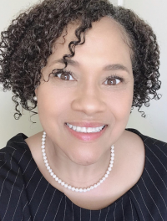
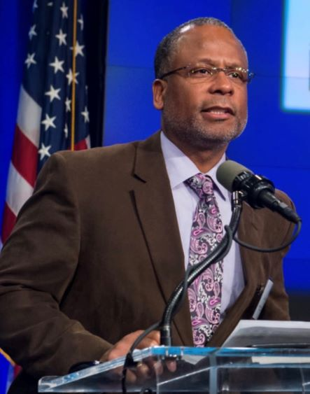
Session Facilitators
RaJade M. Berry-James, PhD
Associate Professor
North Carolina State University
School of Public and International Affairs
Campus Box 8102
Raleigh, NC 27695-8102
Email: rmberryj@ncsu.edu
Phone: 330-519-7519
Calvin C. Johnson, PhD
Visiting Professor
Bowie State University
Management, Marketing and Public Administration
14000 Jericho Park Road
Bowie, MD 20715-9465
Email: ccjohnson@bowiestate.edu
Phone: 301-455-2047

Slide 3
Facilitators’ Bios
RaJade M. Berry-James, PhD
Calvin C. Johnson, PhD
NC State University, School of Public and International Affairs
Associate Professor
MPA Capstone, Social Equity, Cultural Competence, Program Evaluation
NASPAA Executive Council
NAPA Fellow
NASPAA Committee on Diversity, Equity & Inclusion (DEI)
Chair of COPRA, NASPAA
Visiting Professor, Bowie State University
Public Policy Analysis, Evaluation Research
Deputy Assistant Secretary, Research, Evaluation and Monitoring (HUD)
University of Pennsylvania
Executive Office of the Mayor, District of Columbia
The Urban Institute
PhD, University of MD

Slide 4
Overview
Consistent with Standard 1.3 Program Evaluation
Start with Mission
Defined program performance goals and objectives
Identify and measure outcomes
Use results for programmatic Improvements
Review ongoing systematic program self-evaluation
Strategically manage program resources to support mission performance
Align program resources to curriculum, activities, and student support to assess student learning outcomes
The goal is to identify strategic choices to promote diversity, equity and inclusion in your program

Slide 5
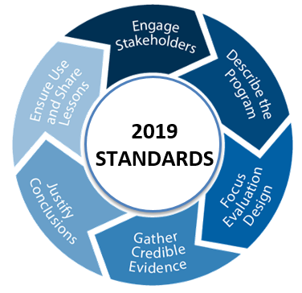
Standard 7 Matching Communications with Mission
Standard 6 Matching Resources with Mission
Standard 5 Matching Operations with Mission: Student Learning
Standard 4 Matching Operations with Mission: Serving Students
Standard 3 Matching Operations with Mission: Faculty Performance
Visual Roadmap
Standard 2
Matching Governance with Mission
Standard 1
Managing the Program Strategically

Slide 6
Start Here

Slide 7
Glossary | Program Evaluation, Direct Measure, & Indirect Measure
Defined as:
Program Evaluation is “the systematic collection of information about activities, characteristics, and outcomes of programs to make judgments about the program, improve program effectiveness, and/or inform decisions about future program development” (Patton, 1997).
Direct Measure is a method of measuring student performance based on a program’s mission and goals that entails the assessment of the skills and knowledge demonstrated in the student work and deliverables, including, but not limited to, pre- and post-test of skills or knowledge, standardized exams, portfolio and capstone evaluations. Course grades are not direct measures.
Indirect Measure is a method of measuring student performance based on a program’s mission and goals that entails perceptions, opinions or thoughts regarding student skills and knowledge by various stakeholders, such as through student surveys and self-assessments, student focus groups, alumni surveys and employer surveys.

Slide 8
Standard 1 | Manage the Program Strategically
1.1 Mission Statement: The program will have a statement of mission that guides performance expectations and their evaluation, including • its purpose and public service values, given the program’s particular emphasis on public service • the population of students, employers, and professionals the program intends to serve, and • the contributions it intends to produce to advance the knowledge, research, and practice of public service.
1.2 Performance Expectations: The Program will establish observable program goals, objectives and outcomes, including expectations for student learning, consistent with its mission.
1.3 Program Evaluation: The Program will collect, apply and report information about its performance and its operations to guide the evolution of the Program’s mission and the Program’s design and continuous improvement with respect to standards two through seven.
Notes:
1.1.2: Describe the processes used to develop and review the mission statement, how the mission statement influences goal-setting and decision making, and how and to whom the program disseminates its mission.
1.2.1: Identify primary mission-based program goals, explicitly declare, operationally define, and justify program performance expectations stated in, or implied by, its mission and its mission-defined goals and objectives. Describe how program goals and objectives align with the mission and public service values in Standard 1. Include a logic model (Inputs, Activities, Outputs, and Outcomes [Achievement of Mission-based Program Goals]) as a visual tool to illustrate how what is being measured contributes to an evaluation of programmatic outcomes and how achievement of these outcomes delivers on promises made in mission statement. Logic model uploaded into Self-Study Appendices page.

Slide 9
Standard 1 | Basis of Judgment
Standard 1.1
The Program’s mission fits with its degree title (i.e., MPA, MPP, MNM, etc.)
The mission statement reflects values of public service.
The Program’s mission is developed and consistently reviewed, with input from program stakeholders.
Standard 1.2
The mission statement endorsed by the Program guides its activities.
The Program has developed cleared goals and objectives that are linked to its mission and public service values, and have measurable outcomes.
Program goals extend beyond goals specific to student learning.
Standard 1.3
The Program’s mission and activities bear a clear and compelling relationship to a well-defined community of professionals outside of the University.
The Program’s defined performance goals, measures of outcomes and programmatic improvements align with its mission and allow for systemic program self-evaluation and strategic management of its resources.
The mission and its related goals and objectives help the program’s decision-makers, students, and stakeholders and other constituents understand the program and its operations.

Slide 10
Standard 5| Universal Required Competencies
5.1 Universal Required Competencies: As the basis for its curriculum, the program will adopt a set of required competencies determined by its mission and public service values. The required competencies will include five domains: the ability
To lead and manage in the public interest;
To participate in, and contribute to, the policy process;
To analyze, synthesize, think critically, solve problems and make evidence-informed decisions in a complex and dynamic environment;
To articulate, apply, and advance a public service perspective;
To communicate and interact productively and in culturally responsive ways with a diverse and changing workforce and society at large.
5.2 Mission-Specific Required Competencies: The Program will identify core competencies in other domains necessary and appropriate to implement its mission.
5.3 Mission-Specific Elective Competencies: The Program will define its objectives and competencies for optional concentrations and specializations.
Notes:
1.1.2: Describe the processes used to develop and review the mission statement, how the mission statement influences goal-setting and decision making, and how and to whom the program disseminates its mission.
1.2.1: Identify primary mission-based program goals, explicitly declare, operationally define, and justify program performance expectations stated in, or implied by, its mission and its mission-defined goals and objectives. Describe how program goals and objectives align with the mission and public service values in Standard 1. Include a logic model (Inputs, Activities, Outputs, and Outcomes [Achievement of Mission-based Program Goals]) as a visual tool to illustrate how what is being measured contributes to an evaluation of programmatic outcomes and how achievement of these outcomes delivers on promises made in mission statement. Logic model uploaded into Self-Study Appendices page.

Slide 11
Standard 5 | Basis of Judgment
Standard 5.1
Programs give all students an opportunity to develop knowledge and skills on each of the five universal required competencies, and are linked to the program mission.
For each universal required competency, at least one student learning outcome is established, program must identify its outcome measures – where, what, and how – to include specifying how the analysis of the resulting data has led to programmatic improvement.
Aligned with the program’s mission, goals, and structure, the student learning assessment process should detail direct and indirect measures, the use of rubric of evaluation, faculty and stakeholder involvement, analysis procedures, and how the analysis is used for overall program improvement.

Slide 12
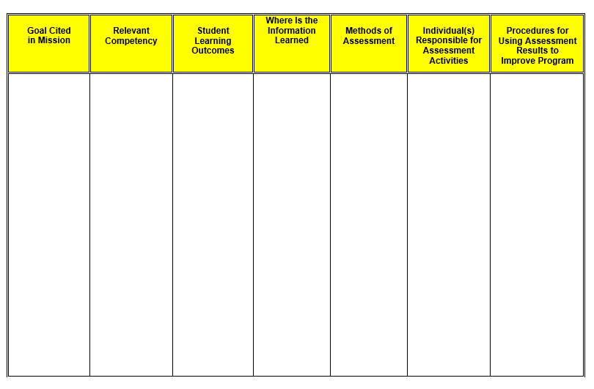
Template| Assessment Plan

Slide 13
Mission Statement | Review Process Adoption, Modification and Review
Students
Graduates
Faculty
Employers
Practitioners
Members of Society
Advisory Council
Internship Supervisors
University Stakeholders

Slide 14
Diversity | Planning and Strategies
Vision & Mission of the Institution
Program
Public Service Values
Strategic Alignment of Diversity, Equity, and Inclusion Initiatives

Slide 15
Diversity, Equity & Inclusion Accreditation Standards
Standard 3.2 Faculty Diversity: The program will promote equity, diversity and a climate of inclusiveness through its recruitment, retention, and support of faculty members;
Standard 4.4 Student Diversity: The program will promote diversity and a climate of inclusiveness through its recruitment and admissions practices, retention efforts and student support services; and
Standard 5.1 Universal Required Competencies: To communicate and interact productively and in culturally responsive ways with a diverse and changing workforce and society at large.

Slide 16
Diversity, Equity & Inclusion| Basis of Judgment
Strategy: Diversity, equity and inclusion activities provide a framework for program evaluation. • Specific goals, steps, and strategies demonstrate evidence of good practice in recruitment, retention, and support of students consistent with its mission and context.
Initiative: Program demonstrates that it appreciates diversity, equity, and inclusion, broadly defined in the context of the program and its mission, as critical in today’s workplaces and professional environments. • Program takes steps to acknowledge and eliminate biases and program cultures that impact faculty recruitment, retention and development. • Program’s recruitment activities reflect a consideration of diversity (with respect to its mission), through its selection of media, audience, and resourcing; and in the eventual composition of its entering students. • Program provides a supportive and inclusive educational climate for a diverse student population.
Evaluation of Effort: Diversity of full- and part-time faculty, research interests of the faculty, curricular continent and other measures of performance to include program data on recruitment and retention demonstrate adherence to the program’s diversity, equity, and inclusion strategies. • Program’s data on recruitment and retention demonstrate adherence to the program’s diversity, equity and inclusion strategies. • Evidence can be found in the diversity of the student body, curricular content, as well as other measures.

Slide 17
Diversity, Equity & Inclusion Plan Curricular and Co-curricular Commitments
Description of Department
Describe academic degree programs in the department as well as the mission of the program
Identify academically and professionally qualified program faculty as well as resources that support curricular and co-curricular revisions
Specify activities, programs, and learning experiences that complement universal required competencies supporting diversity, equity and inclusion as a measureable outcomes
Diversity Curricular and Co-curricular Commitments
Evidence found in the diversity of the faculty, research interests of the faculty, curricular content and program’s outcomes which measure strategic performance in diversity, equity and inclusion.
Program demonstrates efforts that strengthen diversity, equity and a climate of inclusiveness through recruitment and retention initiatives, faculty support, and professional development.
Program should implement inclusive practices to eliminate barriers and reduce bias that fully engage faculty in its mission.

Slide 18
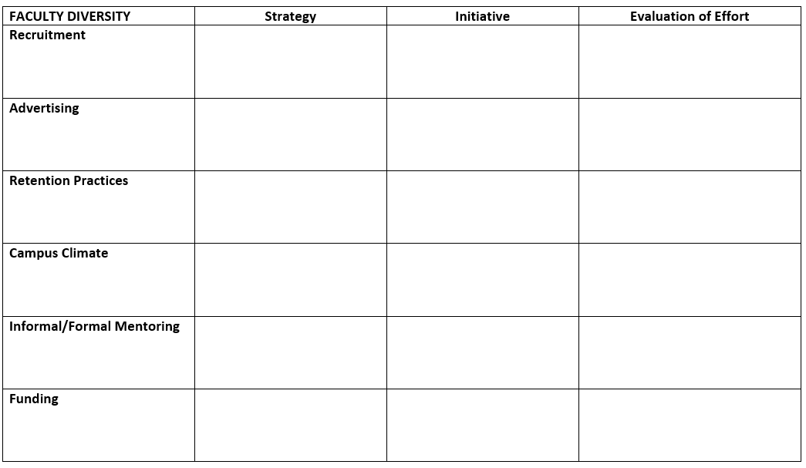
Standard 3 |Faculty Diversity
Standard 3.2 The Program will promote equity, diversity and a climate of inclusiveness through its recruitment and retention, and support of faculty members. What is your faculty diversity goal? What strategy do you employ? How do you evaluate your initiatives with documentation and evidence?

Slide 19
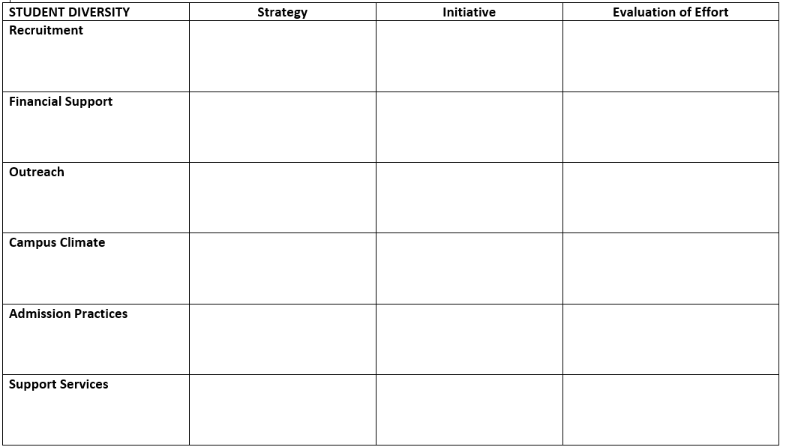
Standard 4 | Student Diversity
Standard 4.4 The program will promote diversity and a climate of inclusiveness through its recruitment, admissions practices and student support services. What is your student diversity goal? What strategy do you employ? How do you evaluate your initiatives with documentation and evidence?

Slide 20
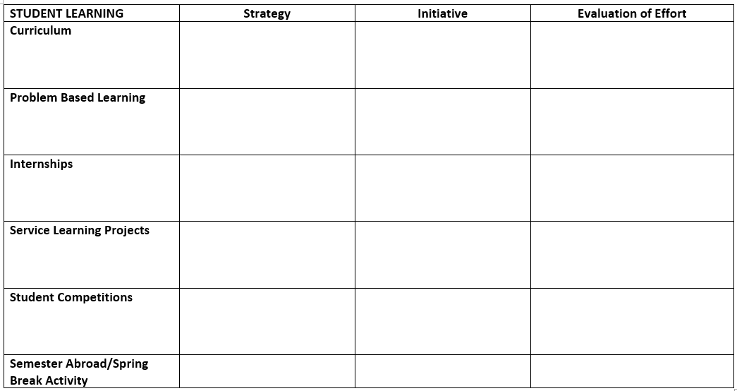
Standard 5 | Student Learning
Standard 5.1 The graduate program will prepare students to communicate and interact productively and in culturally responsive ways with a diverse and changing workforce and society at large. What strategy (approach) do you use to prepare students for a diverse and changing workforce? What initiatives (specific changes) do you employ to reach your student learning goal for diversity? How do you evaluate your strategic approach and specific changes with documentation and evidence?
Notes:
Assign Breakout Rooms for Faculty Diversity, Student Diversity and Student Learning. Have facilitators monitor activity in breakrooms, ask for volunteer to report back.

Slide 21
Before you leave …
Are your program goals consistent with the mission of your program?
Do your goals align with public sector values and the vision for your program?
In order to reach your goals and objectives, have you thought about how long it would take and what resources your program needs?
Do your goals describe desired performance? In other words, are they SMART goals (Specific, Measurable, Attainable, Realistic and Timely)?

Slide 22
Peer Examples | Diversity Plans
Doha Institute for Graduate Studies
Georgia State University
John Jay College of Criminal Justice – CUNY
North Carolina State University
Syracuse University
University of Colorado, Denver
University of Connecticut
University of Minnesota
University of Washington
Victoria University of Wellington
Villanova University
Virginia Commonwealth University
Source: NASPAA Peer Examples Assessment Plans, https://www.naspaa.org/accreditation/standards-and-guidance/peer-examples

Slide 23
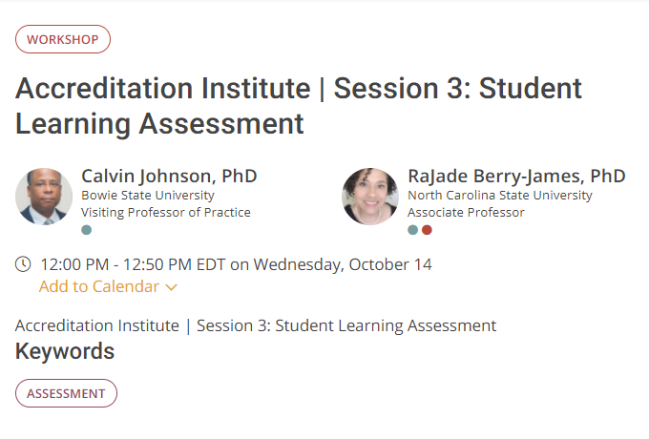
Thank You! Join Us for Session 3
Session 3 Student Learning Assessment Details at https://naspaa2020.pathable.co/meetings/virtual/2njYRf9GNSQGz8hbF

