Slide 1


2026 Admissions Survey Dialogue and Discussion: The Current State of Admissions in Public Service Education
Zachary Owen
Accreditation & Data Associate
Hosted by

Slide 2
Admissions Trends in Public Service Education Broadly
Data from NASPAA’s Annual Data Report

Slide 3
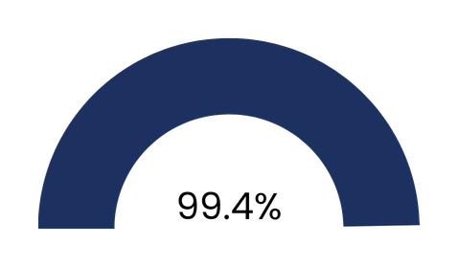
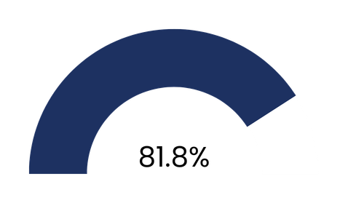
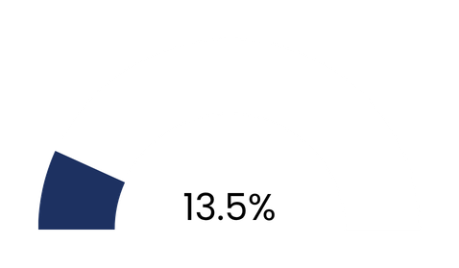
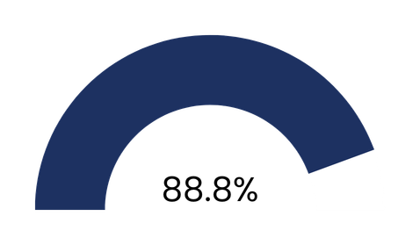
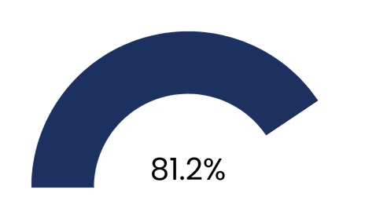

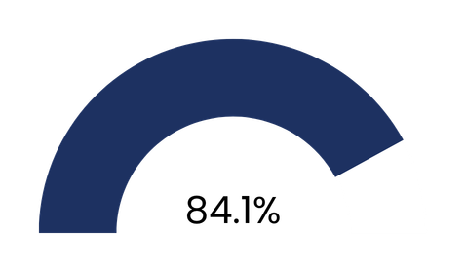
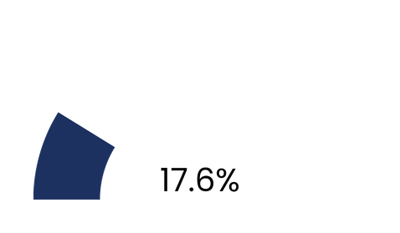
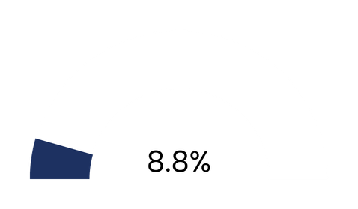
Bachelors Degree
Resume
Writing Sample
Admission Requirements for NASPAA Programs 2024-2025
Statement of Intent
Letter of Recommendation
Interview
GPA
Standardized Test
Professional Experience
170 Programs

Slide 4
Raise your hand if your program requires the GRE for admission.

Slide 5
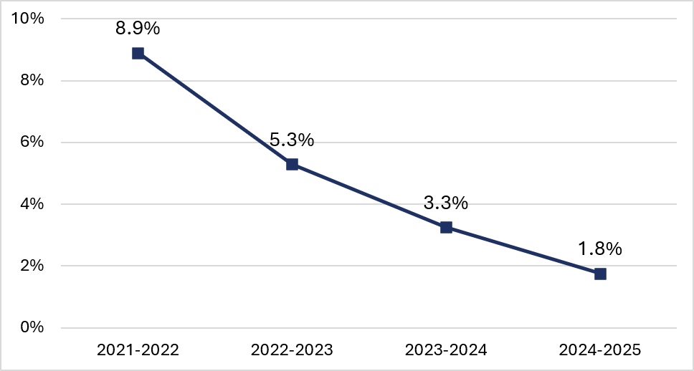
Decline of the GRE Score as an Admissions Requirement for All NASPAA Programs
2024-2025: 170 Programs; 2023-2024: 184 Programs; 2022-2023: 189 Programs; 2021-2022: 191

Slide 6
Raise your hand if your program requires an application fee.
Keep your hand raised if the application fee exceeds...

Slide 7
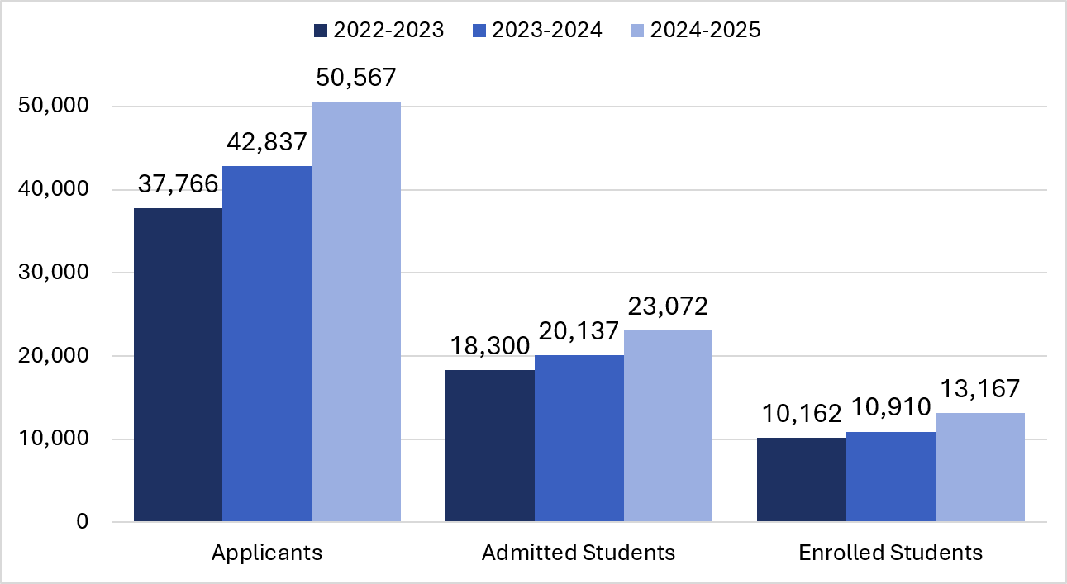
Total Number of Applicants, Admissions, and Enrollments for All NASPAA Programs
2024-2025: 243 Programs; 2023-2024: 217 Programs; 2022-2023: 218 Programs

Slide 8
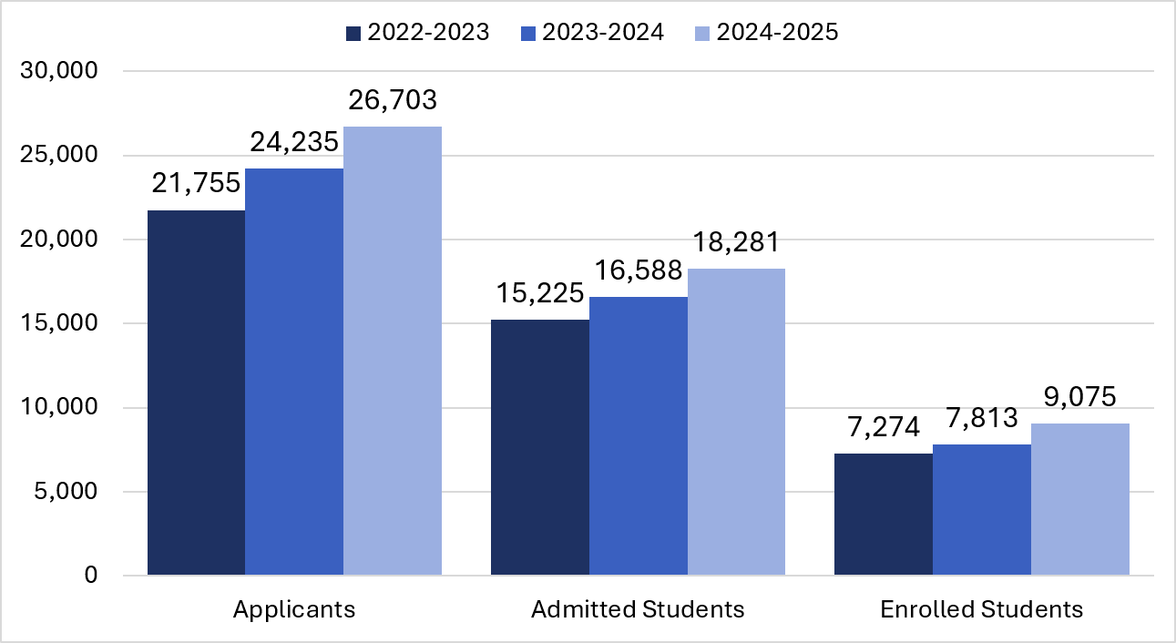
Total Number of Applicants, Admissions, and Enrollments for US-based NASPAA Programs
2024-2025: 212 Programs; 2023-2024: 192 Programs; 2022-2023: 196 Programs

Slide 9
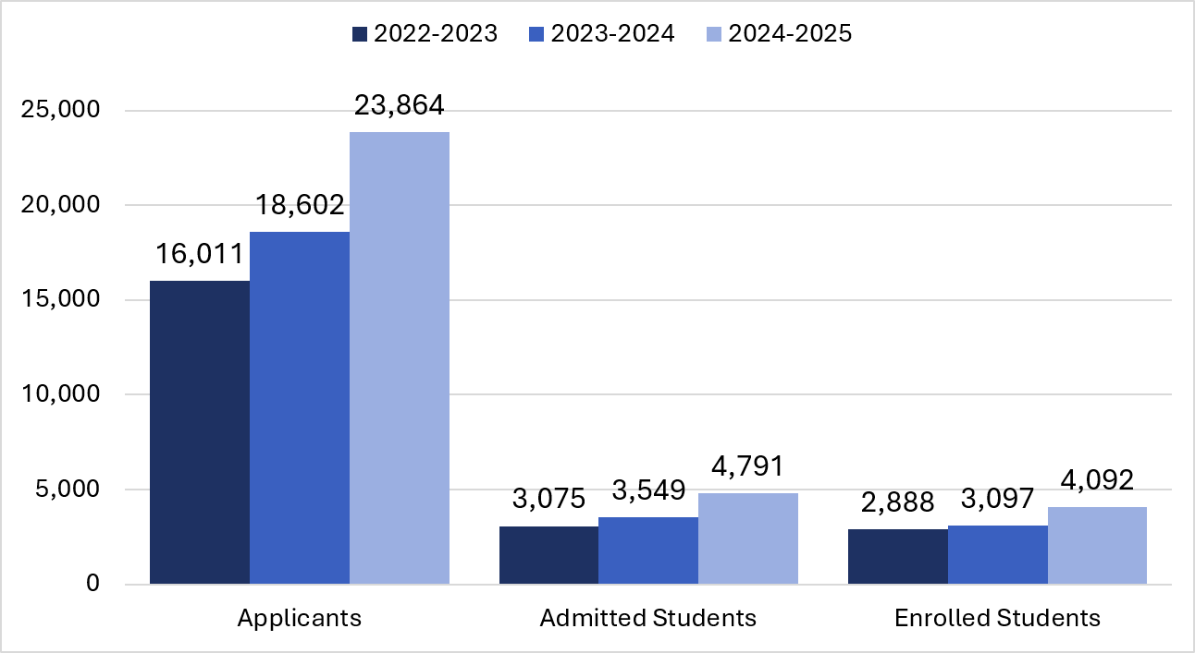
Total Number of Applicants, Admissions, and Enrollments for Non-US-based NASPAA Programs
2024-2025: 31 Programs; 2023-2024: 25 Programs; 2022-2023: 22 Program

Slide 10
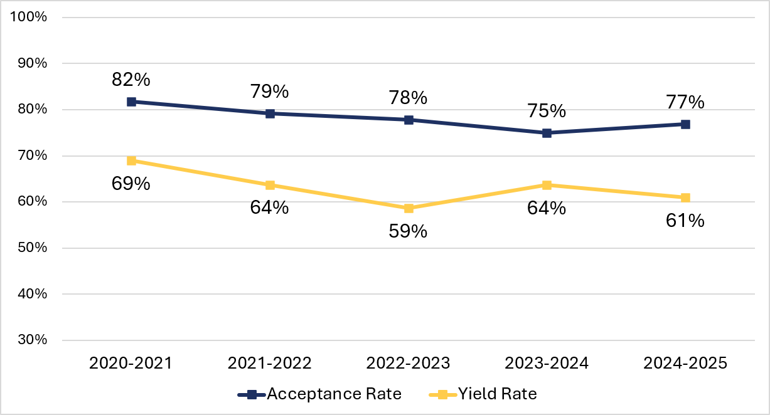
Median Acceptance & Yield Rates for All NASPAA Programs
2024-2025: 243 Programs; 2023-2024: 217 Programs; 2022-2023: 218 Programs; 2021-2022: 221 Programs; 2020-2021: 209 Programs

Slide 11
2026 NASPAA Admissions Survey Results & Discussion

Slide 12
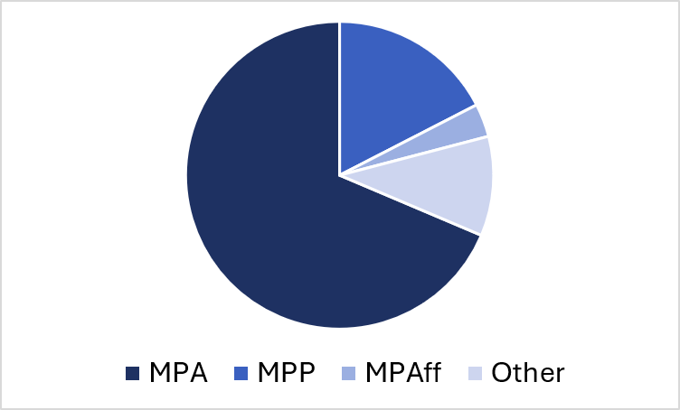
Survey Responses by Degree Title
Master of Public Administration: 59
Master of Public Policy: 15
Master of Public Affairs: 3
Other Degree Titles: 9
86 Program Responses

Slide 13
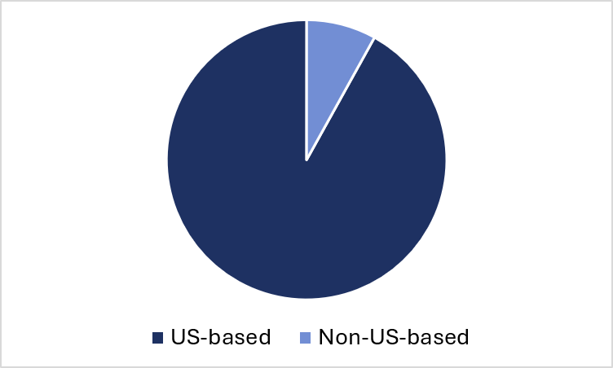
Survey Responses by Program Location
US-based Programs: 80
Non-US-based Programs: 7
Survey Responses by NASPAA Accreditation
Accredited Programs: 66
Non-Accredited Programs: 22
87 Program Responses

Slide 14
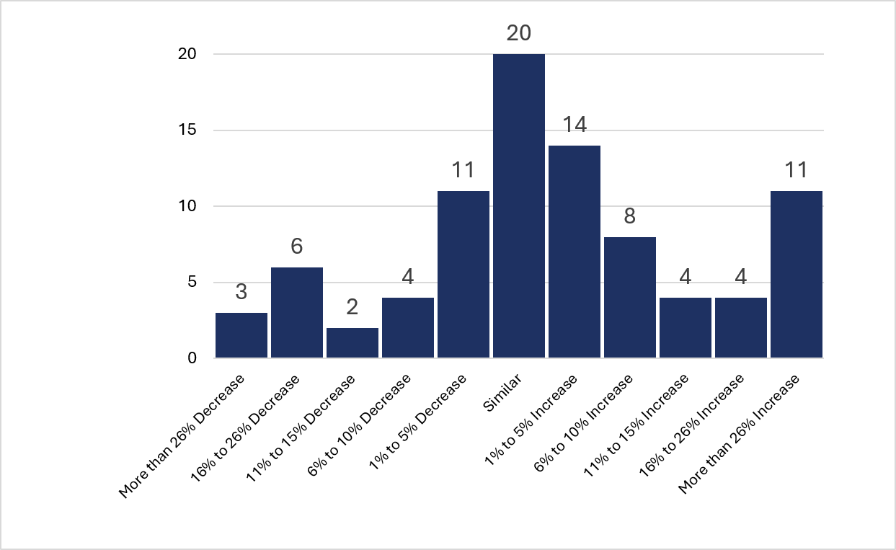
New Student Enrollment Trends | Expected Enrollments for Fall 2026 compared to Enrollments for Fall 2025
87 Program Responses

Slide 15
Raise your hand if your program is offered in more than one modality.
Keep your hand raised if your program is offered in the following modalities...

Slide 16
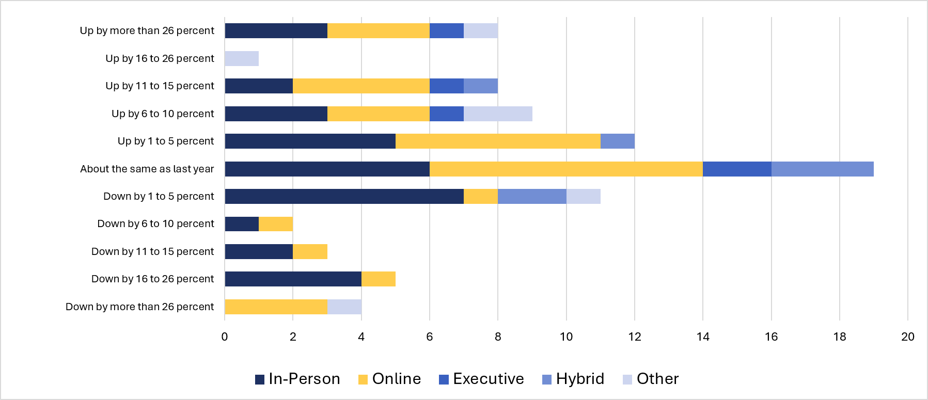
New Student Enrollments by Modality | Expected Enrollments for Fall 2026 compared to Enrollments for Fall 2025
38 Program Responses

Slide 17
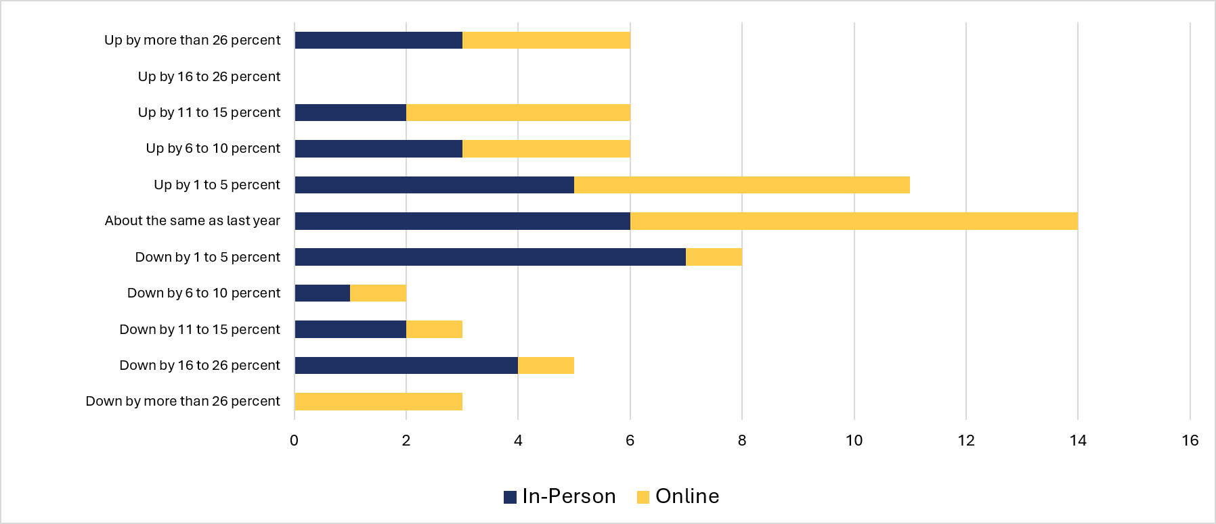
New Student Enrollments (In-Person vs. Online) | Expected Enrollments for Fall 2026 compared to Enrollments for Fall 2025
33 In-Person Responses
31 Online Respones

Slide 18
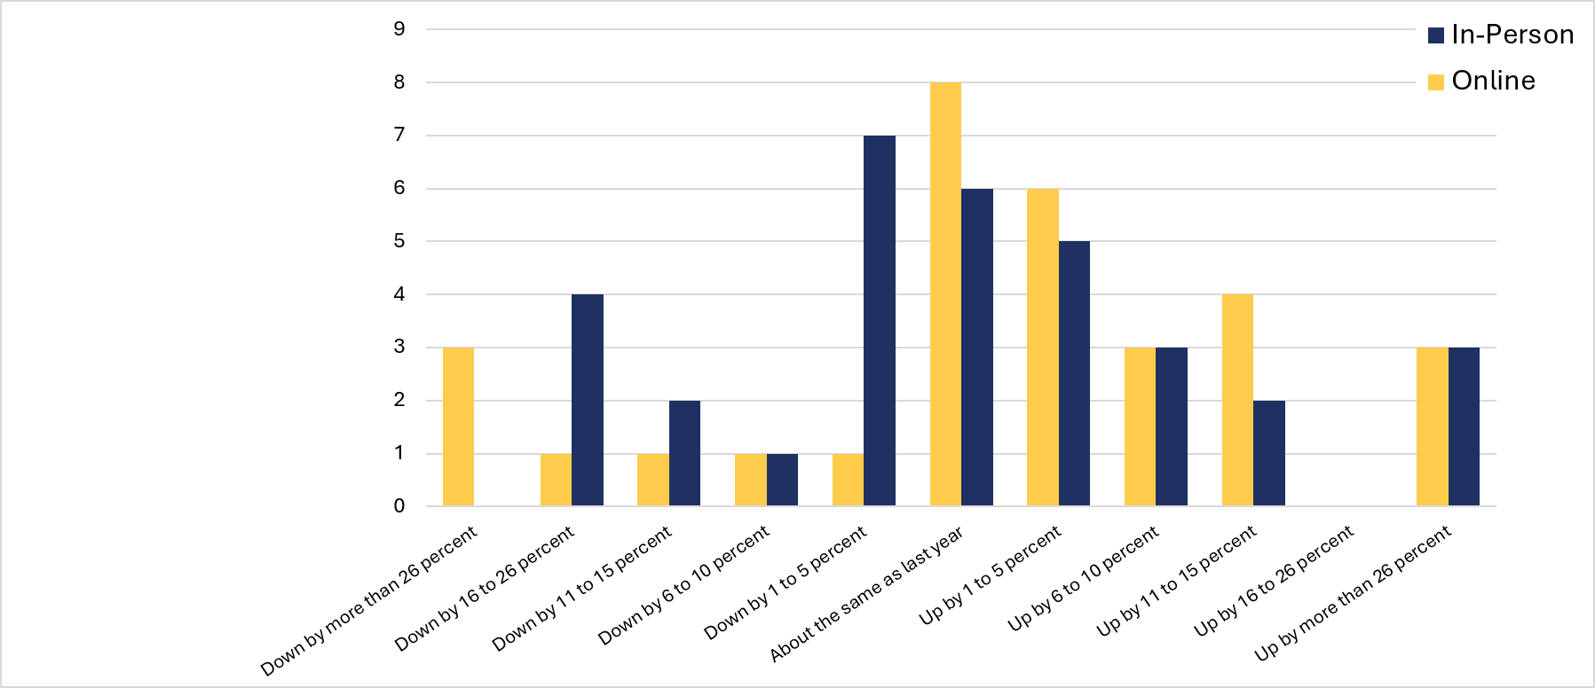
New Student Enrollments (In-Person vs. Online) | Expected Enrollments for Fall 2026 compared to Enrollments for Fall 2025
33 In-Person Responses
31 Online Respones

Slide 19
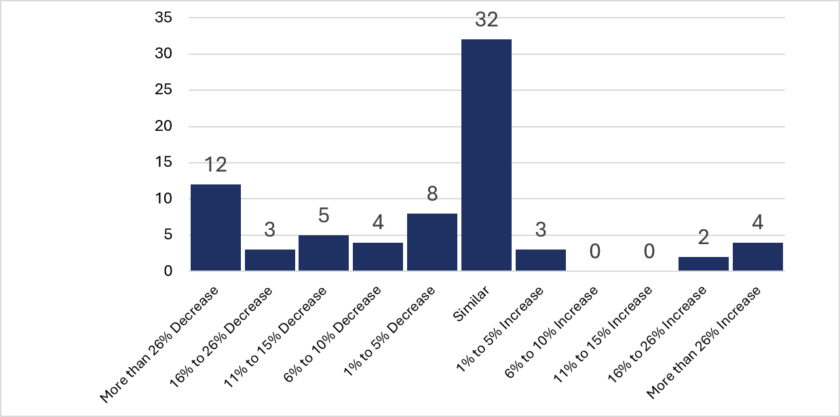
New International Student Enrollment Trends | Expected Enrollments for Fall 2026 compared to Enrollments for Fall 2025
86 Program Responses
13 Programs Did Not Enroll International Students Either Year

Slide 20
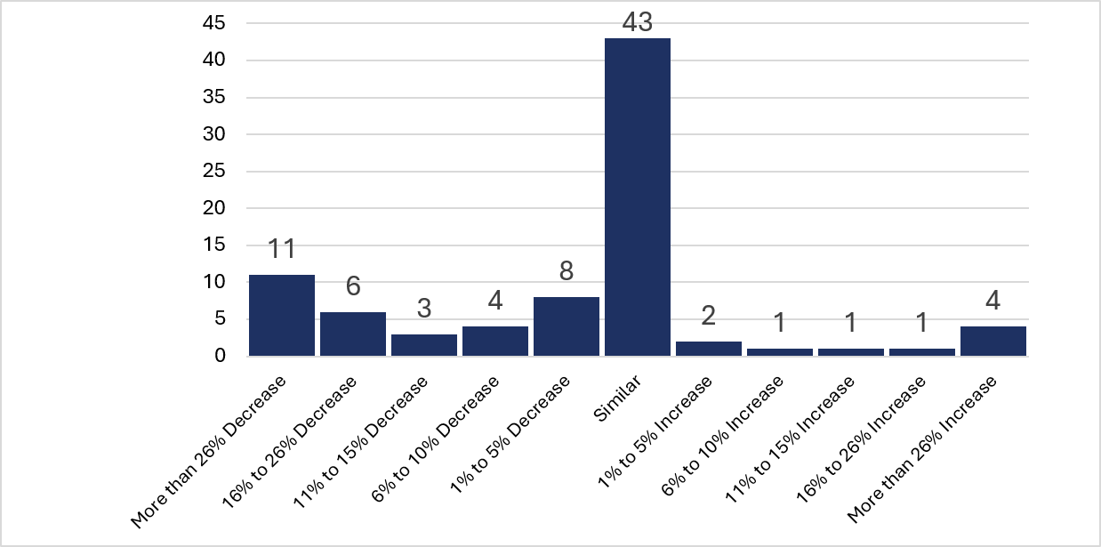
Overall Percentage of International Students in the Program | Expected Percentage for Fall 2026 compared to Percentage for Fall 2025
84 Program Responses

Slide 21
Program Yield Rates | Fall 2025
52.15%
56.50%
Average Yield Rate
Median Yield Rate
72 Program Responses
72 Program Responses
53.54%
57.50%
MPA Average Yield Rate
MPA Median Yield Rate
59 Program Responses
59 Program Responses
45.00%
38.00%
MPP Average Yield Rate
MPP Median Yield Rate
15 Program Responses
72 Program Responses
15 Program Responses

Slide 22
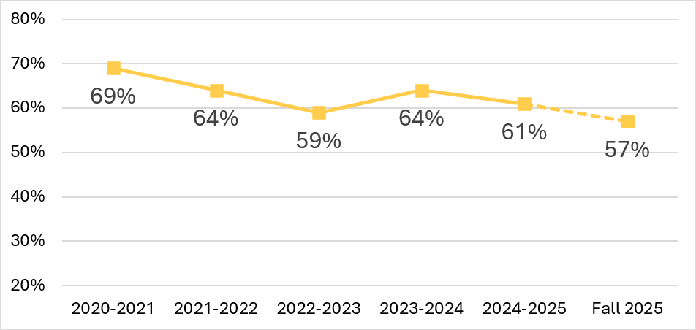
Expected Yield Trends based on 2026 Admissions Survey Data
Fall 2025: 72 Program Responses; 2024-2025: 243 Programs; 2023-2024: 217 Programs; 2022-2023: 218 Programs; 2021-2022: 221 Programs; 2020-2021: 209 Programs | NOTE: Samples are not the same, Fall 2025 is a projection.

Slide 23
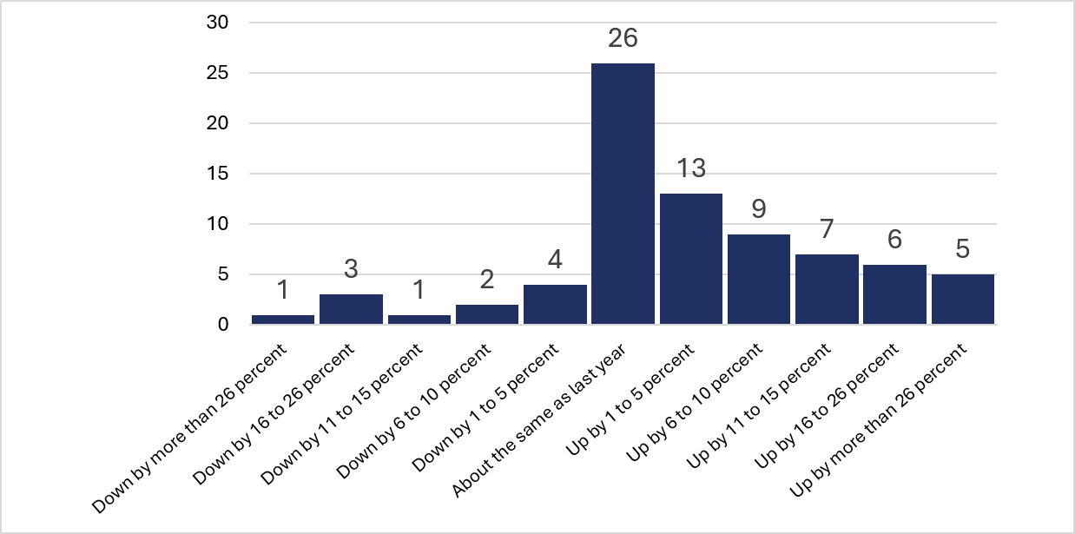
Yield Rate Trends | Fall 2025 compared to Fall 2024
77 Program Responses

Slide 24
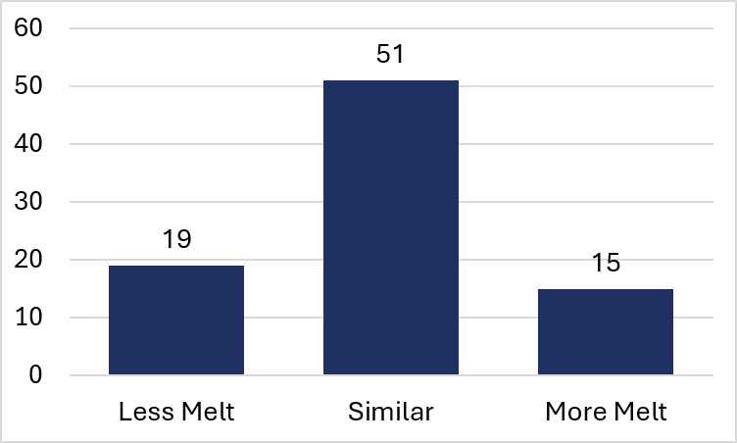
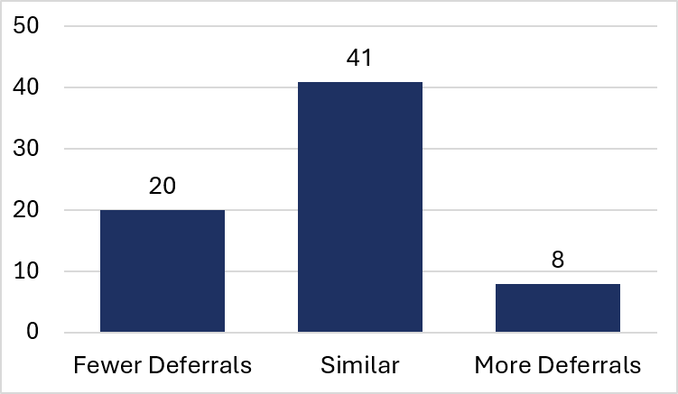
Deferral Trends | Expected Deferrals for Fall 2026 compared to Deferrals for Fall 2025
85 Program Responses | 16 Programs Did Not Offer Deferrals
Melt Trends | Expected Melt for Fall 2026 compared to Melt for Fall 2025
85 Program Responses

Slide 25
Raise your hand if your program’s primary admissions pipeline is...

Slide 26
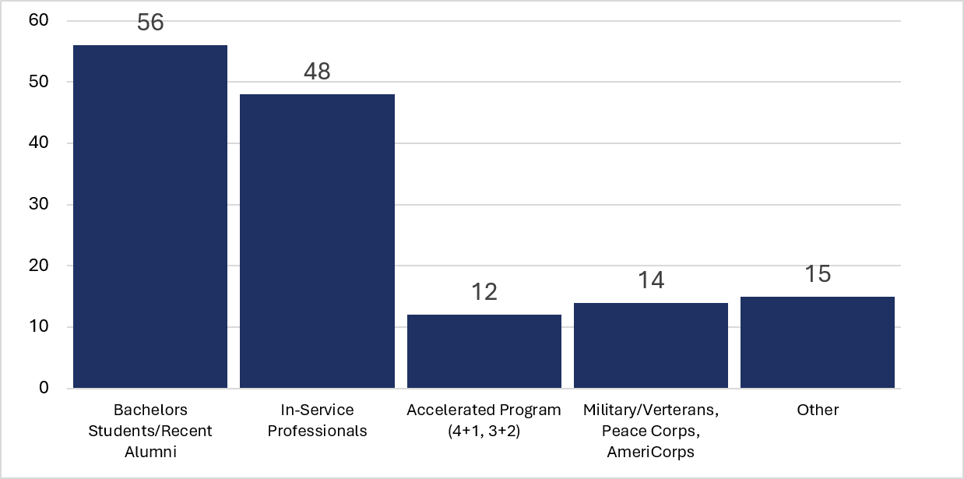
Program Primary Pipelines
74 Program Responses

Slide 27
Anti-Melt Strategies | Common Themes and Unique Ideas
Early and Often: Programs are using a multi-touch approach to keep applicants engaged in the admissions process.
Scholarship and Research Matching: Programs are collecting biographical information from students to match them with appropriate scholarships and faculty. Students then have more personalized funding opportunities, and faculty are able to reach out about research opportunities or class experiences.
Information Sharing: Communications are extremely informative with resources for scheduling an appointment with an advisor, purchasing books from the bookstore, how to register for classes, etc. Some programs have “Save the Date” sections at the beginning of their emails.

Slide 28
Anti-Melt Strategies | Common Themes and Unique Ideas
In-Person Community Building: Programs are hosting happy hours or coffee chats featuring faculty, staff, students, and alumni to showcase the community available within the program.
Showcasing Alumni and Accreditation: Programs are ensuring that their website is up-to-date with a program “Hall of Fame” that features recent alumni. They are also using NASPAA accreditation as a symbol of program quality.
Engagement with Current Undergraduate Students: Programs are hosting curated events for undergraduate student groups, undergraduate courses, simulation exercises, etc.

Slide 29
Anti-Melt Strategies | Common Themes and Unique Ideas
Program Partnerships: Programs are receiving support from outside organizations like Service to Service and CollegeRecon to boost their applicant pool and obtain quality applicants.
Funding Transparency: Programs are being open and honest about funding opportunities within the program. Webinars covering degree financial planning, scholarship opportunities, and the funding process have given students a better understanding of their ability to afford the degree.
Accelerated Programs: 4+1 or 3+2 Programs are becoming much more popular. Often, students receive more funding opportunities for their graduate degree because of their familiarity with faculty/staff.

Slide 30
Thank you!
Any questions?

