Slide 1

2025 NASPAA Admissions Meeting
July 10, 2025
Host: George Mason University

Slide 2
Participation Summary – NASPAA 2025 Admissions & Enrollment Survey
49 NASPAA member schools participated in the 2025 Admissions and Enrollment Survey
70 graduate degree programs completed at least part of the survey
Host: George Mason University

Slide 3
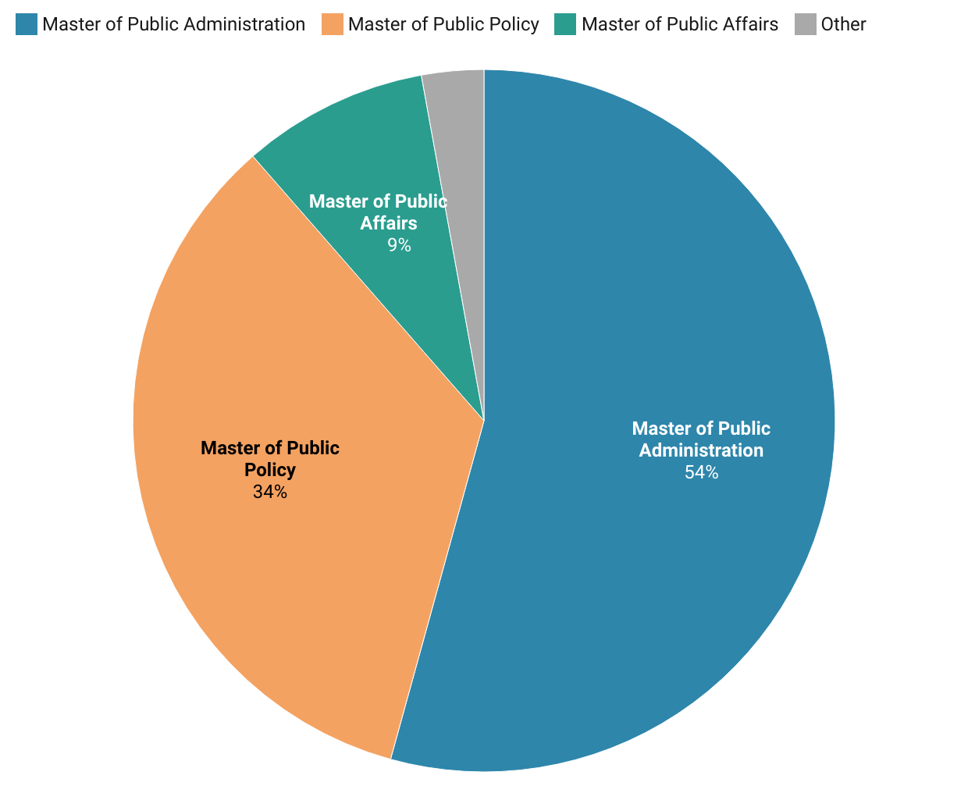
What Type of Graduate Programs Responded? (n=70)
Breakdown of reported programs:
  38 Master of Public Administration (MPA or similar)
  24 Master of Public Policy (MPP or similar)
  6 Master of Public Affairs (MPAff or similar)
  2 Other

Slide 4
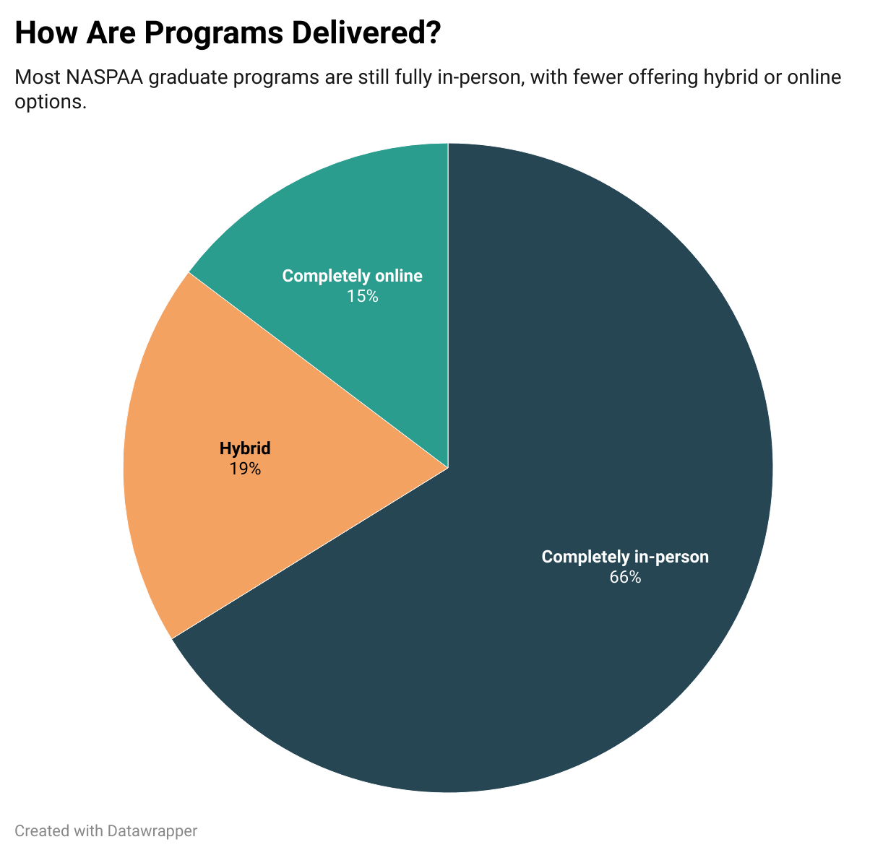
How Are Graduate Programs Delivered?
Out of 68 programs that answered this question:
45 programs (66%) are delivered completely in-person
13 programs (19%) use a hybrid format
10 programs (15%) are completely online

Slide 5
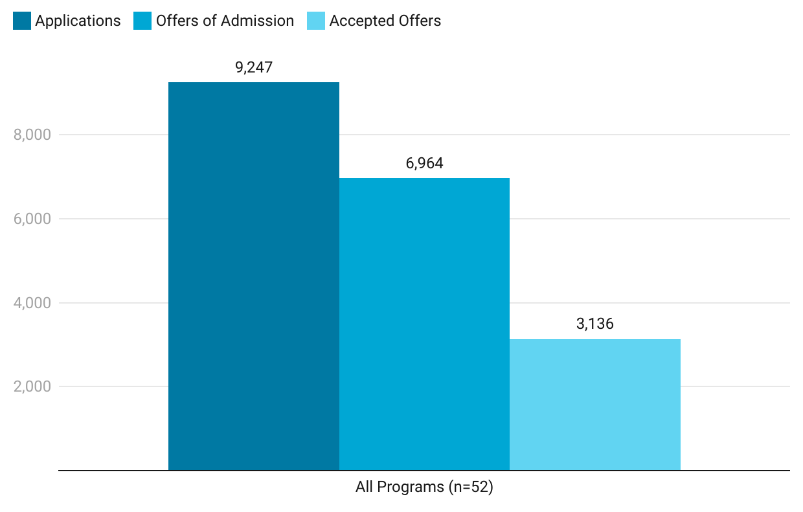
From Applications to Enrollment: Admissions Pipeline
Data from 52 programs
9,247 applications were received across all programs
6,964 offers of admission were made → Acceptance rate: 75%
3,136 students accepted offers → Yield rate: 45%

Slide 6
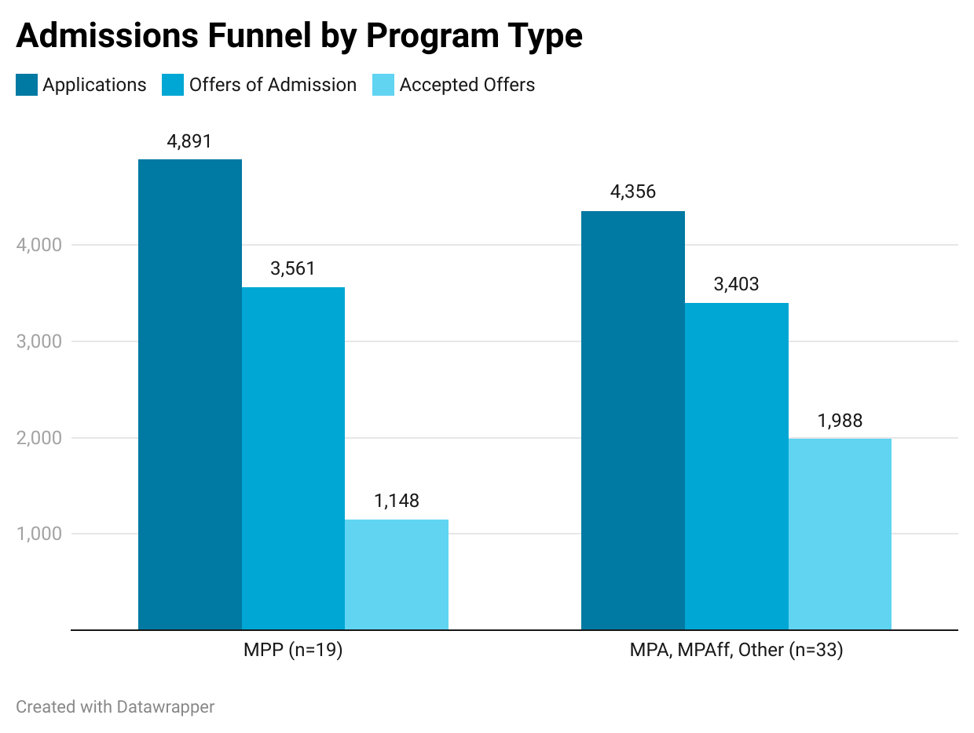
Admissions Funnel by Program Type
MPP programs (n=19)
    4,891 applications
    3,561 offers of admission → Acceptance rate: 73%
    1,148 accepted offers → Yield rate: 32%
MPA, MPAff, Other programs (n=33)
    4,356 applications
    3,403 offers of admission → Acceptance rate: 78%
    1,988 accepted offers → Yield rate: 58%

Slide 7
Acceptance and Yield Rate
MPA, MPAF, and Other:
78% of applicants are offered admission
58% of students accept the offer
MPP:
73% of applicants are offered admission
32% of students accept the offer

Slide 8
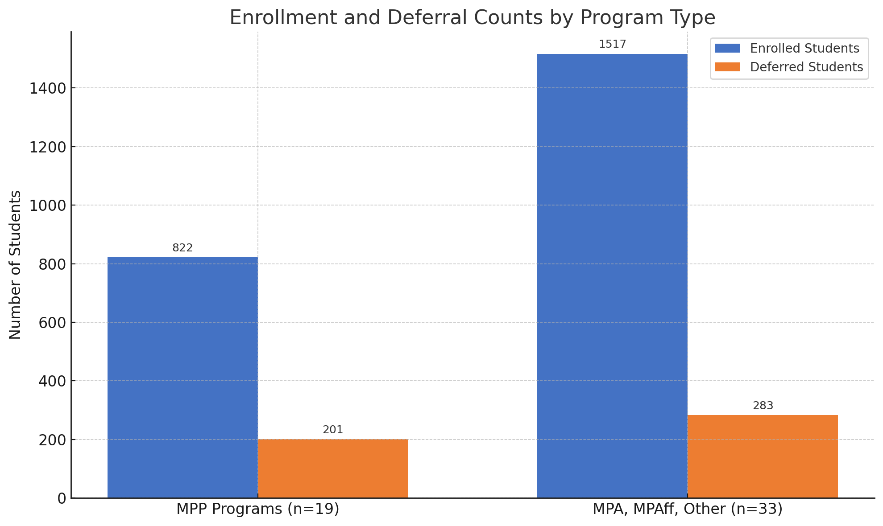
New Enrollments and Deferrals by Program Type
MPP programs (n=19)
    822 students enrolled
    201 students deferred enrollment
MPA, MPAff, Other programs (n=33)
    1,517 students enrolled
    283 students deferred enrollment

Slide 9
Summary Statistics – New Student Enrollment (AY 2024–2025)
All programs:
Minimum: 11 students
Maximum: 139 students
Median: 52 students
Average: 57 students

Slide 10
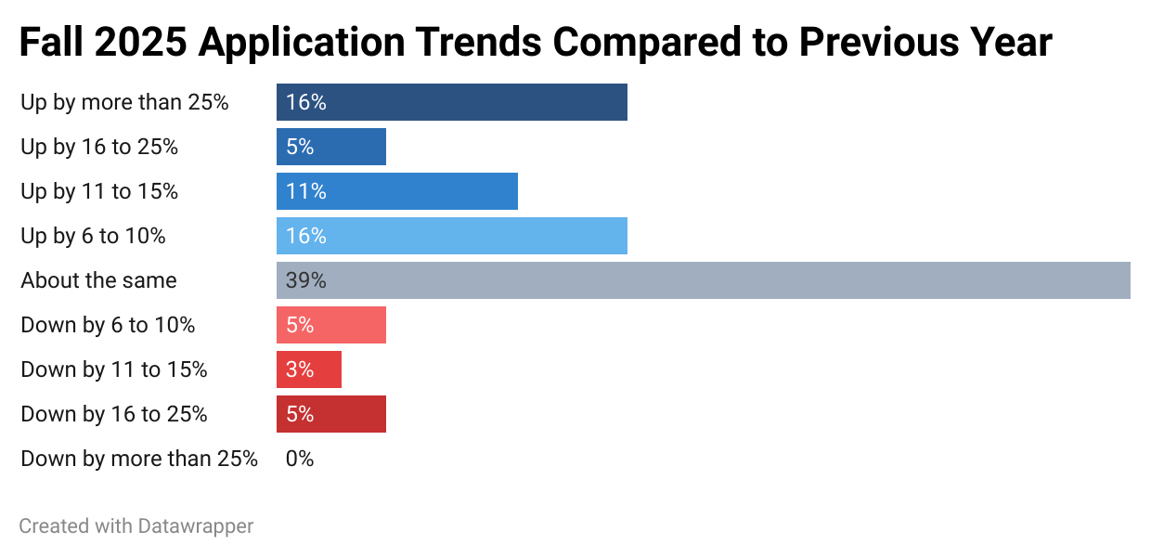
Fall 2025 Application Trends Compared to Previous Year (n=38)
39% of programs (15) reported applications were about the same.
48% of programs (18) saw an increase in applications — including 6 programs reporting a surge above 25%.
Only 13% (5 programs) experienced a decline.

Slide 11
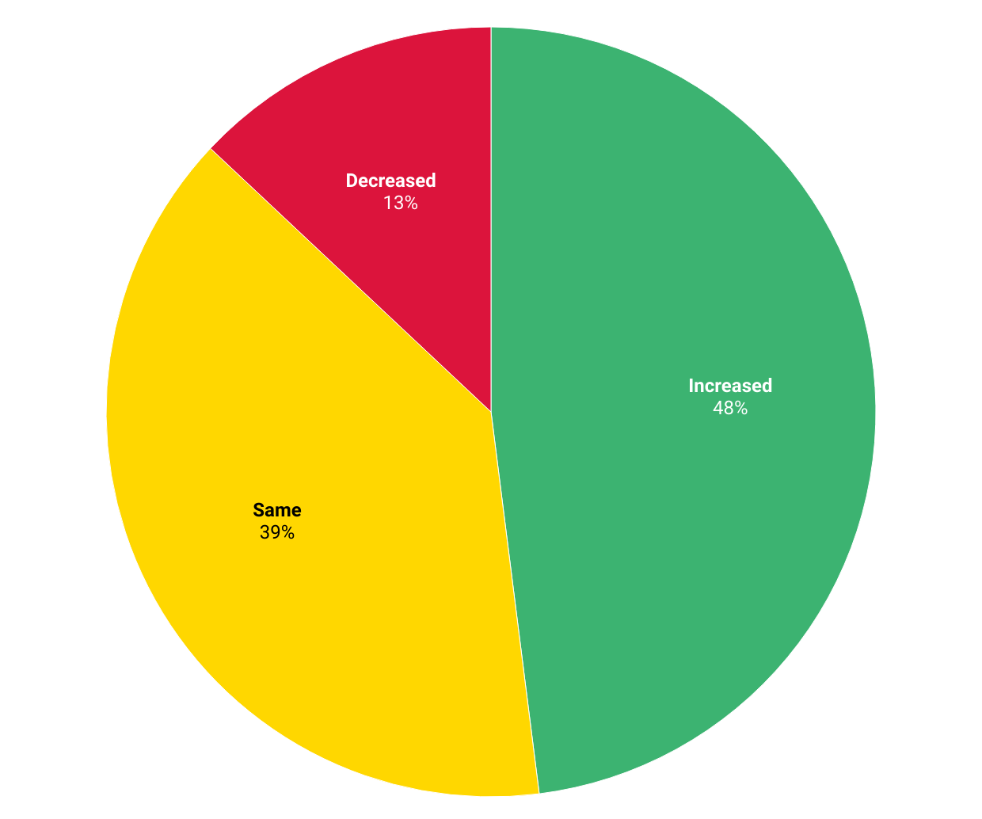
Fall 2025 Application Trends Compared to Previous Year (Grouped)

Slide 12
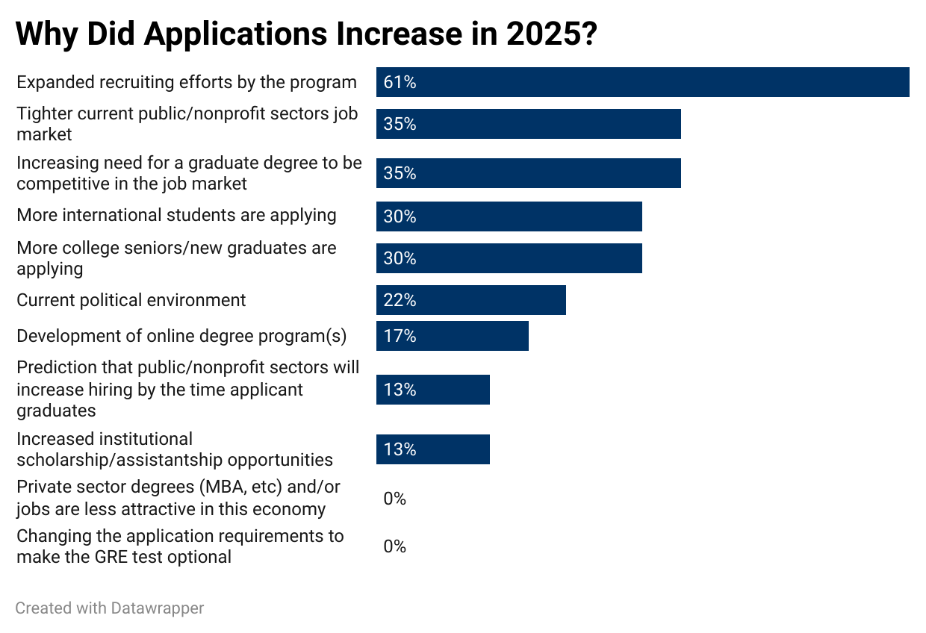
Why Did Applications Increase?

Slide 13
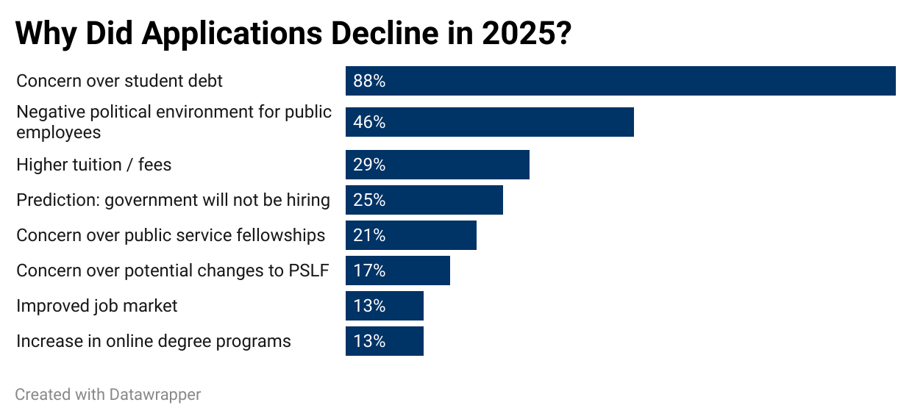
Why Did Applications Decline?

Slide 14
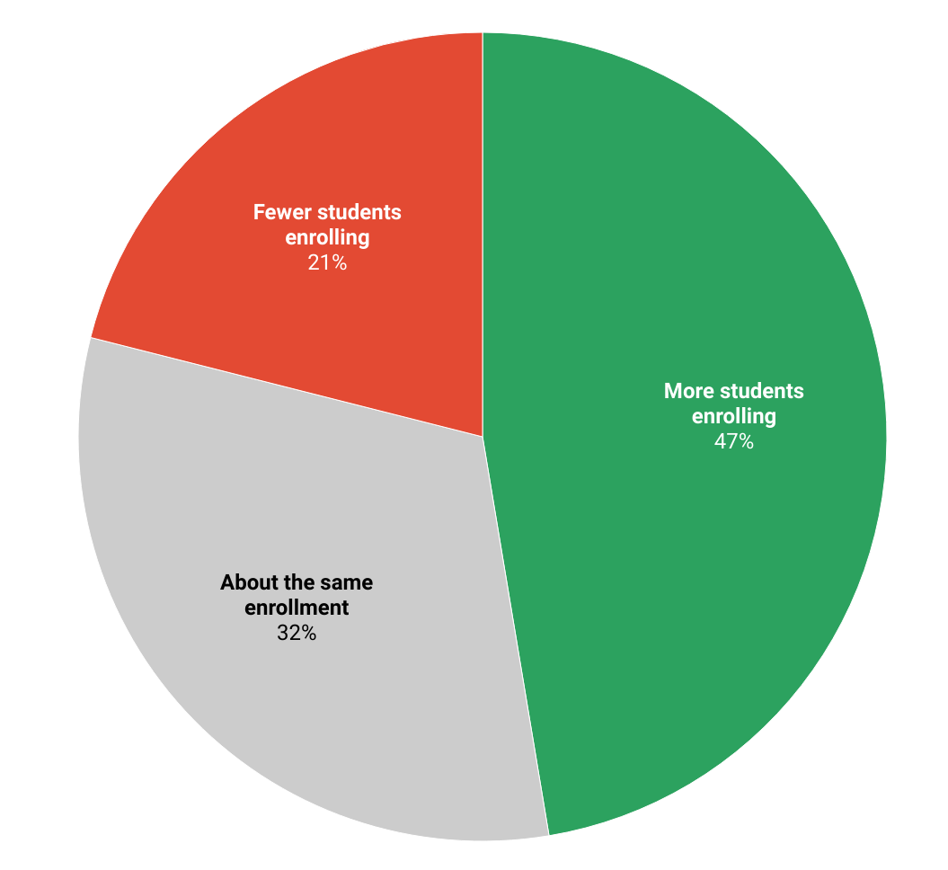
How Do Programs Expect Enrollment to Change in Fall 2025? n = 38 programs
18 programs (47%) expect to enroll more students
12 programs (32%) expect enrollment to stay about the same
8 programs (21%) expect fewer students to enroll

Slide 15
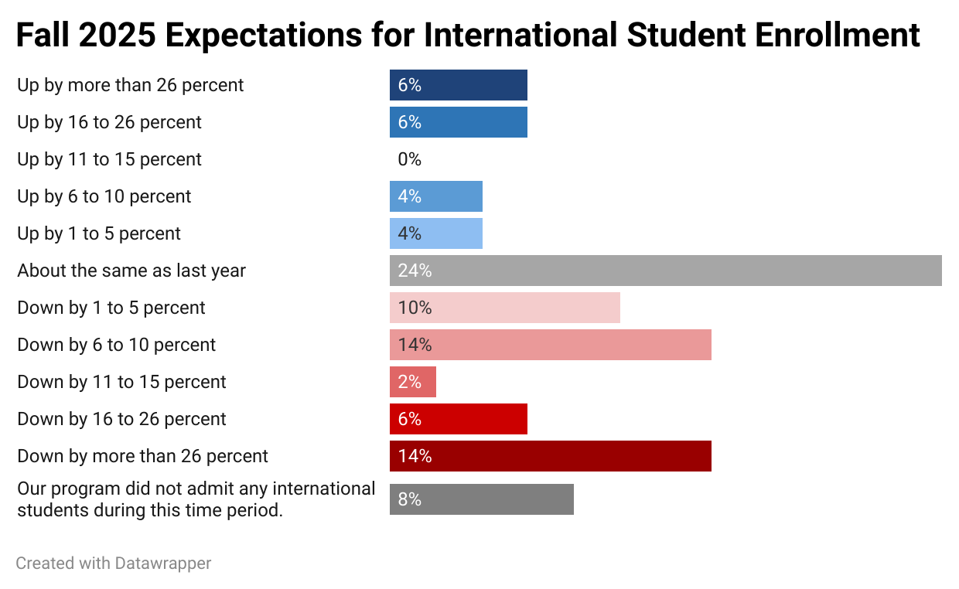
Expected Change in International Enrollment (Fall 2025) n = 49 programs responded
48% of programs expect international enrollment to decrease
24% expect it to remain about the same
20% anticipate an increase, while
8% reported not admitting international students during this time

Slide 16
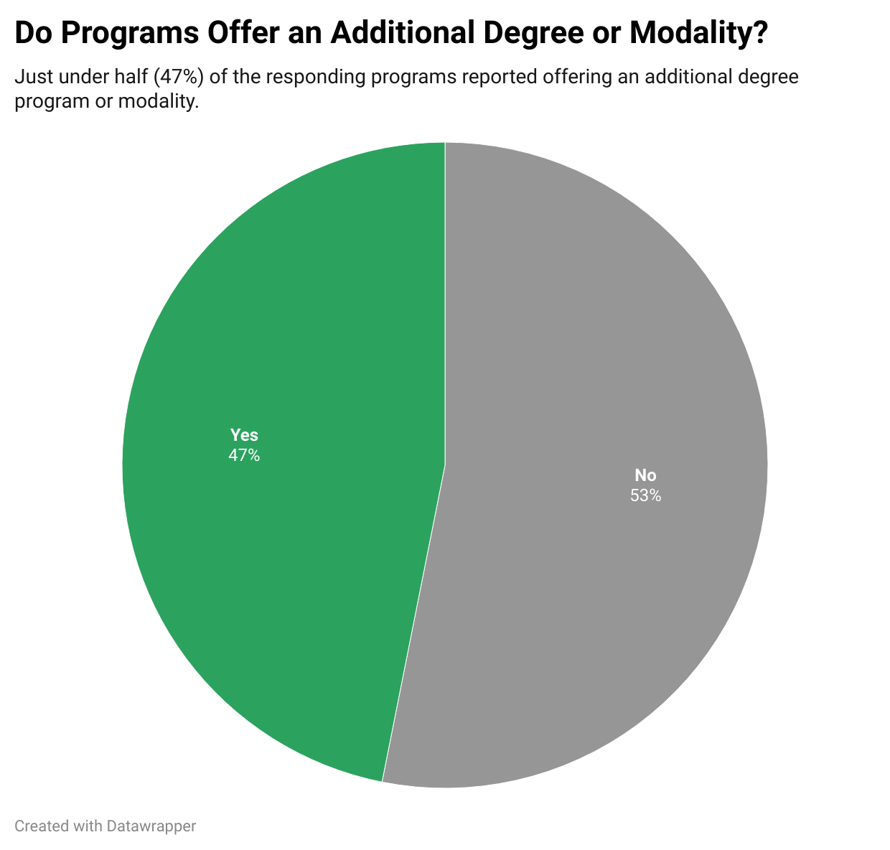
Additional Degree Programs or Modalities (n = 32)
47% of programs (15) reported having an additional program or modality
53% (17 programs) reported no additional offerings
Programs with additional modalities were included in all metrics and charts

Slide 17
Thank you!

