Slide 1

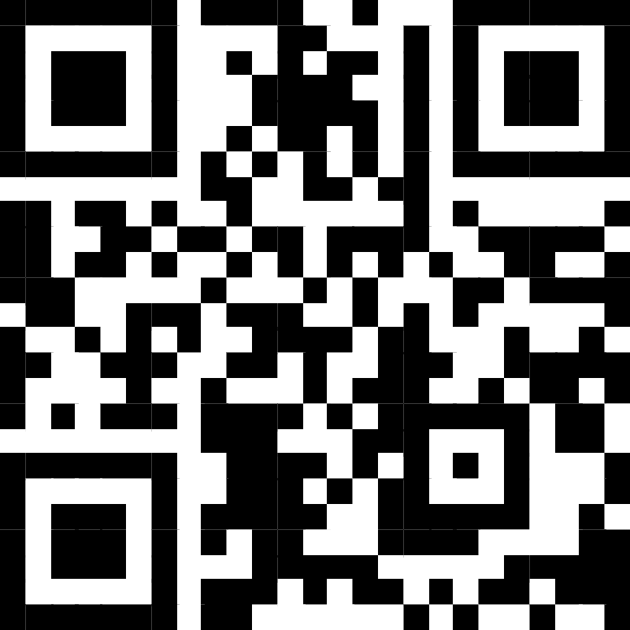
Welcome to the 2025 Accreditation Institute
Agenda & Schedule:
https://tinyurl.com/2s3znp3p
or scan the QR code

Slide 2

Breakfast Discussion
Overview of the Site Visit Process

Slide 3
Site Visit Overview
Site visits are typically held over three days
Visits embrace both evaluative and formative processes
The role of the Site Visit Team
  “Eyes and ears” of COPRA
  Fulfills a reporting function not a decision-making function
Resources
  Site Visit Manual
  COPRA Liaison
  Self-Study
  Interim Report
  Peer Examples
  NASPAA Staff

Slide 4
The Site Visit Team and Their Roles
The team often includes three members:
Chair
Academic (representing accredited programs)
Practitioner
The team could include a fourth member if there are complex modalities or more than one program is under review

Slide 5
The Site Visit Team Typically Meets With:
The program director, program faculty, adjuncts, and others in a program leadership role (e.g., center directors, certificate coordinators)
Program support and admissions staff
Provost, Deans (graduate and college), Department chairs, & the Diversity Officer
Recent graduates, alumni, advisory board members
Students
Employers, internship supervisors, external stakeholders
Student support, job placement, internship support
Meetings requested by COPRA or the SVT

Slide 6
Post-Site Visit Process & Actions
SVT Chair compiles report within one (1) month of the site visit and submits draft through CIVICORE
Program has an opportunity to review for factual errors
SVT Chair finalizes the report and “locks for review” through the CIVICORE site
Program may engage with their COPRA Liaison and/or submit a final written response (by May) that:
  Clarifies or contextualizes SVT findings
  Provides new or updated data
  Reports on progress

Slide 7
Interested in Becoming a Site Visitor?
All site visit training takes place online during the summer
A great way to learn about the process!
If interested in completing the online training, please contact copra@naspaa.org and be on the lookout for communication regarding training opportunities

Slide 8
Welcome to the 2025 Accreditation Institute
Agenda & Schedule:
https://tinyurl.com/2s3znp3p
or scan the QR code

Slide 9

Your Accreditation Institute Facilitator:
Judy Millesen, PhD Dean of Graduate Programs and Strategic Partnerships, Nebraska Wesleyan University
2025-26 COPRA Chair:
Madinah F. Hamidullah, PhD Professor and MPA Program Director, School of Government and International Affairs, Norman J. Radow College of Humanities and Social Sciences, Kennesaw State University
Affiliate Faculty, Department of Public Administration and Policy, Alexander Blewett III School of Law, University of Montana

Slide 10


Breakfast Sponsor
Accreditation Institute
Sponsor

Slide 11


Lunch Sponsors
Accreditation Institute
Sponsor

Slide 12




Break & Beverage Sponsors
Accreditation Institute
Sponsor

Slide 13
Schedule
2025 NASPAA Accreditation Institute
Breakfast and Networking Overview of the Site Visit Process | 8:00-9:00am
Session 1 Value of Accreditation and Peer Review Preconditions and Eligibility Accreditation Process and Timeline | 9:20-10:30am
Session 2 Standard 1: Managing the Program Strategically | 10:45-12:00noon
Lunch | 12:00-1:00pm
Session 3 Standard 2: Matching Governance with the Mission Standard 3: Matching Operations with the Mission: Faculty Performance Standard 4: Matching Operations with the Mission: Serving Students | 1:00-2:30pm
Session 4 Standard 5: Matching Operations with Mission: Student Learning | 2:45-4:15pm
Session 5: Standard 6: Matching Resources with the Mission: Resource Adequacy Standard 7: Matching Communications with the Mission | 4:30-5:00pm
Wrap-Up and Final Thoughts | 5:00-5:30pm

Slide 14
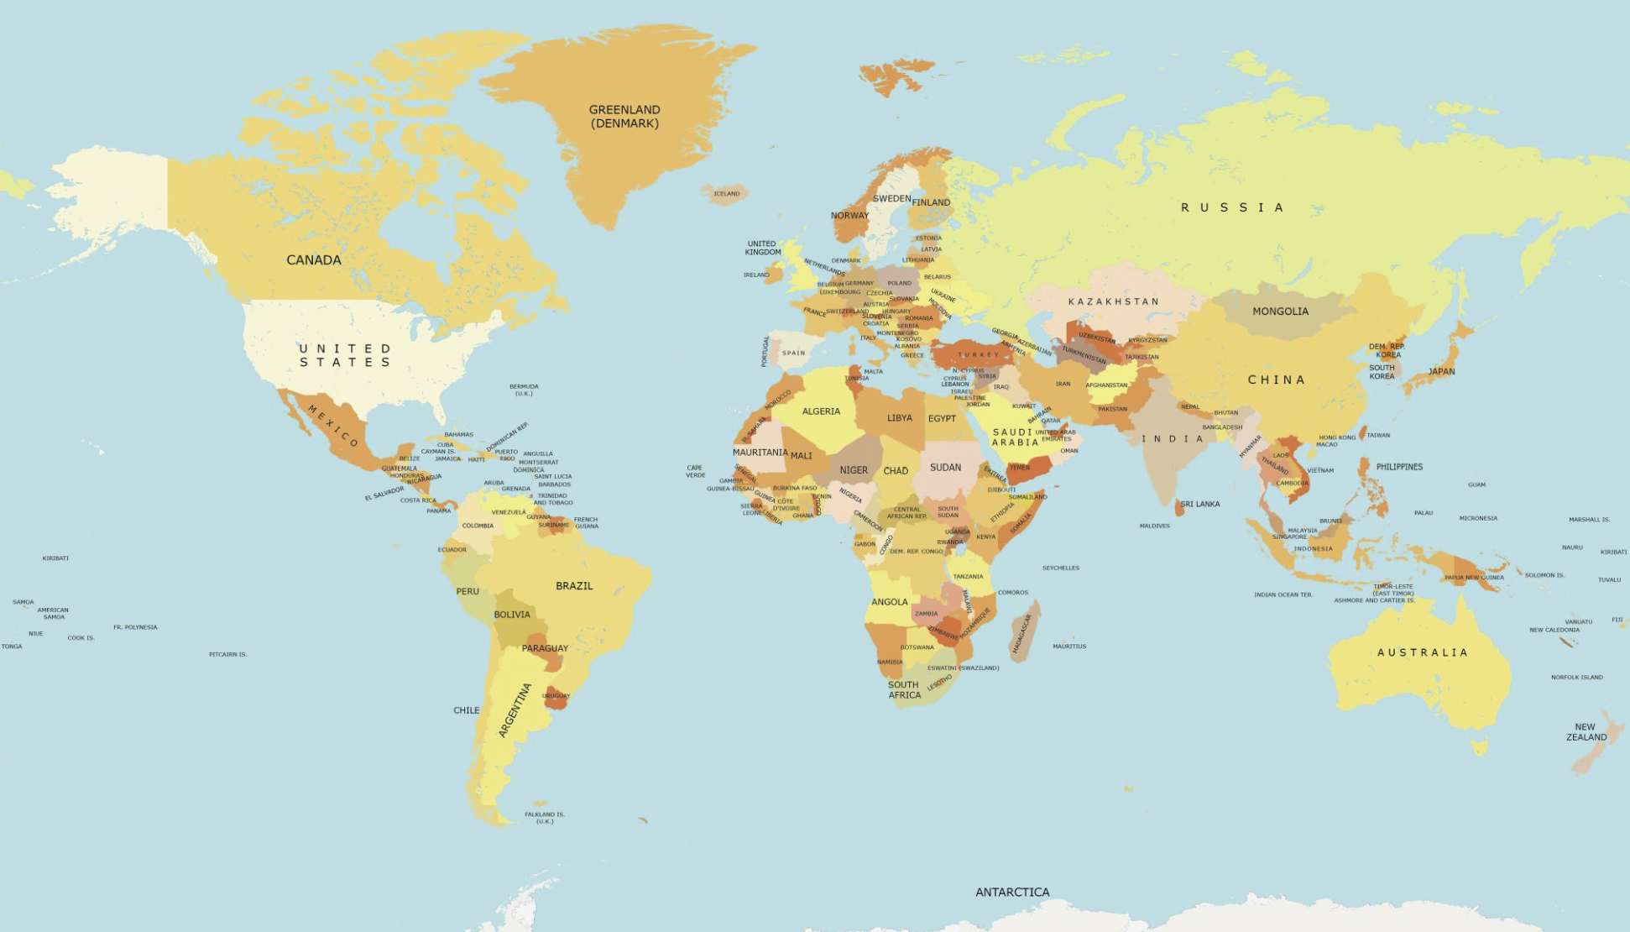

Where is Your Program Located?

Slide 15




Who is here?
Program Director or Principal Representative
Dean or Department Chair
Faculty or Staff
Student

Slide 16




Where are you in the Accreditation Process?
Submitted SSR in August 2025
Currently writing self-study
Seeking first time accreditation
Here to learn more about the process

Slide 17
Session 1
Value of Accreditation and Peer Review
Preconditions and Eligibility
Accreditation Process and Timeline
Agenda & Schedule:
https://tinyurl.com/2s3znp3p
or scan the QR code

Slide 18
Goals for the Session
Provide a broad overview of NASPAA, COPRA, and the role each play in the accreditation process
Review the value of accreditation
Discuss accreditation eligibility, preconditions, and process
Provide an overview of the NASPAA Standards
Share resources that are available for additional assistance

Slide 19
Understanding the Players and their Roles
NASPAA
NASPAA is a Global Network of more than 300 institutional member schools at universities around the world that award degrees in public administration, public policy, public affairs, nonprofit, and related fields. Accredited programs emphasize a commitment to public service values, performance management, and high-quality education
COPRA
The Commission on Peer Review and Accreditation (COPRA) is the Council for Higher Education Accreditation (CHEA)-recognized accreditation body for master's degree programs in public and nonprofit policy, affairs, and administration globally.
COPRA consists of 14 members, 13 of which are academic professionals and one who is a current practitioner.
210
Accredited Programs
11
Countries
196
Schools

Slide 20
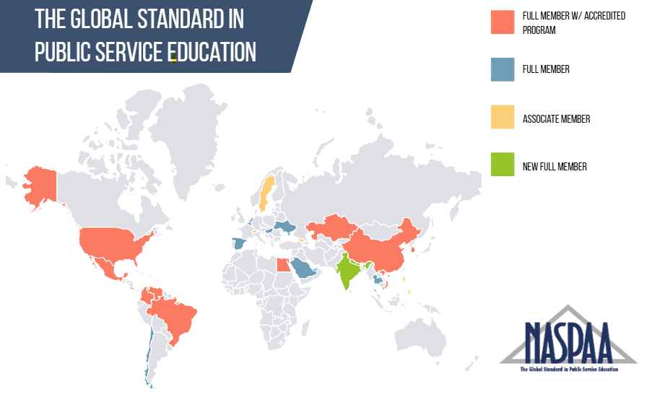
Global Representation of NASPAA Members and Accredited Programs

Slide 21
Benefits of Accreditation
Programs
Visibility to peers
Peer-based formative assessment
Program improvement
Strong student learning outcomes
Students
Quality assurance
Distinction
Employers
Signal of quality and reliability
Expanded partnership opportunities
Institutions
External indicator of quality
Public Service
Expression of program commitment to the field
NASPAA accreditation elevates value of the degree globally

Slide 22
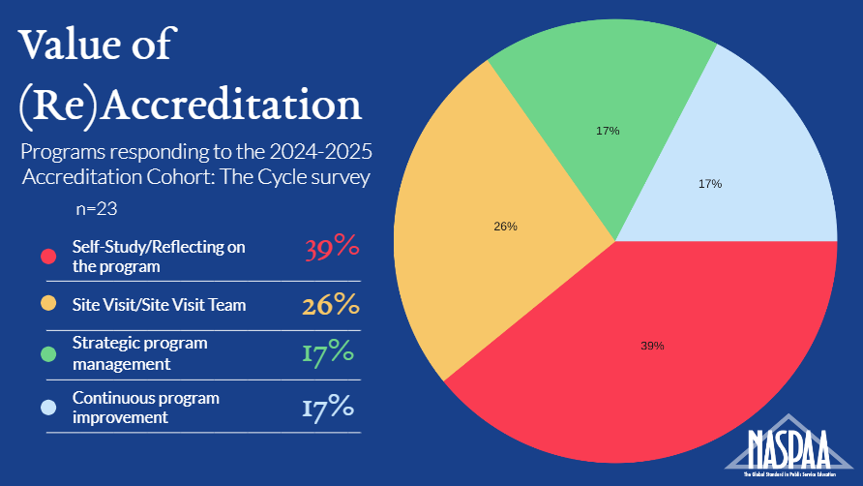
Peer Insights

Slide 23
Steps in the Accreditation Process
Understand and ensure compliance with accreditation Prerequisites/Preconditions
Confirm compliance with institutional membership requirements
Complete the Eligibility Application
Complete the Self-Study
Join an Accreditation Cohort

Slide 24
Preconditions for Accreditation Review
Precondition 1: Program Eligibility
NASPAA member in good standing; offer a Master’s Degree (or comparable post-baccalaureate title) in public affairs/policy/administration; regionally or nationally (or equivalent) accredited; have a nucleus of five qualified faculty; and demonstrate capacity for evaluation
Precondition 2: Public Service Values
Public service values reflected in the mission, governance, and curriculum
Precondition 3: Primary Focus
Students are prepared to be leaders, managers, and analysts in public service
Precondition 4: Course of Study
A curriculum of at least 36 credit hours (or its equivalent) that provides extensive opportunities for student and faculty interaction, collaboration, and to build interpersonal and communication skills

Slide 25
Steps in the Eligibility Process
April 15
May
June
July
Submit Application
Eligibility Committee Review
COPRA Review
COPRA Direction
August 15
September
October
November
Submit Application
Eligibility Committee Review
COPRA Review
COPRA Direction

Slide 26

COPRA Direction:
Outcomes & Recommendations
Do Not Proceed
Program appears to need more than a 3-year horizon
Proceed With Caution
Typically, a 2-3-year time horizon
Proceed to Self-Study
Typically, a 1-2-year time horizon

Slide 27
Is your Program Ready?
Meets preconditions
Collects required data
Engages in strategic program management
  Including an actionable DEI or DEIJA plan
Established process for assessing student learning
  Ongoing evidence of closing the loop for at least three universal competencies
Institutional support for accreditation/reaccreditation
  Preparing the Self-Study Report
  Hosting the Site Visit Team
Capacity to pay accreditation fees

Slide 28
Accreditation Process
Self Study Phase
Accreditation Cohort
Accreditation Decision
Continuous program evaluation and annual reporting
Prepare program data for self-study report Submission – August 15 | COPRA meets – October Interim Report – November Program Response – January Host Site Visit Team – Early Spring | COPRA Accreditation Decisions - June | Annual Maintenance Reports Due – November 1

Slide 29
Accreditation Timeline
August 15
Submit Self-Study Report
October
COPRA Review
November
Interim Report Issued
December-January
Program Response
Outreach to the COPRA Liaison
Site Visit Team Assembled
February-March
Plan & Host Site Visit
Site Visit Team (SVT) Submits Report
April-May
Program Response to the Site Visit Report (optional)
Program Outreach to the COPRA Liaison
June
COPRA Final Action
July
Accreditation Decisions Announced

Slide 30
COPRA Final Action
First time accreditation
Reaccreditation
Seven-year accreditation without monitoring
Seven-year accreditation with monitoring
1- or 2-year deferral
CORPA will communicate areas of concern or nonconformance
Program repeats accreditation process
Denial of accreditation
Seven-year accreditation without monitoring
Seven-year accreditation with monitoring
One-year accreditation
CORPA will communicate areas of concern or nonconformance
Program responds
Program may repeat site visit
Denial of accreditation

Slide 31

Resources Available for the Self-Study
Self-Study Instructions
Glossary of Terms
Basis of Judgement and Rationale
COPRA Policy Statements
Readiness Self-Assessment
Best Practice Peer Examples and Archive of Accreditation Institute Materials
And, don’t forget to reach out to the NASPAA staff, they can be incredibly helpful as you complete your self-study.

Slide 32
Session 2
Standard 1: Managing the Program Strategically
Agenda & Schedule:
https://tinyurl.com/2s3znp3p
or scan the QR code

Slide 33
Goals for the Session
Comprehensive overview of expectations for Standard 1
  What it means and how to document evidence that programs are strategically managed
Highlight the role of mission in strategic program management
Identify various program stakeholders and how their engagement aligns with mission
Define observable programmatic goals and outcomes that advance the mission
Discuss program evaluation processes and how performance outcome link to mission

Slide 34




Setting the Context
The accreditation process starts with mission and commitment to demonstrating that mission drives day-to-day strategic program management
It involves:
  Telling your story
  Introducing your stakeholders
  Sharing your plan
  Evaluating your performance

Slide 35
Rationale and Assumptions
Public service values distinguish NASPAA accredited degree programs from other degree programs
The program is committed to and models the values of global public service
The program invests in mission-based outcomes that promote the values of public service
The program engages in continuous improvement guided by a well-defined strategic management plan within the context of the communities served

Slide 36

Standard 1.1 Mission
The program will have a statement of mission that guides performance expectations and their evaluation, including:
Its purpose and public service values, given the program’s particular emphasis on public service,
The population of students, employers, and professionals the program intends to serve, and
The contributions it intends to produce to advance the knowledge, research, and practice of public service
Share your mission and the date it was adopted (1.1.1)
Describe the process, including who was involved in developing or reviewing the mission along with how you use and share the mission (1.1.2)
Share the public values inherent in the mission (1.1.3)

Slide 37

College of Charleston Master of Public Administration Program
Our mission is to prepare public service leaders. Upon graduation our students will have the ability to think critically and creatively about public issues, the dedication and capacity to serve a diverse community, and the skills to enter a professional position in a public organization.
STAKEHOLDERS
Students
Faculty
Staff
Department of Political Science
College of Humanities & Social
Sciences
Graduate College
Riley Center
Alumni
Advisory Committee Members
Project Partners
Internship Coordinators
NASPAA
SACS

Slide 38

Standard 1.2: Performance Expectations
Link observable program goals, objectives, and outcomes across the seven standards in ways that are consistent with mission inclusive of, but beyond student learning (1.2.1)
Be sure program goals are identifiable and measurable
In addition to being mission-based, program goals must reflect public service values
The program will establish observable program goals, objectives, and outcomes, consistent with its mission and of which students learning is one, but not the only component

Slide 39
College of Charleston Master of Public Administration Program
Our mission is to prepare public service leaders. Upon graduation our students will have the ability to think critically and creatively about public issues, the dedication and capacity to serve a diverse community, and the skills to enter a professional position in a public organization.
STAKEHOLDERS
PROGRAM GOALS
Prepare outstanding public service leaders
Students
Faculty
Staff
Department of Political Science
College of Humanities & Social
Sciences
Graduate College
Riley Center
Cultivate connections that contribute to the well-being of our community
Promote faculty excellence in teaching, scholarship, outreach, and professional service
Alumni
Advisory Committee Members
Project Partners
Internship Coordinators
Offer superior student support activities
Build healthy programmatic, administrative, and governance capacity
NASPAA
SACS
Foster a welcoming environment for all students, faculty, and staff that values and strengthens the diversity of the program
Notes:
Prepare outstanding public service leaders
Cultivate connection that contribute to the well-being of our community
Promote faculty excellence in teaching, scholarship, and service
Offer superior student activities and support
Build healthy programmatic, administrative, and governance capacity
Foster a welcoming environment for students, staff, and faculty
You might also have goals that sound like:
Expand community outreach and involvement
Use data-informed decision-making for program improvements
Maintain and grow the reputation and recognition of the program

Slide 40



Naming What You Do
Describe the things your program does to accomplish the goals you have established

Slide 41
College of Charleston Master of Public Administration Program
Our mission is to prepare public service leaders. Upon graduation our students will have the ability to think critically and creatively about public issues, the dedication and capacity to serve a diverse community, and the skills to enter a professional position in a public organization.
WHAT WE DO
Teaching
Research
Co-authoring with Students
Guest Lectures and Talks
Student Engaged Learning
Project-Based Work
Advising
Career Counseling
Recruitment
Student Social Gatherings
Alumni Events
Community Conversations
Summer Book Club
Strategic Planning
Diversity Efforts
Faculty Development
Professional Development
Curriculum Development &
Review

Slide 42
Standard 1.3 Program Evaluation
The program will collect, apply, and report information about its performance and its operations to guide the evolution of the program’s mission and the program’s design and continuous improvement with respect to standards two through seven
Program Performance Outcomes (1.3.1) Link the things you want to accomplish with your mission and the constituents served by your program Demonstrate how this work advances the knowledge, research, and practice of public service |  | Program Evaluation Process (1.3.2) Describe ongoing program evaluation process Include how evaluation results influence decision making and program operations

Slide 43

Identifying the Data Collected
All programs collect data. Share data that are collected to inform decision making about your program goals.
The data shared to demonstrate compliance with Standard 1 builds out the story of how your program accomplishes its mission-related goals and objectives.
Focus on data quality (not quantity) and share the information you use to make decisions for your program.

Slide 44
College of Charleston Master of Public Administration Program
Our mission is to prepare public service leaders. Upon graduation our students will have the ability to think critically and creatively about public issues, the dedication and capacity to serve a diverse community, and the skills to enter a professional position in a public organization.
INFORMATION COLLECTED
Teaching Observations
Course Evaluations
Reflective Essay Assignments
& Review
Portfolio Review
Degree Completion
Annual Faculty Review
Scholarly Productivity
Conference Participation
Adjunct Credentialing &
Evaluation
Recent Graduate Survey
Alumni Survey
Internship Supervisor Survey
Enrollment Statistics
Budget Adequacy

Slide 45

The Added Bonus
Standard 1 encourages programs to tell the story of their work; the data shared includes:
  Program mission
  Program stakeholders
  Goals that have been established to achieve mission
  Activities that will be undertaken to accomplish the goals
  Information collected to make sure outcomes are achieved
When programs tell a coherent story in Standard 1, they have implicitly shared their logic model, AND they have a strong value proposition that is the foundation for the remaining Standards.

Slide 46
College of Charleston Master of Public Administration Program
Our mission is to prepare public service leaders. Upon graduation our students will have the ability to think critically and creatively about public issues, the dedication and capacity to serve a diverse community, and the skills to enter a professional position in a public organization.
WHO WE COUNT ON
WHAT WE DO
HOW WE MEASURE
TO CREATE
Teaching
Research
Co-authoring with Students
Guest Lectures and Talks
Student Engaged Learning
Project-Based Work
Advising
Career Counseling
Recruitment
Student Social Gatherings
Alumni Events
Community Conversations
Summer Book Club
Teaching Observations
Course Evaluations
Reflective Essay Assignments
& Review
Portfolio Review
Degree Completion
Outstanding public service leaders
Students
Faculty
Staff
Department of Political Science
College of Humanities & Social
Sciences
Graduate College
Riley Center
Connections that contribute to the well-being of the community
Faculty excellence in teaching, scholarship, outreach, and professional service
Annual Faculty Review
Scholarly Productivity
Conference Participation
Adjunct Credentialing &
Evaluation
Alumni
Advisory Committee Members
Project Partners
Internship Coordinators
Superior student support activities
Healthy programmatic, administrative, and governance capacity
Recent Graduate Survey
Alumni Survey
Internship Supervisor Survey
Strategic Planning
Diversity Efforts
Faculty Development
Professional Development
Curriculum Development &
Review
NASPAA
SACS
A welcoming environment for all students, faculty, and staff that values and strengthens the diversity of the program
Enrollment Statistics
Budget Adequacy

Slide 47
Closing the Loop
Program Mission
Gather Information
Analyze the Information
Act on the Information
Share information collected about the things that are done to achieve mission-related goals.
Explain how those data were reviewed, and how you used that information to inform future decision making.

Slide 48

Closing the Loop: Decision Making
Here are a few examples:
  Alumni survey results indicate high satisfaction with a particular outreach event, so you decide to continue the activity or offer additional similar activities
  Review of research productivity shows an impressive number of faculty publications over a particular time period, so you write a press release
  Portfolio review shows a program-wide learning deficit, so you make course adjustments
  Students express interest in or concern over a current event, so you add programming to address these topics

Slide 49
Session 3
Standard 2: Matching Governance with Mission
Standard 3: Matching Operations with the Mission, Faculty Performance
Standard 4: Matching Operations with the Mission, Serving Students
Agenda & Schedule:
https://tinyurl.com/2s3znp3p
or scan the QR code

Slide 50
Goals for the Session
Overview of Standards 2, 3, & 4
  Discuss how programs are managed, by whom, and with what kind of autonomy
  Define program delivery characteristics (modalities) and discuss the importance of identifying any differences in curriculum, expectations regarding the degree, governance structure, or student population served
  Review expectations regarding faculty qualifications and ongoing professional development
  Discuss ways programs can assure students are exposed to diverse views and backgrounds
  Explain requirements related to recruiting, serving, supporting, and retaining students

Slide 51
Standard 2: Matching Governance with Mission

Slide 52
Rationale & Assumptions
An accredited program must have a transparent, identifiable, and effective governance system that encompasses the mechanisms for decision making, resource allocation, student admissions, faculty appointments, and establishing degree requirements
The governance system includes an administrative infrastructure that aligns with and supports the program’s delivery methods
Faculty, especially nucleus faculty members, should play a significant role in the program’s governance, contributing to both decision-making and program execution
The governance system and administrative leadership must ensure the program’s ongoing integrity and alignment with mission

Slide 53
Matching Governance with Mission
2.1 Administrative Capacity
The program will have an administrative infrastructure appropriate for its mission, goals, and objectives in all delivery modalities employed
2.2 Faculty Governance
An adequate faculty nucleus—at least five (5) full-time faculty members or their equivalent—will exercise substantial determining influence for the governance and implementation of the program

Slide 54
Standard 2.1 Administrative Capacity
Define program delivery characteristics (2.1.1)
Identify the administrator(s) and describe their role and decision-making authority (2.1.2)
Describe how the governance arrangements support the mission of the program and match the program delivery (2.1.3)

Slide 55

Standard 2.2
Faculty Governance
Identify nucleus (2.2.1a) and instructional faculty (2.2.1b)
  There must be at least five (5) nucleus faculty members
Define “substantial determining influence” (2.2.2a) and explain how both, the faculty (2.2.2b) and program director (2.2.2c) are involved in involved in program governance and implementation

Slide 56
Standard 3: Matching Operations with the Mission, Faculty Performance

Slide 57
Rationale & Assumptions
Accredited programs must ensure faculty have the credentials and expertise to support its mission, instruction, and curricular outcomes.
The faculty should bring diverse identities, perspectives, and experiences that enrich discussions and prepare students for the professional workplace
The program should demonstrate its commitment and effort to promote diversity, equity, and inclusiveness in ways that eliminate barriers and reduce bias (to the extent possible within it legal and institutional framework)
Program faculty should engage in the scholarship and service in public and nonprofit affairs to enhance teaching, advance the profession, and impact the community.

Slide 58
Standard 3:
Matching Operations with Mission: Faculty Performance
3.1 Faculty Qualifications
The program's faculty members will be academically or professionally qualified to pursue the program’s mission.
3.2 Faculty Diversity
The program will promote equity, diversity and a climate of inclusiveness through its recruitment, retention, and support of faculty members.
3.3 Research, Scholarship & Service
Program faculty members will produce scholarship and engage in professional and community service activities outside of the university appropriate to the program's mission, stage of their careers, and the expectations of their university.

Slide 59
Standard 3.1 Faculty Qualifications
Identify at least five nucleus faculty for the self-study year and the year prior to the self-study (3.1.2)
Provide program policy for determining academically and professionally qualified faculty; align contributions with mission (3.1.1)
Provide the percentage of courses that are taught by nucleus, full-time, and academically qualified faculty in the self-study year (3.1.3)
Describe the steps and strategies the program uses to support faculty in their efforts to remain current in the field (3.1.4)

Slide 60
Standard 3.2 Faculty Diversity
Complete the faculty diversity table and upload DEIJA Plan to Appendix 3 (3.2.1)
1
Explain how current faculty diversity efforts support the program mission (3.2.2)
2
Describe how the diversity of the faculty has changed in the past 5 years (3.2.3)
3

Slide 61

Standard 3.3 Research, Scholarship, and Service
Provide one “exemplary” activity for five of your nucleus faculty members (3.3.1)
Provide some overall significant outcomes or impacts on public service related to these “exemplary efforts” (3.3.2)

Slide 62
Standard 4: Matching Operations with the Mission, Serving Students

Slide 63
Rationale & Assumptions
Student Recruitment
The program will have student recruitment practices appropriate for its mission
Student Admission
The program will have and apply well-defined admission criteria appropriate for its mission
Support for Students
The program will ensure the availability of support services, such as curriculum advising, internship placement and supervision, career counseling, and job placement assistance to enable students to succeed or advance in careers in public service
Student Diversity
The program will promote diversity and a climate of inclusiveness through its recruitment and admissions practices, retention efforts, and student support services

Slide 64
Standard 4.1 Student Recruitment
The program will have student recruitment practices appropriate for its mission
Describe your recruiting efforts
1
Explain how the recruiting efforts reflect your program's mission
2
Demonstrate that your program communicates the cost of obtaining the degree
3

Slide 65

Standard 4.2 Student Admissions
The program will have and apply well-defined admission criteria appropriate for its mission
Describe your admissions policies (4.2.1a), explain any exceptions or alternative pathways (4.2.1b), and share how these policies are mission aligned
Complete the Admissions Criteria table (4.2.1c)
Share application, admission, and enrollment data for the Self-Study Year (SSY) (4.2.2a), provides the FTE for enrolled students in the fall semester of the SSY (4.2.2b), and discuss how the pool of admitted and enrolled students reflects the program mission (4.2.2a)

Slide 66



A Note About Multiple Modalities
1
3
2
4+
Programs with multiple modalities will need to complete an additional table for each modality

Slide 67

Standard 4.3
Support for Students
Describe how you share academic continuance and graduation standards with current and prospective students (4.3.1)
Share the kinds of support systems in place to assist students who might need additional help (4.3.2)
Provide completion and persistence rates for the group of students who entered the program in the academic year that began 5 years before the self-study year (4.3.3a)
List student support services, including internship requirements and support (4.3.4), number of placements, and a sample of at least ten placements (4.3.4a)
Document employment statistics for the year prior to the SSY, six (6) months post-graduation (total and by modality) (4.3.4b)
The program will ensure the availability of support services, such as curriculum advising, internship placement and supervision, career counseling, and job placement assistance to enable students to progress in careers in public service

Slide 68
Standard 4.4 Student Diversity
Discuss the explicit activities your program undertakes on an ongoing basis to promote diversity and a climate of inclusiveness (4.4.1)
Explain how your recruitment and retention efforts include outreach to historically underrepresented populations in ways that serve the program’s mission (4.4.2)
With respect to the legal and institutional context in which your program operates, describe the diversity of your student population (4.4.3)
The program will promote diversity and a climate of inclusiveness through its recruitment, admissions practices, retention efforts, and student support services

Slide 69
Policies Regarding Diversity
The Standards Committee issued a statement in August 2023 affirming NASPAA’s commitment to DEIJA while recognizing that programs may be restricted by governing authorities from engaging in DEIJA-related activities. In November 2024, COPRA released a related policy statement regarding reporting on diversity. The Chairs of COPRA and the Standards Committee released a joint statement in March 2025, reaffirming the two previous statements, emphasizing that programs should operate within their legal and institutional frameworks and noting updates to the Self-Study Instructions that reflect flexibility for affected programs.

Slide 70
Programs with Data Restrictions
COPRA is maintaining an approach consistent with the Standards Committee statement linked below.
The Standards Committee affirms support for NASPAA’s global membership and DEIJA expectations to the extent possible within their legal and institutional framework.
Programs are encouraged to describe what is happening within their environment impacting their ability to report DEIJA data or provide/implement a DEIJA Plan.
August 1, 2023 Statement from the NASPAA Standards Committee
November 8, 2024, COPRA Policy Statement
March 6, 2025, Joint Statement from the NASPAA COPRA Chair and Standards Committee Chair

Slide 71
Session 4
Standard 5: Matching Operations with the Mission: Student Learning
Agenda & Schedule:
https://tinyurl.com/2s3znp3p
or scan the QR code

Slide 72
Rationale and Assumptions
Program graduates should be able to serve the program’s mission and apply learned knowledge and skills, as well as demonstrate adherence to program values in executing public service work
Programs will collect and analyze evidence of student learning on the universal required competencies
Programs will use what was learned to inform decision making and guide program improvement

Slide 73

Matching operations with mission:
Student Learning
PART A: Operationalizing the Competencies. Define what students are expected to know and to be able to do upon graduation with respect to the required universal required competencies and/or mission-specific required competencies in ways that are consistent with its mission
PART B: The Assessment Plan. Share the process for collecting data that will be used to demonstrate how well students are meeting faculty expectations for learning on the required (or other) competencies
PART C: Closing the Loop. Share the ways the program uses evidence about student learning on the required (or other) competencies for program improvement

Slide 74

Standard 5.1 Universal Required Competencies
As the basis for its curriculum, the program will adopt a set of required competencies determined by its mission and public service values. The required competencies will include five domains: the ability
To lead and manage in the public interest
To participate in, and contribute to, the policy process
To analyze, synthesize, think critically, solve problems and make evidence-informed decisions in a complex and dynamic environment
To articulate, apply, and advance a public service perspective
To communicate and interact productively and in culturally responsive ways with a diverse and changing workforce and society at large

Slide 75
Part A: Operationalizing the Competencies
Analyze, Synthesize, Think Critically, Solve Problems, and Make Evidence-Informed Decisions in a Complex and Dynamic Environment
Our mission requires that mastery ensures graduates have an ability to make difficult decisions alongside of those affected by the decisions in ways that are informed by logic, research, and reason with the ultimate goal of advancing the common good.

Slide 76
Defining Learning Outcomes
Analyze, Synthesize, Think Critically, Solve Problems, and Make Evidence-Informed Decisions in a Complex and Dynamic Environment
Our mission requires that mastery ensures graduates have an ability to make difficult decisions alongside of those affected by the decisions in ways that are informed by logic, research, and reason with the ultimate goal of advancing the common good.
Upon graduation students will be able to:
  Describe the scientific method/evidence-based methods and identify reliable data sources to inform decision making
  Employ appropriate qualitative or quantitative data collection and analysis methodologies to aid in decision making or problem solving
  Demonstrate a spirit of inquiry that values diverse perspectives, reflection, and transparency

Slide 77
Other Mission-Related Competencies
Mission-specific required (Standard 5.2)
The program will identify core competencies in other domains necessary and appropriate to implement its mission
Mission-specific elective (Standard 5.3)
The program will define its objectives and competencies for optional concentrations and specializations
Professional
(Standard 5.4)
The program will ensure that students apply their education, such as through experiential learning and interactions with practitioners across the broad range of public service professions and sectors

Slide 78
Mission-Specific Required and Elective Competencies
Describe how each mission-specific competency is defined and supports the mission (5.2)
Discuss how the program’s approach to mission-specific elective competencies (i.e., concentrations/ specializations) are related to mission and contribute to overall program goals (5.3.1) as well as student learning goals (5.3.2)
Describe practices for ensuring the capacity and qualifications of faculty to offer and oversee concentrations/specializations (5.3.3)

Slide 79
Part B: The Assessment Plan
How does the program know how well its students are meeting faculty expectations for learning the required (or other) competencies?
Programs must have a written plan for assessing each competency on a periodic basis. Upload the student learning assessment plan as a Self-Study appendix
The Assessment Cycle
Plan
Assess
Analyze
Reflect & Improve
Sample Assessment Plan: Old Dominion University

Slide 80
Part C: Closing the Loop
How does the program use evidence about the extent of student learning on required (or other) competencies for program improvement?
Programs must: Describe how the competency was defined in terms of student learning outcomes Share the type of evidence used to document student learning Indicate how that evidence was analyzed Discuss how the results were used for program improvement

Slide 81
Remember Our Example
Analyze, Synthesize, Think Critically, Solve Problems, and Make Evidence-Informed Decisions in a Complex and Dynamic Environment
Our mission requires that mastery ensures graduates have an ability to make difficult decisions alongside of those affected by the decisions in ways that are informed by logic, research, and reason with the ultimate goal of advancing the common good.
Upon graduation students will be able to:
  Describe the scientific method/evidence-based methods and identify reliable data sources to inform decision making
  Employ appropriate qualitative or quantitative data collection and analysis methodologies to aid in decision making or problem solving
  Demonstrate a spirit of inquiry that values diverse perspectives, reflection, and transparency

Slide 82

Measuring Learning Outcomes
Describe the scientific method/evidence-based methods and identify reliable data sources to inform decision making
  Measure: A Budget Analysis Assignment will be assessed to determine student ability to provide a strong argument in support of evidence-based decision making grounded in appropriate theoretical frameworks and informed by reliable data and valid research.
Employ appropriate qualitative or quantitative data collection and analysis methodologies to aid in decision making or problem solving
  Measure: The Final Research Paper will assess student performance in relation to both his/her ability to decide on an appropriate data collection strategy and research methodology that adequately considers what is to be accomplished and the constraints affecting the process so that in the end, administrative practice is improved.
Demonstrate a spirit of inquiry that values diverse perspectives, reflection, and transparency
  Measure: Reflective Essays will be used to evaluate the degree to which students openly acknowledge bias and reflect on how personal attributes such as culture, identity, life experience, etc. influence critical thinking and decision making. Students are expected to advance a compelling argument for embracing a spirit of inquiry that values diverse perspectives.

Slide 83
Evaluating Evidence & Improving Practice
Outcome | Analysis | Implications
Describe the scientific method/evidence-based methods and identify reliable data sources to inform decision making | Budget analysis assignment completed in Public Budgeting class | Students performed well on this assignment and no changes are recommended at this time
Employ appropriate qualitative or quantitative data collection and analysis methodologies to aid in decision making or problem solving | Assessment of the final paper prepared in the Research Methods class | Class content tends to emphasize quantitative methods while most students used a qualitative methodology. Future classes will incorporate additional instruction on qualitative methods. The program may also wish to consider adding a dedicated course on qualitative methodology.
Demonstrate a spirit of inquiry that values diverse perspectives, reflection, and transparency | Guided reflection regarding the peer review process associated with the final portfolio project | The first few peer reviews were quite harsh, midway through the class, the instructor added a segment on the value and purpose of peer review. There was a notable difference. This segment has been added to the portfolio class.

Slide 84
Professional Competencies
Programs must provide information on how students gain an understanding of professional practice (5.4)
Opportunities for applied learning (e.g., problem-based class projects, internships)
Opportunities to interact with practitioners (e.g., networking events, alumni gatherings, conferences, workshops, seminars)
Indicate the relative frequency of occurrences (5.4.1)

Slide 85
Session 5
Standard 6: Matching Resources with Mission
Standard 7: Matching Operations with the Mission: Faculty Performance
Agenda & Schedule:
https://tinyurl.com/2s3znp3p
or scan the QR code

Slide 86
Standard 6: Matching Resources with Mission

Slide 87
Rationale and Assumptions
Programs must have the resources needed to pursue their mission, objectives, and continuous improvement
Document resource adequacy over time, not just at the time of self-study (6.1a)
Acknowledge programmatic strengths and limitations by naming areas of strength and places where there might be additional investment in relation to mission
Be transparent about resource allocation by providing clear and detailed information

Slide 88
Matching Resources with Mission
Resource Adequacy
The program will have sufficient funds, physical facilities, and resources in addition to its faculty to pursue its mission, objectives, and continuous improvement (6.1)
Course Availability
Programs will offer a sufficient number of required courses for both the degree (6.2a) and any specialization (6.2b) so as to not delay student time to graduation (6.2c)

Slide 89
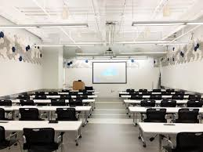


Standard 6.1 Resource Adequacy
Programs are required to report on resource adequacy in the areas of:
  Budget
  Program administration
  Supporting personnel
  Teaching loads/Class sizes/Frequency of class offerings
  Information technology
  Library
  Classrooms, offices, and meeting spaces
(6.1b)

Slide 90

Course Availability
Required courses & frequency of offerings
Specializations & frequency of offerings
Complete course frequency tables for core and specializations

Slide 91
Standard 7: Matching Communications with Mission

Slide 92

Rationale and Assumptions
Communications adhere to public service values of transparency, accountability, and truthfulness
All information and data are linked to and supportive of mission
The data addressed in this Standard have been shared in previous sections of the self-study. This Standard requires programs to document how and where key elements of the data are made publicly accessible (7.1.1)

Slide 93

Public Service Values in Action
Standard 7.1 Communications
  The program will provide appropriate and current information about its mission, policies, practices, and accomplishments—including student learning outcomes—sufficient to inform decisions by its stakeholders such as prospective and current students; faculty; employers of current students and graduates; university administrators; alumni; and accrediting agencies.

Slide 94

CONGRATULATIONS!!

Slide 95
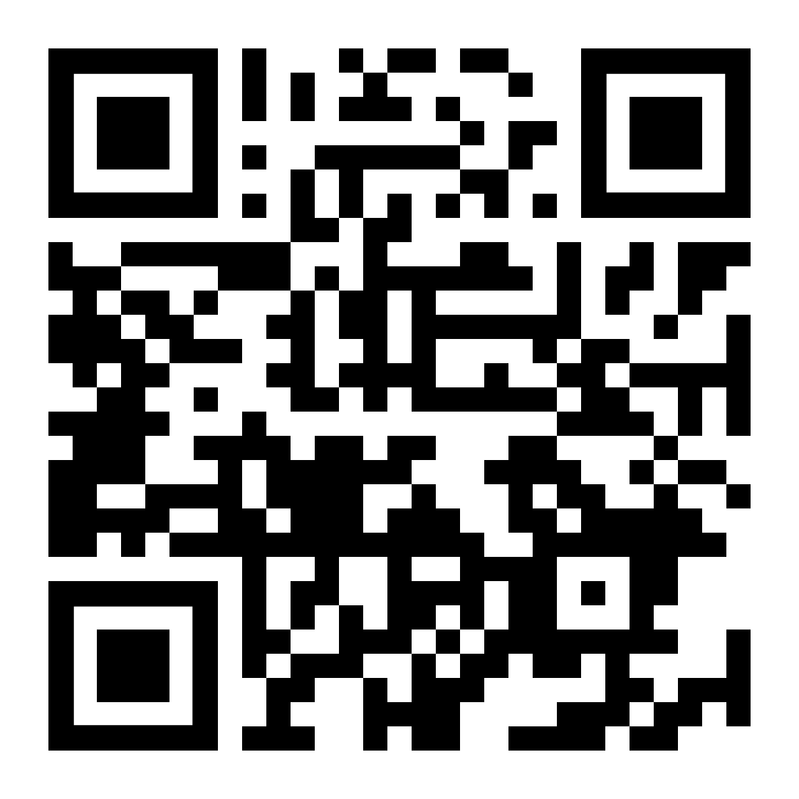
Please complete the Accreditation Institute Assessment Survey

