Slide 1
2024 NASPAA Admissions Meeting
July 11, 2024
Host: Georgetown University

Slide 2
Admissions and Enrollment Survey
Answered any question
23 Degree Programs
Programs
10 MPA (or similar)
9 MPP (or similar)
3 MPAffairs (or similar)
1 Other

Slide 3
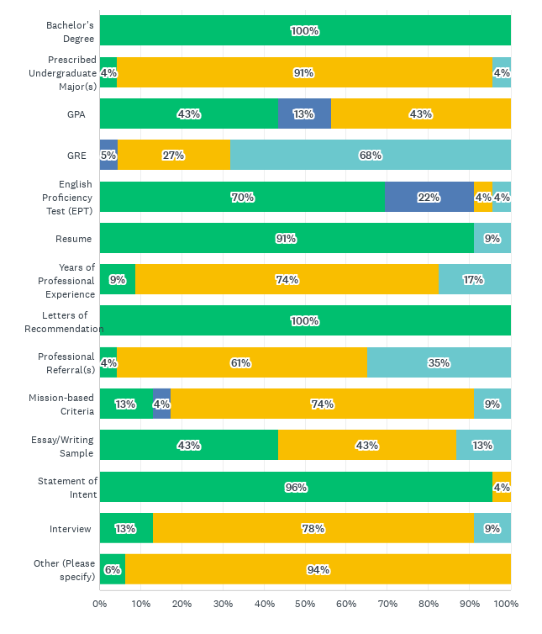
Admission Requirements

Slide 4
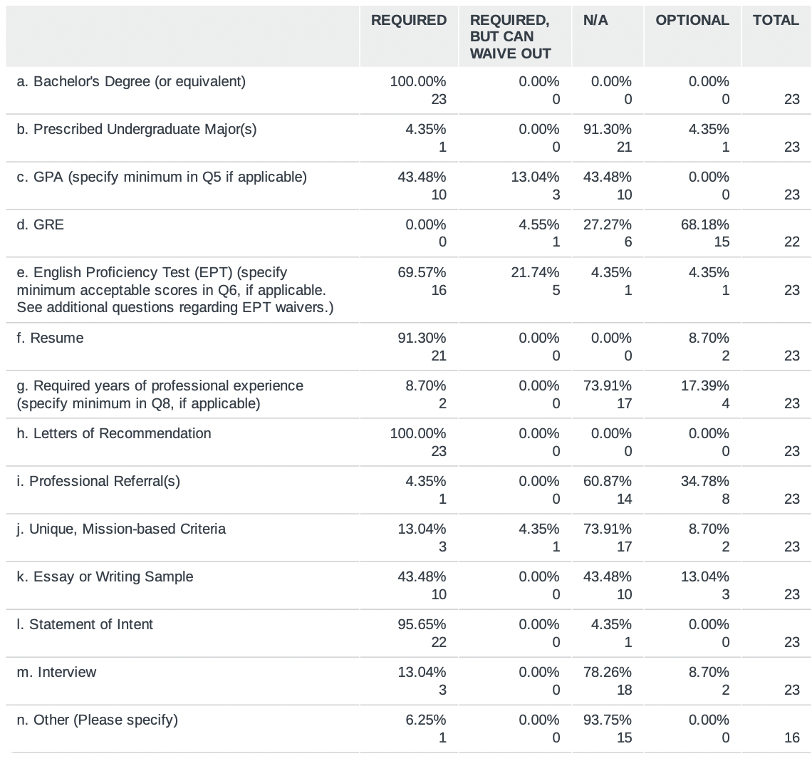
Admission Requirements

Slide 5
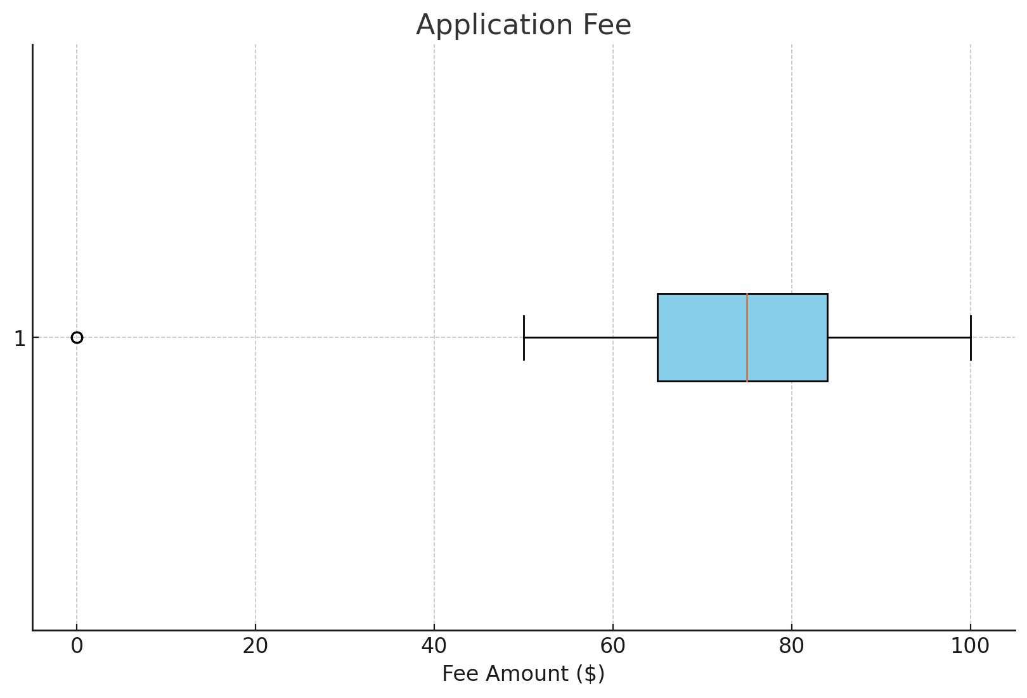
Application Fee (n=22)

Slide 6
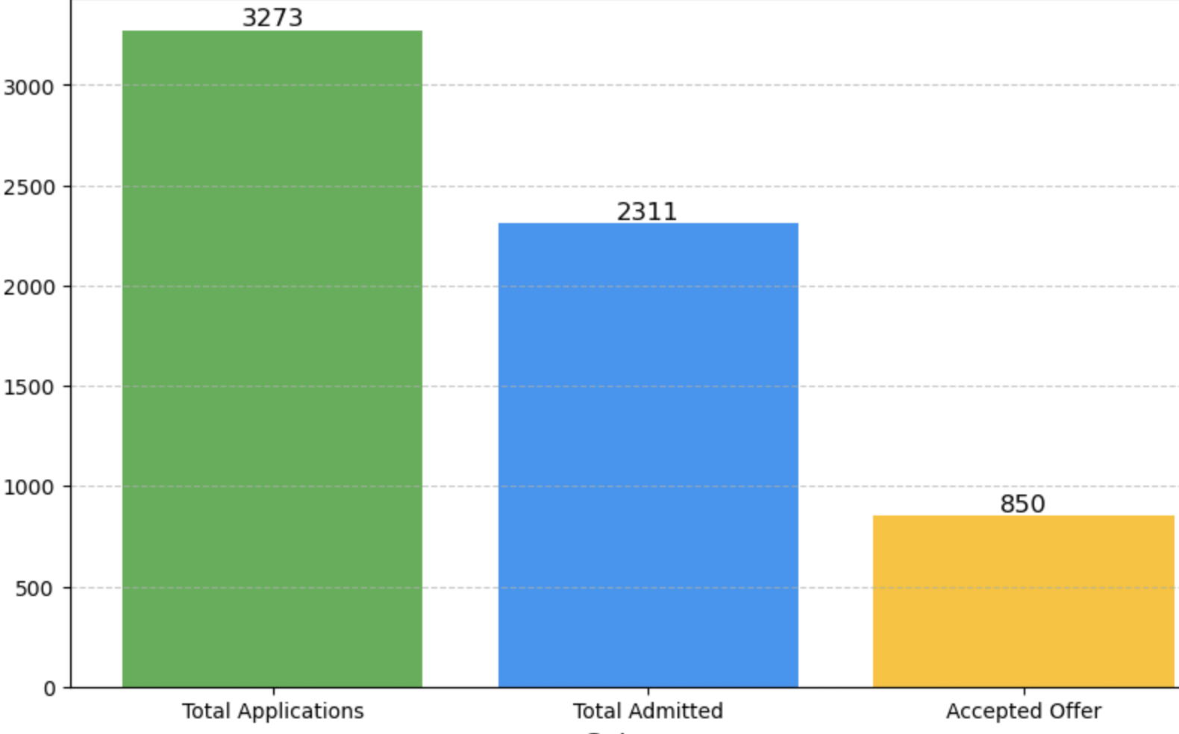
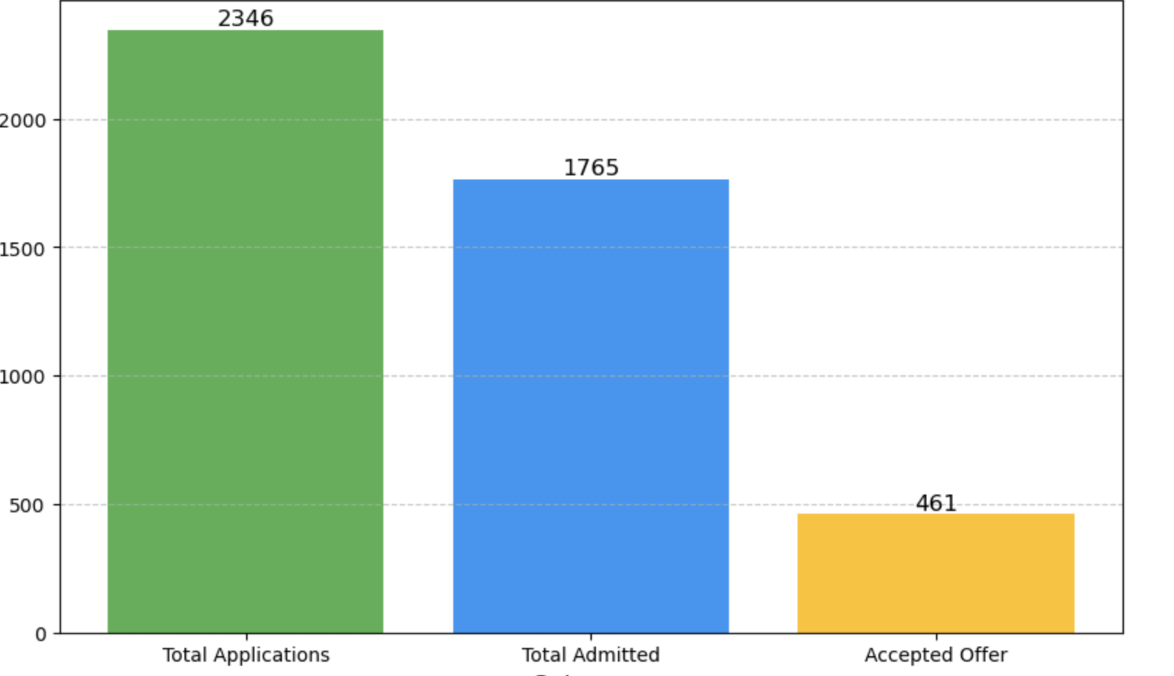
Total Applications and Admissions
MPA, MPAF, and Other, n=13
MPP, n=8

Slide 7
Total Applications and Admissions AY 23-24
MPA, MPAF, and Other:
69.1% of applicants are offered admission
36.8% of students accept the offer
MPP:
76.3% of applicants are offered admission
26.1% of students accept the offer
N=13
N=8

Slide 8
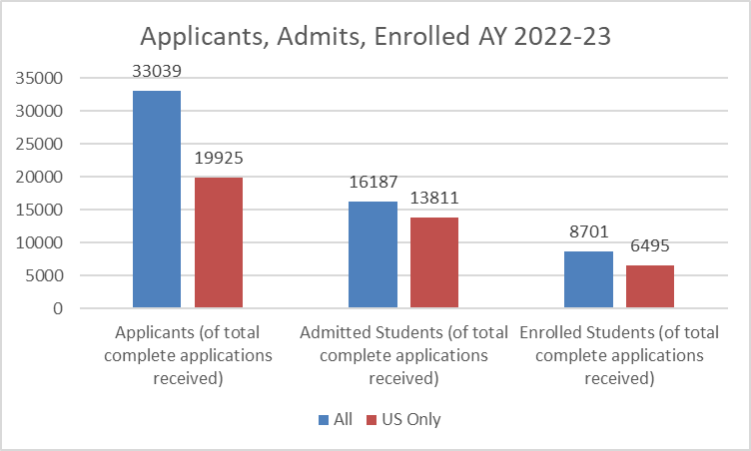
Applicants, Admits Enrolled AY 2022-23
Admit:
Total: 49%
US only: 69%
Enrolled:
Total: 54%
US only: 47%
N= 193 Total
175 Total

Slide 9
Number of Applications Received
N=21
Notes:
On the topic of applications and admissions--
-This graph indicates whether the number of applications received for MPA and MPP programs was down, up, or about the same as last academic year
And if we go to the next slide we can compare these numbers to last years survey results

Slide 10
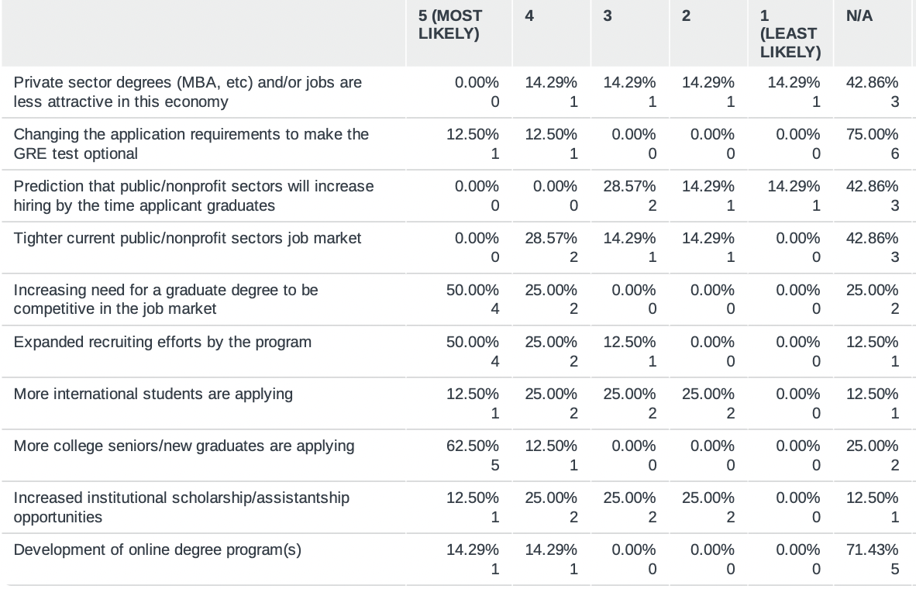
Possible Reasons for Increased Applications

Slide 11
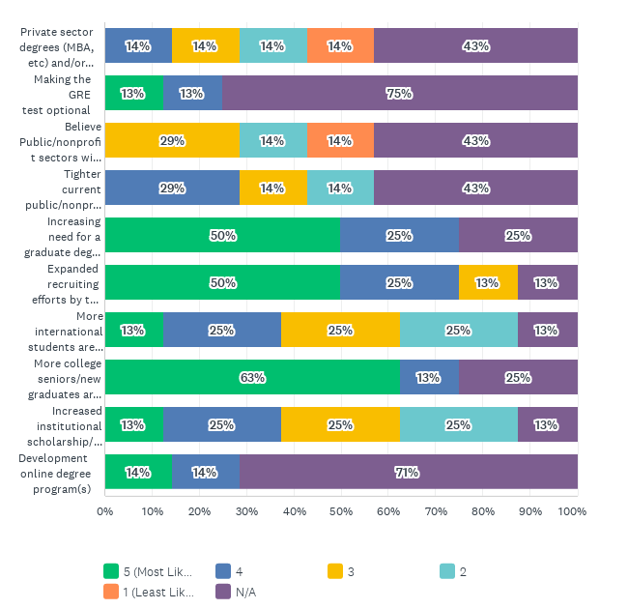
Possible Reasons for Increased Applications

Slide 12
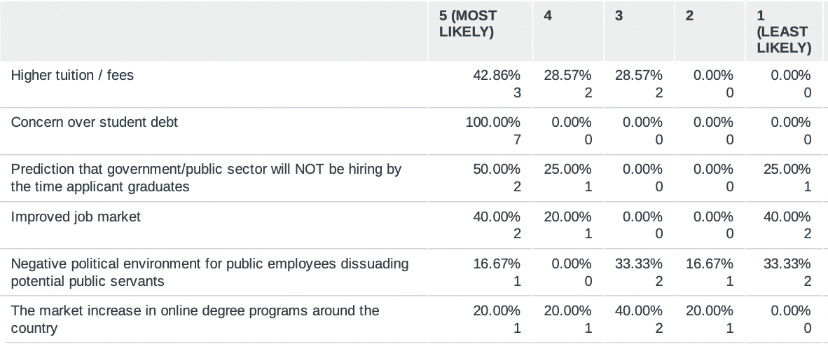
Possible Reasons for Decreased Applications

Slide 13
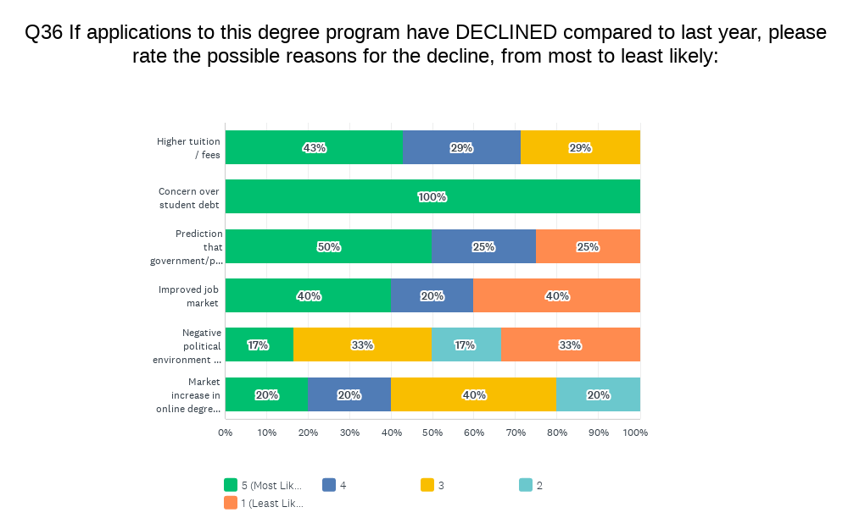
Possible Reasons for Decreased Applications

Slide 14
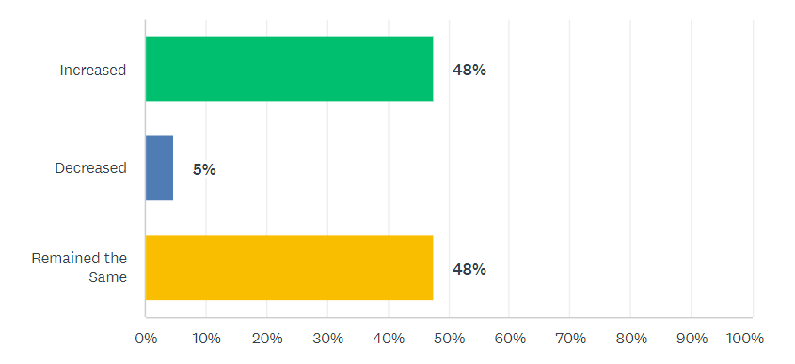
Percent of Deferrals over Last Year
N=23

Slide 15
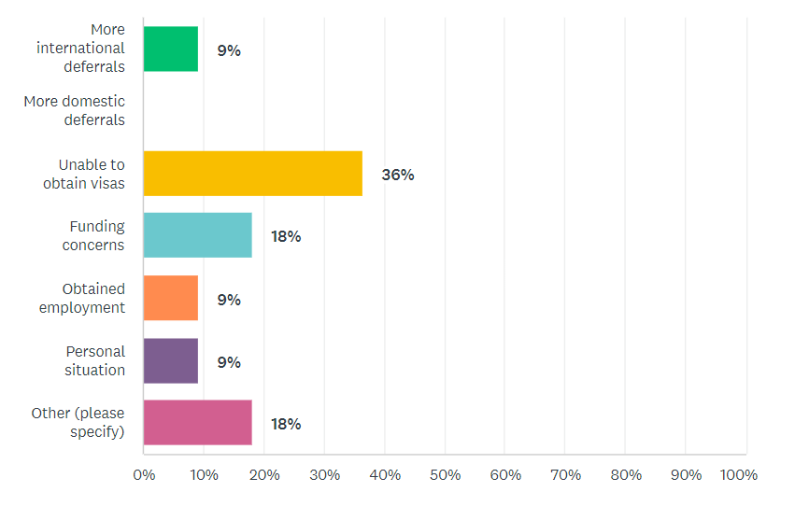
Reason of Increased Deferrals
N=23

Slide 16
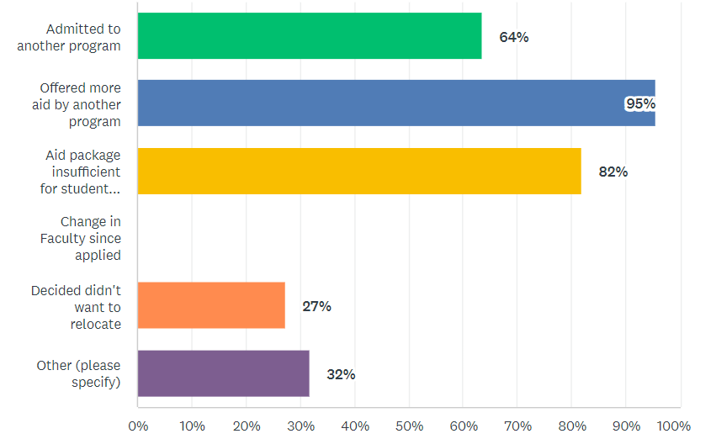
Reason of Decreased Deferrals
N=23

Slide 17
Declined to Enroll—Why?
Other Highlights:
Finance/Student Loans
Work/Employment Schedule
Visa
N=22

Slide 18
Total New Student Enrollment - Total
 | Full Time N=21 | Part Time N=18
Average | 49 | 16
Median | 37 | 6.5
Min | 3 | 0
Max | 127 | 60
Sum | 1031 | 280

Slide 19
Total New Student Enrollment – By Degree
MPA& MPAf
MPP
 | Full Time N=13 | Part Time N=11
Average | 49.4 | 18.9
Median | 42 | 5
Min | 3 | 0
Max | 108 | 60
Sum | 642 | 208
 | Full Time N=8 | Part Time N=7
Average | 48.6 | 10.3
Median | 30.5 | 4
Min | 5 | 0
Max | 127 | 32
Sum | 389 | 72

Slide 20
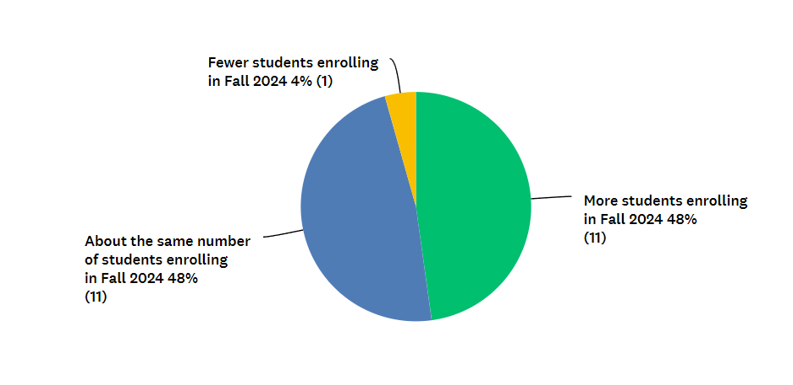
Expected Fall 2024 Enrollment
N=23

Slide 21
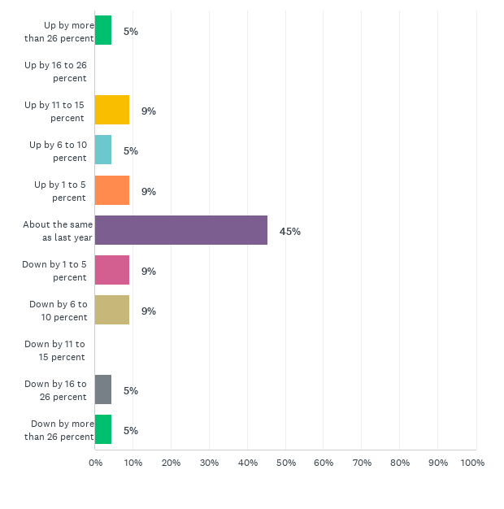
Expected International Enrollment for Fall 2024
N=22

Slide 22
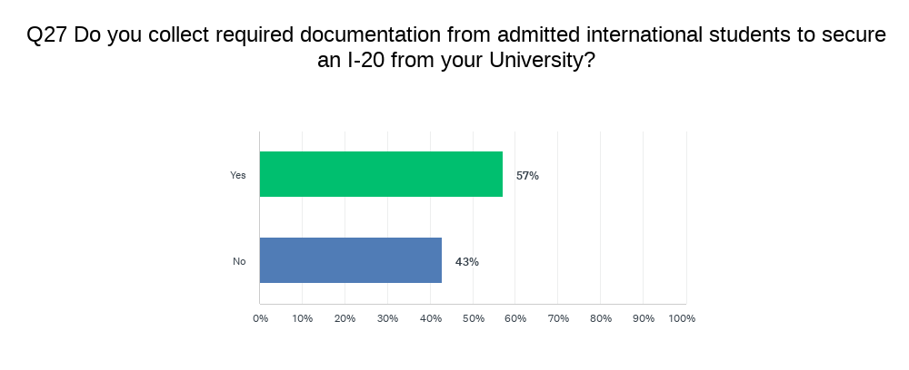
Documents Required for International Students

Slide 23
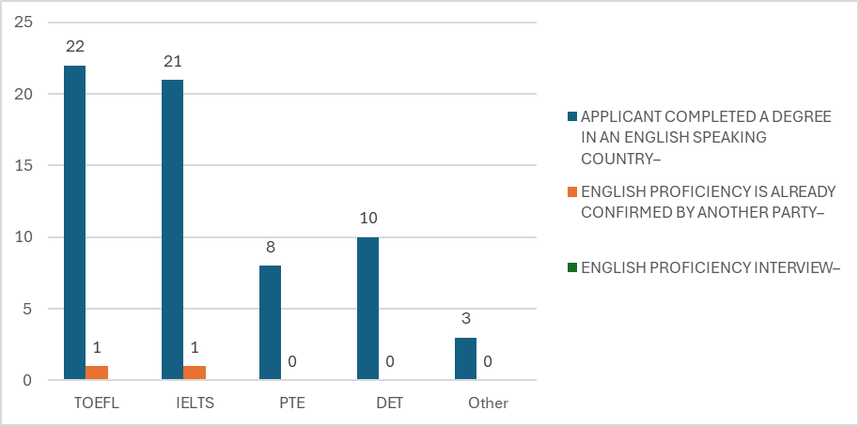
Waive the EPT

Slide 24
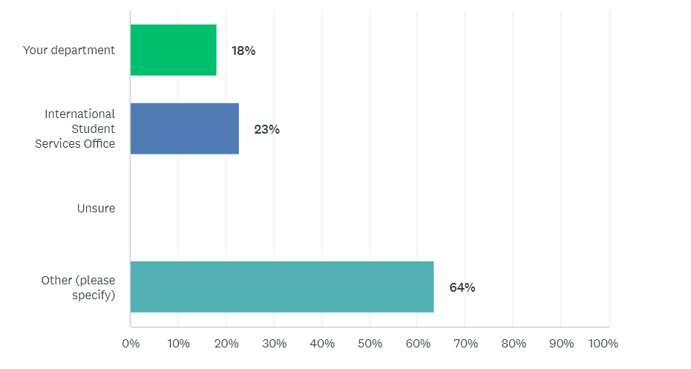
Direct Costs (Tuition and Fees)
Top Other:
Board of Trustees
Board of Regents
Board of Directors

Slide 25
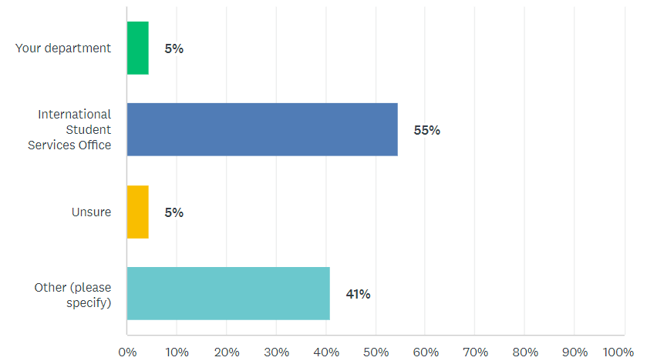
Indirect Costs (Housing, Living Expenses, Books, etc)
Top Other:
Financial Aid office

Slide 26
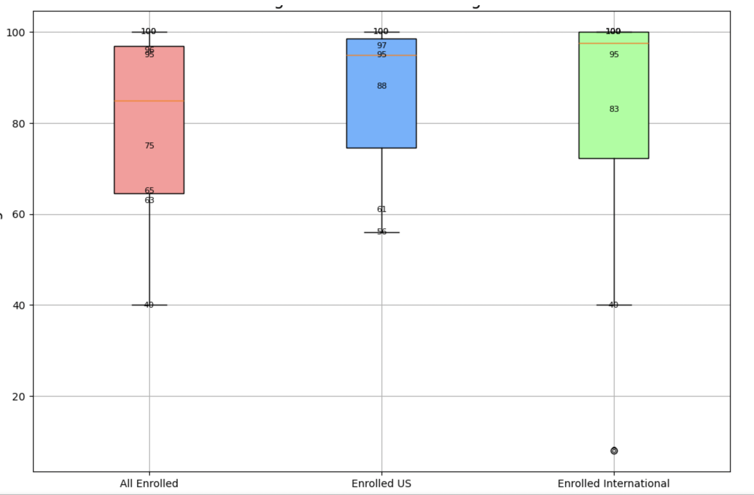
What is the percent (%) of students receiving merit aid:
MPP Degree (n=8)

Slide 27
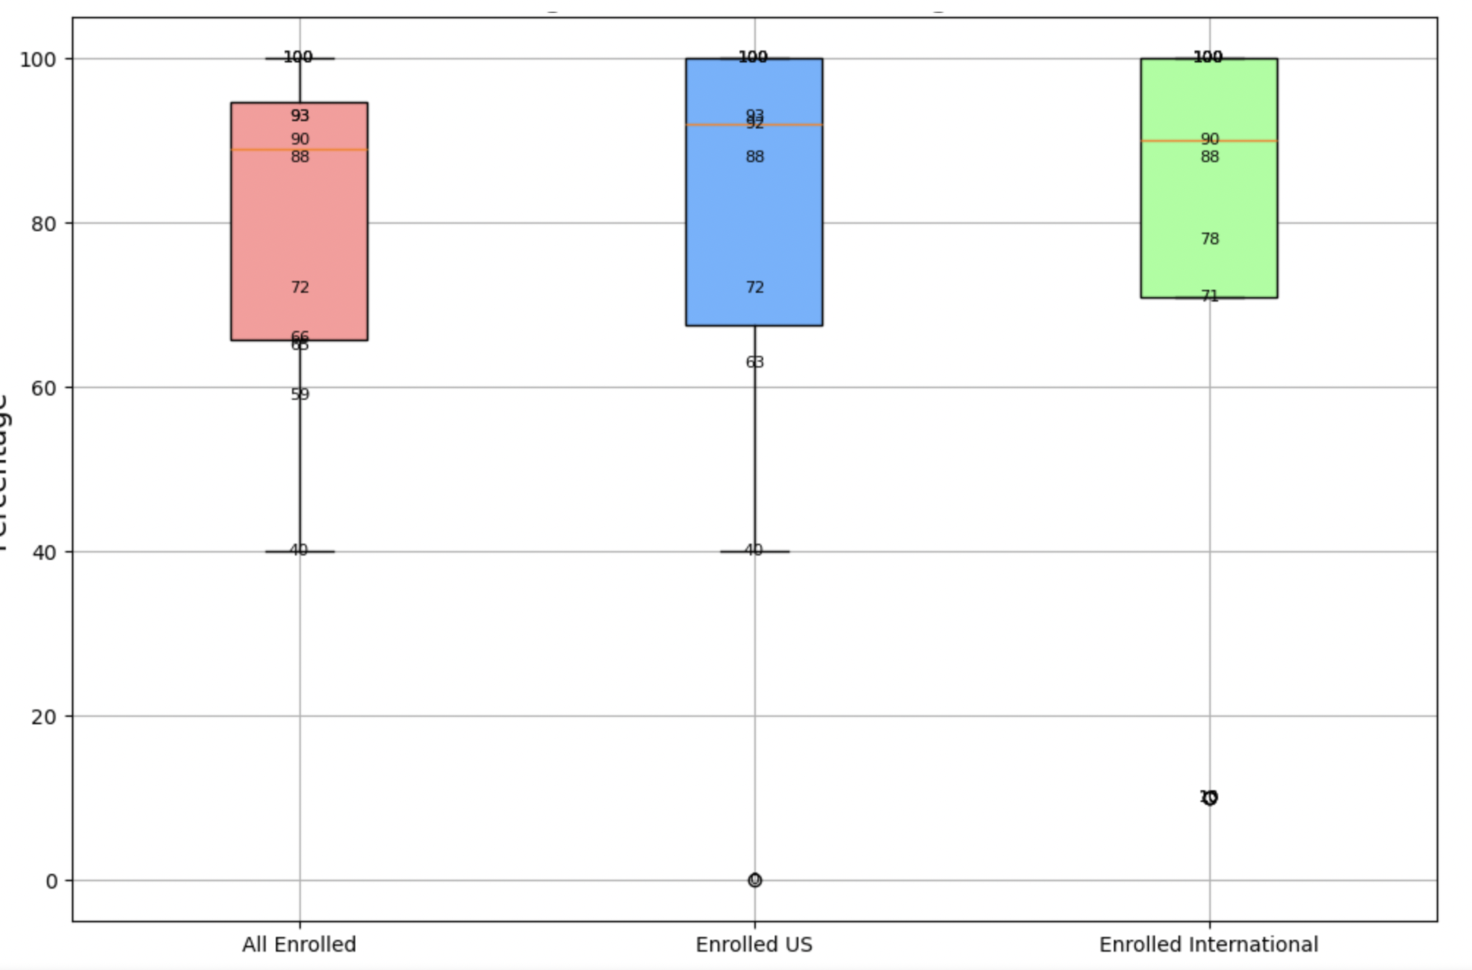
What is the percent (%) of students receiving merit aid:
MPA & MPAf Degree (n=12)

Slide 28
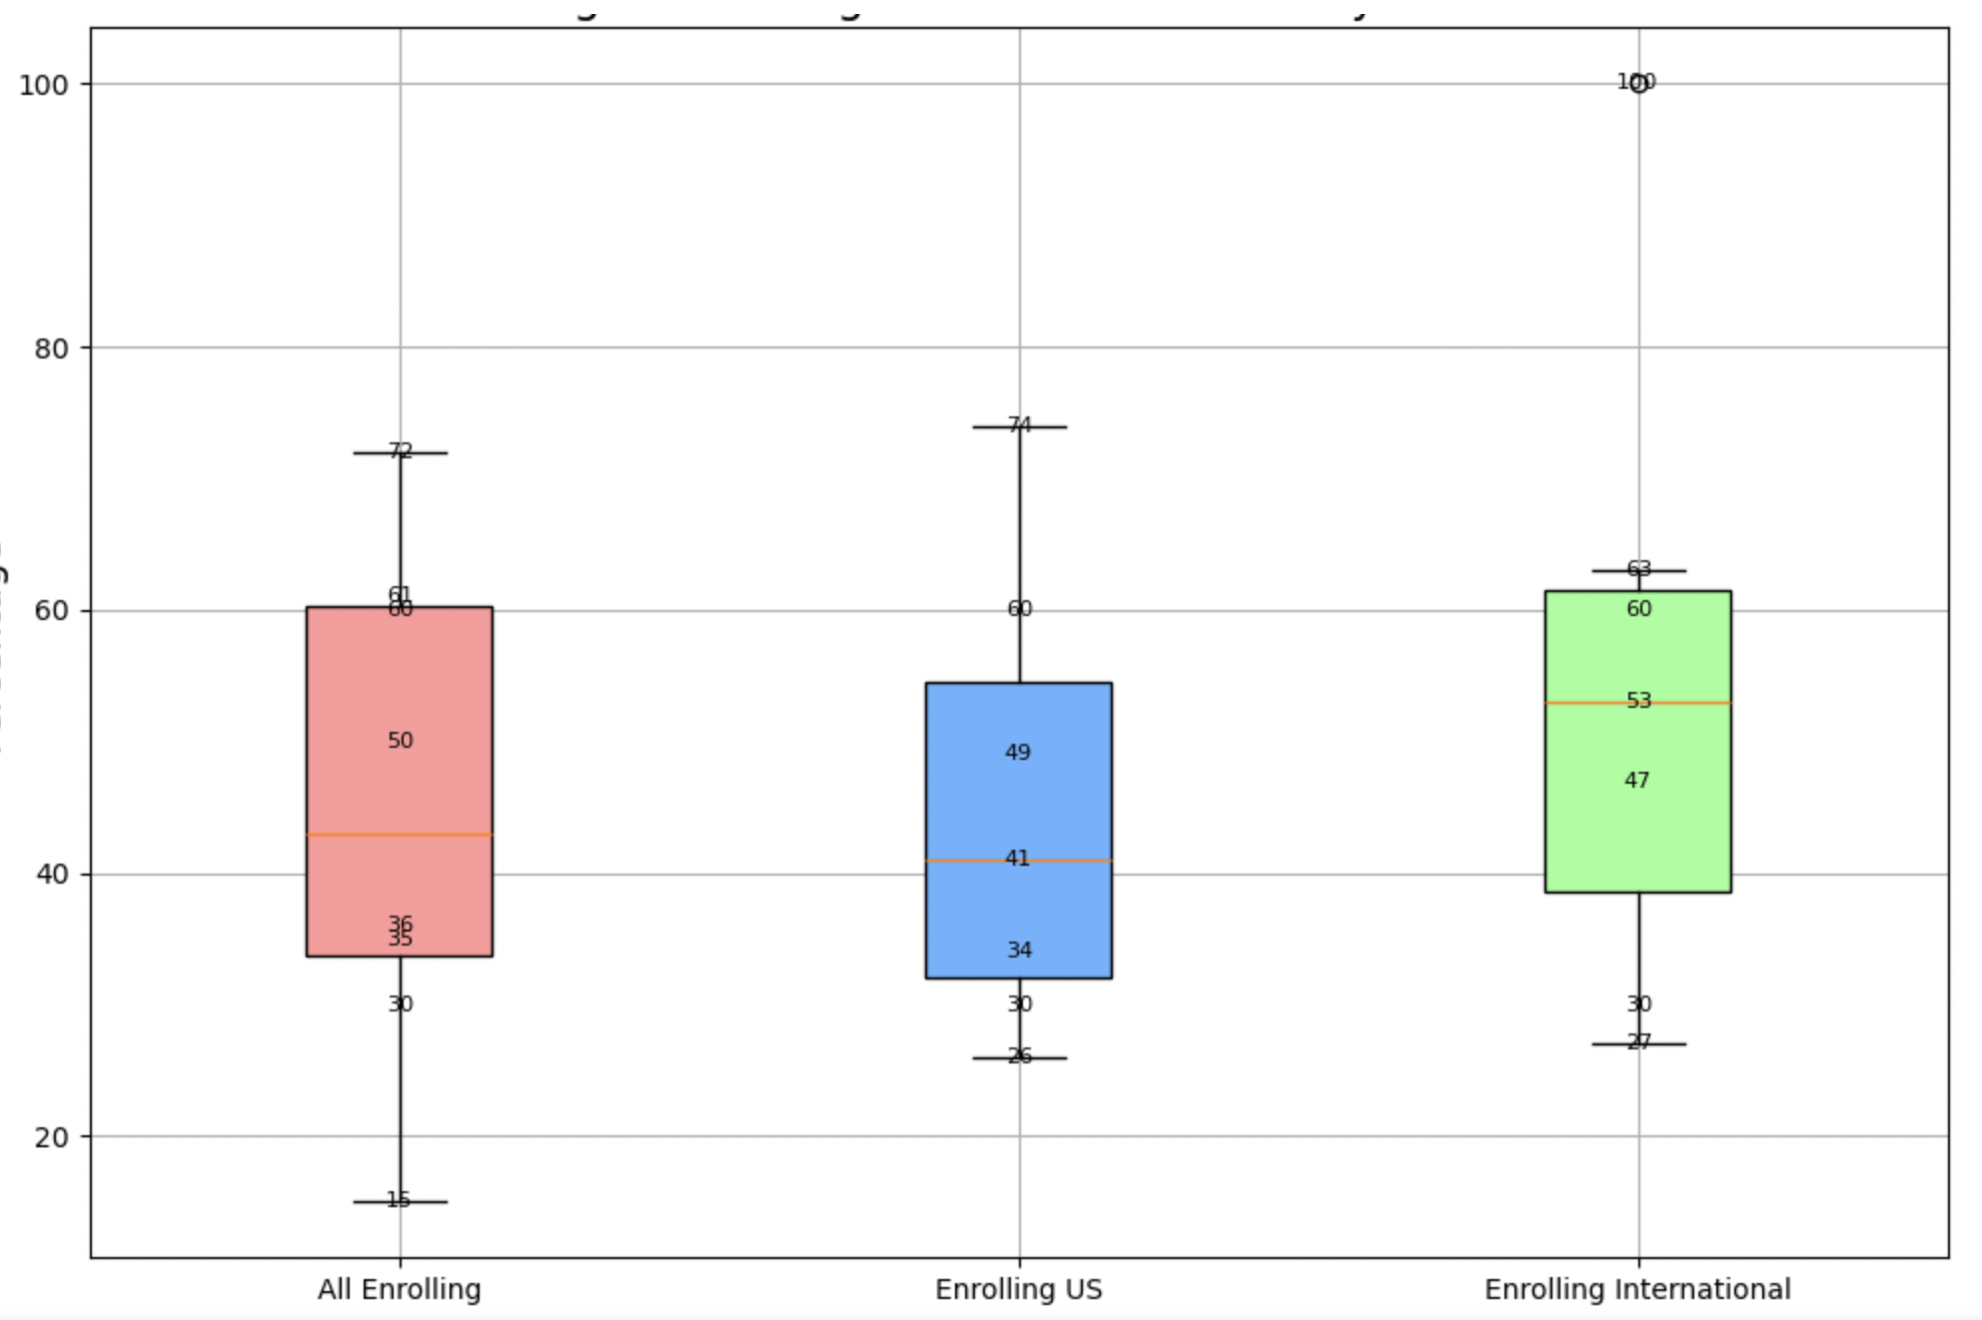
What is the average percent (%) of tuition covered by merit aid:
MPP Degree (n=8)

Slide 29
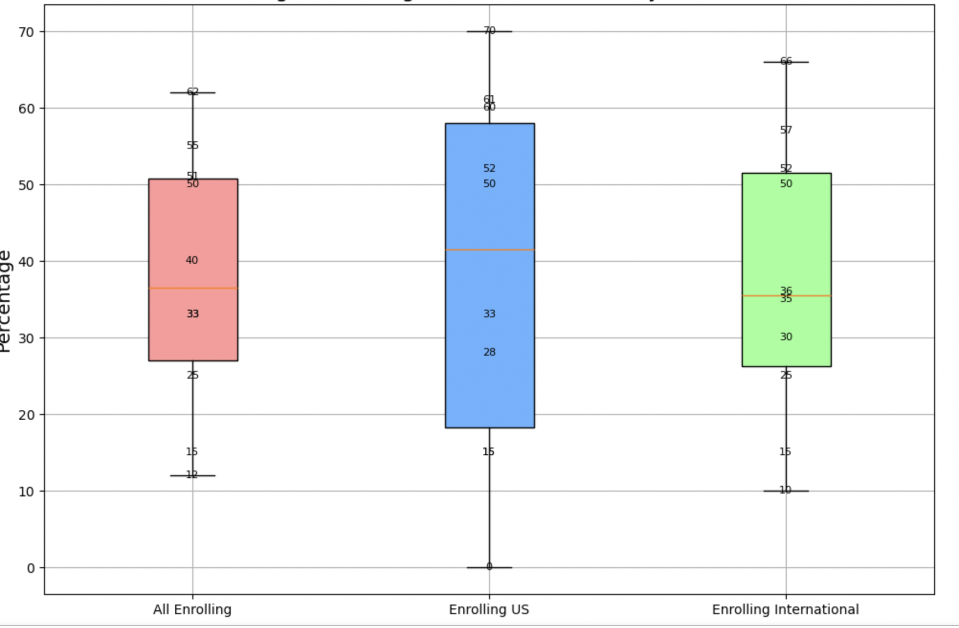
What is the average percent (%) of tuition covered by merit aid:
MPA & MPAf Degree (n=10)

Slide 30
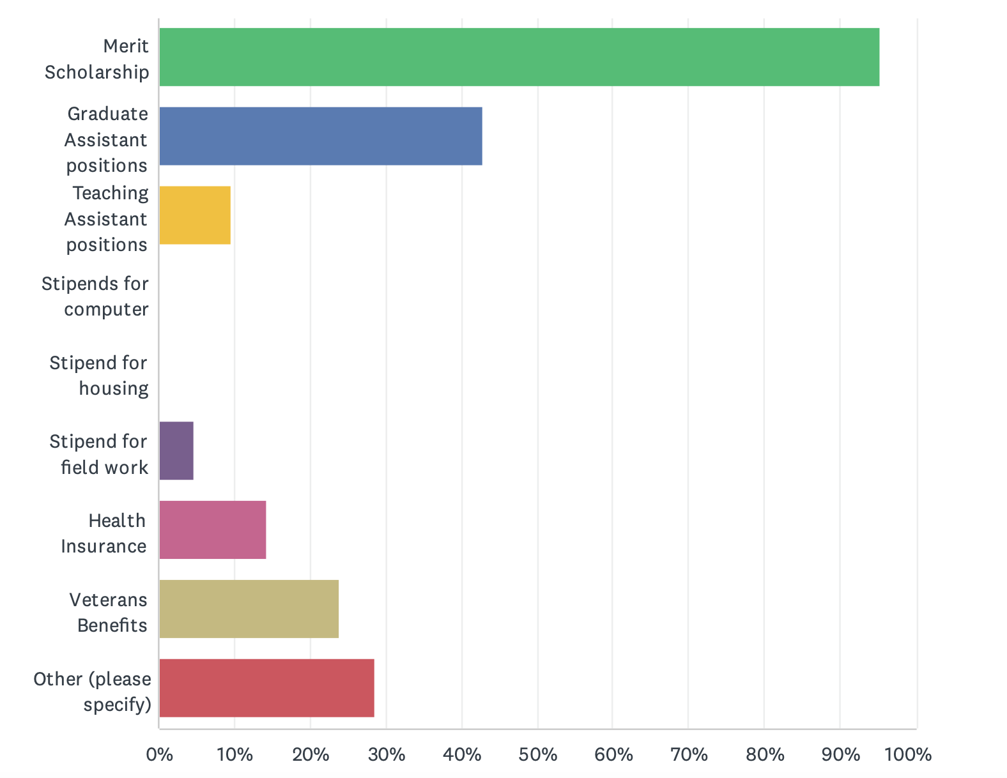
Types of Funding Offered
Other Highlights:
Donor-based Scholarships
Fellowships
Emergency Fund
N=21

Slide 31
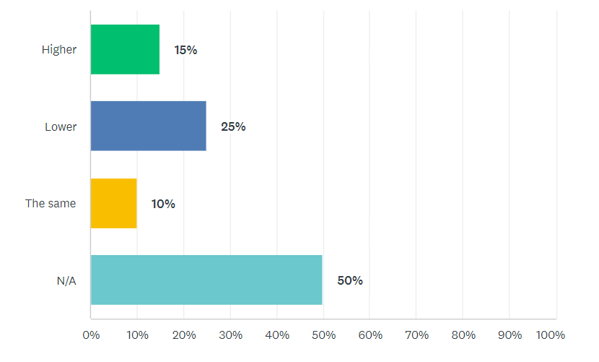
Online Program Interest
N=20

Slide 32
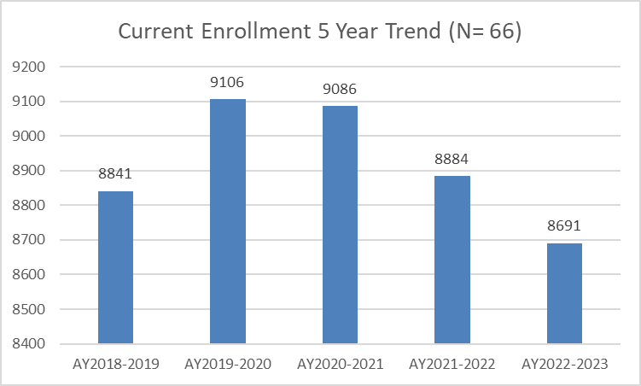
5 Year Enrollment Trend

Slide 33
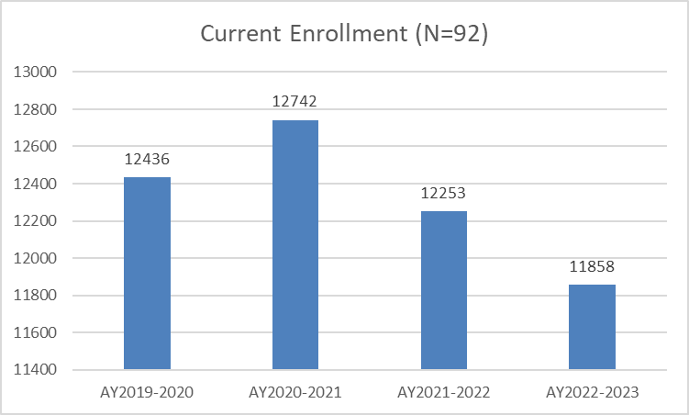
4 Year Enrollment Trend

Slide 34
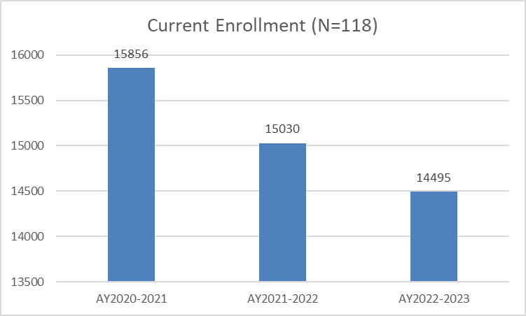
3 Year Enrollment Trend

Slide 35
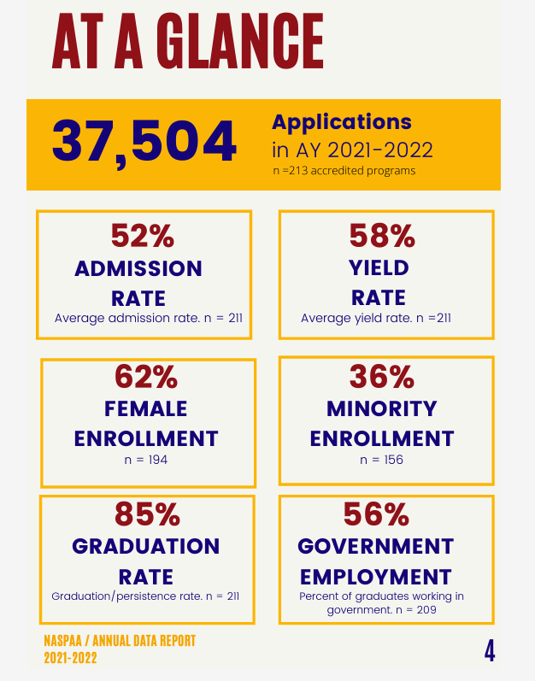
Where you can find Data throughout the year
.naspaa.org/accreditation/data-accredited-programs

Slide 36
Thank you!

