Slide 1
Welcome to the 2018 NASPAA Accreditation Institute!
We will begin promptly at 8:00am

Slide 2
Thank you to Penn State for breakfast!

Slide 3
Institute Structure
6 sessions
Together for the morning with targeted sessions in the afternoon, including Site Visitor Training
60-90 minutes each
Lunch provided!
Interactive and program-focused
Assumes familiarity with accreditation documents and videos
Notes:
8:00 AM
Introduce Jade, Charles
Jeff, Crystal, Heather, Martha

Slide 4
Expectations and Assumptions
We do not repeat the videos (watch them and download the PPTs with notes).
We apply concepts and tools.
You will not write your self-study.
Goal: Return home motivated and prepared with knowledge and strategies to engage your stakeholders in strategic program management, to document what you do in your self-study report, and/or to prepare for the Site Visit.
Notes:
8:00 AM
Also: we do not speak for COPRA!

Slide 5
Session 1: 8:15am-9:00am Holistic Strategic Management
Charles E. Menifield
Rutgers University, Newark

Slide 6
Overview
Managing your program strategically is a forgone conclusion in every program. It is critical that programs look at all of their operations when making decisions that could significantly alter their programs.
Hence, the goal of this session is to consider how strategic planning can be used to develop your short and long term goals.

Slide 7
Standard 1 Managing the Program Strategically
1.1 Mission Statement: The program will have a statement of mission that guides performance expectations and their evaluation, including • its purpose and public service values, given the program’s particular emphasis on public affairs, administration, and policy • the population of students, employers, and professionals the program intends to serve, and • the contributions it intends to produce to advance the knowledge, research, and practice of public affairs, administration, and policy.
1.2 Performance Expectations: The program will establish observable program goals, objectives, and outcomes, including expectations for student learning, consistent with its mission.
1.3 Program Evaluation: The program will collect, apply, and report information about its performance and its operations to guide the evolution of the program’s mission and the program’s design and continuous improvement with respect to standards two through seven.

Slide 8
Standard 1 | Rationale
Accreditation standards reflect NASPAA’s commitment to support programs for professional education that 1) commit to the public service values of public affairs, policy and administration and model them in their operations; 2) direct their resources toward quantitative and qualitative outcomes; and 3) continuously improve, which includes responding to and impacting their communities through ongoing program evaluation.
The commitment to public service values distinguishes NASPAA-accredited programs from other degree programs. The expectation that the Program will:
Define and pursue a mission that benefits its community through education and disseminating knowledge about public affairs, administration and policy reflects NASPAA’s commitment to public service values for example civic virtue, participatory processes and social equity;
Direct resources toward observable and measurable outcomes reflects NASPAA’s commitment to public values of transparency and accountability;
Evolve and improve reflects NASPAA’s commitment to public values of responsiveness and sustainability;
In this way, NASPAA’s accreditation process promotes public service values as the heart of the discipline.

Slide 9
Standard 1 | Basis of Judgment
Standard 1.1
The Program’s mission fits with its degree title (i.e., MPA, MPP, etc.)
The mission statement reflects values of public affairs, administration, and policy
Standard 1.2
The mission statement endorsed by the Program guides its activities.
Standard 1.3
The basis of judgment is how well the Program’s mission and activities bear a clear and compelling relationship to a well-defined community of professionals outside of the University.

Slide 10
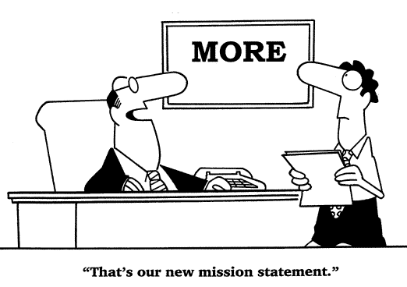
Mission Statement | Realistic

Slide 11
Before you leave …
Revisit your vision and mission statements?
Determine if your vision statement includes public service values and an engagement strategy?
Determine if your mission statement aligns with the vision statement for your program?
Determine if your program goals and objectives align with vision and mission of your program?
Assess your resources and determine if they are sufficient in order to reach your goals and objectives?
Determine if your goals translate to desired performance measures? In other words, are they SMART goals (Specific, Measurable, Attainable, Realistic and Timely)?

Slide 14
Example: Diversity Goals Derived from Mission
“The MPP program inspires, educates, and supports innovative leaders to advance the common good in a diverse world.”
Offer faculty and staff professional development opportunities that will help them improve the frequency and richness of classroom discussions that focus on diversity.
Recruit and retain a more diverse faculty and staff.
Foster a respectful and collegial workplace for program faculty and staff.
Create and support positions, funding, and advancement for diverse faculty.

Slide 15
Holistic Strategic Plan Worksheet
What is your program mission?
What are your program objectives?
How can you measure your program goals?

Slide 16
SWOT Analysis Worksheet
Strengths (What are your assets?)
Weaknesses (Where is the space to grow?)
Opportunities (Where are the untapped markets?)
Threats/Challenges (Obstacles to success?)

Slide 17
Connecting Strengths & Weaknesses to Opportunity & Threats
Internal (Strengths and Weaknesses)
External (Opportunities and Threats)

Slide 18
GAP Analysis
Purpose: A Gap Analysis allows you to assess a challenge in your organization, create a goal to addressing it; and create a solution to solving the challenge.

Slide 19
GAP Analysis Worksheet
Challenge
Organizational Goal
Stakeholder Goal
Current Status
Identifying the Causes
Creating Solutions based on Organizational Strengths
Implementing Solutions
Evaluating

Slide 20
Relevant Resources
Molina, A. D., & McKeown, C. L. (2012). The heart of the profession: Understanding public service values. Journal of Public Affairs Education, 375-396. Retrieved from http://www.naspaa.org/JPAEMessenger/Article/VOL18-2/09_MolinaMcKeown.pdf
Strategic Planning for Public and Nonprofit Organizations: A Guide to Strengthening and Sustaining Organizational Achievement. John M. Bryson. 2018. John Wiley & Sons, Hoboken, NJ.
10 Steps to Successful Strategic Planning. Susan Barksdale. 2006. ASTD, Danvers, MA.
University of Connecticut. (n.d.) How To Write a Program Mission Statement. Retrieved from http://web2.uconn.edu/assessment/docs/HowToWriteMission.pdf
University of Massachusetts - Amherst. (2001, Fall) Program-Based Review and Assessment: Tools and Techniques for Program Improvement. Office of Academic Planning and Assessment. Retrieved from https://naspaaaccreditation.files.wordpress.com/2014/04/program_based-umass.pdf

Slide 21
Thank You!
Charles
Charles.Menifield@Rutgers.edu

Slide 22
Session 2: 9:10am-10:10am Program Evaluation
RaJade M. Berry-James
Associate Professor, School of Public and International Affairs
North Carolina State University
Notes:
RBJ

Slide 23
Overview
Connect mission statement and performance expectations with program evaluation
Analyze program curriculum and student competency
Discuss strategic choices to promote diversity and inclusion in your curriculum and among your program faculty

Slide 24
Standard 1 | Manage the Program Strategically
1.1 Mission Statement: The program will have a statement of mission that guides performance expectations and their evaluation, including • its purpose and public service values, given the program’s particular emphasis on public affairs, administration, and policy • the population of students, employers, and professionals the program intends to serve, and • the contributions it intends to produce to advance the knowledge, research, and practice of public affairs, administration, and policy.
1.2 Performance Expectations: The Program will establish observable program goals, objectives and outcomes, including expectations for student learning, consistent with its mission.
1.3 Program Evaluation: The Program will collect, apply and report information about its performance and its operations to guide the evolution of the Program’s mission and the Program’s design and continuous improvement with respect to standards two through seven.

Slide 25
Standard 1 | Rationale
Accreditation standards reflect NASPAA’s commitment to support programs for professional education that 1) commit to the public service values of public affairs, policy and administration and model them in their operations; 2) direct their resources toward quantitative and qualitative outcomes; and 3) continuously improve, which includes responding to and impacting their communities through ongoing program evaluation.
The commitment to public service values distinguishes NASPAA-accredited programs from other degree programs. The expectation that the Program will:
Define and pursue a mission that benefits its community through education and disseminating knowledge about public affairs, administration and policy reflects NASPAA’s commitment to public service values for example civic virtue, participatory processes and social equity;
Direct resources toward observable and measurable outcomes reflects NASPAA’s commitment to public values of transparency and accountability;
Evolve and improve reflects NASPAA’s commitment to public values of responsiveness and sustainability;
In this way, NASPAA’s accreditation process promotes public service values as the heart of the discipline.

Slide 26
Standard 1 | Basis of Judgment
Standard 1.1
The Program’s mission fits with its degree title (i.e., MPA, MPP, etc.)
The mission statement reflects values of public affairs, administration, and policy.
Standard 1.2
The mission statement endorsed by the Program guides its activities.
Standard 1.3
The basis of judgment is how well the Program’s mission and activities bear a clear and compelling relationship to a well-defined community of professionals outside of the University.

Slide 27
Getting Started

Slide 28
Mission Statement | Realistic

Slide 29
Mission Statement | Review Process Adoption, Modification and Review
Faculty
Students
Alumni
Employers
Internship Supervisors
Advisory Council
University Stakeholders

Slide 30
Diversity | Planning and Strategies
Mission of the Institution
Vision of Institution
Values of Institution
Strategic Planning & Diversity Initiatives

Slide 31
School/Department/Program Diversity Plan
Accreditation Standards
Standard 3.2 Faculty Diversity: The program will promote diversity and a climate of inclusiveness through its recruitment and retention of faculty members;
Standard 4.4 Student Diversity: The program will promote diversity and a climate of inclusiveness through its recruitment, admissions practices, and student support services; and
Standard 5.1 Universal Required Competencies: To communicate and interact productively with a diverse and changing workforce and citizenry.

Slide 32
Diversity |Description of Department & Curricular and Co-curricular Commitments
Description of Department
Describe academic degree programs in the department as well as the mission of the program
Identify academically and professionally qualified program faculty as well as resources to support diversity
Diversity Curricular and Co-curricular Commitments

Slide 33
Standard 3 |Faculty Diversity
Standard 3.2 Faculty Diversity
The Program will promote diversity and a climate of inclusion through its recruitment and retention of faculty members.
What is your faculty diversity goal?
What strategy do you employ?
How do you evaluate your initiatives with documentation and evidence?

Slide 34
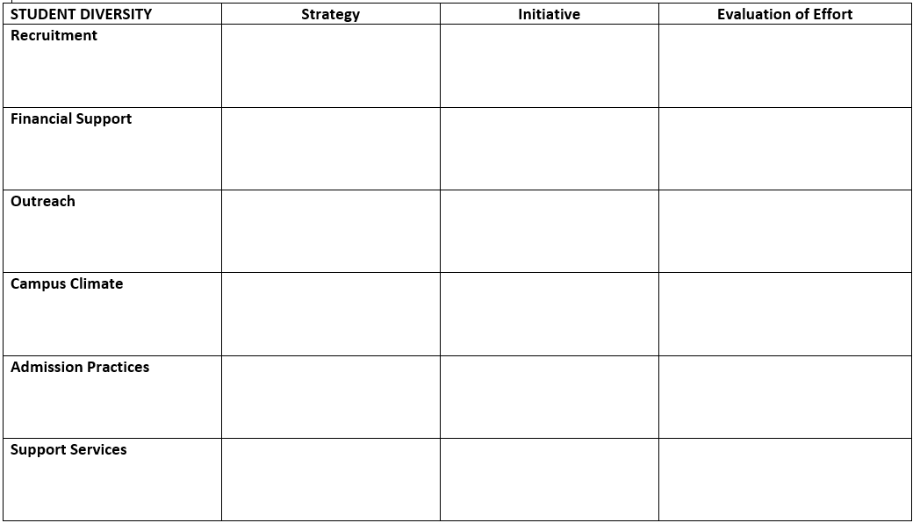
Standard 4 | Student Diversity
Standard 4.4 Student Diversity
The program will promote diversity and a climate of inclusiveness through its recruitment, admissions practices and student support services.
What is your student diversity goal?
What strategies do you employ?
How do you evaluate your initiatives with documentation and evidence?

Slide 35
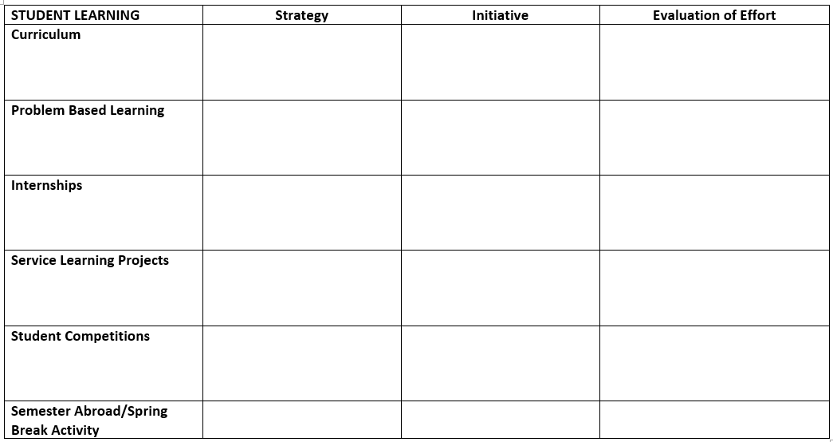
Standard 5 | Student Learning
Matching Operations with the Mission:
Student Learning Goal
The graduate program will prepare students to interact productively with a diverse and changing workforce and citizenry.
What strategy (approach) do you use to prepare students for a diverse and changing workforce?
What initiatives (specific changes) do you employ to reach your student learning goal for diversity?
How do you evaluate your strategic approach and specific changes with documentation and evidence?

Slide 36
Before you leave …
Are your program goals consistent with the mission of your program?
Do your goals align with public sector values and the vision for your program?
In order to reach your goals and objectives, have you thought about how long it would take and what resources your program needs?
Do your goals describe desired performance? In other words, are they SMART goals (Specific, Measurable, Attainable, Realistic and Timely)?

Slide 37
Peer Examples!
Georgia Southern University, MPA (Assessment Plan)
Northeastern University MPA (Assessment Plan and Faculty Qualification Policies)
University at Albany, SUNY, MPA (Self-Study Report and Appendices)
The University of North Carolina at Chapel Hill, MPA (Assessment Plan)
Victoria University of Wellington, MPM & MPP (Diversity Plan)
Virginia Commonwealth University, MPA (Diversity Plan)
Source: https://accreditation.naspaa.org/resources/peer-examples/

Slide 38
Thank You
RaJade M. Berry-James, PhD
Associate Professor
North Carolina State University
School of Public and International Affairs
Campus Box 8102
Raleigh, NC 27695-8102
Email: rmberryj@ncsu.edu
Vmail: 919-515-5027

Slide 39
Thank you to Penn State for breakfast!

Slide 40
Thank you to George Mason University for our refreshments!

Slide 41
Session 3: 10:15am-11:45am Student Learning Assessment
RaJade M. Berry-James
Associate Professor, School of Public and International Affairs
North Carolina State University
Notes:
RBJ

Slide 42
Overview
Discuss sustainable assessment approaches.
Discuss rationale, basic assumptions and basis of judgment for Standard 5.1.
Examine assessment cycle that links program mission and goals to objectives and student learning competencies.

Slide 43
Standard 5.1 | Universal Required Competencies
As the basis for its curriculum, the Program will adopt a set of required competencies related to its mission and [to] public service values. The required competencies will include five domains, the ability:
to lead and manage in public governance;
to participate in and contribute to the public policy process
to analyze, synthesize, think critically, solve problems and make decisions;
to articulate and apply a public service perspective;
to communicate and interact productively with a diverse and changing workforce and citizenry.

Slide 44
Standard 5 |Rationale
Graduate level education should enable the student to demonstrate knowledge and understanding that is founded upon, extends, and enhances that typically associated with the bachelor's level, and provides a basis or opportunity for originality in developing and applying ideas.
Graduate students should be able to apply their knowledge, understanding, and problem solving abilities in new or unfamiliar environments, and within broader or multidisciplinary contexts related to public affairs, administration, and policy.
They should have the ability to deal with incomplete information, complexity, and conflicting demands. Graduate students should reflect upon social and ethical responsibilities linked to the application of their knowledge and judgments.
An accredited program should implement and be accountable for delivering its distinctive mission through the course of study it offers and through the learning outcomes it expects its graduates to attain. While all accredited degree programs must meet these standards, NASPAA recognizes that programs may have different missions with varying emphases.
The curriculum should demonstrate consistency and coherence in meeting the program’s mission. The program being reviewed should demonstrate how its curricular content matches the emphasis of its overall mission.

Slide 45
Standard 5 | Basic Assumption
NASPAA intends the accreditation process under the new standards to be developmental, that is, to advance the public esteem for all the degree programs it accredits as well as to improve the educational effectiveness of each degree program.
Programs that provide accurate information on student learning and student attainment of required competencies will not be held to an ideal standard of perfection.
Rather, programs will be expected to demonstrate that they understand the competencies expected of graduates, that they have instituted teaching and learning methods to ensure that students attain these competencies, and, where evidence of student learning does not meet program expectations, that action has been taken to improve performance.

Slide 46
Standard 5 | Basis of Judgment
It is expected that all students in degree programs accredited by NASPAA will have the opportunity to develop skills on each of the five universal required competencies.
The program shows that it requires the five universal competencies of public affairs, policy and administration and links them to the program mission.
The program defines each of the required competencies in terms of at least one student learning objective (but there may be more than one).
The emphasis that a particular program places on each of these competencies is consistent with its mission.
An accredited program need not assess all competencies every year or cohort, but rather at a frequency appropriate for its mission and goals.
However, assessing each competency only once during a seven year accreditation cycle would not likely be sufficient for conformance in most programs.

Slide 47
One Assessment Cycle

Slide 48
Assessment Planning
Keys to Assessment Planning | Important Questions
Assessment Methods | By what measure(s) will you know that students are meeting programmatic learning objectives?
 | From whom, and at what points, will you gather data?
 | How will you collect the assessment information?
Assessment Processes | When will you conduct the assessment?
 | Who will be responsible for each component?
 | What is the overall timeline for the assessment plan?
 | How will your data be used to evaluate the program?
Adapted from University of Massachusetts - Amherst. (n.d.) Program-Based Review and Assessment: Tools and Techniques for Program Improvement. Office of Academic Planning and Assessment. Retrieved from https://naspaaaccreditation.files.wordpress.com/2014/04/program_based-umass.pdf, pp.

Slide 49
Assessment | Linking Objectives to Curriculum

Slide 50
Assessment | Linking Objectives to Data
Notes:
No grades!

Slide 51
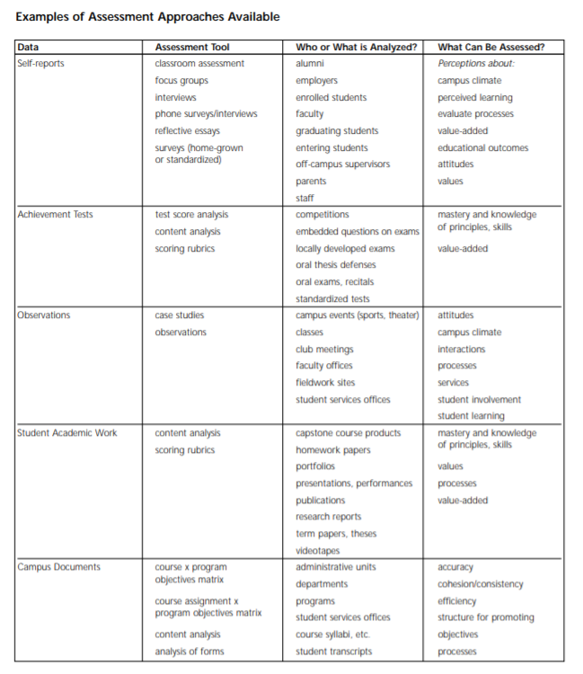
Notes:
Direct and indirect measures
Limited – most important – measures
Use rubrics, multiple assessors
Do not use grades as your metric
Pay attention to reliability and validity

Slide 52
Sample | Course-Based Assessment/Program Review
Notes:
Good rubrics:
Clearly describe the expected knowledge, skills and abilities the student work should demonstrate
Articulate the differences between exceptional, acceptable, needs work, etc.
Use the review of student work, do not use grades.
Reliability = Consistency = Inter-Rater Reliability
Multiple evaluators, the same rubric, compare assessments
Discuss, clarify cell descriptions, minimize subjectivity
Validity = Measuring Intended Competency
In Design (face validity, Advisory Board)
In Application (multiple measures of each competency and compare)

Slide 53
Best Practices
Multiple measures – direct and indirect.
Use rubrics or other assessment tools.
Validity: Faculty (or other stakeholders) who have not taught the course assess the student work.
Reliability: Two or more faculty reviewing common work.
Achievement of performance targets: If your program finds that students are not meeting targets, the temptation is to change the targets or the process rather than reflecting on what substantive changes should be made to curriculum, pedagogy, or the like, based on the evidence you found.
Use of results: Align your program changes with the evidence you found.

Slide 54
Before you leave …
Do you understand how to create a sustainable assessment strategy for your graduate degree program?
Is your assessment plan realistic, given your program realities? Your program’s self-study timeframe?
Does your assessment strategy include the collection of direct measures as well as indirect measures?
Is your assessment plan sustainable, with a SMART Program Goals and Objectives (Specific, Measurable, Achievable, Realistic and Time-bound) identified?
Do your program resources support your assessment processes? Have you identified an assessment committee? Did you charge the committee?
Are you following best practices in student learning assessment?

Slide 55
Peer Assessment Plans
Binghamton University
Eastern Kentucky University
Georgia State University
Georgia Southern University
Indiana University, Bloomington
Northeastern University
The KDI School of Public Policy and Management (Assessment Visual)
San Francisco State University
Syracuse University
The University of Georgia
University of Minnesota
University of North Texas
The University of North Carolina at Chapel Hill
West Chester University
Adapted Assessment Plan Self-Evaluation Tool
Sample Assessment Plan Template
Source: NASPAA Peer Assessment Plans, https://accreditation.naspaa.org/resources/peer-examples/

Slide 56
Thank You
RaJade M. Berry-James, PhD
Associate Professor
School of Public and International Affairs
Campus Box 8102
Raleigh, NC 27695-8102
Email: rmberryj@ncsu.edu
Vmail: 919-515-5027

Slide 57
Session 4: 11:45am-12:15pm Questions! Ask us anything.

Slide 58
Thank you to West Chester University for Lunch!

Slide 59
Session 5B: 1:30-2:15pm The Accreditation Review
RaJade M. Berry-James
Associate Professor, School of Public and International Affairs
North Carolina State University

Slide 60
Overview
Discuss assessment readiness and the mechanics of the assessment process
Discuss the accreditation review process for programs seeking accreditation or reaccreditation
Discuss strategies to assist the site visit team

Slide 61
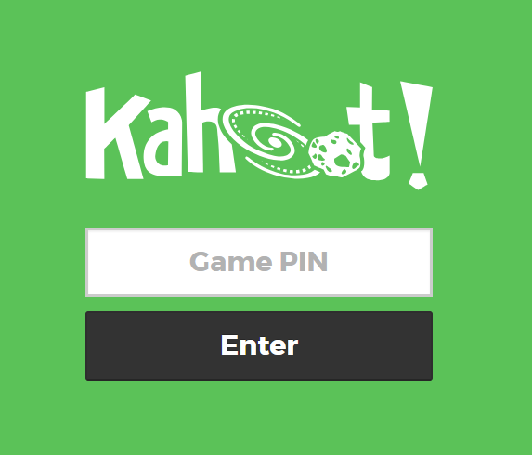
Accreditation Review | Are you Ready?

Slide 62
Preparing for the Self Study
Wide-spread institutional support for (re)accreditation?
Necessary data?
Strategic processes?
Student learning assessment?
Workload plan – writing, editing SSR?
Institutional approval and payment?

Slide 63
Strategic Management Processes
Mission review; logic model
Process for widespread involvement of stakeholders
Strategic Plan not required but you will need to document program goals & public service values linked to your mission
What are they; how do you assess goal achievement?
Notes:
The centerpiece of the accreditation process is your program mission. All of the standards ask you to align what you are doing to your mission. Your mission provides the context for your program goals and public service values. It will drive the kind of students you recruit and the faculty you hire.
Your mission will link to the curriculum you establish and the way you define the universal competencies. COPRA expects that you have a documented process in place for establishing and reviewing your mission, and that you have widespread involvement of your stakeholders. For many programs, this is done by establishing Advisory Boards, Alumni Boards, Employer Advisory Boards, or some other external bodies. It also means establishing a process for involving students, faculty and other university stakeholders.
How you establish and implement strategic program management is up to you. COPRA doesn’t require that you have a strategic plan. However, the Commission does expect you to document your program goals and the process by which you assess goal achievement. So for many programs it makes sense to engage in strategic planning.
COPRA also expects that programs will provide a logic model that illustrates how your program moves from inputs to outputs to outcomes in achievement of your goals and, ultimately, your mission.

Slide 64
Student Learning Assessment
Written Assessment Plan
Define the 5 required Universal Competencies
Assess at least 3 competencies
Gather Evidence
Analyze Evidence
Use Evidence to improve program, make changes or confirm program outcomes
Confirm that you’ve closed the loop!

Slide 65
Accreditation Process
August 15: submit and lock the SSR
NASPAA Data Center
October: COPRA review
October – November: Interim Report
COPRA liaison
Notes:
For those of you who are familiar with the pre-2009 accreditation process, it is important to understand that everything is now online. You’ll use the Civicore system to submit all accreditation documents.
The SSR itself is completed by filling in the report template. You have the opportunity – and you are strongly encouraged – to upload supplemental documents as appendices to your report.
-- What kind of documents?
COPRA’s 14 Commissioners include a practitioner and academics who represent a broad mix of programs… large, small, national, regional, research universities and teaching-intensive institutions, international programs, and so on.
Your program’s SSR is reviewed by one Commissioner who is your liaison, and this person is assisted by 2 or 3 other Commissioners. Together they note areas of concern or issues that need clarification and they make a preliminary recommendation about whether it appears your program is ready to go to a site visit.
During the October COPRA meeting the entire Commission carefully reviews and discusses each SSR and determines the recommendation that will be made regarding going to the site visit, as well as the questions and requests for clarification, organized by the standards, that you will be asked to respond to.
There are two important points to emphasize. First, even if COPRA recommends that you delay a site visit, the program is permitted to proceed with a site visit and sometimes that happens. Whether or not that is a wise decision really depends on the nature of the concerns and whether the program thinks it can address them.
Second, every program is assigned a liaison. You can and should reach out to this person. Liaisons can discuss and clarify the Interim Report and provide useful information about COPRA’s comments.

Slide 66
Accreditation Process
January: program response to the Interim Report
Response not required but is a good idea
November-January: Site Visit Team assembled
December-January: Site Visit dates set
Availability of university stakeholders
Notes:
Purpose of IR and IR response
-- for program
-- for SVT
How SVTs are constructed
Basic SV format: 2 ½ days
Line up availability of university personnel
Take a couple of minutes and list the people at your institution with whom you would want the SVT to meet

Slide 67
Site Visit Team Meetings
Program faculty, Adjunct faculty, Staff
Students, Alumni
Advisory Board(s)
Chairs, Deans, Chief Academic Officer
Career Counselors
Internship Advisors, Internship Supervisors
Other COPRA-requested meetings

Slide 68
The Site Visit
A few weeks prior: Site Visit Chair, Program Director agree on itinerary
Be prepared to be flexible
January – March: Site Visit
Documents, records, EVIDENCE
SVT work space
Notes:
**USE YOUR SV CHAIR**

Slide 69
Accreditation Process
1 month after SV: Chair posts draft report in NASPAA Data Center
Programs may only correct errors of fact
1 – 2 months after SV: Final Site Visit Report loaded in NASPAA Data Center
Program response (May)

Slide 70
Accreditation Process
June: COPRA Summer Meeting
Document review
SSR, Interim Report, response to IR, SVR, response to SVR
Liaison and “group of 3” make initial recommendation
Full Commission reviews, discusses, determines final action

Slide 71
Final Action (Reaccreditation)
Accredited 7* years, no monitoring
Accredited 7* years with monitoring
Accredited 1 year
Letter to program outlines areas of concern, nonconformance
Program must respond
Second SV (perhaps abbreviated) may be required
Denial of Accreditation
* Fewer years if program has had a delay
Notes:
These are the possible outcomes for programs seeking reaccreditation.

Slide 72
Final Action (Accreditation)
Accredited 7 years, no monitoring
Accredited 7 years with monitoring
1 or 2 year deferral
Letter to program outlines areas of concern, nonconformance
Program submits second Self-Study Report
Second Site Visit
Denial of Accreditation
Notes:
And these are the possible outcomes for unaccredited programs seeking accreditation.

Slide 73
Questions on the Process?
Take 5 minutes, talk at your table about your questions, worries, concerns ABOUT THE MECHANICS OF THE ACCREDITATION PROCESS
Choose a spokesperson to report

Slide 74
Self Study Reports
Binghamton University (Appendices) (2013-14 cohort)
College of Charleston (2013-14 cohort)
The University of Georgia (2014-15 cohort)
The University of Texas at Austin (Appendices) (2012-13 cohort)
University at Albany, SUNY (Appendices) (2016-17 cohort)
University of Minnesota (Appendices) (2013-14 cohort)
University of New Orleans (Appendices) (2012-13 cohort)
University of Washington (Appendices) (2013-14 cohort)
Source: NASPAA Peer Assessment Plans, https://accreditation.naspaa.org/resources/peer-examples/

Slide 75
Logic Model Peer Examples
Binghamton University
Indiana University, Bloomington
Northern Illinois University
The University of Georgia
University of Missouri-St. Louis
University of North Dakota (full 2011 Self-Study Report available here).
West Chester University
Willamette University
Source: https://accreditation.naspaa.org/resources/peer-examples/

Slide 76
Thank You
RaJade M. Berry-James, PhD
Associate Professor
School of Public and International Affairs
Campus Box 8102
Raleigh, NC 27695-8102
Email: rmberryj@ncsu.edu
Vmail: 919-515-5027

Slide 77
Thank you to West Chester University for Lunch!

Slide 78
Session 5A: 1:30pm -2:15pm Starting the Accreditation Process
Charles E. Menifield, PhD
Rutgers University-Newark

Slide 79
Overview
In this session, we discuss the accreditation process for programs that are considering accreditation. More specifically, we will discuss each phase of the pre- and post- accreditation process.

Slide 80
Thinking about Accreditation

Slide 82
Phases of the Accreditation Process

Slide 83
Accreditation | Prerequisite Phase
Become a NASPAA Member
Attend the Accreditation Institute
Examine the self-study report and each of the data points and assessment processes needed to complete the self-study
Establish a clear connection between the accreditation process your program’s strategic initiatives
Determine if you have five or more years of student data and one year of faculty data (self-study year)
Ensure that you have examined your school’s processes and data before starting the process
Notify NASPAA that you intend to pursue accreditation and request any information that you may need

Slide 84
Eligibility Phase |Year 1
Complete an Eligibility Application and submit by April 15 or August 15
COPRA will review the application against the NASPAA Preconditions for Accreditation Review and recommend whether or not the program is prepared to move forward to self-study.
Programs will provide:
Basic program information (Name and Contact Information)
Institutional Accreditation Information
Program’s Mission Statement
Program Values as related to the Mission Statement
Description of faculty and student diversity
Summary of program focus in preparing students for employment
Program Characteristics (data on full- and part-time students, population served (Pre-service vs In-Career), credit hours, etc.)
Capacity to Evaluate (history of program, number of full time faculty, current program evaluation, and resources available to sustain the program)

Slide 85
Self-Study Phase |Year 2
Programs gather data for self-study report and submit self study report by August 15
Programs have up to 3 years to submit a self-study after the eligibility application has been reviewed
Programs can request an eligibility counselor to provide support early on
The self-study requires conformance against 7 Standards that address various components of the program
Standard 1: Managing the Program Strategically addresses the mission of the program, performance expectations, and program evaluation.
Standard 2: Matching Governance with the Mission examines administrative capacity and faculty governance.
Standard 3: Matching Operations with the Mission: Faculty Performance examines faculty qualifications, faculty diversity and faculty research productivity & service.
Standard 4: Matching Operations with the Mission: Serving Students examines student recruitment, student admissions, support for the students, student completion and employment, and student diversity.
Standard 5: Matching Operations with the Mission: Student Learning examines universal, mission specific required, mission specific elective and professional competencies.
Standard 6: Matching Resources with the Mission examines the adequacy of program resources.
Standard 7: Matching Communications with the Mission examines appropriate and current information about the program mission, policies, practices, and accomplishments.

Slide 86
Accreditation Cohort |Year 3
Receive and Respond to Interim Report (Fall, Winter)
Work with COPRA liaison, Site Visit Chair
Host Site Visit (Spring)
Respond to Site Visit Report (May)
Accreditation Decision (July)

Slide 87
Are You Accreditation Ready?
27 – 36 = You’re off to a good start
18 – 26 = You have some catching up to do
<18 = You may not be ready

Slide 88
Mechanics of Accreditation
In addition to the SSR, COPRA expects the following documents (at minimum):
A Diversity Plan
An Assessment Plan
A logic model
Other documents that programs have found very useful:
Strategic Plan
Program Evaluation Plan showing how the program engages in ongoing assessment of standards 2 through 7
Curriculum map

Slide 89
Relevant Resources
Eligibility Application. https://accreditation.naspaa.org/considering-accreditation/eligibility-application/
Considering Accreditation: https://accreditation.naspaa.org/considering-accreditation/
­Self-Study Instruction: NASPAA Standards. 2017. https://naspaaaccreditation.files.wordpress.com/2017/11/ssi-instructions-2017-final1.pdf
NASPAA Official Standards & Policies. https://accreditation.naspaa.org/resources/official-standards-policies/

Slide 90
Thank You
Charles
Charles.Menifield@Rutgers.edu

Slide 91
Session 6 2:30pm-4:00pm
Site Visitor Training
Facilitators:
Jade Berry James, North Carolina State University
Charles Menifield, Rutgers University - Newark

Slide 92
Site Visitor Foundations
Value of Site Visiting
Feedback
Sharing new practices
Networking
Roles and responsibilities of Site Visitors
“Eyes and Ears” of COPRA
Report on Standards through Evidence, without judgment
Confidentiality
Working effectively as a team
Collaborate early and often
Prepare in advance
Notes:
1. Goals for Site Visit Preparation Session a. Become Familiar with Accreditation Process and NASPAA Standards
b. Preparation requirements for service as a Site Visitor
2. NASPAA Mission and Role of Accreditation a. Excellence in Education & Training for Public Service
b. Peer Review – Formative & Evaluative Processes
3. Assessment Tenants a. Mission Based; Outcomes Oriented; Public Service Oriented
4. Accreditation Process and Steps a. Self-Study Report (August); COPRA Interim Report; Program Response; Site Visit (Spring); Site Visit Report; Program Clarification; Program Final Response; COPRA Decisions (July)
5. Roles and responsibilities of site visitors a. ‘Eyes and Ears’ of COPRA
b. Report on Standards without Judgment - Evidence
c. Confidentiality
6. Site Visit Team a. Chair, Academic, Practitioner
b. Review and managing multiple reports
c. Work effectively as a team, and i. Responsibilities of individual members and the team before, during and after a site visit.
ii. Responsibilities of site visitors to prepare in advance and to, wherever possible, notify the program of additional data/documentation needs in advance.
iii. What to Avoid
7. Value of Site Visit a. Feedback, Sharing New Practices, Network

Slide 93
Accreditation Process & Reports
Self-Study Report
Interim Report
Program Response
External Site Visit (Draft Report, Program Response, Final Report)
COPRA Decision (may include Monitoring)
Annual Reports (required)
Notes:
Key elements for the AI workshop is in program management and in documenting program management in the Self-Study Report

Slide 94
NASPAA Accreditation Standards
Program Strategic Management (first among equals!)
Program Administration & Governance
Faculty Qualifications, Diversity, Performance
Student Services, Diversity
Student Learning
Program Resources
Program Transparency & Communications
Notes:
Review the standards. Emphasize the importance of mission.
S1: Mission, performance expectations, program evaluation (performance outcomes & ongoing assessment processes
St 2 Modalities, admin capacity, decision-making authority, faculty governance, nucleus, substantial determining influence
S3 AQ/PQ, faculty diversity
S4 Recruitment, admits, acceptances, enrollments; internships, completion rates, placements; student diversity
S5 , S6, S7…

Slide 95
Guiding Questions
What information do you need?
How will you obtain it?
Data sources?
Qualitative vs. quantitative
Triangulation of multiple data sources
Writing the Site Visit Team Report:
How will you document your findings in Report?
How do you balance formative & summative?

Slide 96
Case and Case Questions
Read Interim Report
Notes:
Distribute Example 3
Ask COPRA liaison
Same questions as above
Plus: Is this linked to a standard? If not, do not cite.

Slide 97
Case and Case Questions
1. What are the strengths of the mission statement provided in relation to the Standards. What are the weaknesses?
Notes:
Ask COPRA liaison
Same questions as above
Plus: Is this linked to a standard? If not, do not cite.

Slide 98
Case and Case Questions
2. During the Site Visit, who would you want to meet with to address COPRA’s Interim Report concerns? What questions might you ask?
Notes:
Ask COPRA liaison
Same questions as above
Plus: Is this linked to a standard? If not, do not cite.

Slide 99
Case and Case Questions
3. What supporting documentation might you need to see to explore the issues raised in the interim report and provide evidence back to COPRA?
Notes:
Ask COPRA liaison
Same questions as above
Plus: Is this linked to a standard? If not, do not cite.

Slide 100
Case and Case Questions: Item 4
To date, we have completed one cycle of assessment. During 2016-17 and 2017-18 academic years, we considered Competency 5 “to communicate and interact productively with a diverse and changing workforce and citizenry.” We did this using a sample of papers students had written in our Ethics course as well as completed capstones, and a student exit survey. Our data show that students generally felt good about the skills they acquired in these courses. We did see one item of concern—students reported that while they felt confident in their written and oral skills, they had been exposed to few opportunities to explore cultural interactions. Based on this, we have revised the way we teach our capstone course to incorporate more attention to this. Otherwise, we have been pleased and have made no other changes as a result of our analysis.
Notes:
What open questions remain for you?
Thinking about what you would explore deeper on the ground, what would you report to COPRA?

Slide 101
Case and Case Questions
4. Writing a Response (Item 4)
Notes:
Ask COPRA liaison
Same questions as above
Plus: Is this linked to a standard? If not, do not cite.

Slide 102
Scenarios for Site Visit Teams
On the Ground Conduct
Site Visit Report
Notes:
Ask COPRA liaison
Same questions as above
Plus: Is this linked to a standard? If not, do not cite.

Slide 103
Final Lessons Learned
At every meeting, communicate:
The site visit is a collegial activity designed to improve programs and, thereby, the profession and public service
You do not speak for COPRA, you report to COPRA
The site visit report is a piece of the entire puzzle
The Program has an opportunity to comment on a draft of the SVT Report, and
Collegiality on the visit does not mean a positive decision
Notes:
Manage expectations
Ask members of the audience for their questions or advice they would give to members of a SVT

Slide 104
Reflection
What will you take away from this session?
Notes:
Track on flip chart

Slide 105
Mission-driven
Outcomes-oriented
Evidence-based
Accreditation-earning
Program Management
Notes:
Many thanks to all of you who have served on accreditation teams or who plan to do so.
You will learn a great deal and you will contribute to the profession.

Slide 106
…is not only about voluntarily conforming to standards set by NASPAA for educational programs in public service.
…is also about pursuing excellence in public service through education by executing well on a mission-based strategy.
Notes:
Finish up promptly at 4:00 pm

Slide 107
Please join COPRA and your colleagues for a reception hosted by West Chester University in the Café at 4:30pm!
Notes:
Note our printed schedule incorrectly says 5:00pm!

