Slide 1


中国专业学位教育质量认证
Chinese Professional Degree Education Accreditation
林梦泉
中国·教育部学位与研究生教育发展中心
LIN Mengquan
China Academic Degrees and Graduate Education Development Center (CDGDC)
Beijing，Apr.13，2015

Slide 2
01
专业学位研究生教育质量保障现状
Status quo of Quality Assurance in Professional Degree Education
02
中国专业学位研究生教育认证
Chinese Professional Degree Education Accreditation
主要内容
Content
03
中国MPA教育认证
Chinese MPA Education Accreditation
04
未来展望
Future Prospect

Slide 3
1
PART ONE
专业学位研究生教育质量保障现状
Status quo of Quality Assurance in Professional Degree Education

Slide 4
1.1 中国研究生教育基本情况
Overview of GE in China
专业学位
Professional Degree
中国研究生招生、在校生人数情况统计
The Number of Chinese Postgraduates Enrolling and Studying at School
2014年招生规模组成：
博士：7.1万
硕士：56万
(其中专硕占42%)
Enrollment in 2014:
PHD :71,000
Master:560,000
(42% is PD students)
截至2014年
专业学位授予单位574所
博士专业学位授权点108个
硕士专业学位授权点2856个
Until 2014
PD awarding institutions: 574
PHD PD awarding units: 108
Master PD awarding units: 2856

Slide 5
1.2 中国研究生教育主要特点
Main Features of GE in China
1)依法自主办学
Self-running within the framework of law;
2)国家审核的学位授权制
Government approval of authorizing degrees ;
3)硕士、博士两个独立完整的层级，学术、职业两种类型
Independent system for Master and Doctoral degrees, two-category (academic and professional) degrees;
4)培养模式与途径的多样化和多渠道
Diversified cultivating modes and channels;
5)多主体、多元化的质量保障监督体系
Multi-agent and diversified quality assurance and supervision system.

Slide 6
1.3 专业学位研究生教育
Graduate Education of PD
1990年以来，国务院学位委员会先后批准设置40种专业学位
Since 1990, 40 kinds of professional degrees are set by Academic Degrees Committee of the State Council
初步形成以硕士学位为主，博士、硕士、学士三个学位层次并举的专业学位教育体系
A professional degrees education system was founded, including three degree level, namely PHD, Master, and Bachelor
培养目标逐步符合行业需求
Educational objectives gradually meet the requirements
现状
Present Situation

Slide 7
1.3 专业学位研究生教育
Graduate Education of PD
输出质量、社会认可度不高
Unsatisfied outcomes quality and social recognition
学生应用型培养不足
Lack of practice training
整体质量管理缺乏系统性
Lack of systematic management
问 题
Problem
迫切需要建立多元协同的质量保障机制
Establish a integrated QA system

Slide 8
1.4 中国研究生教育改革方向
Reform Direction in GE
1条
主线
服务需求，提高质量
2个
着力点
分类推进培养模式改革
统筹构建质量保障体系
One
goal
Satisfy requirement;
Improve quality.
Two focuses
Classified reform of education model
Integrated establishment of QA system

Slide 9
1.5 外部质量保障与监督
External QA and Supervision
政 府
资格准入：学科目录与<学科简介>，《基本要求》学位基准，准入审核 审批（国家暂不增量）
定期评估：6年一轮“合格评估”，论文抽检博士10%
第三方
选优排名：排名、选优性评估（大学、学科、论文）
质量认证：建筑、工程、MBA、MPA
Government
Standard & Permission: degree requirements;
programs permission.
Evaluation (Audit): periodic evaluation for qualification.
NGO
Ranking: ranking; selection for excellence (institution, discipline, graduate thesis).
Accreditation: architecture, engineering , MBA, MPA, etc.

Slide 10
2
PART TWO
中国专业学位研究生教育认证
Chinese Professional Degree Education Accreditation

Slide 11
2.1 开展专业学位质量认证的必要性
Necessity of PD Education Accreditation
Agree with national strategy development demand
符合国家战略发展需求
Improve external quality assurance system
完善外部质量保障体系
贯彻落实《关于深化研究生教育改革的意见》《关于加强学位与研究生教育质量保障和监督体系建设的意见》精神
有利于解决专业学位研究生“内部质量管理不健全、外部监控作用不明显”问题
国家层面
National Level
有利于提高社会对办学单位专业学位教育质量的辨识，提高专业学位教育的社会认可度
适时开展专业学位质量认证，有利于促进专业学位质量提升，鼓励优秀、带动后进
提升专业学位培养质量
Improve the quality of professional degrees education
满足社会需求
Satisfy the social demand

Slide 12
2.1 开展专业学位质量认证的必要性
Necessity of PD Education Accreditation
Clear institutional mission
明确院校使命
Improve the quality
提高院校质量
帮助培养院校明确使命，指导学院在使命的指引下结合所在地区社会发展状况，明确其市场定位和发展目标
帮助培养院校制定相应的发展战略，提高质量，建立持续改进机制
院校层面
Institutional level
帮助培养院校根据实践，明确自身项目定位的特色和办学优势
帮助培养院校形成国际视野、中国特色、促进中国发展和文明进步的高水平教育机构
彰显院校特色
Highlight institutional characteristics
形成高水平教育机构
Form high-level
educational institution

Slide 13

2.2 中国高质量MBA教育认证
CAMEA
1）发展历程
Development Process
探索开展认证研究
Begin to do research on accreditation
2000
初步制定国内认证包括标准、流程、制度、管理等一系列文件的初稿，开展相关论证工作
Formulate and demonstrate the standards, process, administration and other articles(draft).
2007
教育部学位中心
全国MBA教指委
单位自愿申请，9所院校参加
CAMEA was jointly carried out by CDGDC and CNMESC in 2012，including 9 institutions voluntarily participating.
联合开展
2012
7所院校通过认证，10所院校正在开展相关认证工作，数所学校正在申请认证
7 institutions have been accredited, 10 institutions are in the process, several institutions are waiting in line.
至 今
Till now

Slide 14
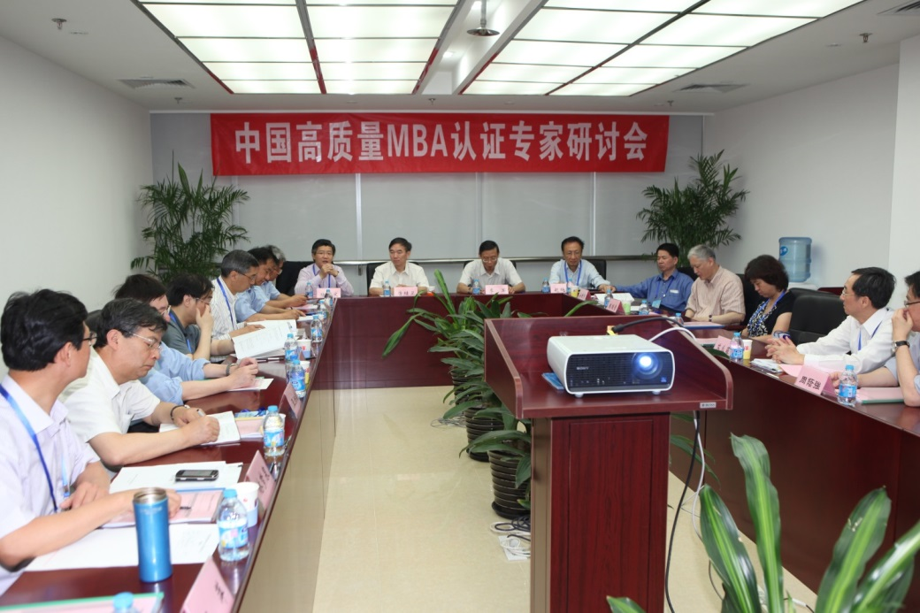
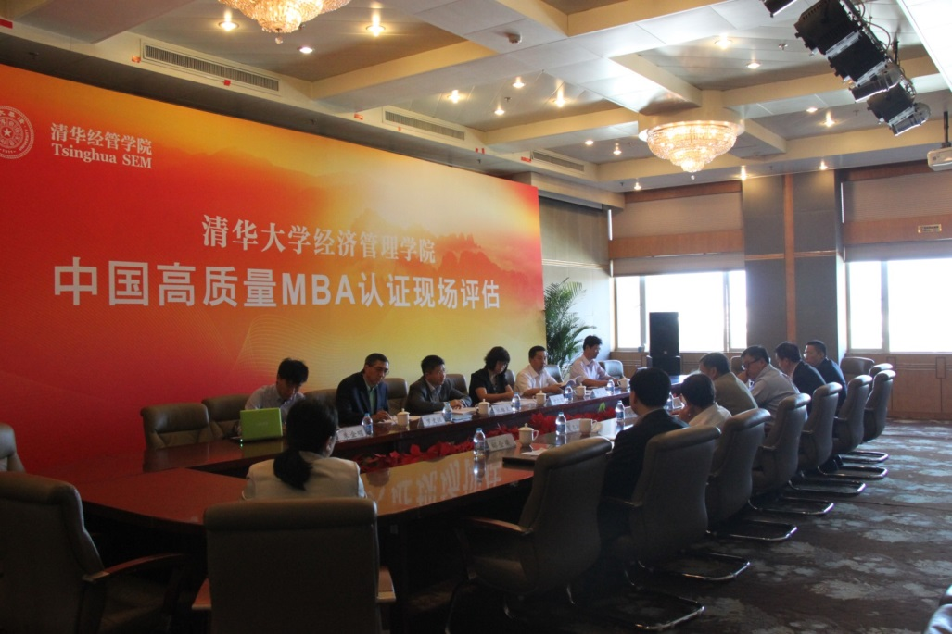

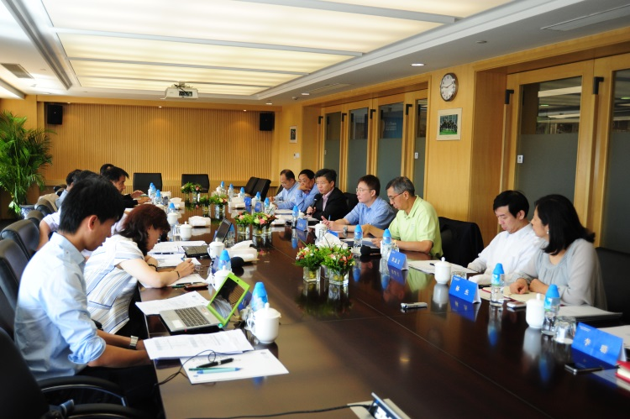
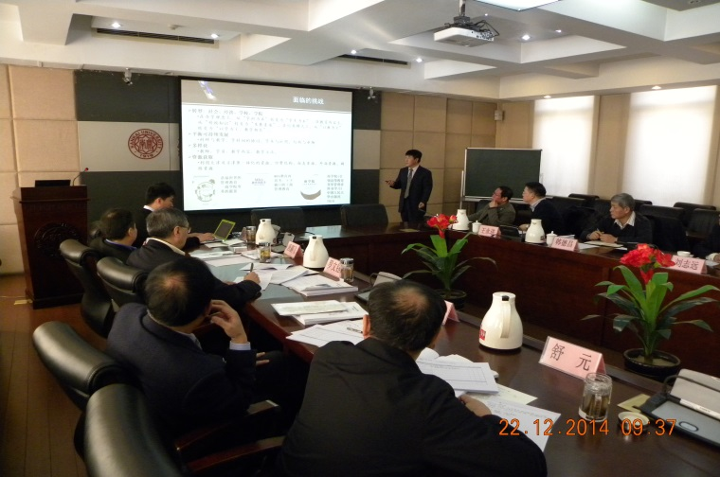
2.2 中国高质量MBA教育认证
CAMEA

Slide 15
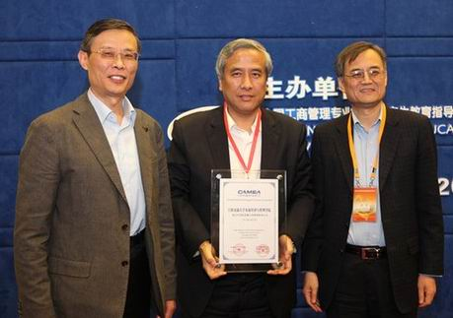
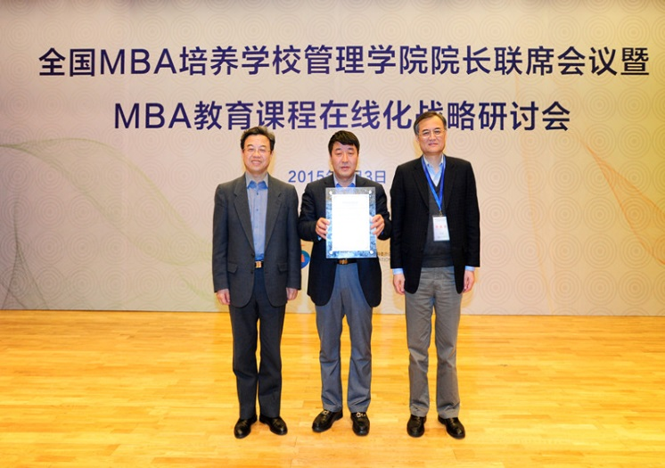
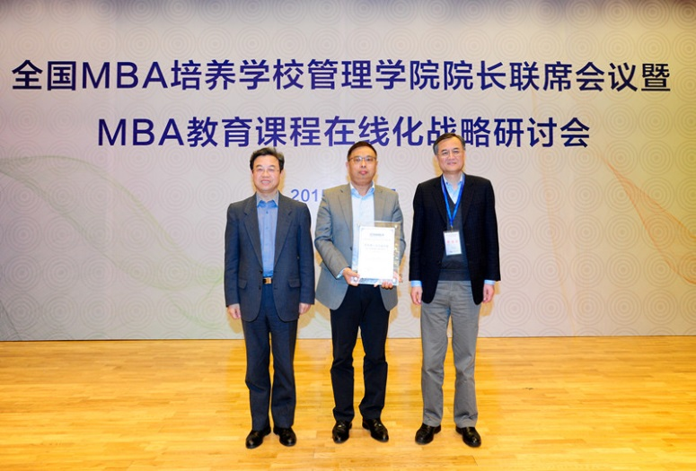
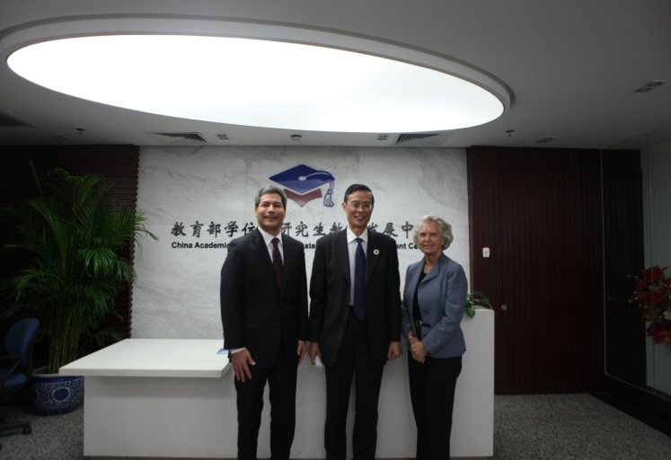
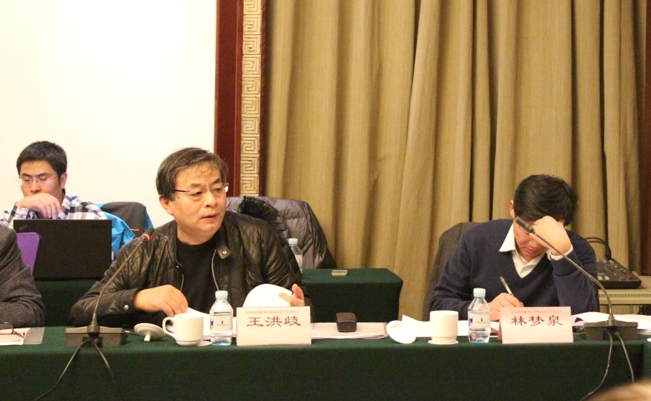
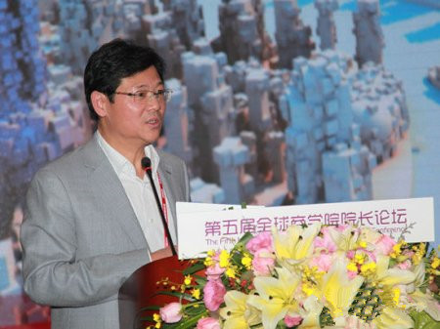
2.2 中国高质量MBA教育认证
CAMEA

Slide 16
2.2 中国高质量MBA教育认证
CAMEA
Institutions | Accredited | In the process
School of Economics and Management, Tsinghua University | √
School of Management, Fudan University | √
Antai College of Economics and Management, Shanghai Jiao Tong University | √
School of Economics and Management, Tongji University | √
College of Business, Shanghai University of Finance and Economics | √
Business School, Nankai University | √
School of Business, East China University Of Science And Technology | √
Guanghua School of Management, Peking University |  | √
School of Business, Renmin University |  | √
School of Management, Zhejiang University |  | √
College of Management and Economics, Tianjin University |  | √
Business School, Sichuan University |  | √
…… | …… | ……
Total | 7 | 10

Slide 17
3
PART THREE
中国MPA教育认证
Chinese MPA Education Accreditation

Slide 18
3.1 发展历程
Development Process
2013
探索开展认证研究
Begin to do research on accreditation
成立MPA认证前期筹备领导小组，初步制定MPA认证包括标准、流程、制度、管理等一系列文件的初稿
Set up MPA accreditation preparing leading group, formulate and demonstrate the standards, process, management and other articles(draft).
2014
进一步修改指标体系、认证标准、流程等，成立MPA认证组织架构，且正式开始试点
Revise the standards, process, management and other articles, build the organization, and begin accreditation formally.
2015

Slide 19
3.2 拟成立的组织架构
Framework(Draft)
教育部学位中心 全国MPA教指委
（认证委员会）
CDGDC & National MPA Education Steering Committee
Commission of Accreditation
认证工作委员会
Accreditation Committee
认证办公室
Accreditation Office
认证申诉委员会
Appeal Committee
咨询与服务
Consulting & Service
行政事务
Administration
认证组织
Organization
国际合作
International Cooperation

Slide 20
3.3 认证标准（草案）
Accreditation Standard(draft
使命与战略 Mission and Strategy
项目培养质量 Education Quality
组织与行政能力 Organization and Administration
资源与配置 Resources distribution
创新与特色 Innovation and features
认证特色
Features
使命导向、过程监控；
创新在项目培养中的作用；
培养项目的质量机制
Mission-oriented, process-monitoring;
Innovation;
QA system.

Slide 21
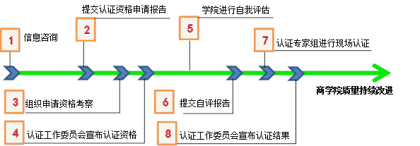
3.4 认证流程
Accreditation Procedure
Submission of Eligibility Application
Self-evaluation
Inquiry
Peer Review
Site Visiting
Submission of
Self-evaluation Report
Continuous Improvement
Committee:
Eligibility Decision
Committee:
Accreditation Decision

Slide 22
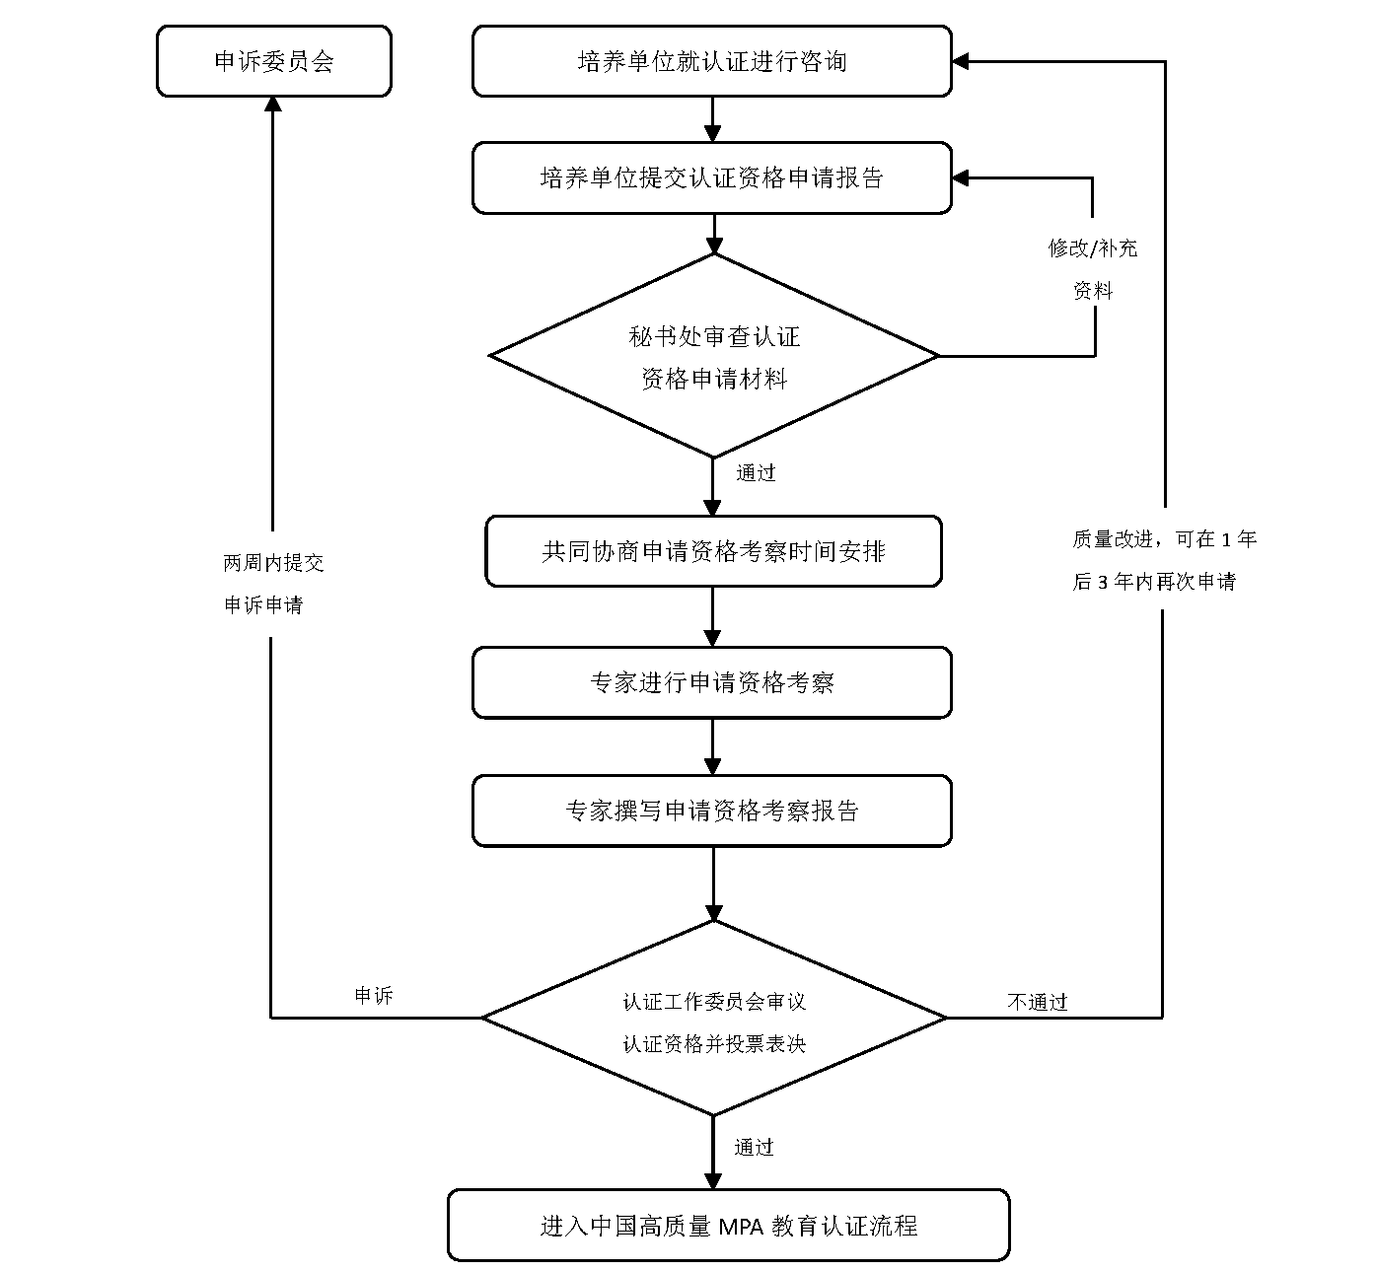
Eligibility Process
认证资格申请流程

Slide 23
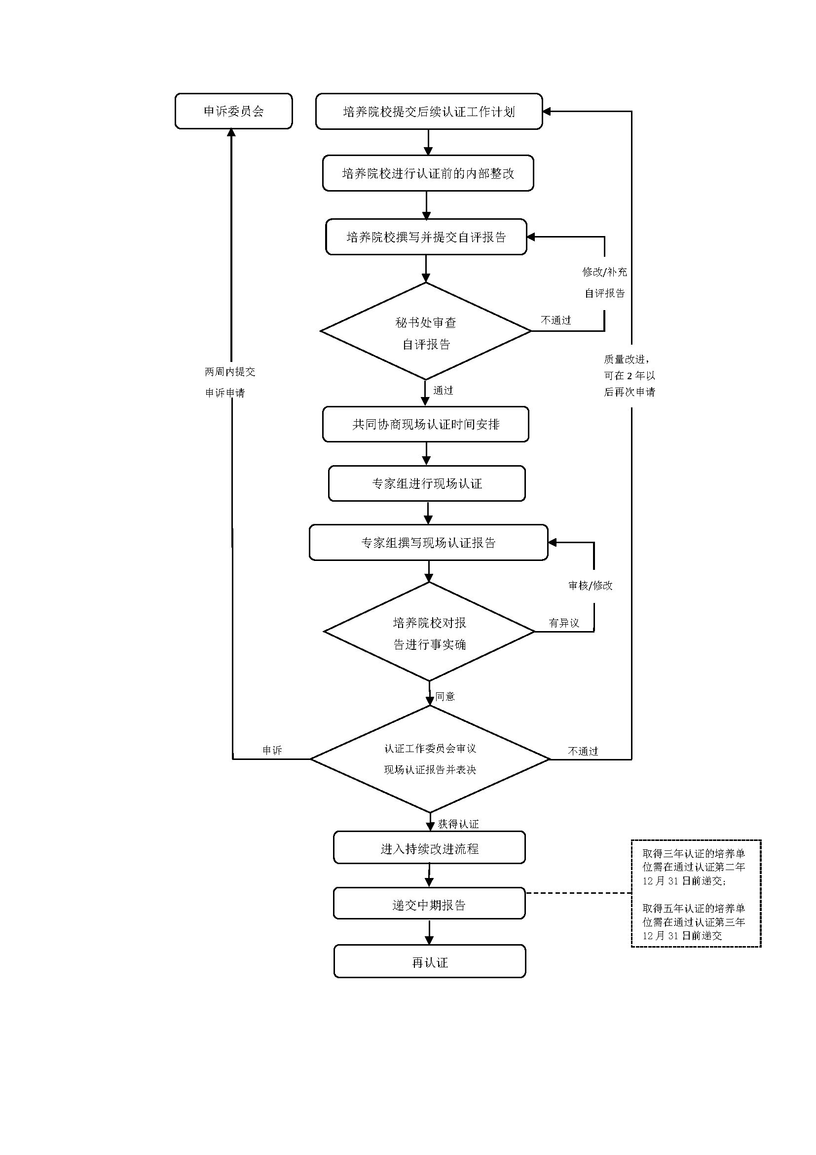
Accreditation Process
中国高质量MPA教育认证流程

Slide 24
4
PART FOUR
未来期望
Future Prospect

Slide 25
4.1 未来发展方向
Future Development
中国MPA认证品牌创立后，可加强与国际机构认证的交流合作
Suggestions of Cooperation in the Future
1) 标准与特色的研究
Research on standards and features
2) 认证专家、观察员的互派
Exchange of accreditation experts and observors
3) 资源信息的共享
Information sharing
4) 合作开展认证
Accreditation cooperation
5) 发起互认联盟
Initiation of accreditation association

Slide 26
THANKS FOR YOUR WATCHING
MPA教育认证办公室 MPA Accreditation Office
联 系 人：朱金明、谢佳宏
联系电话：010-82378166、82378734
传 真：010-82379489
E-mail: zjm@cdgdc.edu.cn
Contact: ZHU Jinming XIE Jiahong
Tel: +8610 82378166, +8610 82378734
Fax: +8610 82379489
E-mail: zjm@cdgdc.edu.cn

